Slide 1
WELCOME TO
Computer Science and Software Engineering

Slide 2
Computer Science & Software Engineering (CSSE)
Two programs:
1. Bachelor of Computer Science (Dr. Wang ugpd-compsci@concordia.ca )
2. Software Engineering (Dr. Rigby peter.rigby@concordia.ca )
3. Chair of the Department: (Dr. Paquet joey.paquet@concordia.ca )
Programs advisors: Natallia Lapko and Carly Carruthers
How to contact us:
1. cse-ugrad@concordia.ca
2. IN-PERSON: ER Building 10th floor
3. ZOOM MEETING ID: 825 8607 8275
https://www.concordia.ca/ginacody/computer-science-software-eng/students/undergraduate.html

Slide 3
ZOOM & IN-PERSON SCHEDULE (program advisors Natallia and Carly)
Mondays
ONLINE advising 10am – 12pm
Tuesdays
IN-PERSON advising 2pm – 4pm
Wednesdays
IN-PERSON advising 2pm – 4pm
Thursdays
ONLINE advising 2pm – 4pm

Slide 4
ZOOM SCHEDULE (Faculty members)
To book an appointment:
Undergraduate Program Director (Dr. Wang) booking page
Undergraduate Faculty Adviser (Dr. Houari) booking page
Undergraduate Faculty Adviser (Dr. Pankratov) booking page
Undergraduate Faculty Adviser (Dr. Xiao) booking page
General booking page: here

Slide 5
How We Help
DEPARTMENT ADVISORS | SAS ADVISORS
WE PROVIDE ACADEMIC ADVISING CONCERNING: Appropriate course selection Course sequence / re-sequence Grade requirements Program requirements Perform credit audits Course registration assistance Present options and counsel students regarding the procedures for requesting re-evaluations, deferrals, grade changes, etc Advise students regarding failed /conditional standing To sum up: we advise on University policies and procedures as well as available student services | Transfer a course that you are currently taking in a Gegep/college: email to Sakib Shahid sakib.shahid@concordia.ca
 | Internal transfer credits (for courses completed at Concordia): submit a request online https://www.concordia.ca/ginacody/students/academic-services/undergraduate/requests.html For questions: Amnah Abdul Razzak amnah.abdulrazzak@concordia.ca
 | External transfer credits (for courses completed at another university): submit a request online https://www.concordia.ca/ginacody/students/academic-services/undergraduate/requests.html For questions: Reihane Karimian reihane.karimian@concordia.ca
 | SAS provides online advising (below). To see them in person: EV Building 2nd floor Tuesdays, from 10 to 11 a.m. https://concordia-ca.zoom.us/j/86356135228 Meeting ID: 863 5613 5228 Thursdays, from 3 to 4 p.m. https://concordia-ca.zoom.us/j/86356135228 Meeting ID: 863 5613 5228

Slide 6
Program Requirements
Bachelor of Engineering, Software Engineering
Bachelor of Computer Science
Bachelor of Computer Science Joint Major in Data Science
Bachelor of Computer Science Joint Major in Computation Arts and Computer Science
Bachelor of Computer Science in Health and Life Sciences
Minor in Computer Science
Extended Credit Program (BCompSc, including Joint Majors)
Extended Credit Program (BCompSc Health and Life Sciences)
Extended Credit Program (SOEN)

Slide 7
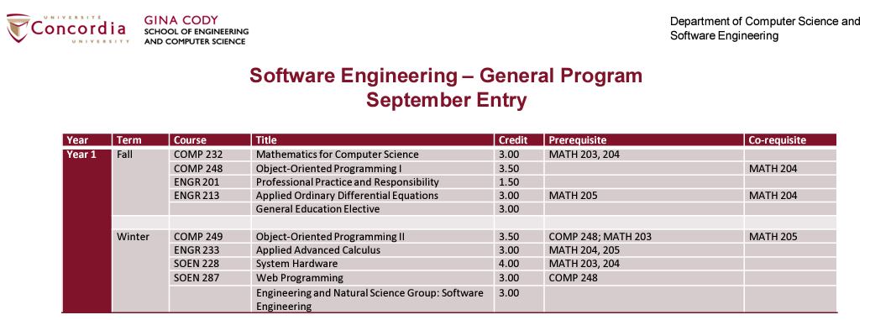
What Courses To Take
Course sequences

Slide 8
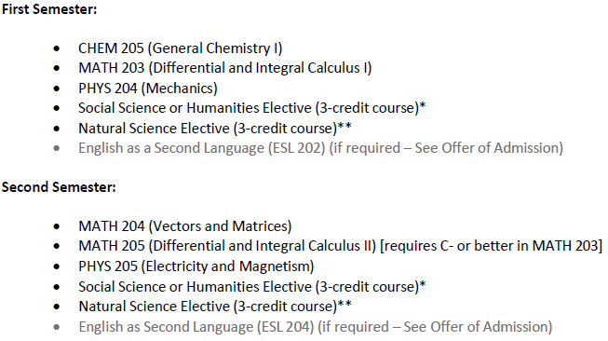
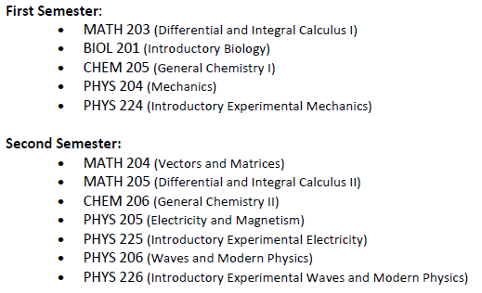
Extended Credit Program
ECP (BCompSc, including Joint Majors)
ECP (SOEN)
ECP (BCompSc Health and Life Sciences)

Slide 9
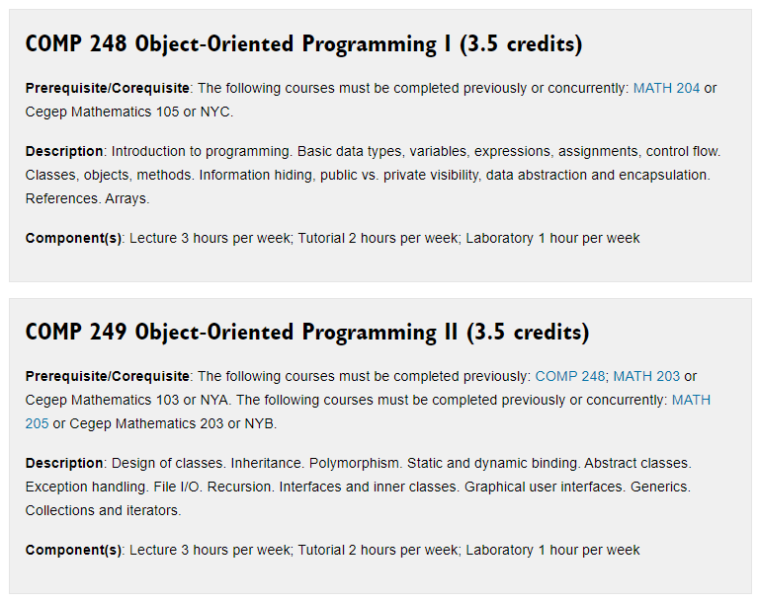
What The Course Is About
Course Descriptions

Slide 10
How To Register For A Course
Having trouble navigating the course registration system?
The Welcome Crew Mentors have you covered!
Register for an upcoming workshop: Course registration: How to use the system
Course registration guide

Slide 11
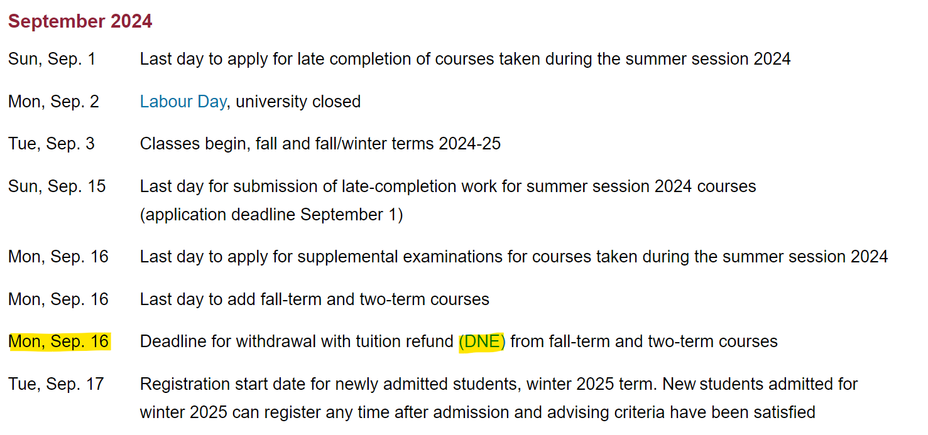
Academic Calendar
Important Academic Dates

Slide 12
CO-OP
Institute for Co-operative Education
COOP Director Dr. Jayakumar: jayakumar@cse.concordia.ca
General inquiries: info.coop@concordia.ca
How to apply: https://www.concordia.ca/academics/co-op/programs/undergraduate.html

Slide 13
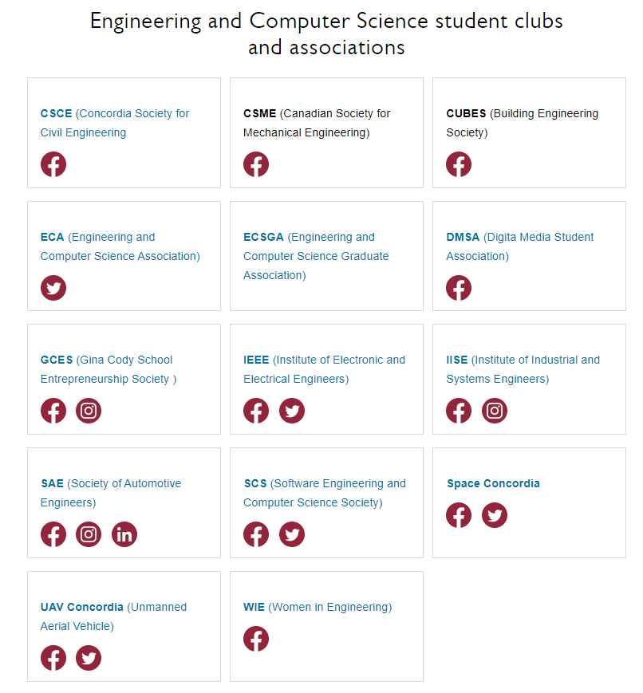
Student Clubs and Associations
Student Associations

Slide 14
Student services at Concordia
Student Hub
Birks Student Centre
Student Academic Services – Gina Cody School
Academics & Library resources
Co-op & Student Exchange
Student Associations & Clubs
Financial services & funding
IT support & software
Sports, fitness & recreation
Safety & security
Housing & food

