Slide 1
2018–19 Budget Conversations Presenters: Graham Carr, Provost and VP, Academic Denis Cossette, Chief Financial Officer
September 2018

Slide 4
2018-19 Concordia’s Operating Budget
Total Revenues | $496.9 million
Total Expenses | $498.8 million
Operating Deficit - Forecast | $1.9 million

Slide 5
Concordia: Historical Context
$90 million: cumulative Quebec government budget reductions between 2010-11 and 2016-17
Impact : Deficit position
 | Budget | Actual
2015-16 |  | $9.3 million
2016-17 | $6.3 million | $5.9 million
2017-18 | $3.9 million | $3.6 million
2018-19 | $1.9 million

Slide 6
Government Funding Approach
First re-investment in 2017-18: $ 3.2 M
Second re-investment in 2018-19 (1): $ 9.5 M
Cumulative $ 12.7 M
14% of reductions recovered
As per the proposed government 5-year plan, reductions will have been recovered by 2022-23
Note 1: $3.2 M 2017-18 re-investment
$4.3 M 2018-19 re-investment
$2.0 M 2018-19 additional re-investment

Slide 7
Quebec Reality
Second year of reinvestment, after many years of cuts
Quebec university sector facing declining student population.
Quebec finding ways to manage this decline, mainly in regions
One solution: new funding formula
Concordia context
3% growth in student population per year in last 2 years
Financial performance improving, but still in deficit
Many new initiatives in progress
Budget has to support this momentum

Slide 8
Building the Budget
Fall and Winter
Key assumptions determined
Budget planning process launched – all sectors advised
Various draft versions prepared and reviewed by the BRWG and the President’s Executive Group (“PEG”)
May
Government of Quebec gives Concordia final guidelines regarding revenues
Final budget is prepared
Budget is approved first by the Finance Committee, then by the Board of Governors
Sectors are notified of budget allocations

Slide 9
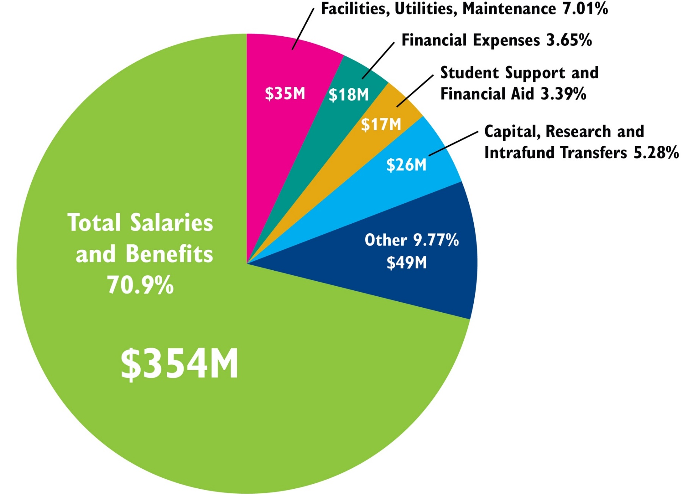
Projected Expenses: $498.8 million

Slide 10
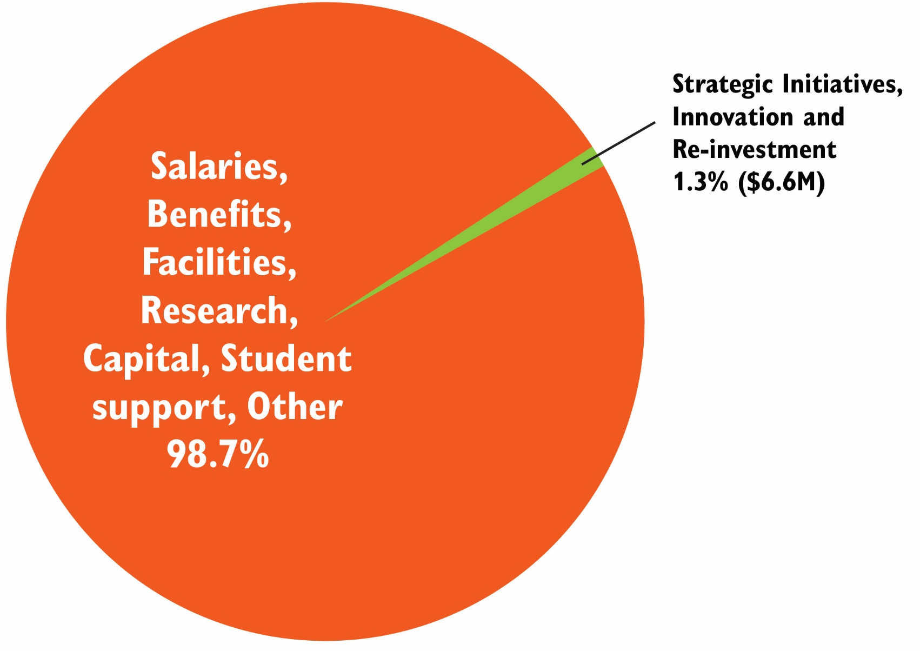
Projected Expenses: $498.8 million

Slide 11
Expense Categories

Slide 12
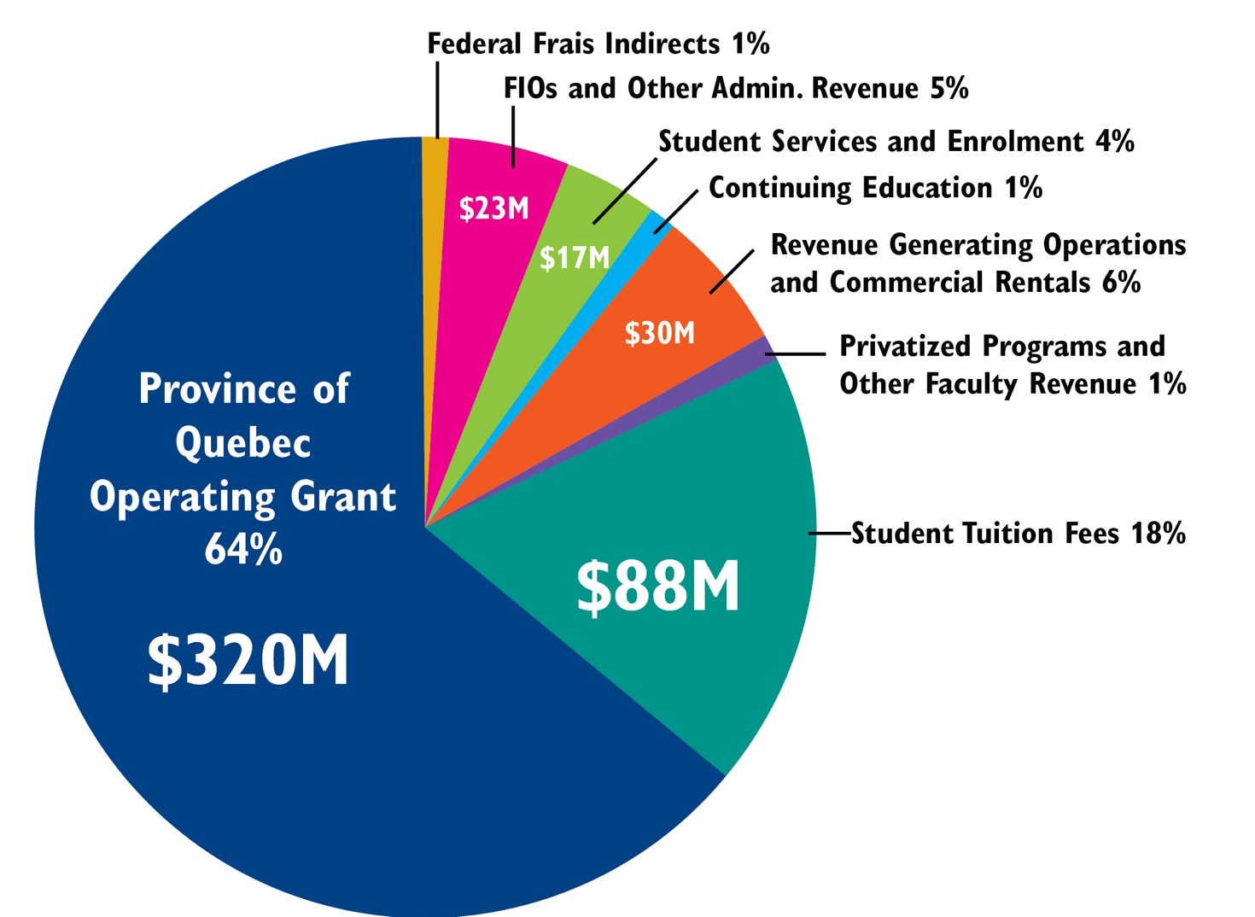
Projected Revenues: $496.9 million

Slide 13
Investing in Our Future
2018-19 budget reflects ongoing commitment to investing in our future as a next-generation university by:
Making strategic investments that enhance the student experience and maintain momentum for our 9 Strategic Directions initiatives; and
Returning to a balanced budget, supported by ongoing robust financial planning and evaluation.

Slide 14
Questions?

Slide 15
Appendix

Slide 16
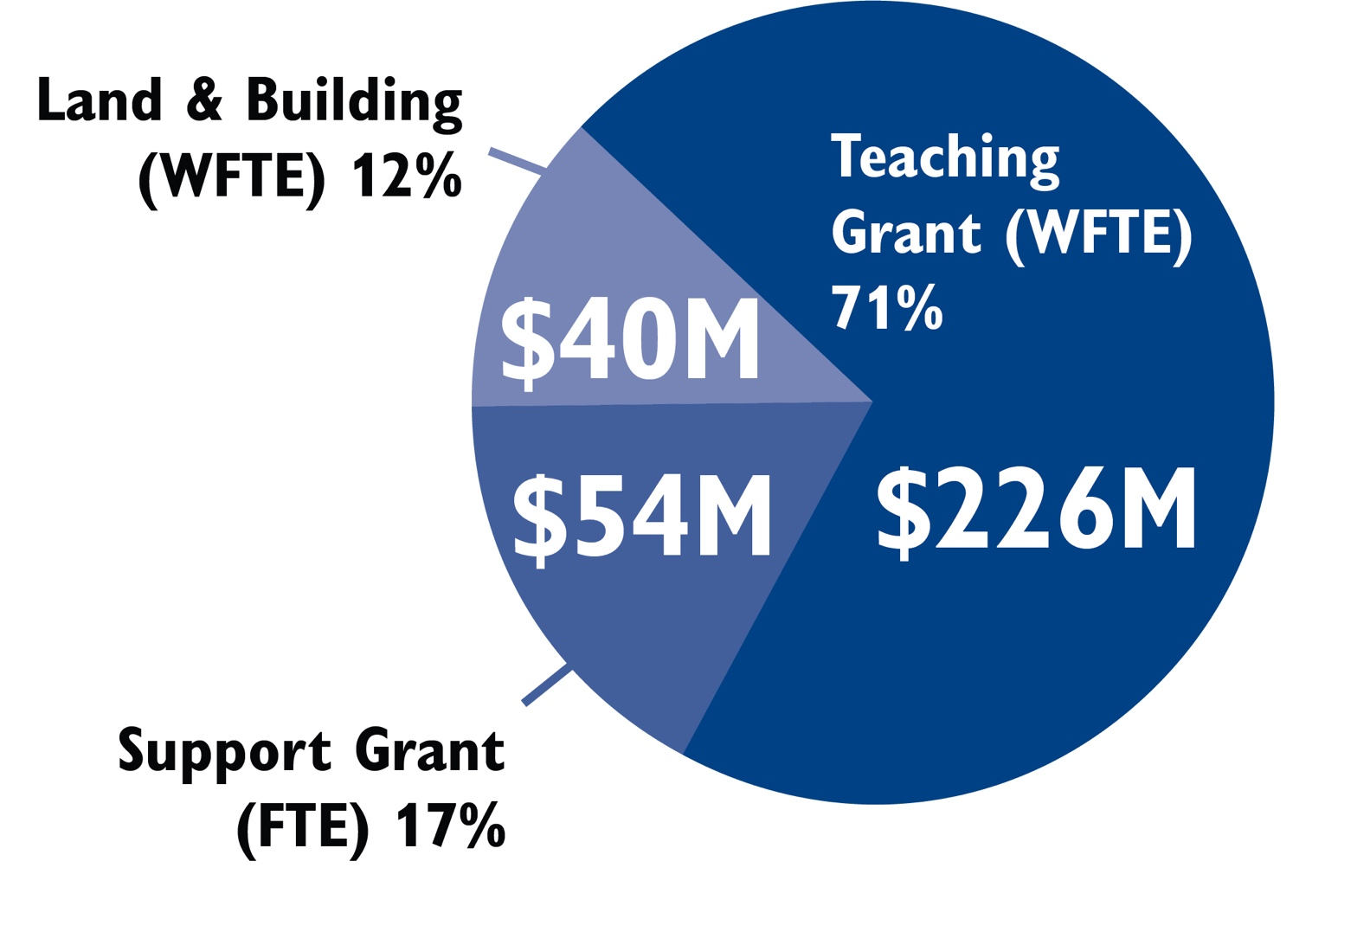
Quebec Operating Grant: $320 million

Slide 17
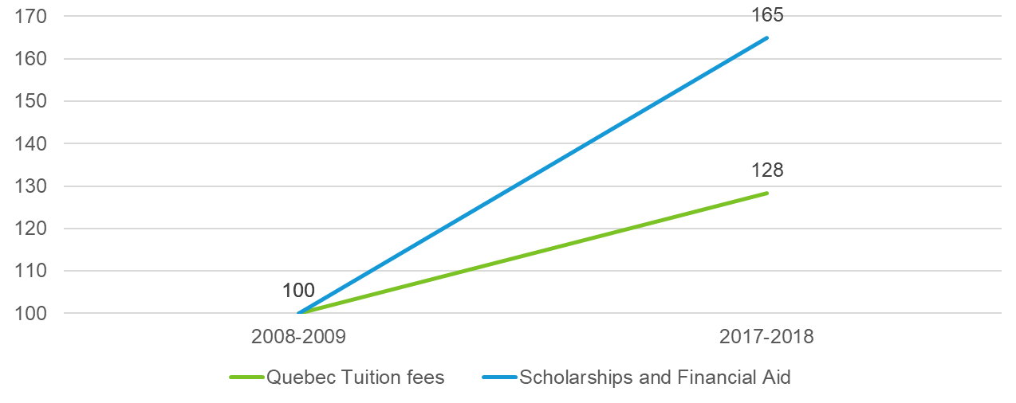
Tuition Fees, Bursaries and Financial Aid, 2008-09 to 2017-18, per Student
Additional annual investment compared to 2008-09: $ 4.8 M

Slide 18
FTEs and Projections 2010-11 to 2018-19 (9-year history)

Slide 19
Graduate and International Students, 2010-11 to 2017-18 (8-year history)

