Slide 1
2017–18 Budget Conversations Presenters: Graham Carr, Provost and VP of Academic Affairs Denis Cossette, Chief Financial Officer
September 2017

Slide 2
Charting Our Future as a Next-Generation University

Slide 16
Annual Operating Budget – Process
Budget Review Working Group (BRWG)
Reviews current state and develops assumptions.
Budget planning begins in the fall, involves all sectors.
Constantly reviews assumptions and forecasts to respect current funding situation and strategic alignment of the university’s priorities, in collaboration with the Faculties and units.
BRWG Members
Graham Carr, Provost and VP, Academic Affairs
Denis Cossette, CFO
Roger Côté, VP, Services
Christophe Guy, VP, Research and Graduate Studies
Jean-François Hamel, Senior Director Financial Planning and Budgets
Lisa Ostiguy, Deputy Provost
Gracy Pardillo, AVP Finance and Controller
VP Services
VP Research and Graduate Studies
Controller
CFO

Slide 17
Annual Operating Budget: Timeline

Slide 18
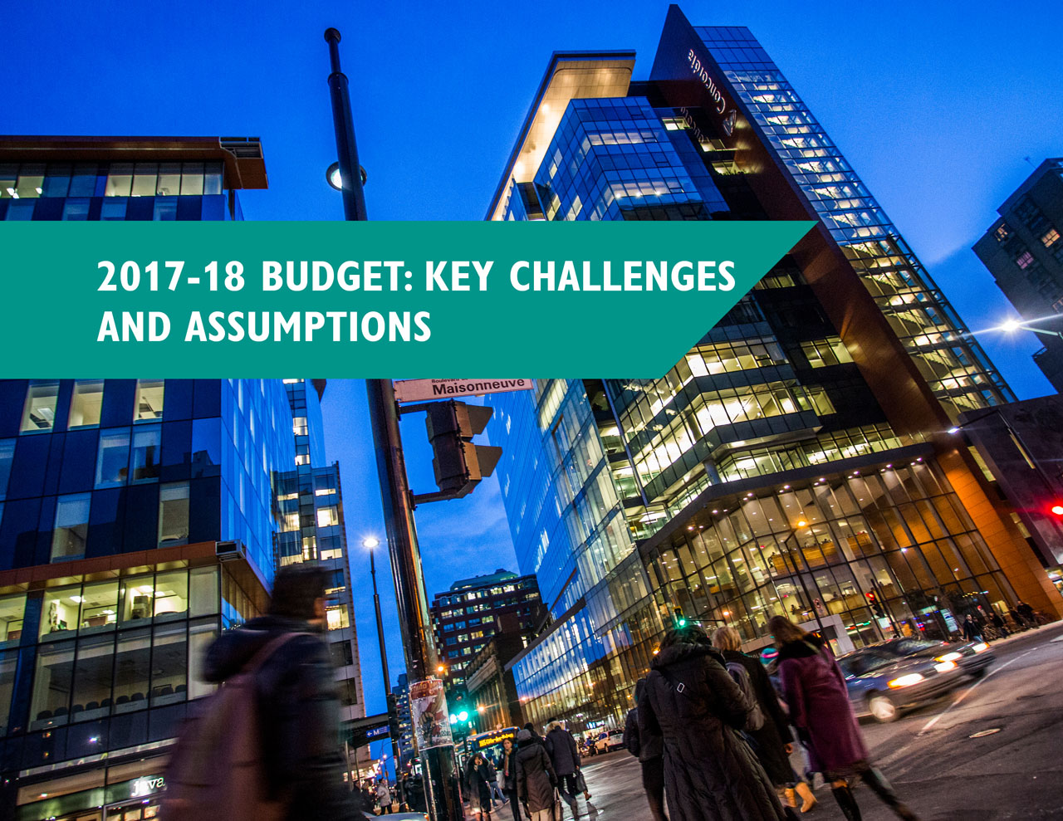

Slide 19
2017-18 Operating Budget: Key Challenges and Assumptions
Government of Quebec funding and legal framework requirements (e.g. prescribed decisions such as tuition fees, pension reform)
Increases in government funding lower than annual cost increases
Most costs are fixed, e.g. salaries and utilities
Deficit reduction
Need to adapt to changing environment

Slide 20
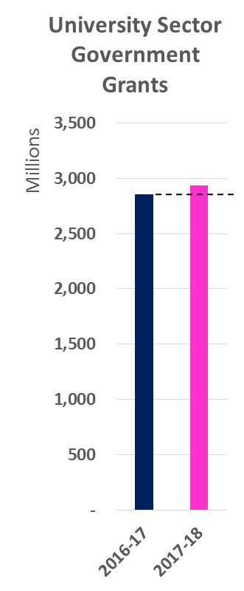
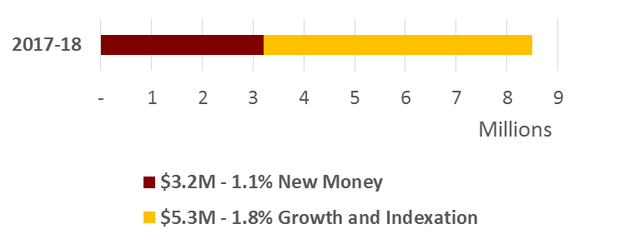
Government of Quebec: University Funding
3% increase in university sector ($85M)

Slide 21
2017-18 Concordia’s Operating Budget
Total Revenues | $473.7 million
Total Expenses | $477.6 million
Operating Deficit - Forecast | ($3.9 million)

Slide 22
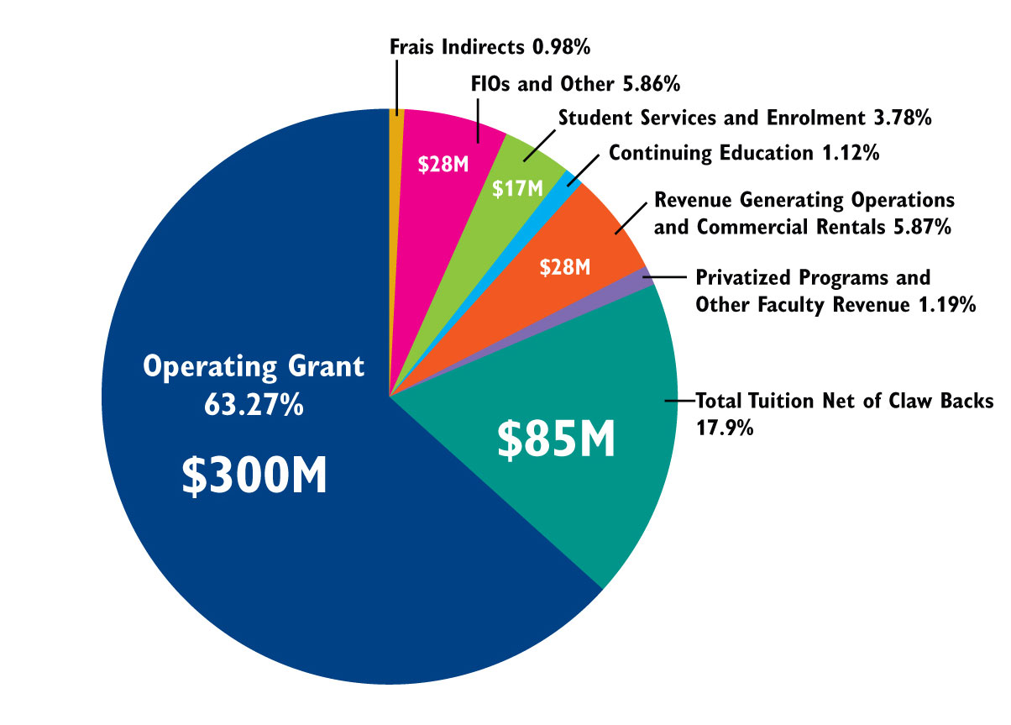
Projected Net Revenues: $473.7 million

Slide 23
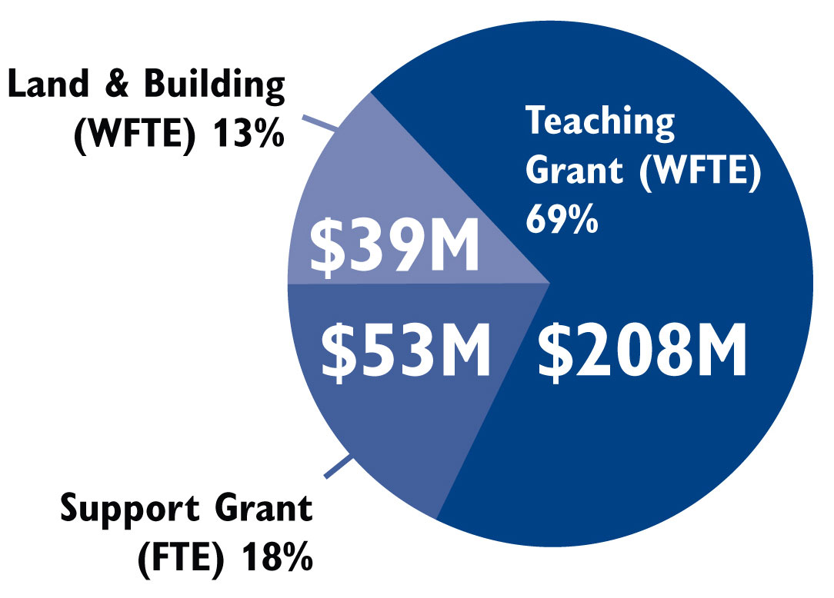
Operating Grant: $300 million

Slide 24
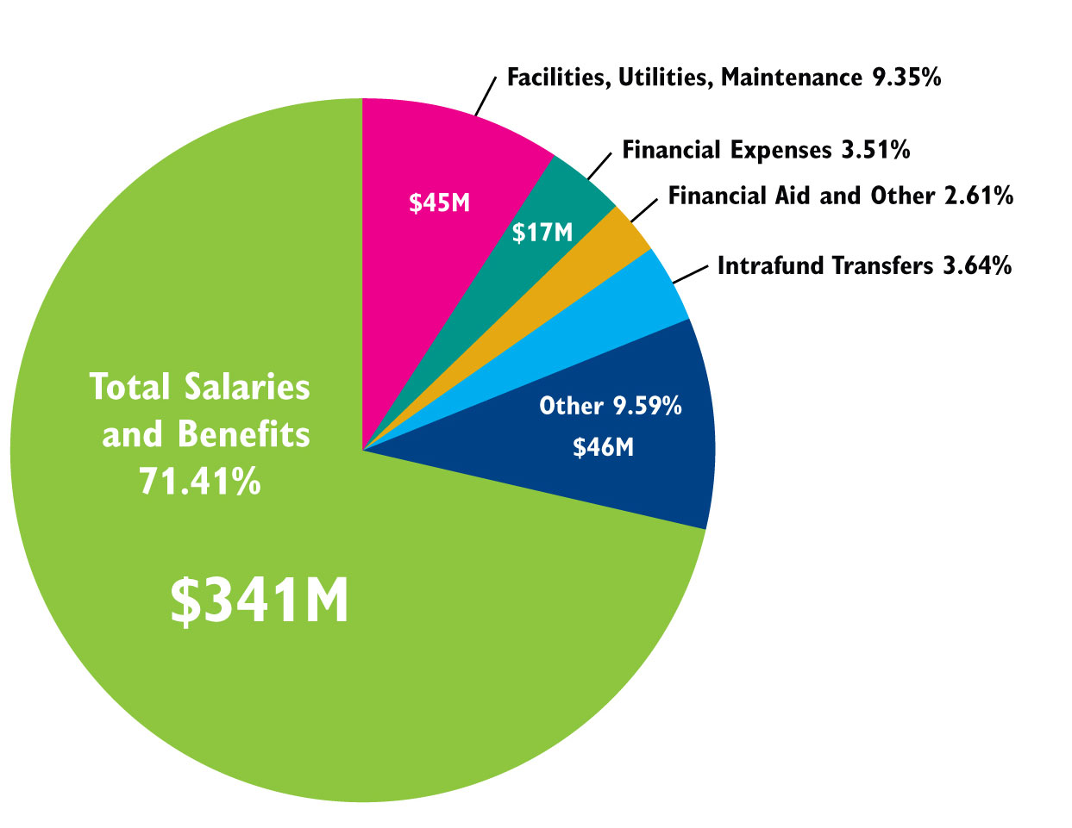
Projected Expenses: $477.6 million

Slide 25
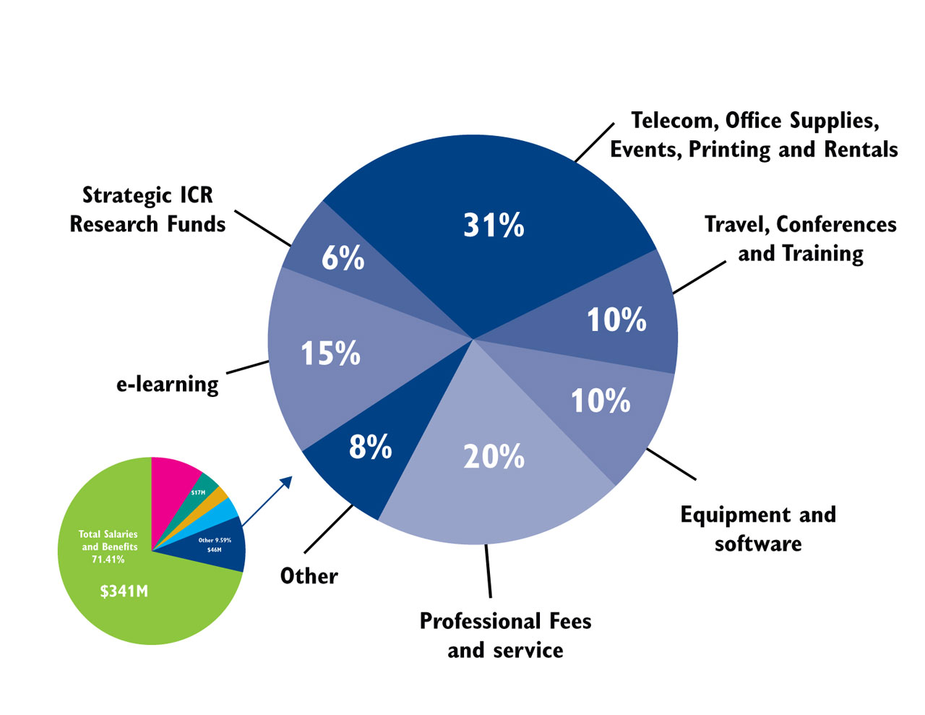
Other Expenses: $46 million

Slide 26
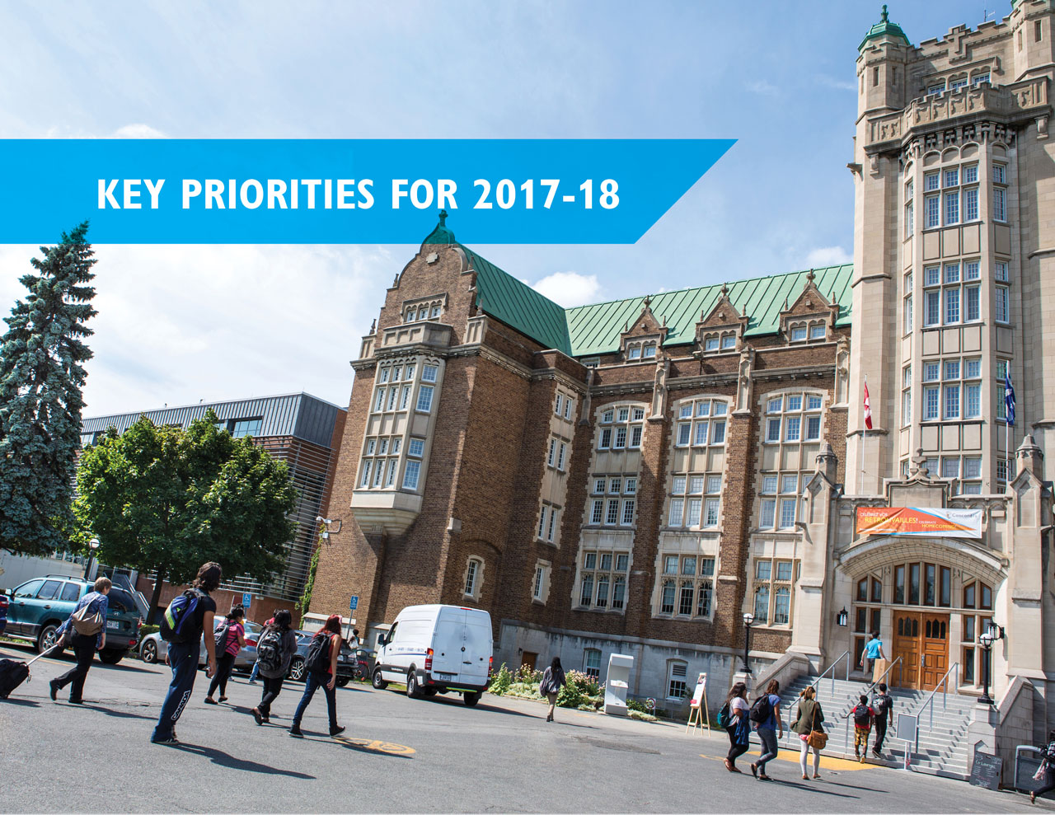

Slide 27
Key Priorities for 2017-18
Strategic investments, including:
Enrolment Incentives
Strategic Directions Initiatives
Postdoctoral Hiring
Support to researchers (indirect costs)
Campaign for Concordia
Reduction of annual deficit
Reduction of the deficit by 58% over past two years
Cumulative Government of Quebec budget reductions since 2010-11: $ 90 million

Slide 28
Reducing Annual Deficit
 | Budget | Actual | Cumulative deficit since 2008-09
2015-16 |  | $9.3 million | $14.1 million
2016-17 | $6.3 million | $5.7 million | $19.8 million
2017-18 | $3.9 million |  | $23.7 million

Slide 30
Investing in Our Future
2017-18 budget reflects ongoing commitment to investing in our future as a next-generation university by:
Making strategic investments that support enhancing enhance the student experience;
Re-allocating funds to build on the momentum from our 9 Strategic Directions initiatives; and
Returning to a balanced budget, supported by ongoing robust financial planning and evaluation.

Slide 31
Questions?

