Slide 1
Online learning in the time of COVID-19: What meta-analytic evidence says
Robert M. Bernard Eugene F. Borokhovski,
Richard F. Schmid Rana M. Tamim
CSLP Systematic Review Team
Concordia University, Montreal, QC
http://doe.concordia.ca/cslp

Slide 2
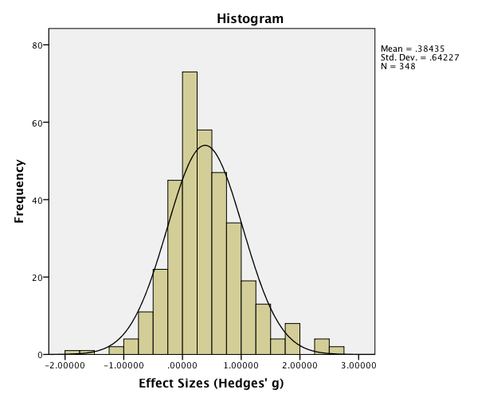
Agenda
Slides 2-17 What is a meta-analysis and what questions can it answer?
What do our meta-analyses and others’ tell us about
online learning?
Slides 18-20 Suggestions for designing and implementing online instruction
derived from meta-analyses and other professional
literature.
Slide 21 References.
Discussion/Q&A

Slide 3
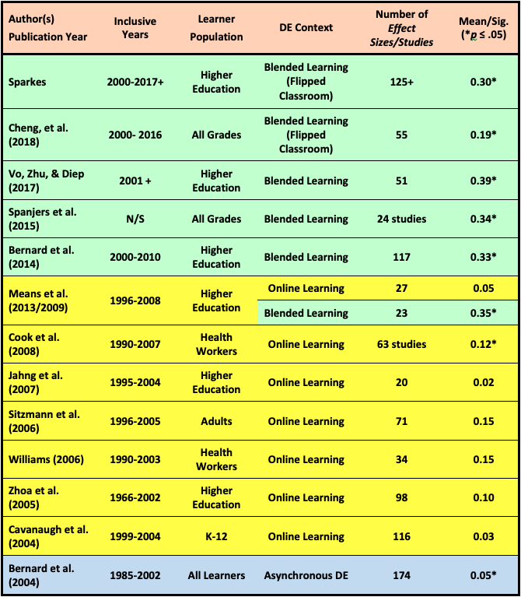
The Big Picture: Meta-analyses of distance education, online learning and blended learning

Slide 4
Purpose of Meta-analysis:
Estimate the average effect size in the population
p
p
p
ES
ES
ES
ES
Population
Population
p
ES
ES
ES+
Samples: Individual Interpretations
Meta-Analysis: Overall Interpretation
p
p

Slide 5
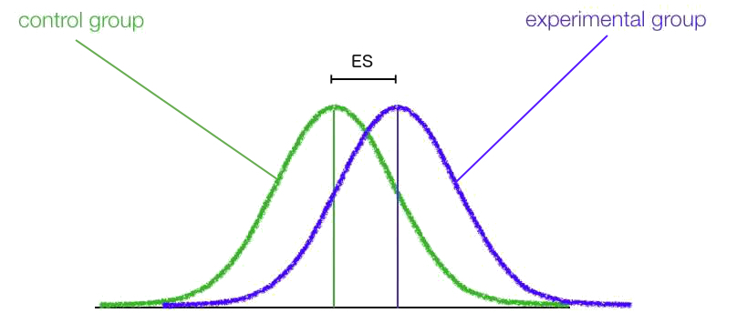
Effect Size Calculation:
Based on information found in samples from the experimental literature
An ES is the measurement of the impact of an intervention or the strength of the relationship between two variables.
Cohen (1988)
Hedges & Olkin (1985)

Slide 6
Effect Size Meaning: Interpretation of the magnitude of ES
Cohen’s (1988) Qualitative Descriptors
Small
Medium
Large
Cohen, J. (1988). Statistical power analysis for the behavioral sciences (2nd ed.). Hillsdale, NJ: Lawrence Erlbaum Associates.

Slide 7
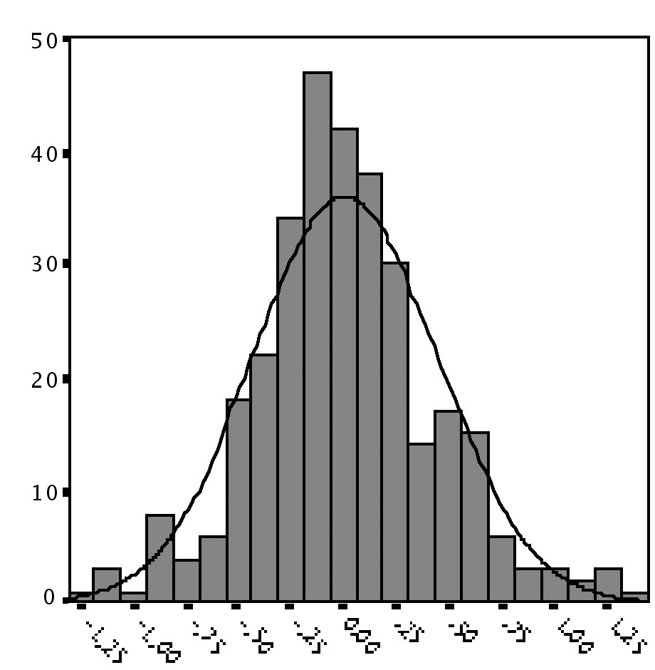
Distribution of Effect Sizes
Purpose: Explain variability in effect sizes
ES⁺ (avg.)
Variability around the average

Slide 8
Example of a Meta-Analysis Bernard et al. (2004) RER
Average Effect Size (ES⁺)
ES+
Variability around the Average
➜ Overall achievement (k= 318, N = 54,775): g⁺ = 0.013
The distribution is heterogeneous (p < .000)

Slide 9
Judging by the Average Effect Sizes online learning is actually modestly more effective than classroom instruction.
Meta-Analyses | Pub. Date | Inclusive Dates | Comparison | k | Mean ES | Sig. (p)
Bernard et al. | 2004 | 1985-2003 | OL vs. CI | 59 | 0.12 | = .05
Source: New analysis of previous work from Review of Educational Research
Sitzmann et al. | 2006 | 1996-2005 | WBI vs. CI | 71 | 0.15 | ≤ .05
Source: Personnel Psychology
Cook et al. | 2008 | 1990-2007 | OL vs. CI | 63 | 0.12 | = .045
Source: Journal of the American Medical Association
U.S. DOE | 2009 | 1996-2006 | OL vs. CI | 28 | 0.05 | ≤ .05
Source: U.S. Department of Education Meta-Analysis of Online Learning

Slide 10
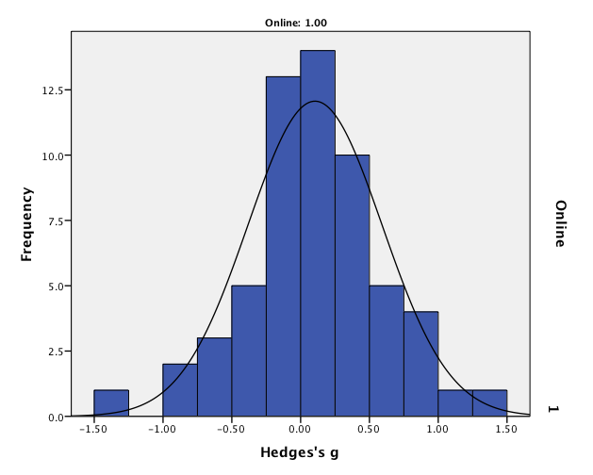
But the average effect is surrounded by wide variability.
OL < CI
OL > CI
Effect Size
Source: Bernard, Abrami, Lou et al. (2004). Review of Educational Research.

Slide 11
Which means that online learning can be significantly better than classroom instruction.
OL > CI
Effect Size

Slide 12
Or it can fail miserably. What makes the difference?
OL < CI
Effect Size

Slide 13
Student interaction with teachers, other students and course content all contribute to better DE and online learning, but which has the greatest impact on achievement?
Student-Student
Student-Content
Student-Teacher
Moore, M.G. (1989). American Journal of Distance Education
Anderson (2003). International Review of Research in Open and Distance

Slide 14
We found out! More interaction leads to improved achievement gains, but …
Improved
Achievement Outcomes
ES⁺ = +0.38
(k = 74)
Student-Teacher
ES⁺ = +0.32
Student-Student
ES⁺ = +0.49
Student-Content
ES⁺ = +0.46
Source: Bernard et al. (2009). Review of Educational Research.

Slide 15
We also learned that designed S-S interaction treatments are more effective than contextual S-S treatments.
S-S interactions designed into a course using sound pedagogical principles are more effective than just providing technology-enabled functions, e.g., chat rooms/unmonitored forums. What matters is the pedagogy, NOT the technology.
Student-Student (SS) Interactions
SS Designed
ES⁺ = +0.50
(k = 14)
SS Contextual
ES⁺ = +0.22
(k = 22)
Source: Borokhovski et al. (2012). Distance Education.

Slide 16
The Big Picture: Meta-analyses of distance education, online learning and blended learning

Slide 17
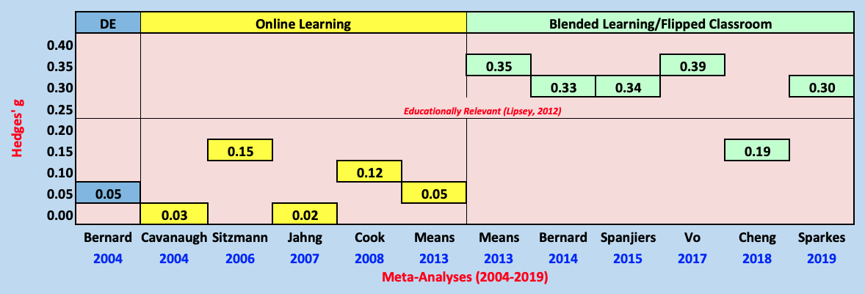
Viewed another way across all technology-supported strategies
. . . it is clear that some classroom instruction (CI), added to
online learning (OL), produces results better than straight CI or straight OL.

Slide 18
Summary of average effect sizes
Online Learning (OL alone) Meta-Analyses
+ 7 meta-analyses; 428 studies
+ Average Effect Size (ES⁺) = approx. +0.10
Blended Learning (OL+CI) Meta-Analyses
+ 5 meta-analyses; 372 studies
+ Average Effect Size (ES⁺) = approx. +0.31

Slide 19
Findings from meta-analyses
and other professional literature
OL can be effective across a wide range of content and learners
But that means …
Instructional clarity and intentionality: It is essential for educators to design lessons and use online resources with defined learner outcomes.
Collaboration*: OL is more effective when students are required to actively engage, as opposed to working independently or passively viewing material. Collaboration and active engagement distinguish well-designed OL from classic distance education, where students typically worked in isolation.
Meaningful activities*: Collaboration requires the inclusion of meaningful activities. Video capture of lectures can range from brilliant to boring. Get students active for some components of a course, using synchronous (e.g., breakout rooms in Zoom in a live session) or asynchronous methods (group assignments over the following week, ideally reported back to the live session for whole group discussion)
*These two goals becoming increasingly challenging as class size increases. This is where “emergency remote teaching” can break down – to be discussed in Q&A.

Slide 20
Findings from other meta-analyses (cont’d)
Online quizzes are more effective than other OL experiences, such as assigning homework, so use both.
More media? More media doesn’t necessarily help – should only be used for specific instructional purposes. For example, YouTube vignettes of content/applications can serve as core or supplementary material.
Instructional tasks that stimulate active learning and deep student thinking should be used whenever possible. As noted in meaningful activities, scenarios requiring problem solving, decision making, and critical thinking work best. Our meta-analyses show that “cognitive tools” (e.g., simulations) maximize technology’s impact. Presentation software (e.g., PowerPoint) shows no meaningful positive impact.
Feedback, Feedback, Feedback. OL should allow teachers and peers to provide student feedback, correcting misunderstandings, clarifying expectations, and directing additional learner strategies. Instructor monitoring is critical, but as noted earlier, student/student feedback yields significant dividends (contrary to many popular beliefs).

Slide 21
Findings from other meta-analyses (cont’d)
Social presence. It is important for instructors to maintain social presence in the learning process, providing feedback, communicating regularly, modelling participation, and creating an inviting tone.
Self-regulation and Metacognition. OL seems to be optimized when self-regulation (planning, monitoring, evaluating) is central to the learning experience. Meta-cognition is thinking about one’s thinking, a key component to effective learning.
Accommodate. Accommodating individual student situations does NOT mean compromising on standards. Where possible, as we routinely do with students with special needs - give them more time, and perhaps more support.
Bottom line: Emergency remote OL teaching can result in a high level of student success, which is our primary objective. But the simple truth is: it is more work, especially initially, for instructors.
Primary reference: Connecticut Center for School Change (2020). Evidence-based practices in online and distance learning: A research review for educators during the COVID-19 pandemic. Hartford, CT.

Slide 22
References to Meta-analyses
Bernard, R. M., Abrami, P. C., Lou, Y., Borokhovski, E. . . . . (2004). How does distance education compare to classroom instruction? A Meta-analysis
of the empirical literature. Review of Educational Research, 74(3), 379-439.
Bernard, R. M., Abrami, P. C., Borokhovski, E. . . . (2009). A meta-analysis of three interaction treatments in distance education. Review of Educational Research, 79(3), 1243-1289.
Bernard, R. M., Borokhovski, E., Schmid, R. F., Tamim, R. M. . . . (2014). A meta-analysis of blended learning and technology use in higher education: From the general to the applied. Journal of Computing in Higher Education. 26(1), 87-122.
Borokhovski, E., Tamim, R. M., Bernard, R. M. . . . (2012). Are contextual and design student-student interaction treatments equally effective in distance education? A follow-up meta-analysis of comparative empirical studies. Distance Education, 33(3), 311-329.
Schmid, R. F., Bernard, R. M., Borokhovski, E., Tamim, R. M. . . . (2014). The effects
of technology use in postsecondary education: A meta-analysis of classroom applications. Computers & Education, 72, 271-291.
Tamim, R. M., Bernard, R. M., Borokhovski, E., Abrami, P. C., & Schmid, R. F. (2011). What forty years of research says about the impact of technology on learning: A second- order meta-analysis and validation study. Review of Educational Research, 81(3), 4-28.

Slide 23
Discussion

