Slide 1
We would like to begin by acknowledging that Concordia University is located on unceded Indigenous lands. The Kanien’kehá:ka Nation is recognized as the custodians of the lands and waters on which we gather today. Tiohtià:ke/Montréal is historically known as a gathering place for many First Nations. Today, it is home to a diverse population of Indigenous and other peoples. We respect the continued connections with the past, present and future in our ongoing relationships with Indigenous and other peoples within the Montreal community.

Slide 2
Women in the Field of Education Center for the Study of Learning and Performance, Concordia University
Workshop by Amélie Crasci & Neslihan Sriram-Uzundal
November 20, 2023

Slide 3
Agenda
Facilitators Introduction
Activity 1: Poll & Discussion
Activity 2: Discussing Issues of Women in the Field of Education
Amélie Crasci: Intimate-Partner-Violence (IPV) Against Women
Neslihan Sriram-Uzundal: Epistemic Injustice in Higher Education
Activity 3: A Vision Board Representing What the Future Holds for Women in the Field of Education
Conclusion
Notes:
I want to present to you our agenda. The topic „women in the field of education“ is vast, and we won‘t be able to cover everything, so we have decided to speak generally about issues women face in education. We will start with a brief introduction of ourselves. We are both women, and we are both associated with education. Afterwards, we will go on with our first activity. It is a poll that asks different questions that come to mind first when one thinks of women in the field of education. This will be followed by activity two, which aims to discuss issues women face in the field of education on different levels such as the social, the cultural, the theoretical, etc. Amélie will then present her project that smartly uncovers the connections between Intimate partner violence and Education. I will then offer my own Ph.D. project, which talks about epistemic injustice in education, whereby I conduct interviews with minority women. This will be followed by activity 3, where we aim to create a vision board hinting at what the future holds for women in the field of education. We will – together as a group – end with a conclusion.

Slide 4
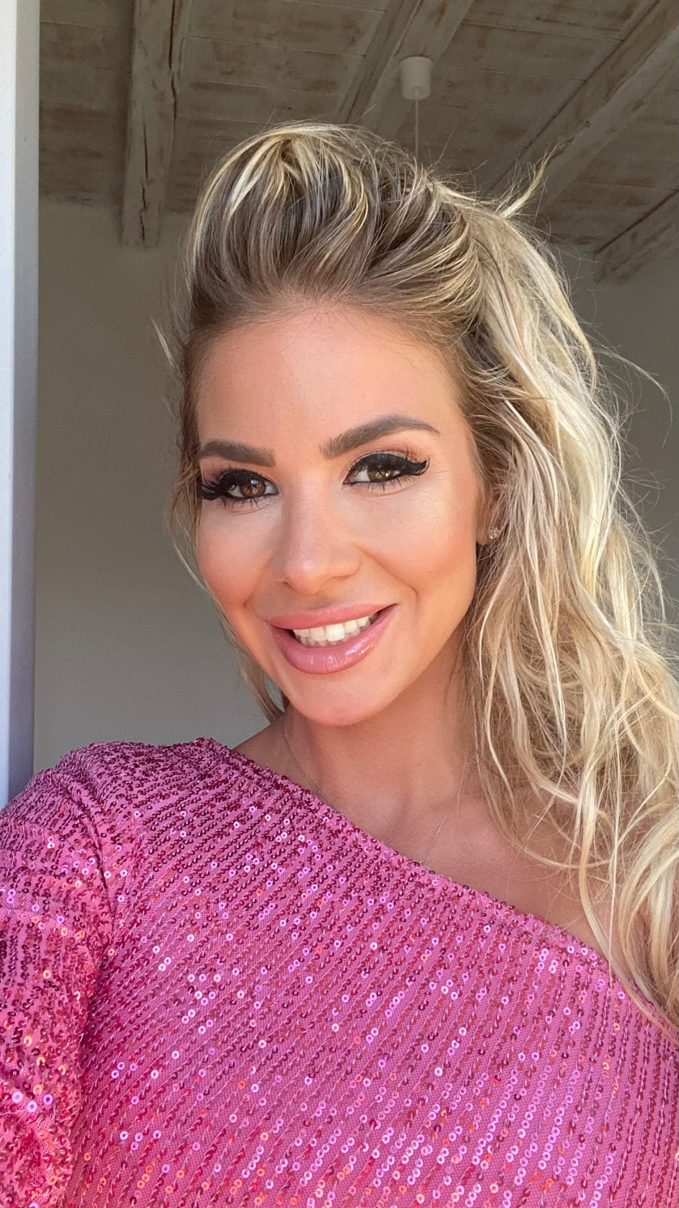
Amélie Crasci MA student, Educational Studies
BA, Psychology (Concordia University, 2016)
Community Vocational Education Teacher for Adult Immigrants (English Montreal School Board, 2017 - Present)
Volunteer Work (Chez Doris, Auberge Transition, YWCA, WIWC, AMI-Quebec, 2022 - Present)
Mental Health & Women’s Advocate

Slide 5
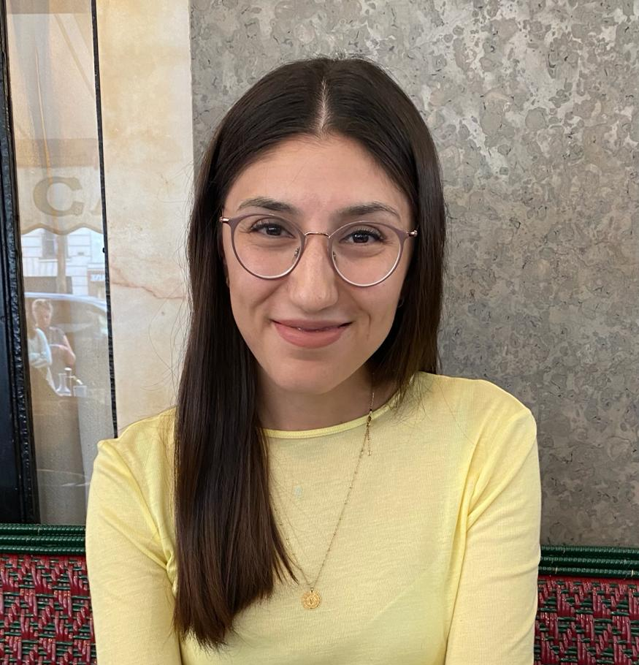
Neslihan Sriram-Uzundal PhD student, Educational Studies
M.Ed. (German/English/Education Studies)/M.A. German Literature (University of Tuebingen, Germany, 2021)
German Teacher for students of all ages who are aspiring a German diploma that enables access to German universities (DSQ Montréal, 2021 - Present)
Volunteer Work: Teaching illiterate women at the mother center Mössingen (Mössingen, Germany, 2019-2021) & Pilot Project: visiting schools all over Germany to motivate young minority women to pursue higher education degrees while measuring the state of minority background teachers (2017-2021)

Slide 6
Activity 1: Poll & Discussion
Take out your cell phones.
Scan the QR-Code.
Respond to each question following our instructions.

Slide 7
Activity 2: Discussing Issues of Women in the Field of Education
Issues of women in education appear on different levels: the historical, the social, the cultural, and the theoretical.
In groups, consider an example for each level women face in education.
Write your examples on paper.
You have 20 minutes.

Slide 8
Amélie: IPV Against Women
What is it?
IPV is synonymous with domestic violence, and it implies abuse that is committed from an intimate partner, which can be sexual, physical, psychological, emotional, financial, or spiritual.

Slide 9
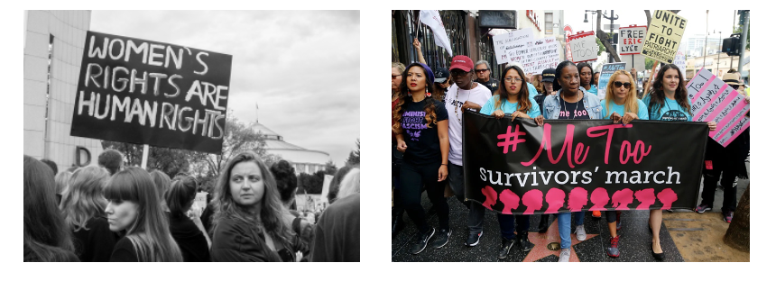
Amélie: IPV Against Women
Society
#MeToo movement founded by American activist Tarana Burke (2006) later prompting #MeToo movement in Hollywood (2017) to fight against sexual violence towards women
Entertainment
Drama/biography movie, “She Said” (2022), about Harvey Weinstein sexual assault allegations towards female actors in Hollywood:
https://youtu.be/ASrsrxTin4A?si=dcCzYyJ-WbNUWbLe
Truth-based story turned Netflix show, “Maid” (2021), about a woman fleeing an abusive relationship to build a safe and better life for her and her child:
https://youtu.be/Qgm0-iP0fUk?si=iK8qxGtIqEOxmNZP
Canadian Toronto-based sitcom Netflix series, “Workin’ Moms” (2023), about women redefining themselves through motherhood and their careers, demonstrating the strength and resilience that women have to be able to “do it all’, while in reality, society often undermines them.

Slide 10
Amélie: IPV Against Women Cont‘d
Books…

Slide 11
Amélie: Gender Pay Gaps in Quebec Institut de la statistique du Québec (November 2022):
“In 1998, the average hourly earnings for women in paid employment amounted to about 83% of men’s earnings. In 2021, this ratio has increased to about 91%, as average hourly earnings were $27.39 for women and $30.16 for men.”
https://statistique.quebec.ca/en/communique/gender-wage-gap-what-has-changed-since-1998

Slide 12
Amélie: Gender Pay Gaps - Higher Education in Canada CBC News (September 2022):
“At the University of Alberta, the average salary of a female faculty member is almost $19,000 less than her male counterpart. At the University of Calgary, that gap grows to more than $23,000.”
https://www.cbc.ca/news/canada/edmonton/gender-pay-gap-persists-at-canadian-universities-1.5739466

Slide 13
Amélie: Education and IPV Against Women
Gender inequality is a clear and prominent societal issue as seen through women’s abuse experiences across different industries, both locally and internationally, as well as through the gender pay gap in our province and country.
MA thesis in Ed Studies: focuses on changing Quebec education curricula to reflect more awareness, prevention strategies, and solutions for intimate partner violence against women, to achieve gender-equality justice in both the educational sphere, as well as in society.
Document, “Sex Education in the Context of Education Reform” in Quebec and Concordia University’s “Report of the Task Force on Sexual Misconduct and Sexual Violence” are missing important elements, such as about educating others on all aspects of IPV —> Holes in the system.

Slide 14
Amélie: IPV Against Women
After hearing about my project, how can we bridge the gap between IPV and the missing elements within the sex education of Quebec to better reflect gender equality?

Slide 15
Neslihan: Epistemic Injustice in Higher Education Experiences of Discrimination and Racism of Minority Women in Higher Education
Theoretical Framework: Epistemic Injustice?
Underlying idea
Excerpts from an Interview
References

Slide 16
Neslihan: Epistemic Injustice in Higher Education Experiences of Discrimination and Racism of Minority Women in Higher Education
1. Theoretical Framework: Epistemic Injustice?
The theories and philosophies evolving around epistemic injustice try to find an answer to the following questions:
“Who has voice and who doesn’t? Are voices interacting with equal agency and power? In whose terms are they communicating? Who is being understood and who isn’t (and at what cost)? Who is being believed? And who is even acknowledged and engaged with?” (Kidd et al., 2017, p. 1)

Slide 17
Neslihan: Epistemic Injustice in Higher Education Experiences of Discrimination and Racism of Minority Women in Higher Education
1. Theoretical Framework: Epistemic Injustice?
Broad Definition:
“Epistemic injustice refers to those forms of unfair treatment that relate to issues of knowledge, understanding, and participation in communicative practices. These issues include a wide range of topics concerning wrongful treatment and unjust structures [my own emphasis] in meaning-making and knowledge producing practices, such as the following: exclusion and silencing, invisibility and inaudibility (or distorted presence or representation); having one’s meanings or contributions systematically distorted, misheard, or misinterpreted; having diminished status or standing in communicative practices; unfair differentials in authority and/or epistemic agency; being unfairly distrusted, receiving no or minimal uptake, being coopted or instrumentalized; being marginalized as a result of dysfunctional dynamics; etc.” (Kidd et al., 2017, p. 1)

Slide 18
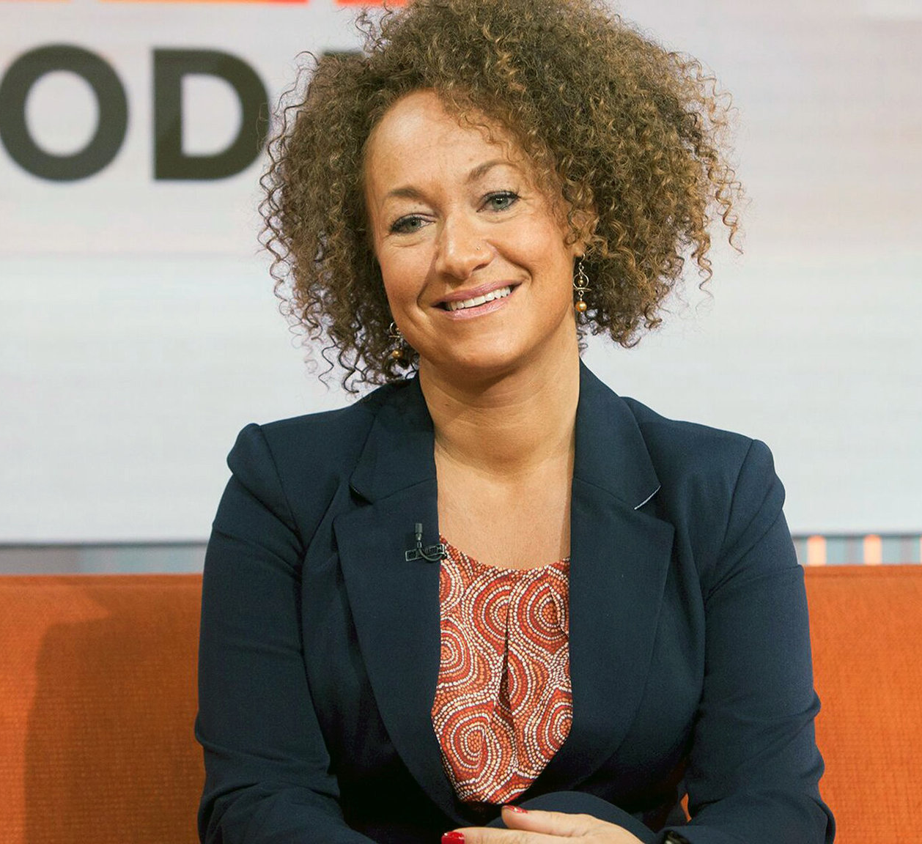
Neslihan: Epistemic Injustice in Higher Education Experiences of Discrimination and Racism of Minority Women in Higher Education
1. Theoretical Framework: Epistemic Injustice?
Hegemonial Hashtags &
ONET: Cleaning Company (https://www.youtube.com/watch?v=pSbLUVvn2lU) &
Rachel Dolezal (https://en.wikipedia.org/wiki/Rachel_Dolezal)

Slide 19
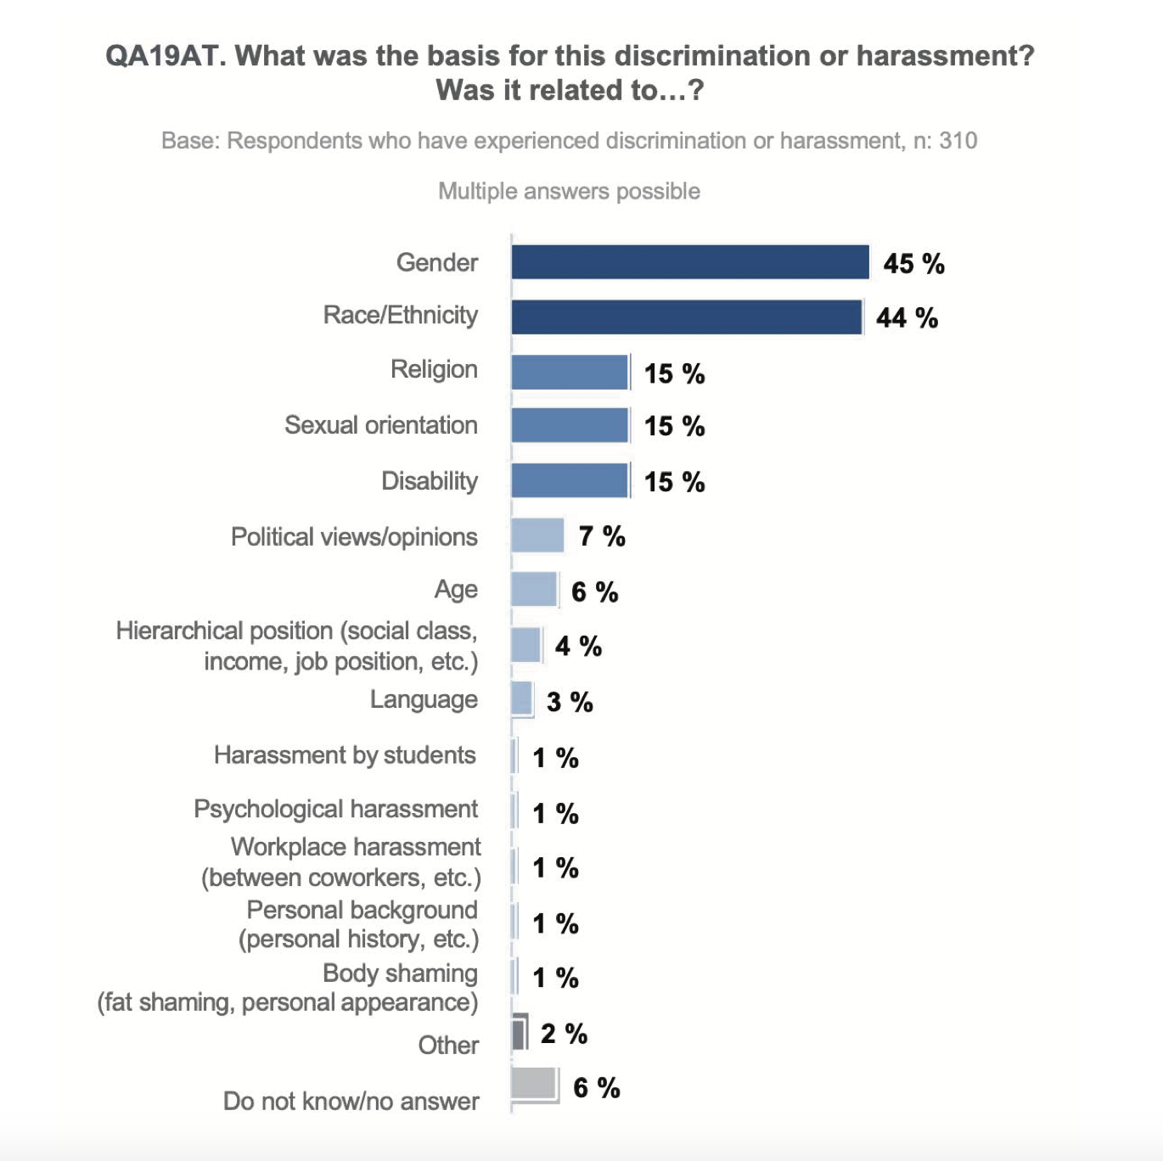
Neslihan: Epistemic Injustice in Higher Education Experiences of Discrimination and Racism of Minority Women in Higher Education
1. Theoretical Framework: Epistemic Injustice?
This is from the EDI Report of Concordia University: https://www.concordia.ca/content/dam/concordia/offices/provost/docs/Working-Group-EDI-Report.pdf

Slide 20
Neslihan: Epistemic Injustice in Higher Education Experiences of Discrimination and Racism of Minority Women in Higher Education
Compare educational systems
2. Underlying idea:
Revert asymmetrical voice distribution
Let the subaltern speak
Compare two societies that claim to be diverse
Decolonize feminist discourse
Create theory from the narrative
Provoke change
…

Slide 21
Neslihan: Epistemic Injustice in Higher Education Experiences of Discrimination and Racism of Minority Women in Higher Education
3. Excerpts from an Interview:
Interviewer: | What do you think about tokenism?
Interviewee: | Yes, this is, is especially dangerous in education because they want to present us and they want to say, look, she is a foreigner, but she still made her way in the German education system. You can do it yourself. That’s why they want us us in education. Yes, that’s the only reason. Yes, you can do it, too. And then, the German government establishes laws for that. Yes, we need a 3% quota for school. 3% of teachers need to have a migratory background.

Slide 22
Neslihan: Epistemic Injustice in Higher Education Experiences of Discrimination and Racism of Minority Women in Higher Education
3. Excerpts from an Interview:
Interviewer: | Can you elaborate on this?
Interviewee: | Yes. You need to have 3%. My training, my my my practical term, its, that between the Bachelor’s and the Master's. I go to school. On the first day at school, they ask me if I speak German. On St. Nicholas’ Day I had to stay longer because St. Nicholas was Turkish. And symbolically, it’s more beautiful if I distribute chocolate to the students, I then think to myself, I will never be a teacher. I, I finished my teaching degree, but I will never, I will not allow them to do this with me, I will not allow them to reduce me to that. In my teaching seminar, after the, after my practical term, the professor asked the class if anyone had changed their minds about going to, be a teacher. It was the last day of the seminar. I raise my hand and say that I don’t want to be a teacher anymore, then she discusses it with me. First, she acts like she understands me, then she says that I must go to school [as a teacher]. She says that I have to fulfill the 3% quota. It is disgusting, it is so disgusting to be confronted with such an argument. I told her, told her then that I would like to take another path, an academic path. She looks me in the eye and says that I have to become a teacher for the 3% quota.

Slide 23
Neslihan: Epistemic Injustice in Higher Education Experiences of Discrimination and Racism of Minority Women in Higher Education
Before hearing about my project, have you ever thought about minority women facing discrimination and racism in the field of education?

Slide 24
Neslihan: Epistemic Injustice in Higher Education Experiences of Discrimination and Racism of Minority Women in Higher Education
6. References
Grele, R. J. (1994). History and the languages of history in the oral history interview. Who answers whose questions and why? In E. McMahan & K. L. Rogers (Eds.), Interactive oral history interviewing (pp. 1-18). Lawrence Erlbaum Association. doi: 10.4324/9780203812891
Kidd, I. J., Medina J., & Polhaus G. (2017). Introduction to The Routledge Handbook of Epistemic Injustice. In I. J. Kidd, J. Medina & G. Polhaus (Eds.), The Routledge Handbook of Epistemic Injustice (pp. 1-10). Routledge.

Slide 25
Activity 3: A Vision Board Representing What the Future Holds for Women in the Field of Education
Reflect upon strategies/approaches for improving the situation of women in the field of education.
How can you personally or your own research contribute to improve the situation of women in the field of education?
Use these questions to create a vision board to represent what the future holds for women relative to the field of education.

Slide 26
Conclusion
Thank you for your attention.

