Slide 1
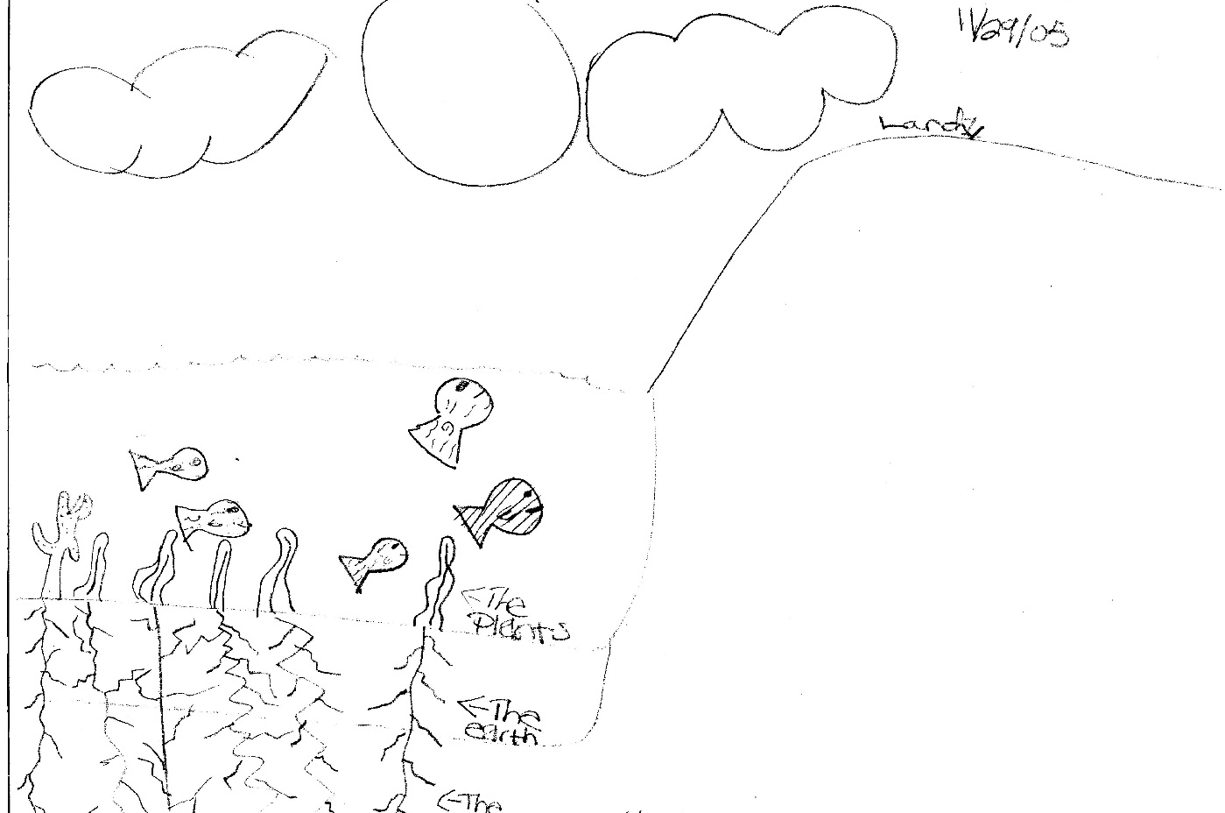
STRAND 1: Science Learning: Development of Student Understanding Admin Symposium-Developing Science Literacy and the Potential for Conceptual Change
NARST
93RD ANNUAL INTERNATIONAL 2020 CONFERENCE, MARCH 15–18
Developing Science Literacy and the Potential for Conceptual Change
Keri-Anne Croce, Towson University
Marcia J. Watson-Vandiver, Towson University
Huili Hong, Towson University
Renee Rice-Moran, East Tennessee State University
Bridget T. Miller, University of South Carolina
Christie Martin, University of South Carolina
Richard Lamb, East Carolina University
Etopio Etopio, University of Buffalo
Jonah B. Firestone, Washington State University Tri-Cities
Calvin S. Kalman, Concordia University

Slide 2

Defining what it means to develop science literacy
Developing science literacy means learning how to communicate and interpret science through texts and spoken words. Science literacy includes actions and dialogue that allow individuals to synthesize ideas, formulate arguments, defend ideas, and reframe concepts to accommodate new information
(Croce & Firestone, 2020).

Slide 3
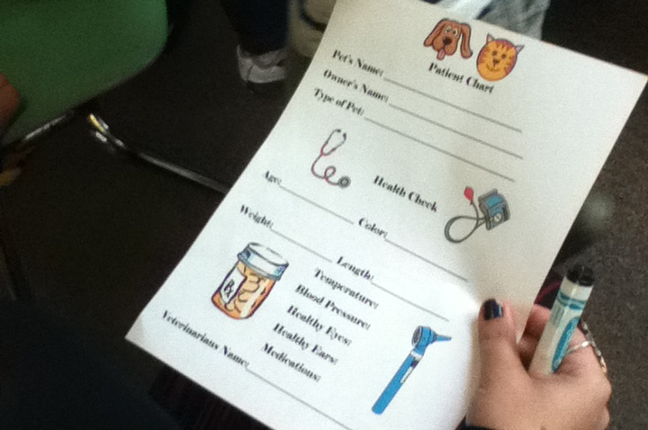
Science and decision-making
We all need science literacy on a daily basis. From big decisions such as what motivates us to vote or commonplace examples such as when we choose an allergy medicine. For example, some consumers look for antihistamines in the products that they choose to relieve allergy symptoms. Perhaps a doctor suggested the use of antihistamines or the consumer deduced this information after reading a magazine article. The scientific studies that could discuss the impact of antihistamines are not printed on the packaging for the allergy medicine. The consumer is relying on information from secondary sources that interpret the original research studies. This suggests that the future of science literacy may involve helping individuals become critical consumers of information within secondary sources of science content.
(Croce & Firestone, 2020)

Slide 4
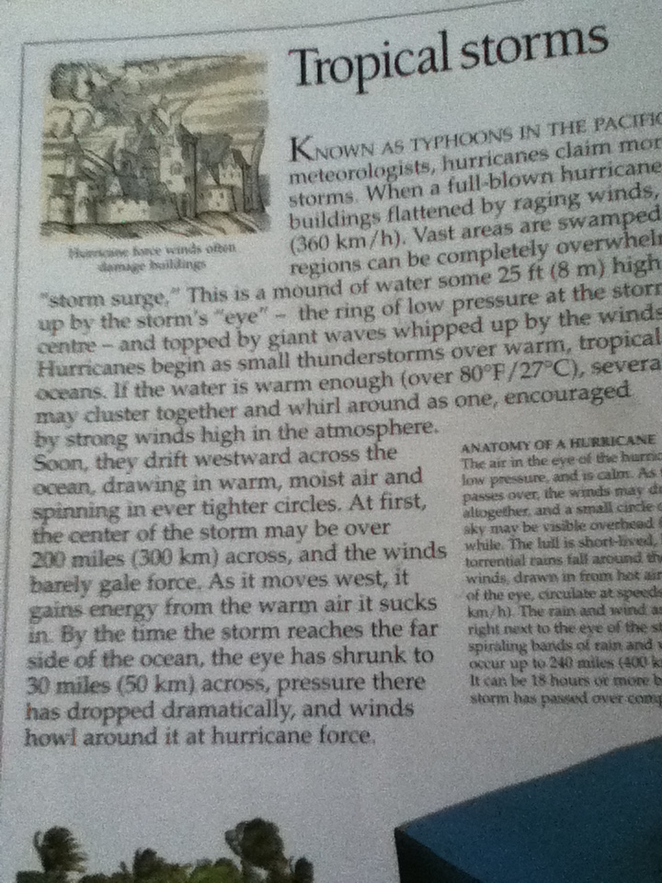
Science and decision-making
As we engage in science literacy every day, we draw on the emotional, the cognitive, and the social. Because our engagement with science literacy often impacts our decision-making, it is important to examine all the facets of science literacy from the perspective of multiple stakeholders.
(Croce & Firestone, 2020)

Slide 5
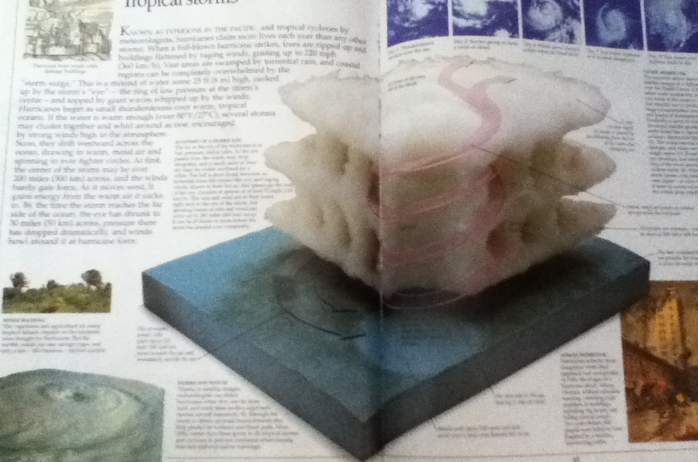
The social component of science literacy
One element of science literacy examines the social. Power dynamics exists among authors, publishers, readers, and members of scientific communities. Critical scientific literacy considers how the presentation of images and ideas may influence a reader’s ideas about science
(Croce, 2015).

Slide 6
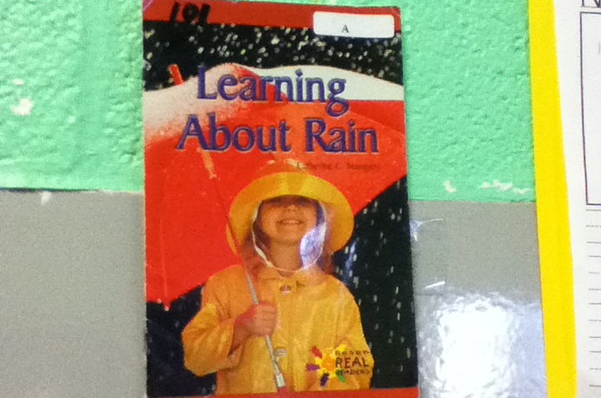
The social component of science literacy
The tools and practices of a community may influence how its members develop scientific literacy (Tolbert, Barton & Moll, 2018). These components of science literacy address the social.
(Croce & Firestone, 2020)

Slide 7
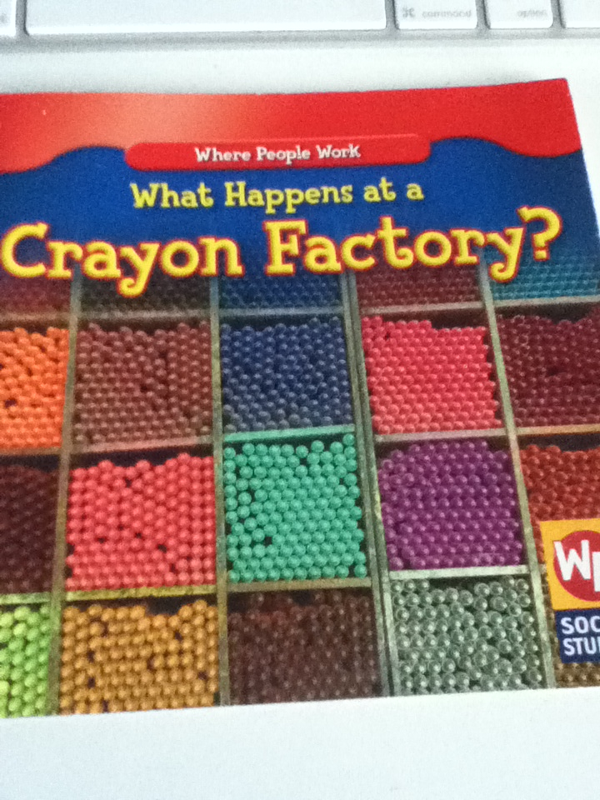
Critically analyzing science texts
Today, science literacy increasingly requires individuals to distinguish between primary and secondary sources. Primary sources of written science texts (e.g., published scientific studies) or verbal scientific communications (presentations) ideally describe extrapolated patterns and articulate how phenomena come together. Being a scientist involves understanding how to develop primary sources for science texts. In contrast to this, individuals who develop science literacy may often rely on secondary sources that provide interpretations of scientific data. Commercials, websites, and reports from Congress often provide conflicting and misleading explanations of primary sources. In recent years, individuals increasingly rely on secondary sources to help guide their decision-making.
(Croce & Firestone, 2020)

Slide 8
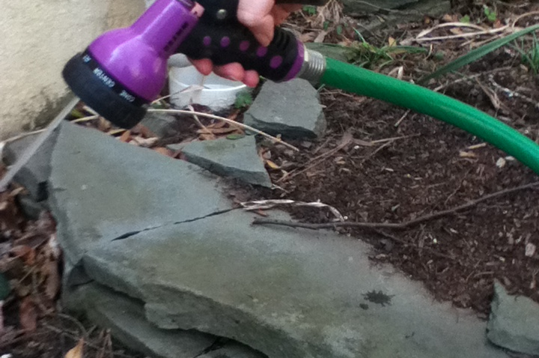
Science literacy as a social interactional inquiry process
Students should be given opportunities to do and talk science in a variety of contexts (Lemke, 1990). Therefore, it is not enough for our science and language arts teachers to do science with students by asking them to write lab reports or read the content-rich scientific texts. Science literacy can be developed in an interpersonal, social inquiry process. We emphasize the importance of interactive scientific literacy discourses where the teacher and students engage with each other’s ideas, cultures, and prior knowledge.
Hong, Keith, Rice Moran (2020)

Slide 9

Science literacy as a social interactional inquiry process
Students co-construct and practice a culture of inquiry in and out their classroom. Scientific literacy as an interpersonal social inquiry is also a means for creating an inquiry culture and hence improving the quality of students’ science literacy experience and the depth of their thinking and learning in and out of their classroom (Osborne, 2010). Collaborative teaching of scientific concepts logical reasoning, exploration, and presentation of the scientific value and learning can provide a systematic way and a supportive learning environment for students to do, talk, read, and write science across different ages, grades, and classes.
Hong, Keith, Rice Moran (2020)

Slide 10
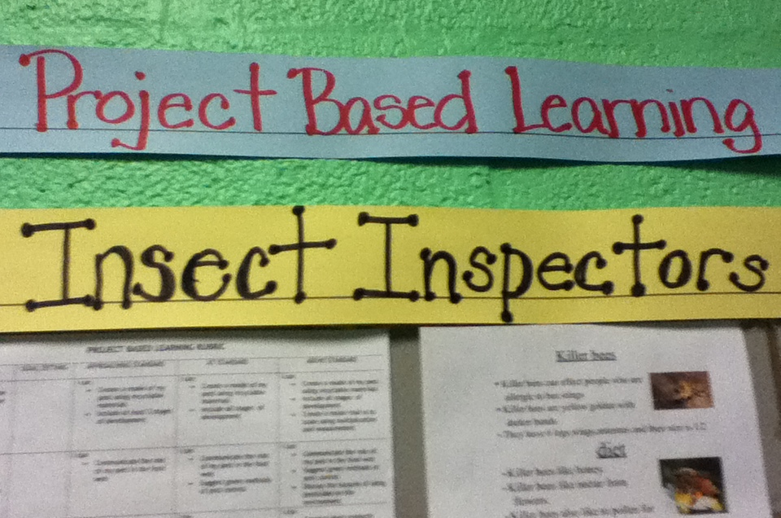
Project based learning
Miller, Martin, & Spence indicate that project-based learning allows students to develop prototypes and artifacts to disseminate to others, allowing them to take action toward solving real problems
(Miller, Martin, & Spence, 2020)

Slide 11
Science literacy and virtual reality
Virtual reality may be used in conjunction with texts to help stimulate students’ cognitive abilities as they write. Further research should be conducted in order to understand how additional cognitive resources required in the processing of VR and textual information affect student learning. More in-depth exploration of instructional practices associated with VR environments might allow for building effective pedagogies that can be put in place in order to support student cognition (Lamb, Etopio, Firestone, Zeder, Hand, 2020).
Yamamoto & Nakakoji (2005) suggest there are underlying cognitive attributes, such as critical thinking, that influence learning in science classrooms and that these attributes can now be measured more directly and accurately using fNIRS. Using realistic 3D immersive environments as targeted interventions at critical times may help to contribute to our understandings of science learning.
Teachers may consider providing realistic, immersive, and interactive virtual reality experiences in addition to textbook discovery in order to facilitate students’ development as writers of science. Future studies may examine if the impact on students’ cognition occurs differentially based upon the science topic or content addressed (Lamb, Etopio, Firestone, Zeder, Hand, 2020).

Slide 12
Equity within science literacy
As noted, African Americans in the U.S. have served a significant role in sciences, both as lead pioneers and calamitous victims. In relation to science literacy, the promotion of historical accuracy and understanding are paramount. Considering the current landscape of sociopolitical skepticism towards research sciences, science literacy will play an especially important role in reshaping future citizenry (New York State School Boards Association, 2017).
Watson-Vandiver (2020)

Slide 13
Equity within science literacy
The vitality of science is often overshadowed by the unrealistic misnomer that science disciplines are sterile and disentangled from bias. Within U.S. contexts especially, this is not the historical case. Thus, it is important to explore access and literacy in relation to science equity.
Watson-Vandiver (2020)

Slide 14
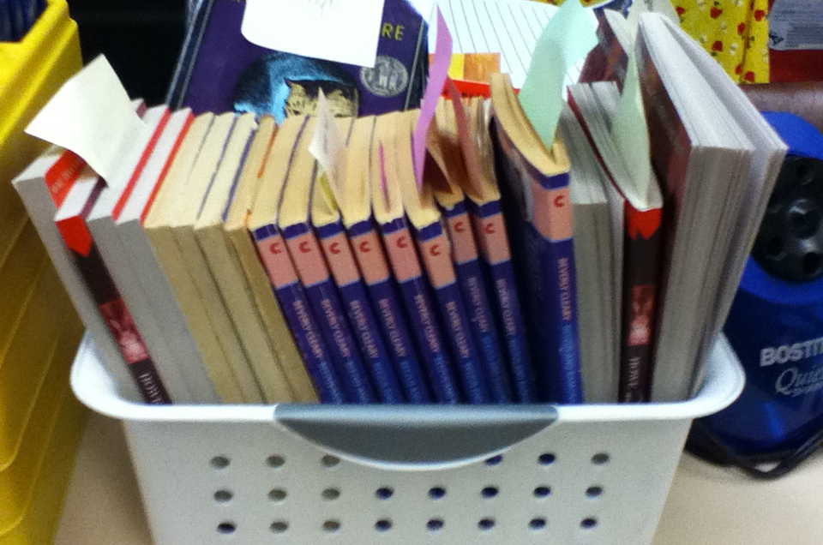
The future of science literacy
The future of science literacy does not center around one group of participants. Sociologists, scientists, scientist-journalists, Congress, educators and citizens of the globe must unite to help support the evolution of science literacy in the 21st century.
(Croce& Firestone, 2020)

