Slide 1
Research Integrity and Conflict of Interest
Cameron Skinner, Associate professor
Department of Chemistry & Biochemistry
RIO

Slide 2
Research Integrity
Public trust
Results
Funding
Research subjects (of mice and men…)
Training
Growing awareness of failures
Misused funds
Synthesized research
Misappropriation of research

Slide 3
Research Integrity
Researcher
Intellectual Property
Hiring (RA’s)
Working with students
Publications
(authorship)
Research subjects
Human & Animal
Funding
seeking & spending
Working with Data

Slide 4
Does this apply to me (& my students)?
All research at Concordia covered
Includes all funded and unfunded work
On campus and off campus
Additional level of reporting & oversight when federally/provincially funded
If bursary/assistantship originates with federal/provincial funding
Thesis, and thesis work considered “research”, if deposited then also considered academic

Slide 5
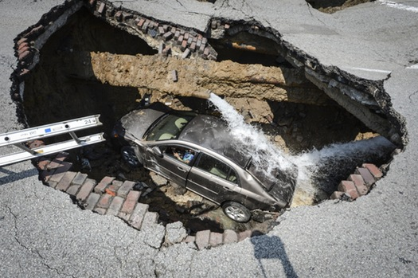
Common pitfalls
Authorship
Publications
Conflicts of interest
Photo: LT. MATTHEW HERTZFELD, TOLEDO, OHIO FIRE AND RESCUE DEPARTMENT VIA AP found at
http://www.startribune.com/ohio-sinkhole-swallows-car-driver-escapes-with-help-of-ladder/214214761/

Slide 6
Research Misconduct: How to end up in hot water….
Breaching other policies within research context
Bad “research” behavior
COI – declare and oversight
Plagiarism/Authorship – clear stated rules
Misused funds – follow Agency rules
Breach of research contracts – get help from OOR
Fraudulent use of data – Get written permission
Etc.

Slide 7
Yep, we’ve got a Policy for that!
Search “Policy” on Concordia’s main page
Policy on Intellectual Property (VPRGS-9)
Policy for the Ethical Review of Research Involving Humans (VPRGS-3) & Animals (VPRGS-13)
Policy on Conflicts of Interest in Research (VPRGS-5)
Policy for the Responsible Conduct of Research (VPRGS-12)

Slide 8
Questions? Unsure? Call me!
Cameron Skinner Loyola Campus – SP 275-27 x3341 RIO@Concordia.ca
© Scott Adams

