Slide 1
Research Orientation for New Faculty Hires
Monica Toca
Manager, Research Ethics

Slide 2
Overview
Background
Principles
Scope
Process
Q&A

Slide 3
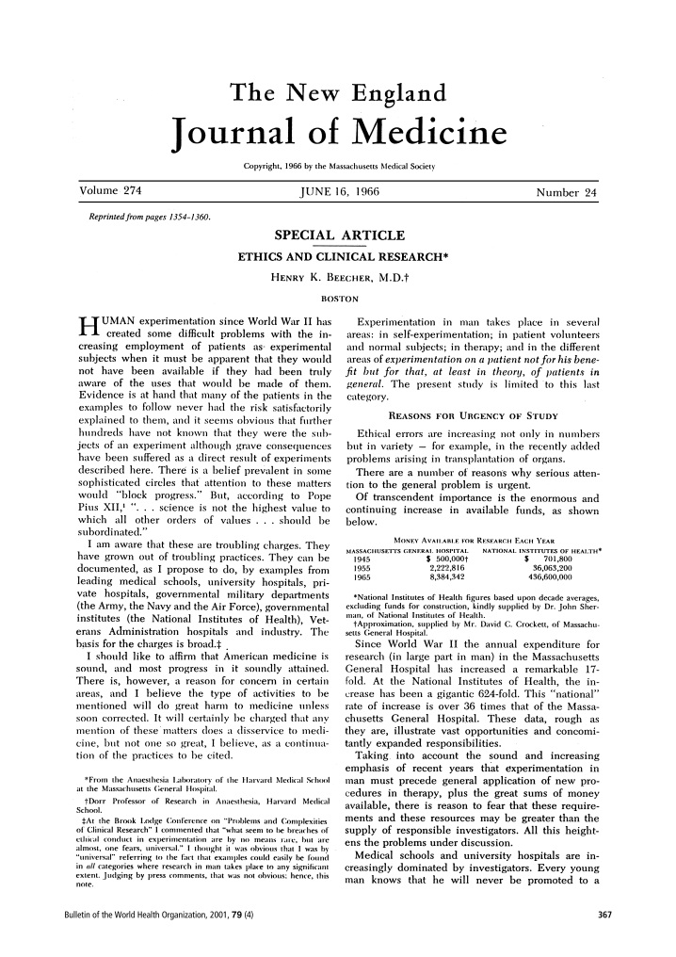
Background
Questionable medical research in the 20th century:
Treatment withheld despite proven efficacy
Continuing studies despite evidence of toxicity
Administration of toxic substances to improve understanding of disease
Experimental surgical techniques tested on healthy patients
Infants exposed to high doses of x-rays for dubious purposes
Henry K. Beecher. Ethics and Clinical Research. NEJM. 1966; 274: 367 – 372.

Slide 4
The Three Principles - TCPS2 (2010)
Respect for persons
Concern for welfare
Justice

Slide 5
Respect for Persons
Respect for persons
Typically framed as an issue of autonomy and of informed consent
Special protections for individuals with reduced autonomy:
Children
Mentally incapacitated adults
Prisoners
Employees
Other considerations:
Relationship with the participant
Relationship with the community

Slide 6
Respect for Persons
Elements of informed consent
An ongoing process
Information
Such as the objective, risks, benefits, methods etc.
Comprehension
How will participating affect me?
Voluntariness
At a minimum, lack of coercion
Articulation of a choice
Written consent forms most common.
Other means of obtaining and documenting consent may be appropriate. (See TCPS Art. 3.12)

Slide 7
Concern for Welfare
Broad conception of harms and benefits
E.g. physical harm, but also psychological harm, risk to privacy, financial well-being
Maximize benefits
To the participant
To society at large
Minimize risks
Reasonable risk-benefit ratio

Slide 8
Justice
Minimally, justice requires fair subject selection
Not choosing subjects on a convenience basis
Inclusiveness in subject selection
Other considerations
Access to the fruits of research
Research priorities

Slide 9
Scope
What research is subject to ethics review?
Research: “an undertaking intended to extend knowledge through a disciplined inquiry or systematic investigation.” (TCPS2 p. 15)
Participant: “those individuals whose data, or responses to interventions, stimuli or questions by the researcher, are relevant to answering the research question.” (TCPS2 p. 16)
Disciplined inquiry: “an inquiry that is conducted with the expectation that the method, results, and conclusions will be able to withstand the scrutiny of the relevant research community.” (http://pre.ethics.gc.ca/eng/policy-politique/interpretations/scope-portee/)
See the “Cheat Sheet”

Slide 10
Scope
Secondary use of information
“REB review is not required for research that relies exclusively on secondary use of anonymous information… so long as the process of data linkage or recording or dissemination or results does not generate identifiable information” (TCPS art. 2.4)

Slide 11
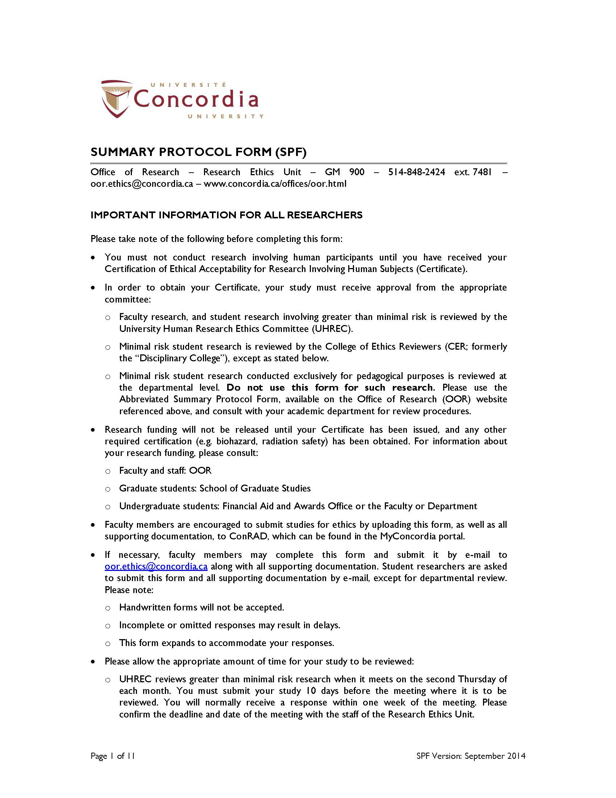
Process
The Summary Protocol Form (SPF):
Please use the most recent version
Follow the instructions
SPF Version: February 2019

Slide 12
Other supporting documentation
Scholarly Review Form (only if you are conducting greater than minimal risk research)
Recruitment materials to be used, such as advertisements or letters to participants
Instruments to be used to gather data, such as questionnaires or interview guides
Consent Form
Oral Consent script
Debriefing script
List of resources to whom participants can be referred if necessary
Letters of support from participating organizations
Submit on ConRAD or via e-mail: oor.ethics@concordia.ca

Slide 13
Research Ethics Boards (REB)
“Human Research Ethics Committee” (HREC) at Concordia
Mandate: “review the ethical acceptability of all research involving humans”
Independent of the researcher
Emphasis on protecting the rights and well-being of research participants

Slide 14
Initial review
Triage based on risk level
Delegated review
Full committee review
Possible outcomes:
Approved
Approved with comments / recommendations
Conditional Approval
Queries
Not approved

Slide 15
Normative Texts
Among the most important:
TCPS 2 (2018) - Tri-Council Policy Statement: Ethical Conduct for Research Involving Humans
Civil Code of Quebec
Professional codes of ethics

Slide 16
Contact Information
Initial review of faculty/staff research, and general inquiries:
Monica Toca Manager, Research Ethics monica.toca@concordia.ca 514-848-2424 ext. 2425
Our website: http://www.concordia.ca/research/for-researchers/ethics.html

