Slide 1

Research Orientation for New Faculty Hires
August 28, 2019

Slide 2
Research Support at Concordia
Administrative Services
Strategic and Institutional Research Initiatives
Research Development
Research Grants Administration
Research Partnerships and Innovation
Research Ethics
Research Events and Information Systems
Knowledge Mobilization

Slide 3

Services Provided by the RPI
Manage Concordia’s research output intellectual property (IP) portfolio
Negotiate, draft and review all research-related agreements with public and/or private sponsors
Assist in identifying potential partners and developing relationships
Provide guidance regarding research agreements (MTAs, NDAs, R&D contracts etc.), IP, and technology transfer
Assist in partnership project funding proposal development and review

Slide 4
Why Collaborate with Industry?
R&D collaborations between university and industry are a key driver of innovation and the nation’s economy
Governments recognizing the importance of these collaborations have developed and expanded a variety of partnership funding programs
Some of the many benefits to companies include: intellectual and financial leveraging, opportunity to participate in the training of HQP, access to specialized infrastructure and expertise
Benefits to Universities include:
Opportunities to work on applied, cutting-edge, research topics
Access to broader spectrum of research funding opportunities
Students have the opportunity to work with, and learn from, industry experts
Organizational reputational growth through long-term relationships with strategic R&D partners

Slide 5
Relationship Building
A few tools to get started in building relationships with industrial partners are:
Seminars & invited talks
Open Houses
Lab/Company Visits
Teaching & co-teaching
Match-making Events

Slide 6
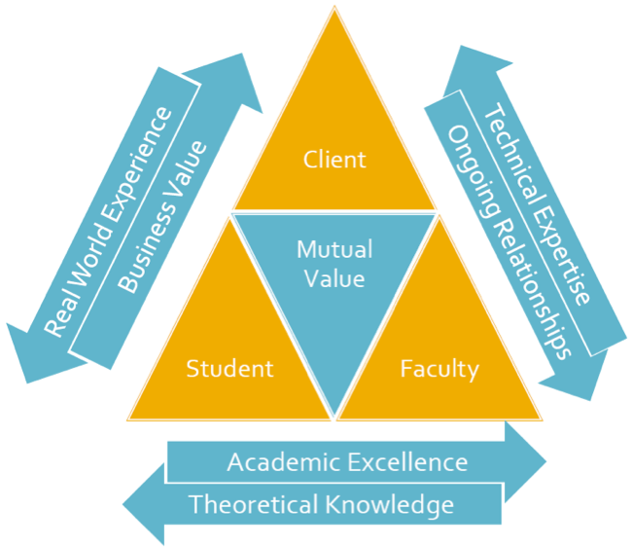

University-industry collaboration triangle

Slide 7
R&D Government Programs
DURATION

Slide 8
NSERC- Alliance Grants

Slide 9
Project size

Slide 10
Cost-sharing options

Slide 11

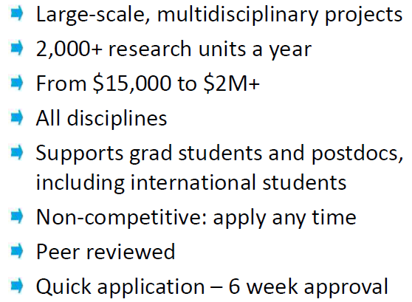

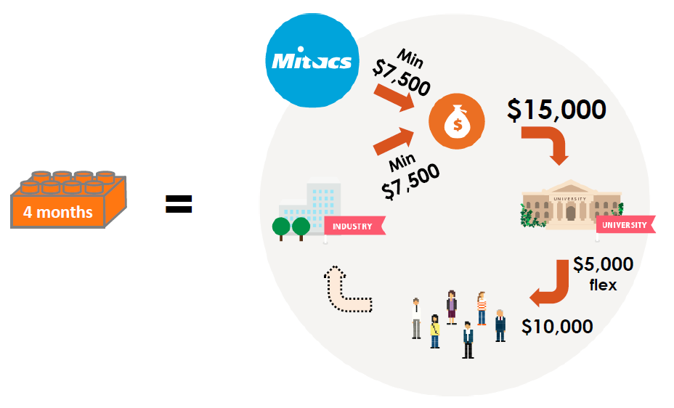
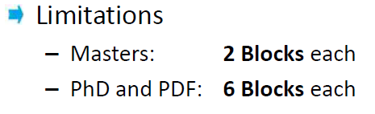
Mitacs Accelerate

Slide 12
Quebec Research Consortia
MESI
Prompt
Prima
CRIAQ
Inno-vEE
CRIBIQ
CQRDA
Quebec-Innove

Slide 13
CONTACT US:
Shelley Sitahal
Director
Shelley.Sitahal@concordia.ca
Ext. 4874
Vanessa Buzzelli
Advisor Internship and Service Agreements
Vanessa.Buzzelli@concordia.ca
Ext. 4873
Nadia Manni
Research Agreements Specialist
Nadia.Manni@concordia.ca
Ext. 7336
Karan Singh
Research Agreement Specialist
Karan.Singh@concordia.ca
Ext. 5917
Cliff Pavlovic
Intellectual Property Specialist
Cliff.Pavlovic@concordia.ca
Ext. 7340

Slide 14
CONTACT US:
Guillermo Mendoza-Suarez
Advisor, Research Development and Partnerships, ENCS
guillerm@encs.concordia.ca
Ext. 3208
Anna-Maria Moubayed
Business Development Specialist
ammoubayed@mitacs.ca
514-220-5368
Research Agreement Specialist, TBA
Research Agreement Specialist
Karan.Singh@concordia.ca
Ext. 8045

