Slide 1
Embrace the World Concordia International August 28, 2018

Slide 2
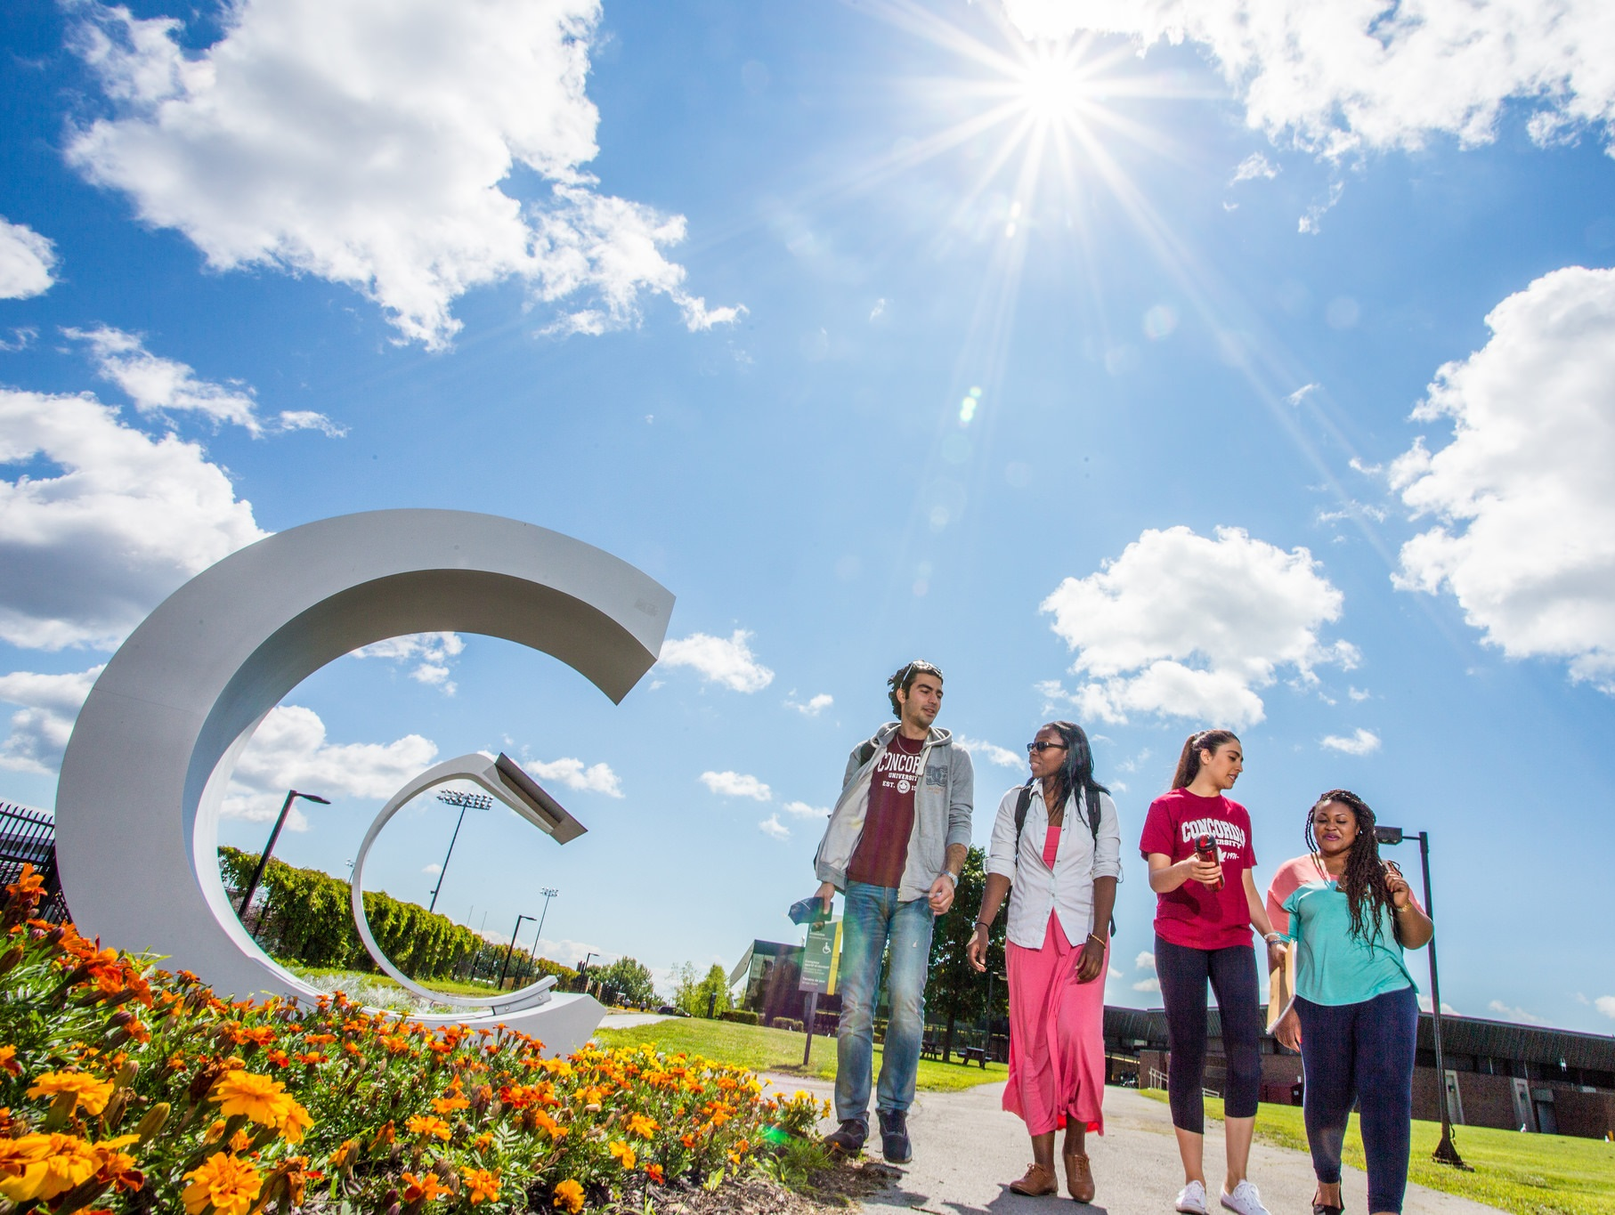
Rationale
Academic Opportunities
Resources
Reputation

Slide 3
Joint research projects
Recruitment
Services
Academic
Exchange Programs
Network

Slide 4
President
Provost
VPRGS
Recruitment
International Students Office
Concordia International
SGS

Slide 5
5

Slide 6
Four
Directions
Demonstrate research leadership in addressing global challenges
Establish an academic environment that fosters the mobility of individuals
Implement global next generation initiatives
Globalize our outreach for greater impact and visibility

