Slide 1
POLI 815/648 Feminist Critiques of Public Policy Library Workshop
Michelle Lake, Subject librarian: Political Science, SCPA, First Peoples Studies and Government Publications
Michelle.Lake@Concordia.ca

Slide 2
Welcome!
Who am I?
Michelle Lake, librarian for Political Science, the School of Community and Public Affairs, First Peoples Studies and Government Publications
Michelle.Lake@Concordia.ca / Zoom Office Hours – Wednesdays 2-4pm
What do I do?
Provide research support
Help students with library databases
Help students find and access materials they need
Help with citation issues
Choose the books we buy for the above subject areas

Slide 3
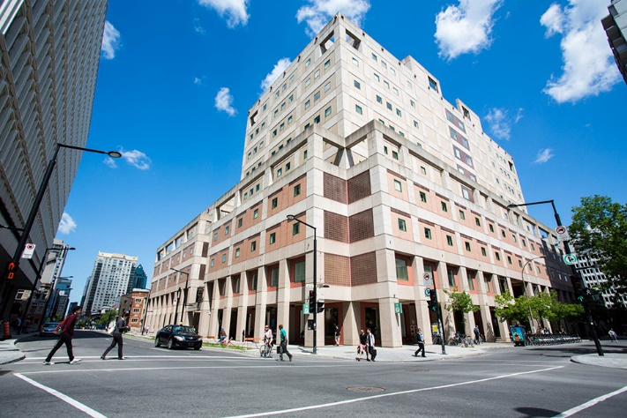
The Librar(ies)
Webster Library – SGW Campus
24/7 access, with student card, after 11pm
2nd, 3rd, 4th, and 5th floor of LB - “Library Building”
Poli Sci, Government Info, Maps, History, Social Sciences, Humanities, Engineering & Fine Arts
Interlibrary Loans
Current Print Journals
Dissertation Writer’s Rooms – LB5
Vanier Library – Loyola Campus
24/7 access, with student card, after 11pm
1st, 2nd, and 3rd floor VL – “Vanier Library”
Sciences, Psychology, Communications & Journalism
Special Collections
Print Journal Archive

Slide 4
Library: in person
Library is open 24 hours, 7 days a week until the end of the semester.
Services such as the loans desk, Ask Us desk and chat help are not open 24/7, check the library website for hours if you need a particular service.
Course Reserves room is open - need to use the call number of a book to locate them in course reserves
Procedural masks need to be worn at all times in the library.

Slide 5
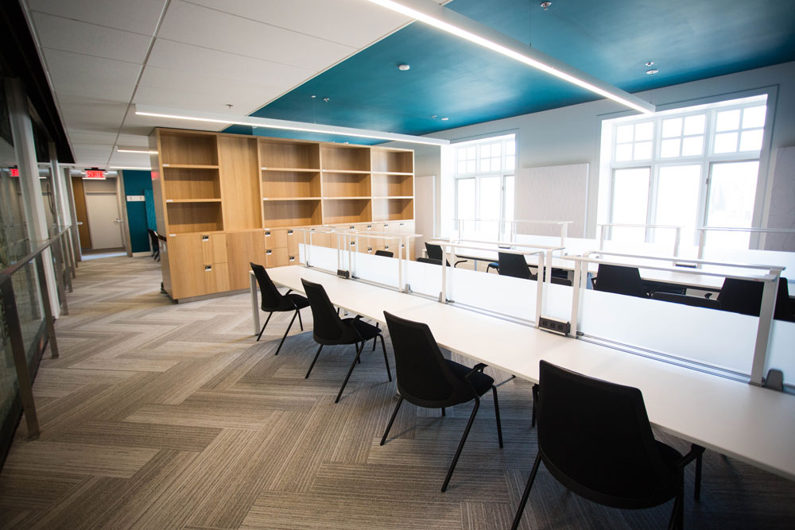
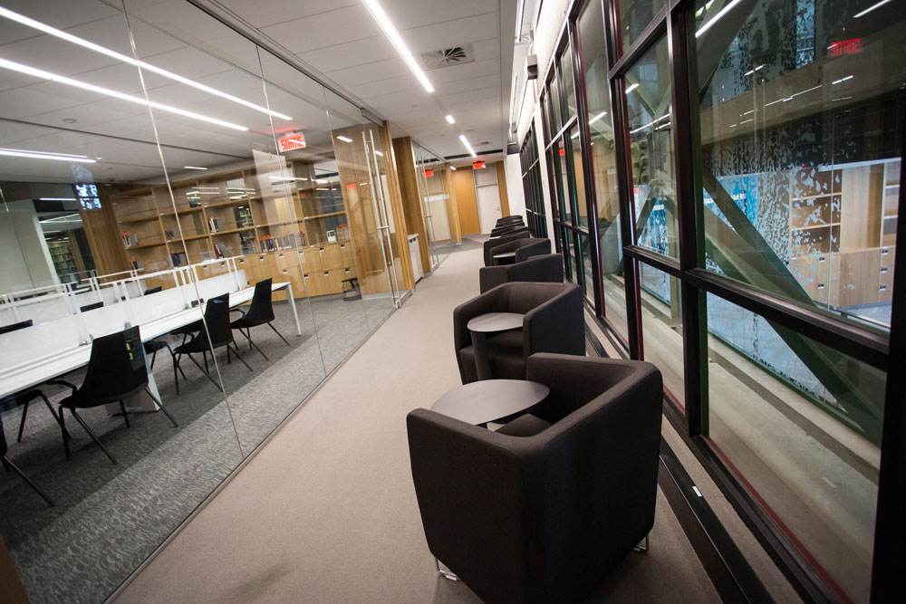
Graduate Student space - LB5
4 Dissertation writers’ rooms & Quiet reading room
Lounge, kitchenette & book lockers
Dedicated printer, copier, scanner
Notes:
**Note: all grad space is on 5th floor, with exception of Seminar and Thesis Defence Room (3rd floor)

Slide 6
Lockers & Shelves
A number of lockers in Webster Library's Dissertation Writers' Rooms on LB-5 become available three times during the academic year. The dates for this year are:
Monday, October 4, 2021
Monday, January 24, 2022
Monday, May 30, 2022
On the above dates, requests for lockers and shelves can be made at the Webster Loans Desk (see opening hours), near the entrance to the Library, and will be treated on a first come first served basis.
Shelves can be requested anytime during the year.

Slide 7
Collections – Print Books
Public aspects medicine, Medicine and the state RA 1-1270 (LB5)
Political Science & Government, J – JZ (LB4)
Law, K-KZ (LB4)
Canadian Law, KE (LB4)
Social Sciences: Public Policy, Economics, Statistics, Human rights, Social services, Social work, Public welfare, H-HV (LB4)
Women, The Family, Sexuality, Sex roles, Parenting, Children, Marriage, Men, Feminism, HQ (LB4)
History of North and South America, First peoples/Indigenous studies E-FC (LB3)

Slide 8
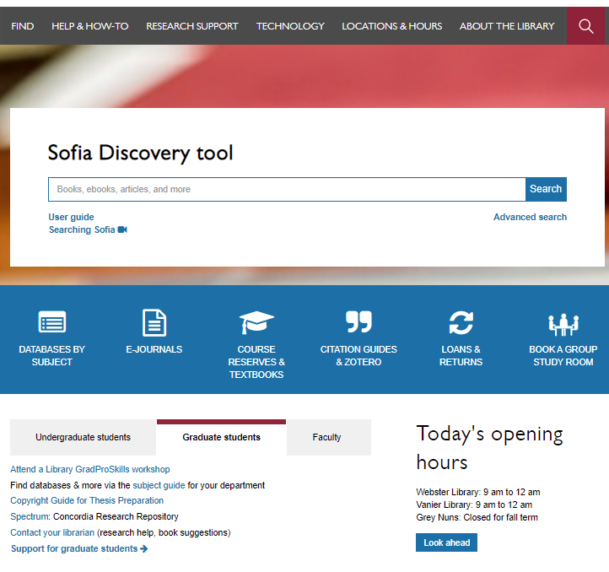
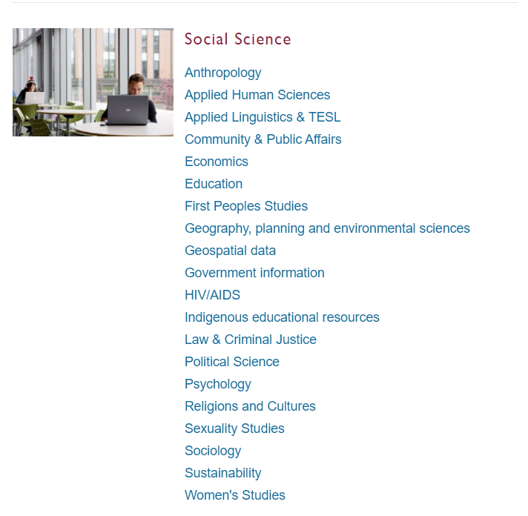
The library website has a section for Graduate student services
There is a link directly to the subject guides, which are set up by the subject librarians
https://library.concordia.ca/

Slide 9
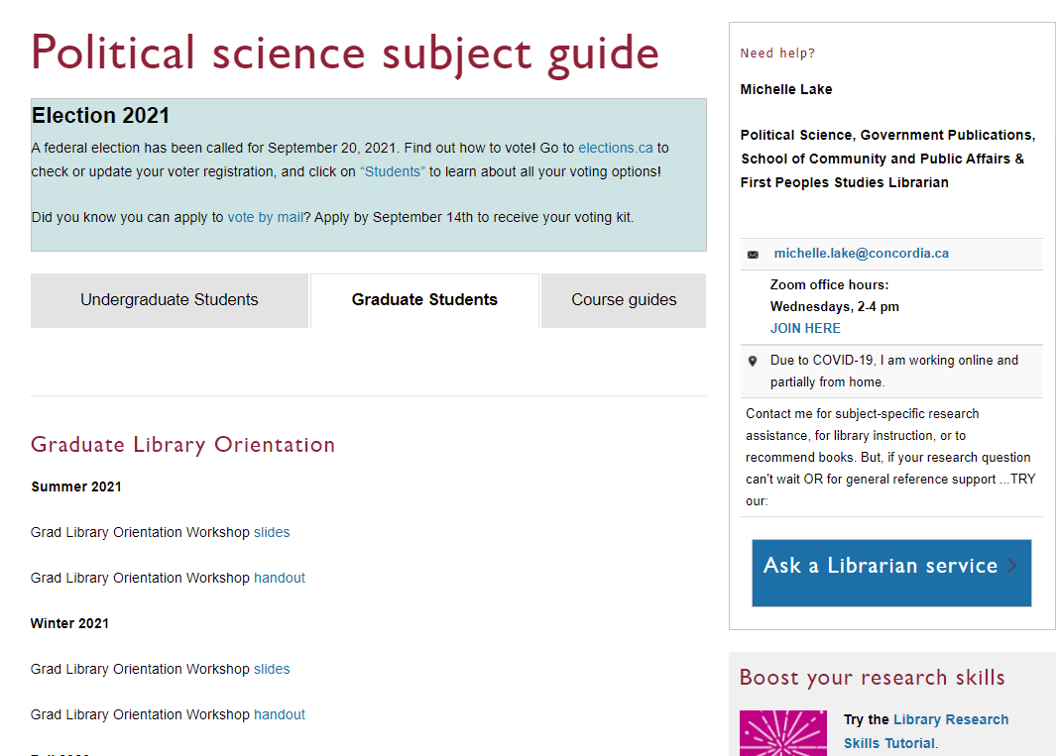

Slide 10
Locating known items

Slide 11
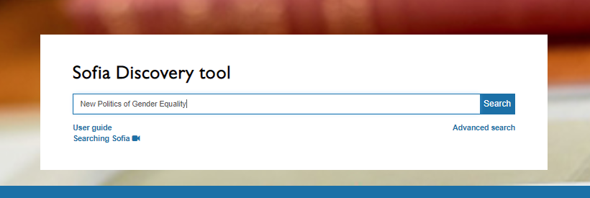
Squires, J. 2007. The New Politics of Gender Equality. Palgrave.
What is this?
A book -> Search Sofia

Slide 12
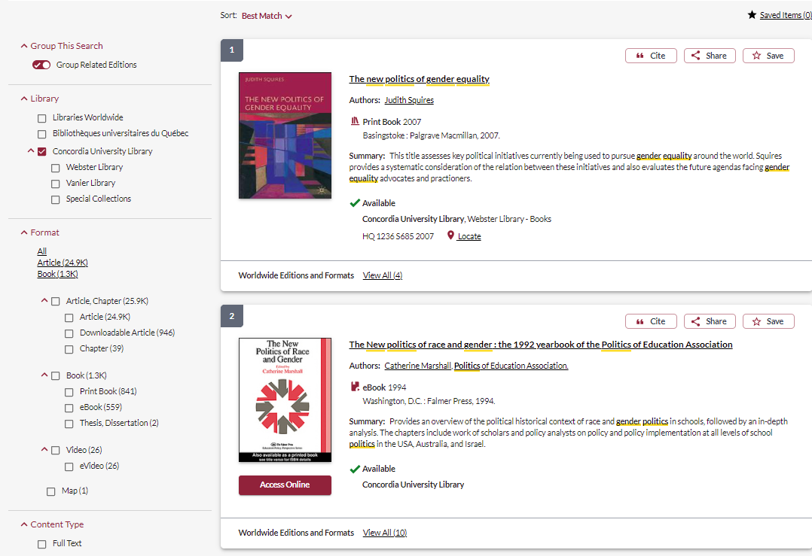

Slide 13
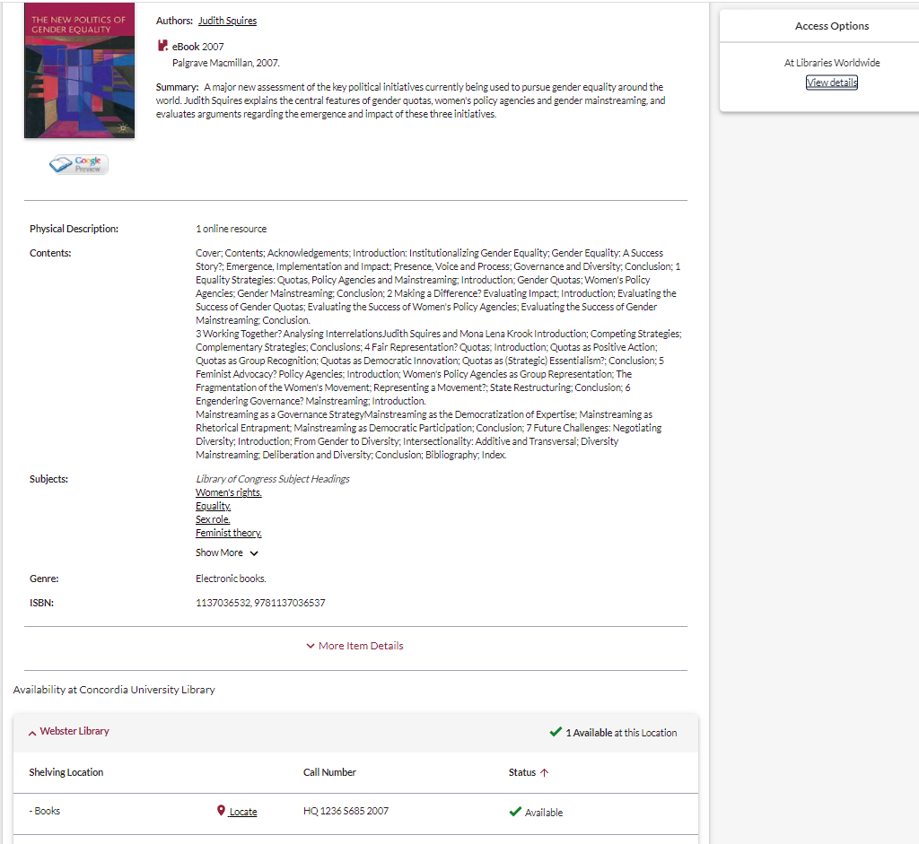
All libraries worldwide will include Quebec libraries, but will not provide you with access options for the e-book
This particular book is only available in print at Concordia Library and there is one copy.
You might want to consider Article delivery.

Slide 14
Article Delivery
Articles and chapters from Concordia's print collection of books and periodicals (e.g., journals, magazines, newspapers and conferences),can be scanned and emailed to you as a PDF attachment.

Slide 15
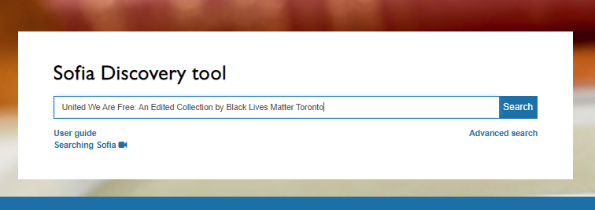
Maynard, R. and L. Betasamosake Simpson. 2020. Towards Black and Indigenous Futures on Turtle Island: A conversation. In United We Are Free: An Edited Collection by Black Lives Matter Toronto. (eds. Syrus Ware, Sandra Hudson, Rodnet Diverlus) University of Regina Press.
What is this?
A book chapter -> Search Sofia

Slide 16
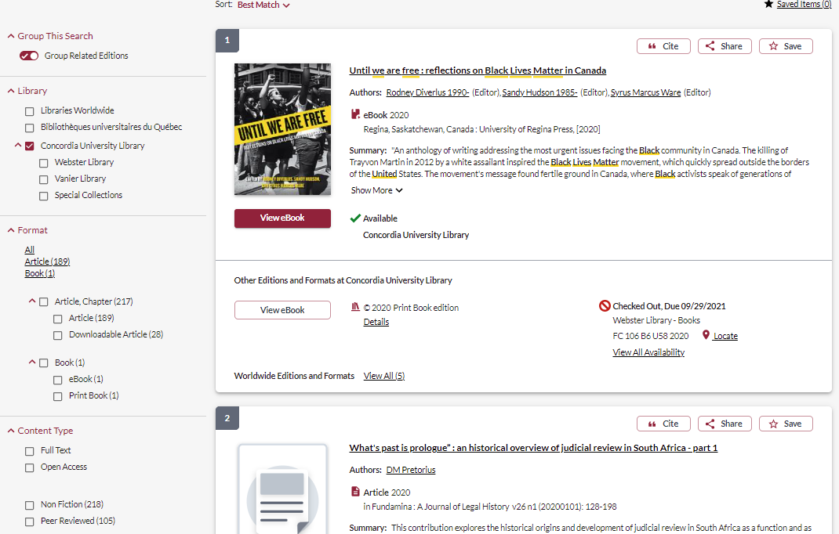

Slide 17
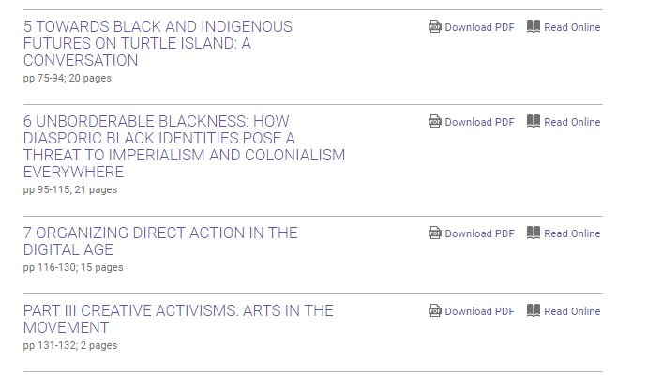

Slide 18
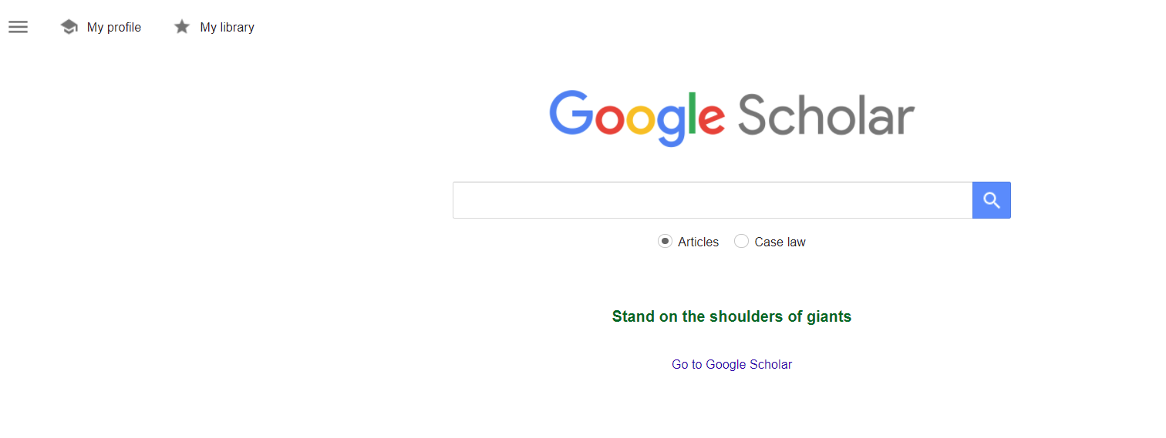
Yuval-Davis, N. 2006. Intersectionality and Feminist Politics. European Journal of Women’s Studies 13(3), pp. 193-209.
What is it?
A journal article -> Google Scholar
Set up Google Scholar to recognize and access Concordia resources

Slide 19
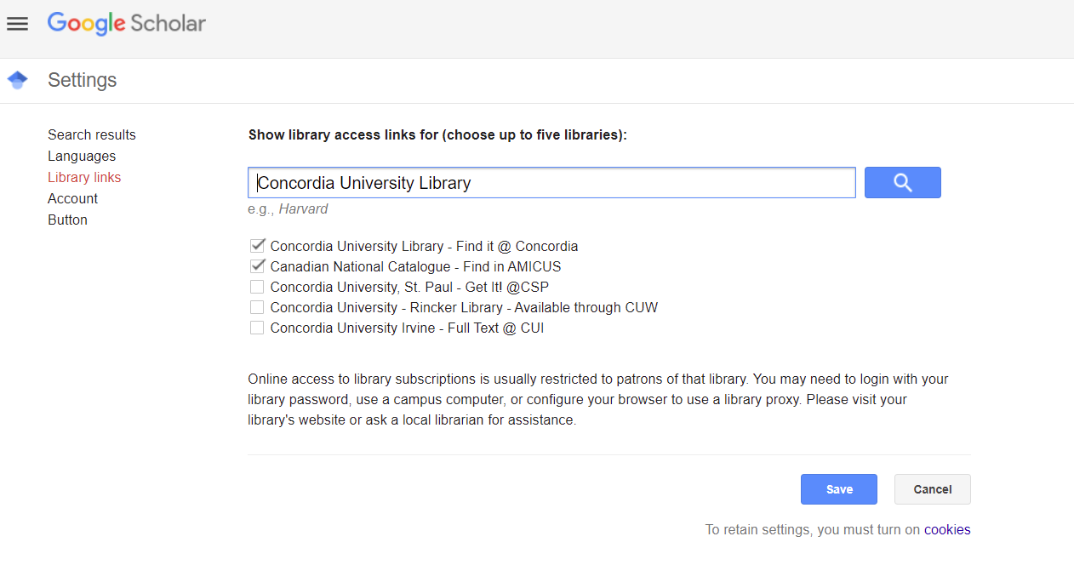

Slide 20
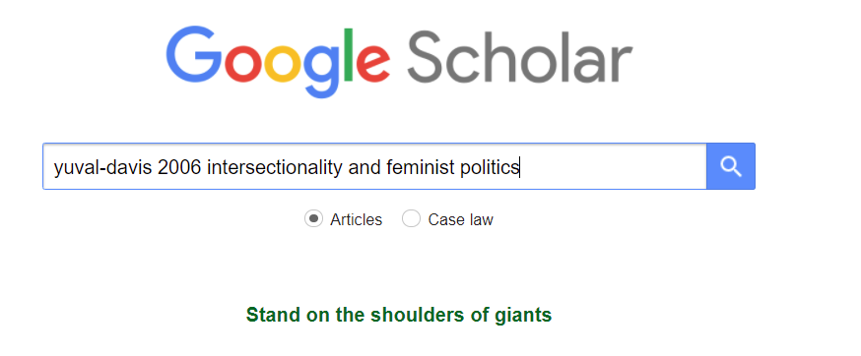

Slide 21
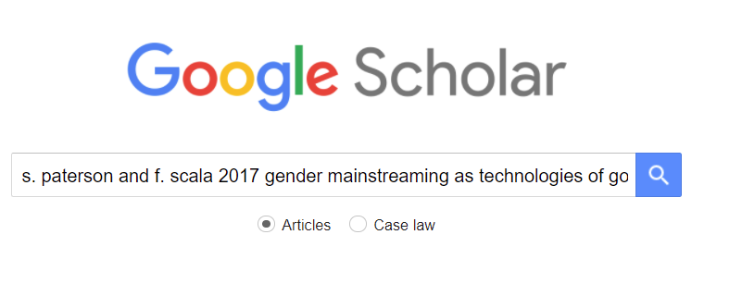
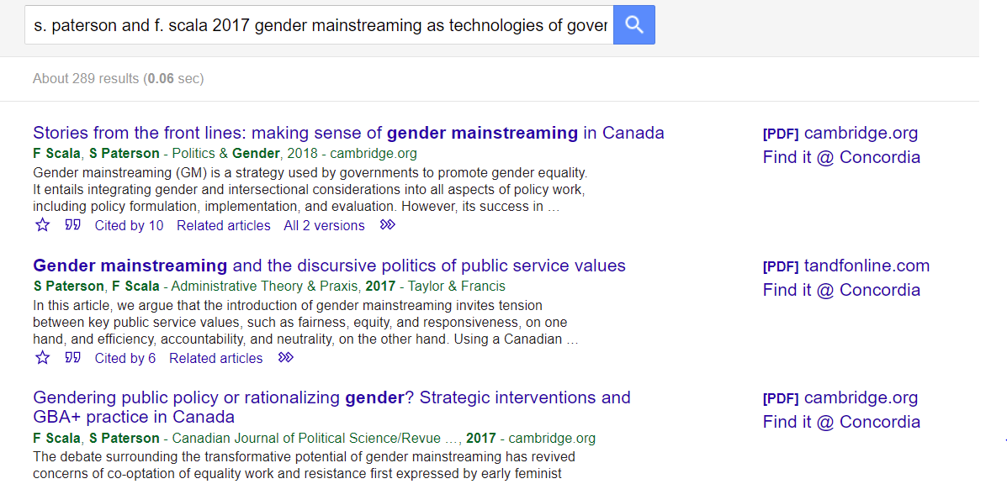

Slide 22
Resources for your assignments

Slide 23
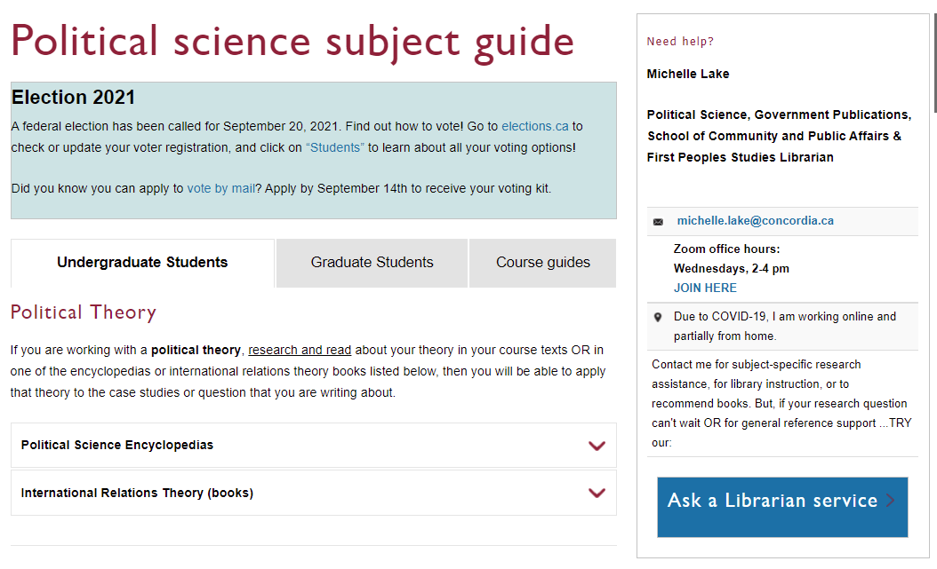
Op-Ed: Newspapers
Scroll down to find newspaper databases

Slide 24
Choose: Commentary, Editorial and Letters to the Editor

Slide 25
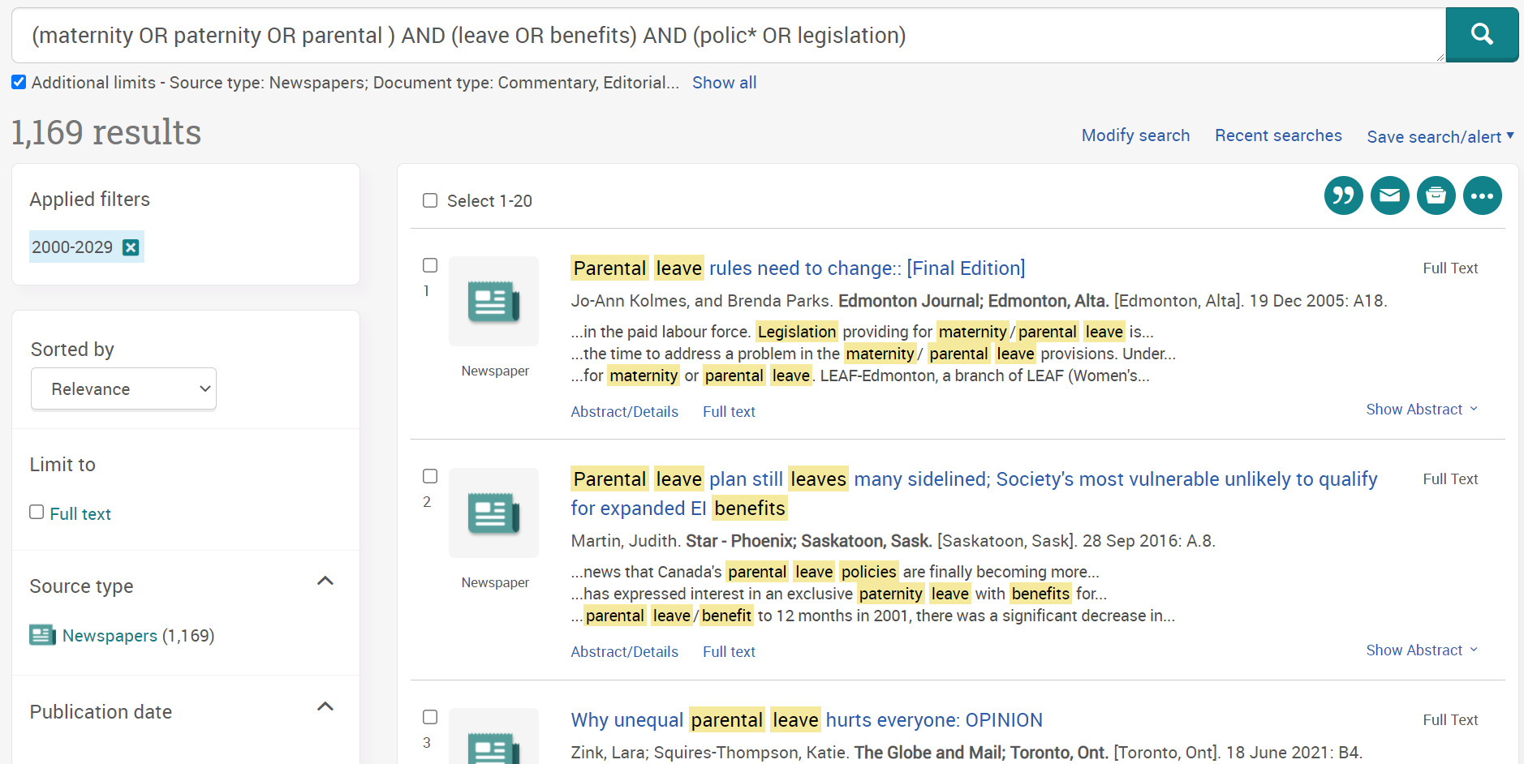
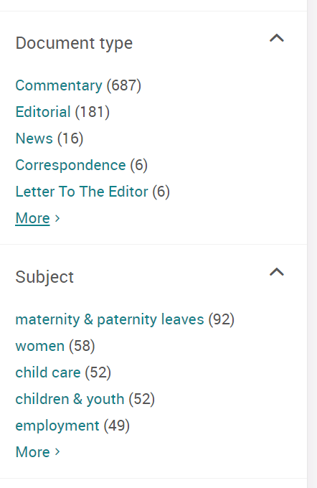
Limits
You can also add Opinion as a keyword with AND, as some newspapers include that in the article title.

Slide 26
Searching for books
Search Tip: In Sofia, AND/OR must be in all caps or they will not be recognized as stop words in the search

Slide 27
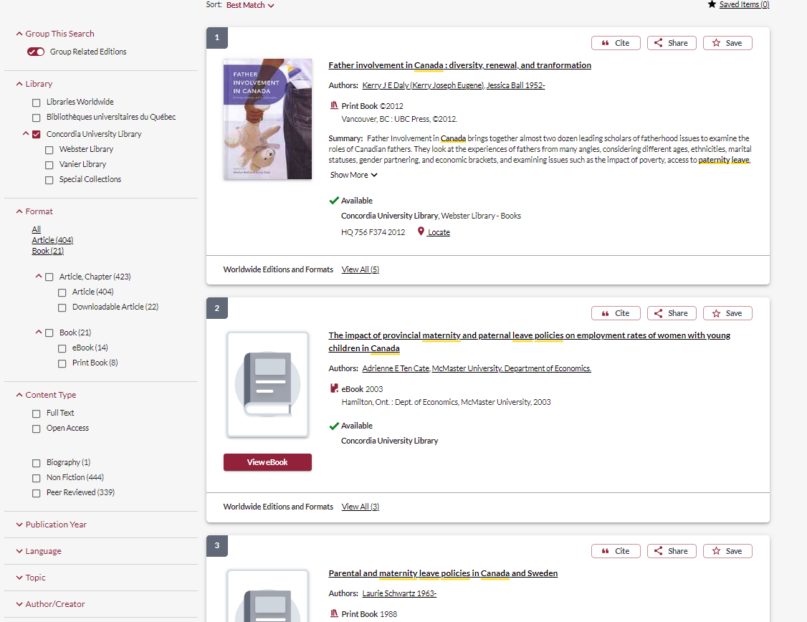

Slide 28
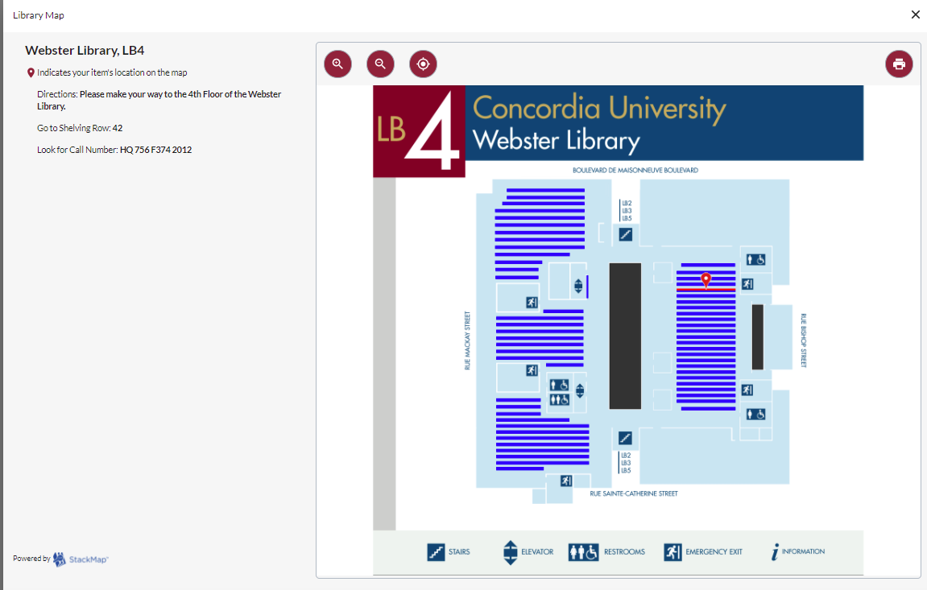

Slide 29
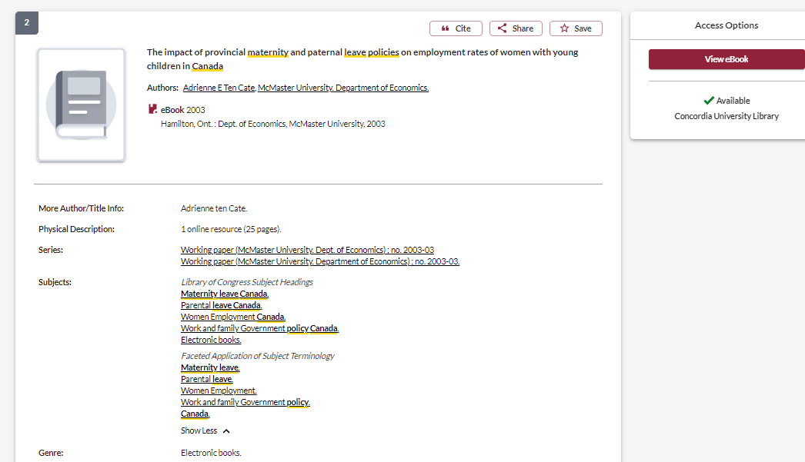
These subject headings can lead you to other resources on the same topic

Slide 30
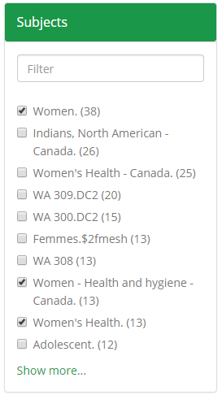
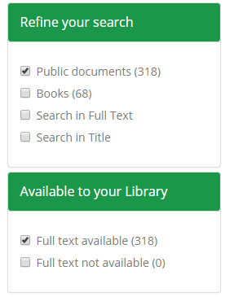
DesLibris -Canadian Public Policy Collection
This is an online collection of policy documents, government publications and scholarly ebooks. All Canadian publications; you can use your narrowing options to find just “public documents”, or narrow by subject keyword.

Slide 31
Finding journal articles

Slide 32
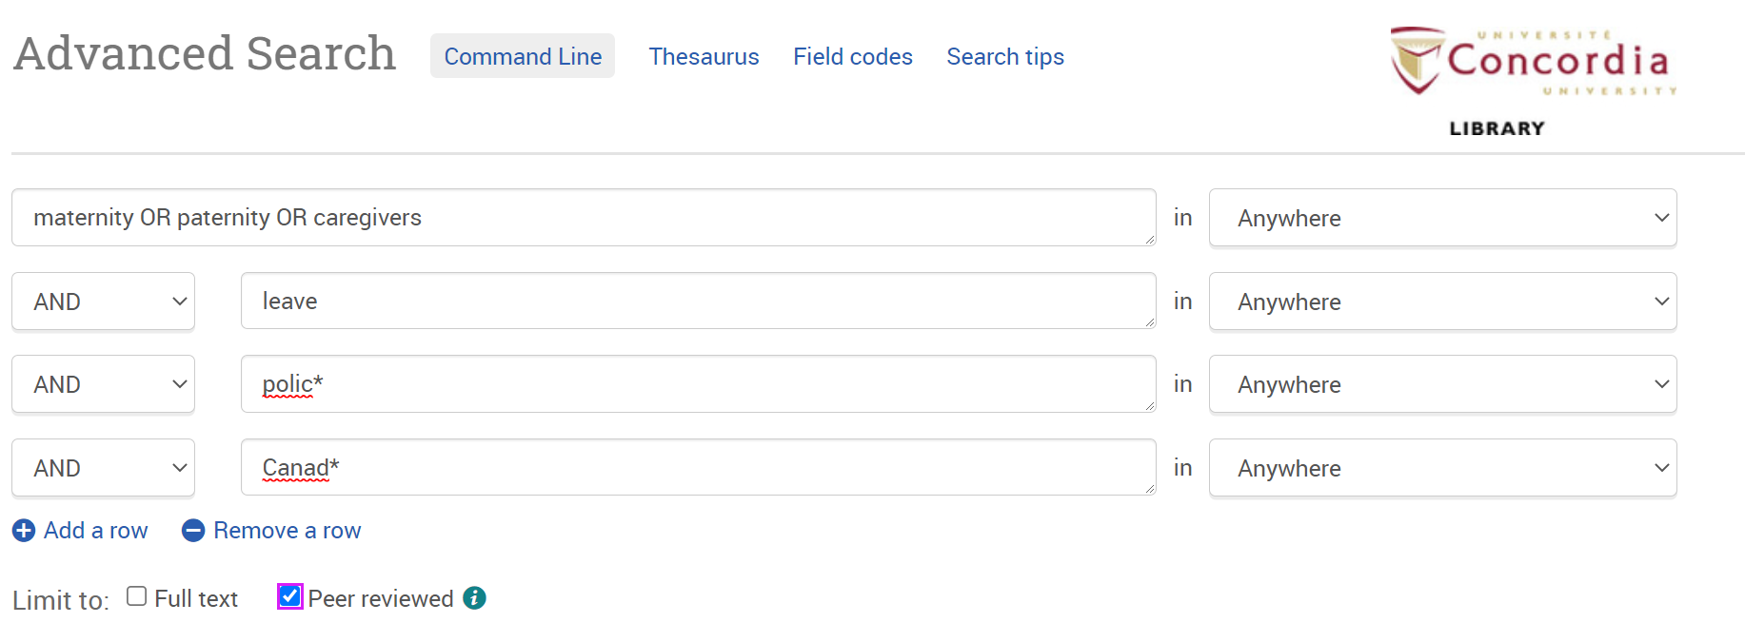
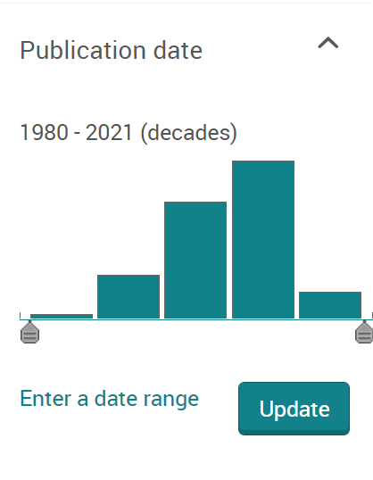
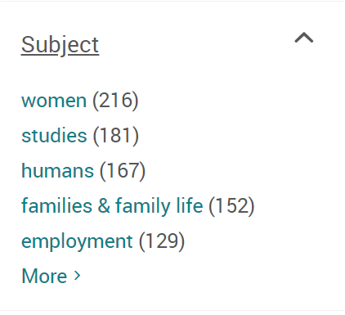
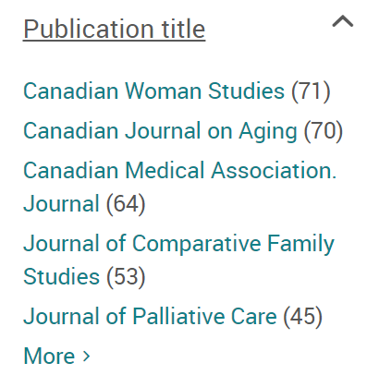
ProQuest Combined Canadian
Journal Article Database
Limits

Slide 33
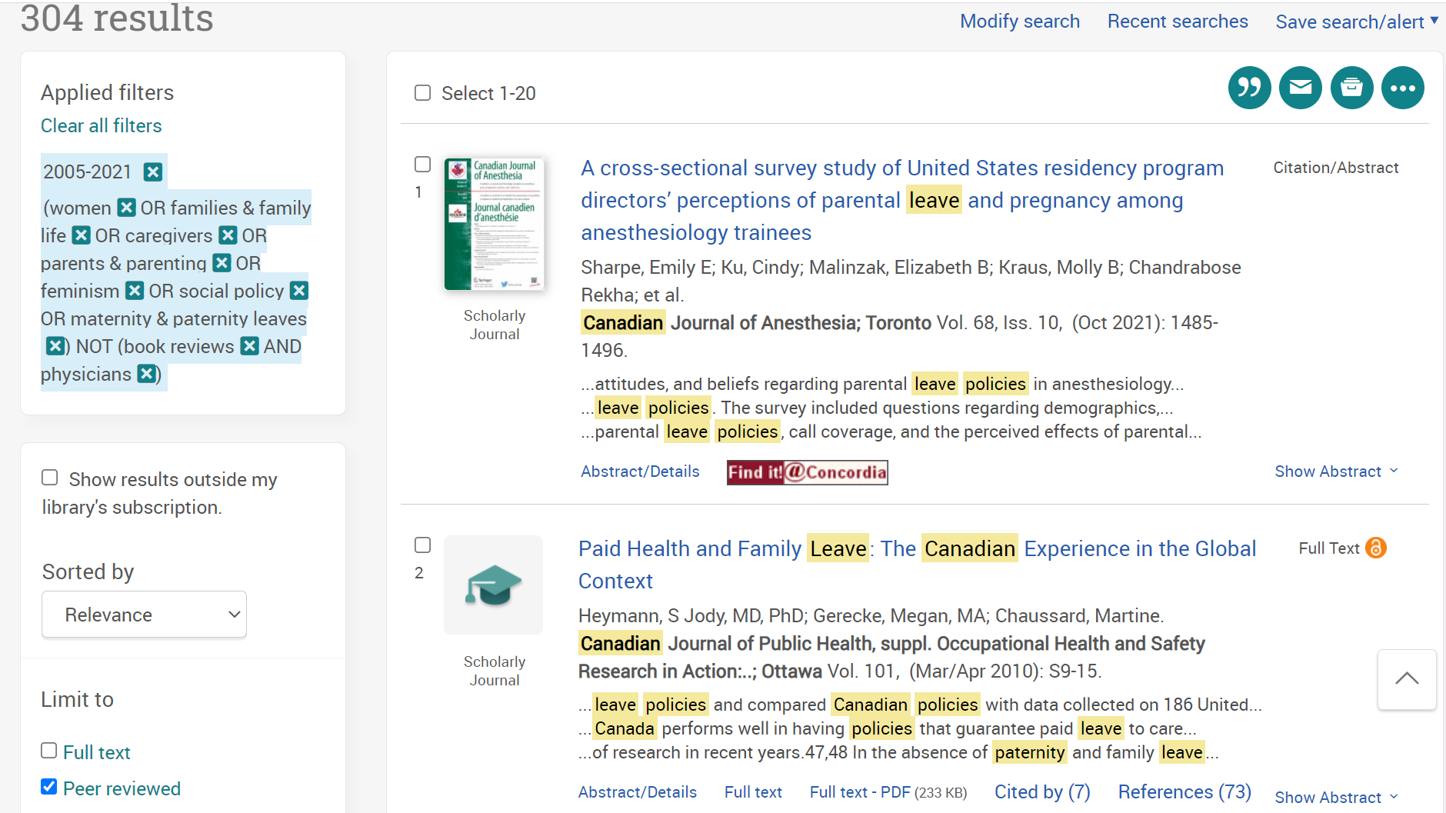
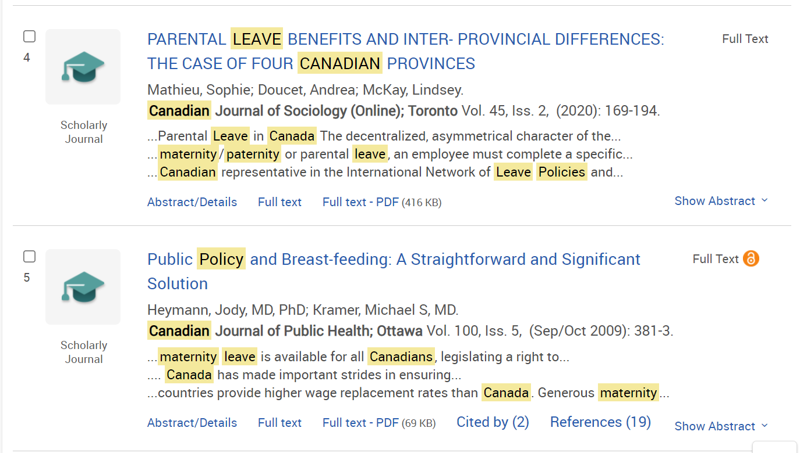

Slide 34
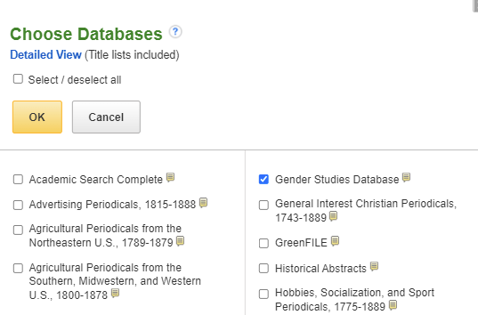
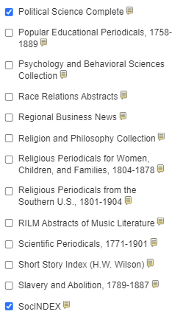
3 EBSCO databases combined:
Political Science Complete
Gender Studies Database
SocINDEX

Slide 35
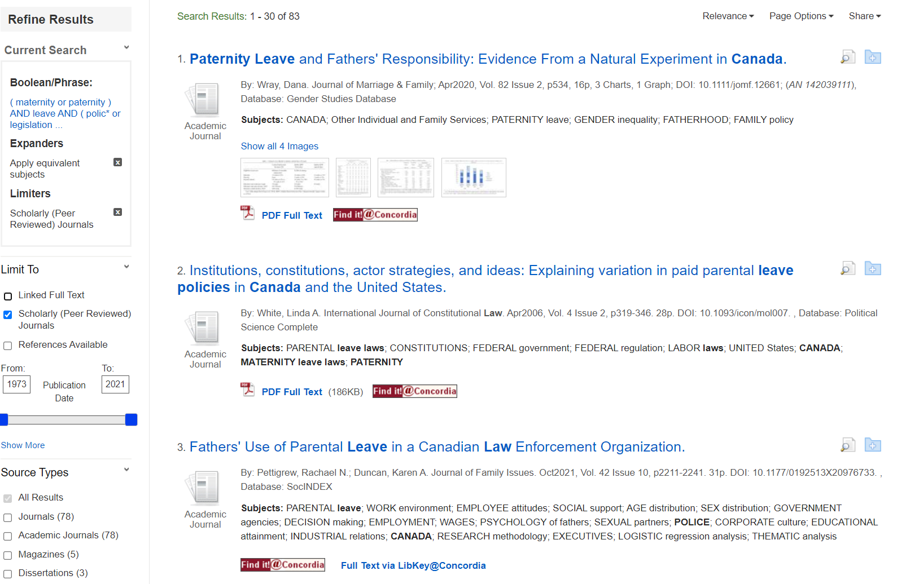

Slide 36
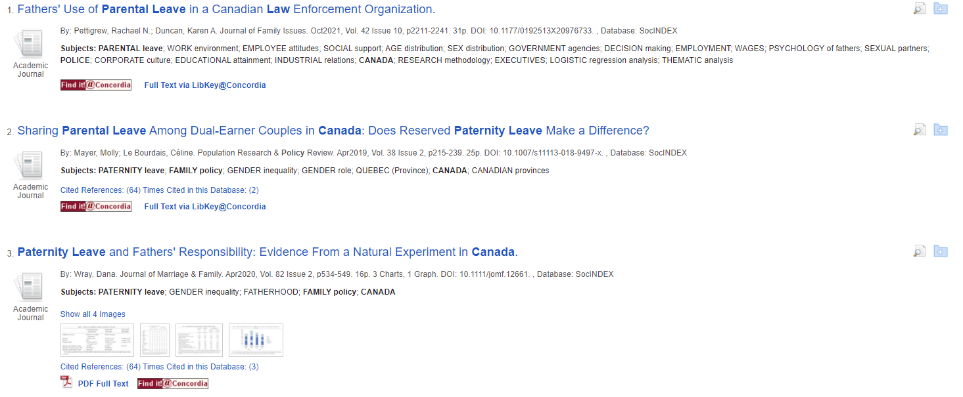
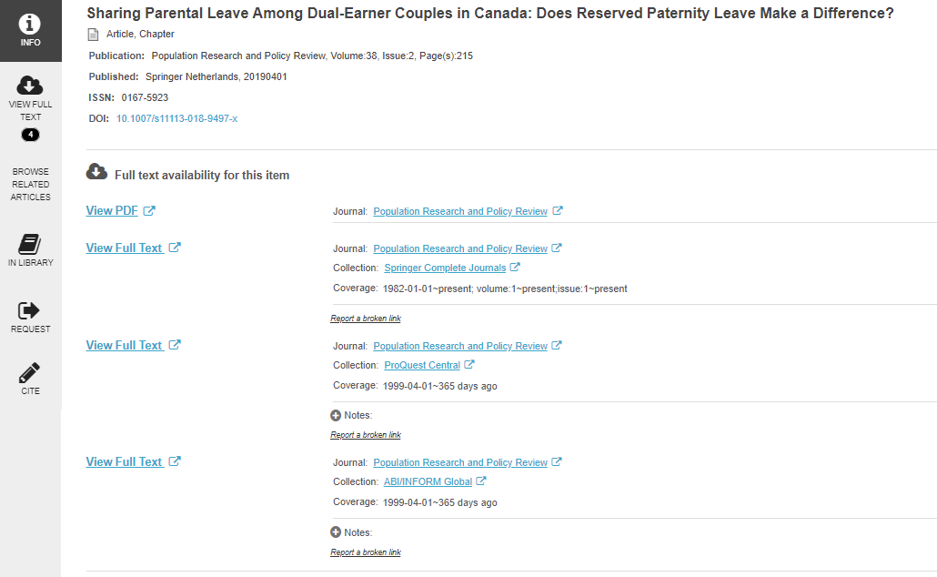
Use the Find it @ Concordia to access the articles

Slide 37
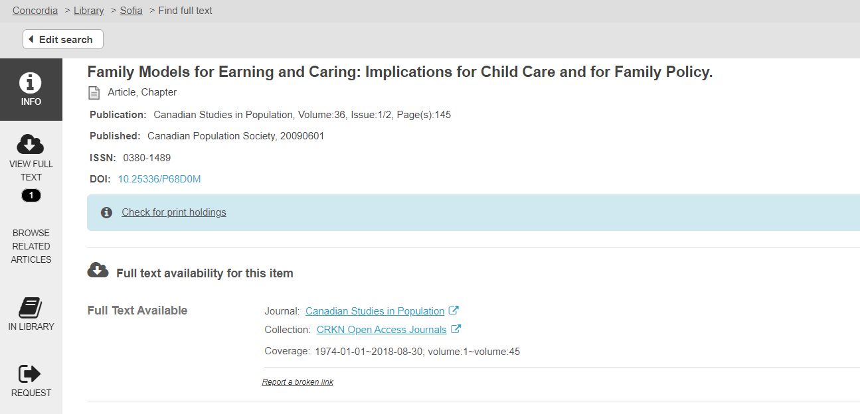
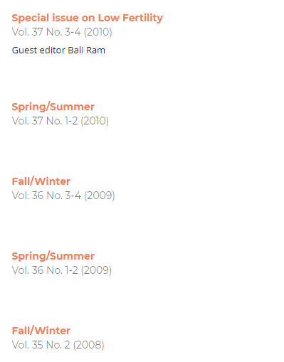

Slide 38
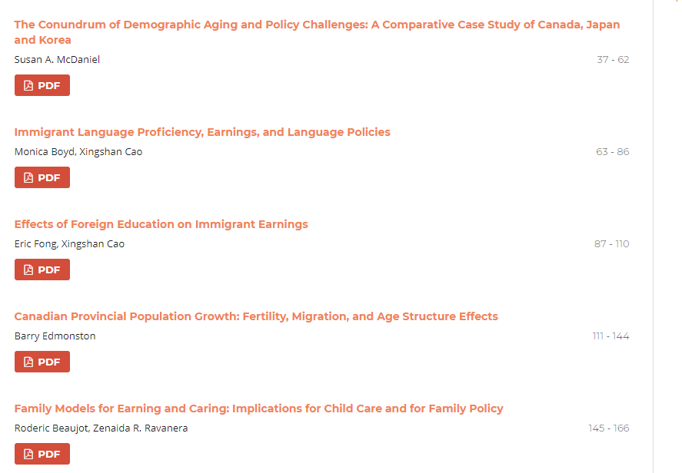
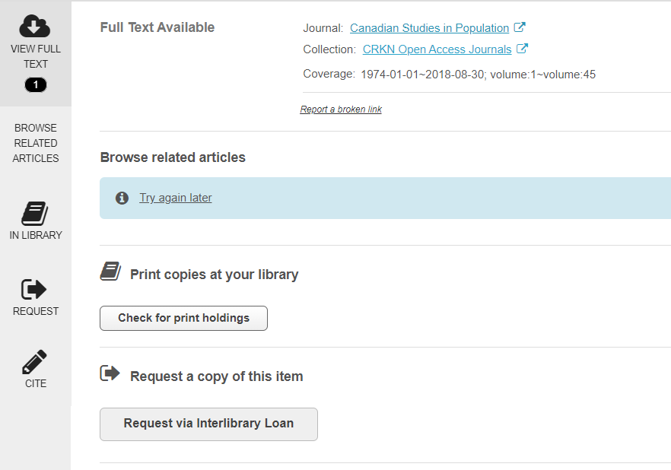

Slide 39
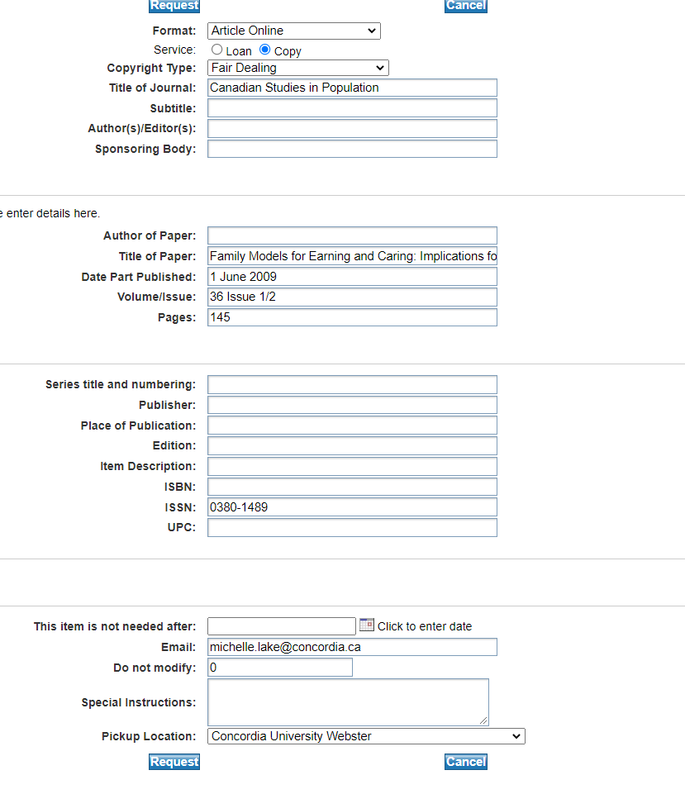
Interlibrary loans (ILL), via Colombo, allows you to access material not available at Concordia University Library.
This service attempts to obtain the research materials you need from other libraries, either in Quebec, Canada or abroad.
In most cases articles and book chapters will be delivered to you electronically.
There are no restrictions on what you can request (ex: book, article, video, microfilm, etc.), but currently we are unable to borrow e-books from other libraries.

Slide 40
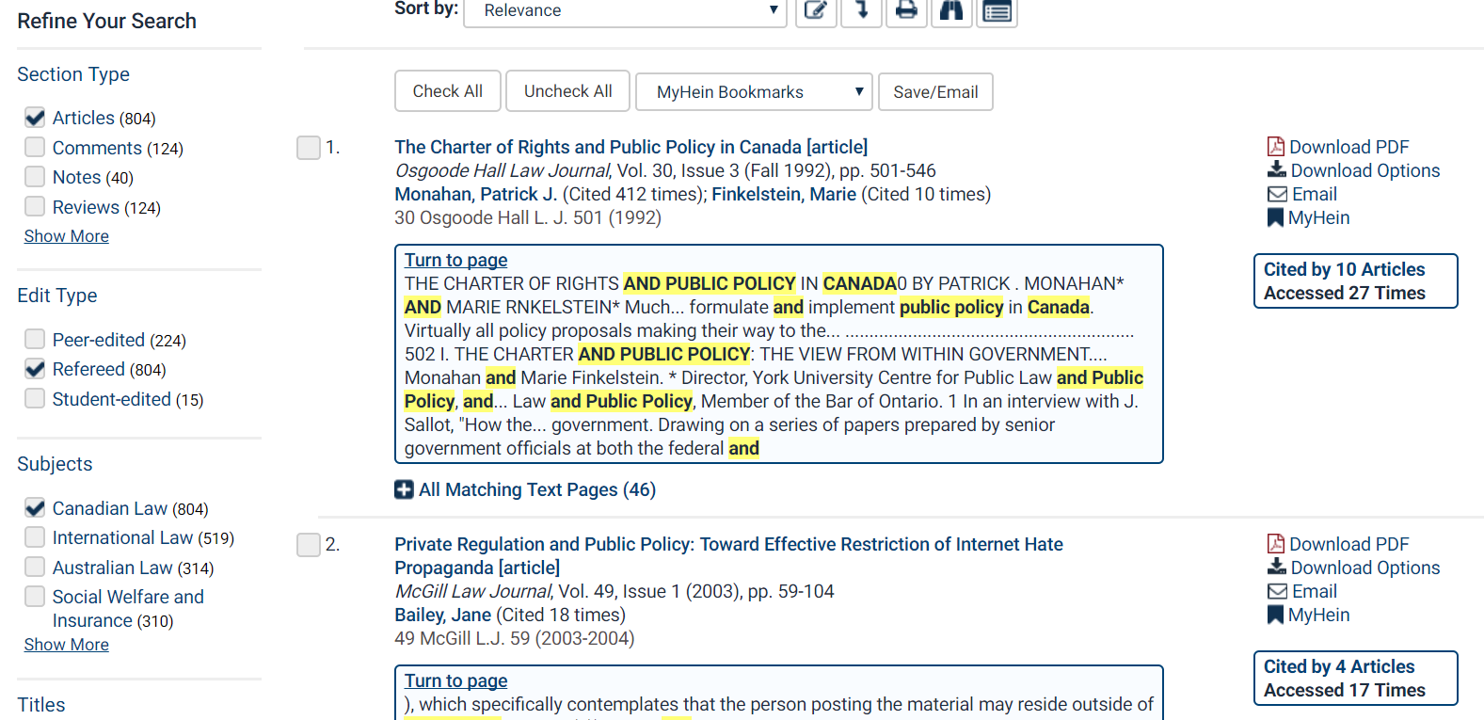
HeinOnline Law Journal Library
Refine your search with limits. All the articles in the database are from law journals.
The database is almost entirely PDFs.

Slide 41
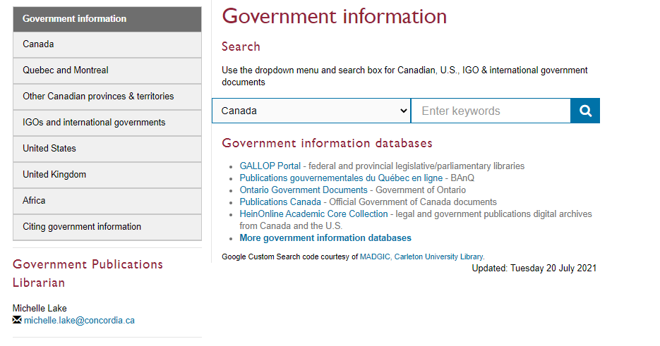
Finding policy or government information
This is a custom Google Search, which searches through all the Canadian government websites and publication catalogues
Because it is a Google style search, you can be broad and you don’t need to use AND/OR.
Adjust your keywords as you search.

Slide 42
GradProSkills Library Workshops
GPLL231: Library skills & resources: maximize your graduate research potential (Sept 21 or Oct 7)
GPLL243: Using Zotero for Grads (Sept 24)
GPLL245: Researching Indigenous topics at the library and beyond (Sept 28)
GPLL257: Accessing Open Data (Oct 27)
GPLL259: Proposal to publication: what authors should know about scholarly book publishing (Oct 27)
More Library GradProSkills Sessions Here: https://www.concordia.ca/students/gradproskills/workshops/partners/qlib.html

Slide 43
Need help, ask us!

