Slide 1
POLI 366 Politics of Africa Library Workshop
Michelle Lake
Librarian for Political Science, SCPA, FPST, and Government Publications
Michelle.Lake@Concordia.ca

Slide 2
Who am I?
Michelle Lake, librarian for Political Science, the School of Community and Public Affairs, First Peoples Studies, and Government Publications
Michelle.Lake@Concordia.ca / Make an appointment or ask a question
What do I do?
Provide research support, assist with and teach search strategies
Help students navigate library databases, books, journals, and other sources
Help students find and access materials they need
Assist with evaluation of sources
Build guides, resources and pathfinders to help students locate research materials
Help with citation issues
Choose the books we buy for my subject areas: political science, public policy, community and public affairs, First Peoples studies and government information

Slide 3
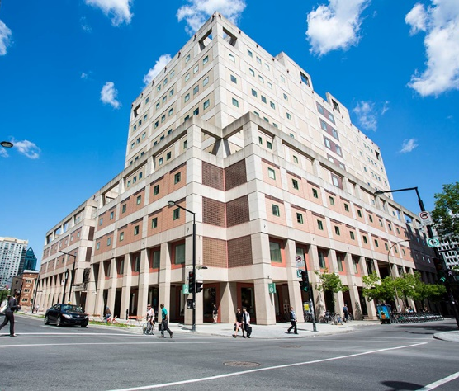
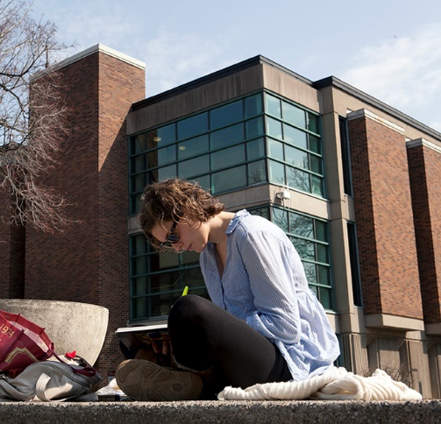
The Librar(ies)
24/7 access, with student card, after 11pm
Webster Library (LB) – downtown on SGW campus & Vanier Library (VL) on Loyola campus
Webster: Social Sciences, Humanities, Business, Engineering & Fine Arts
Vanier: Science(s), Health, Communications, Journalism and Psychology
Course Reserves Room(s): have the required undergraduate print textbooks for the courses taught at that campus (for example: Webster has the Political Science and SCPA course reserves)

Slide 4
Library Services
Your student card is your library card.
You need it to:
borrow books (up to 100 a time)
borrow a laptop and other technology (for 24 hours)
print on campus (add money to your Dprint account)
access the library overnight during 24/7 hours.
Webster library has 5 book scanners (And Vanier has 2!) that can be used for free to scan chapters from our print books and email them to yourself as a PDF.
To use Library databases, access online articles and ebooks when you are off campus, login with your MyConcordia Netname and password.

Slide 5
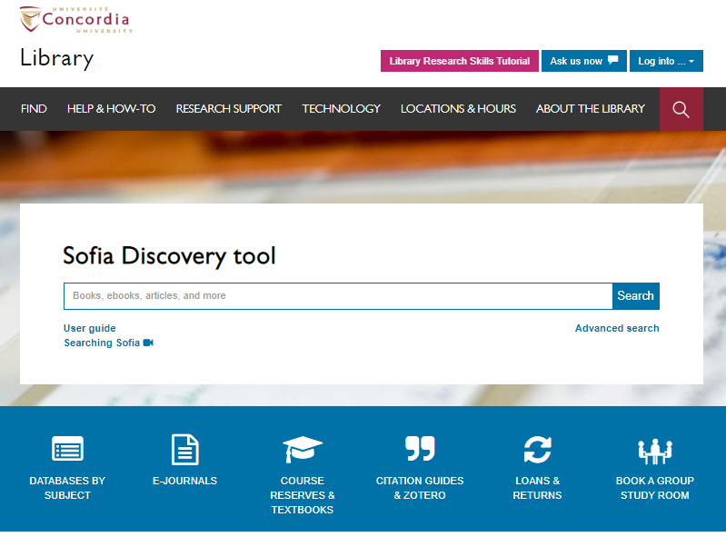
Use the Sofia Discovery tool to find print books, ebooks, and journal articles from the library.

Slide 6
Fioramonti, Lorenzo. 2018. “Africa’s Development Narratives: From Growth to Wellbeing,” 737-749 in Samuel Ojo Oloruntoba and Toyin Falola, eds., The Palgrave Handbook of African Politics, Governance and Development. New York: Palgrave Macmillan.

Slide 7
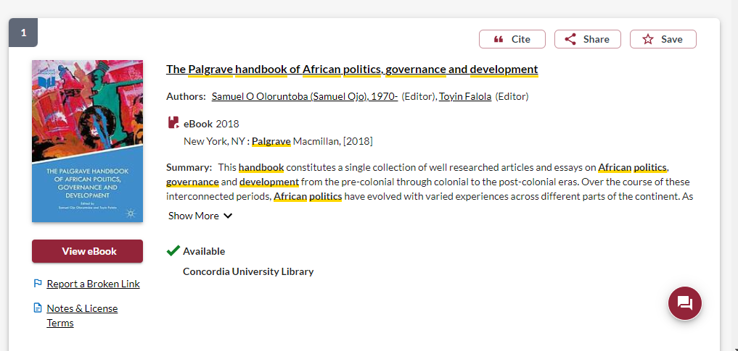
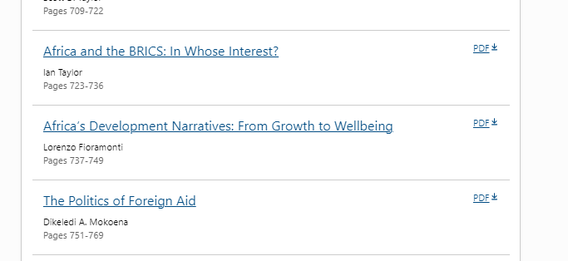

Slide 8
Englebert, Pierre. 2000. “Pre-Colonial Institutions, Post-Colonial States, and Economic Development in Tropical Africa”, Political Research Quarterly 53, no 1: 7-36 doi: 10.1177/106591290005300101

Slide 9
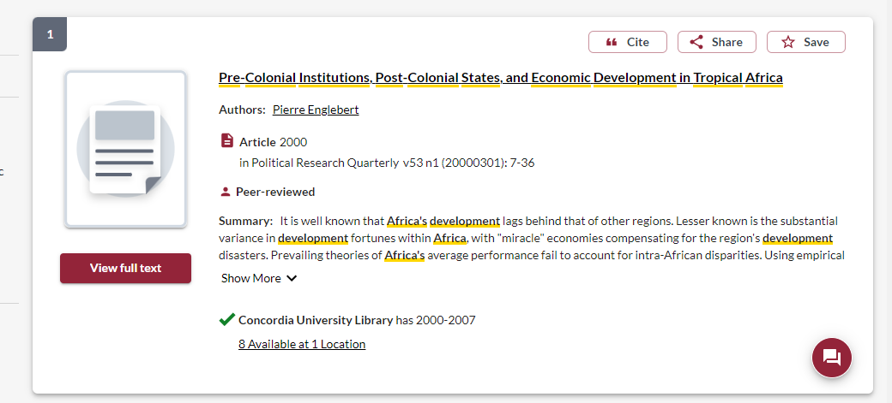
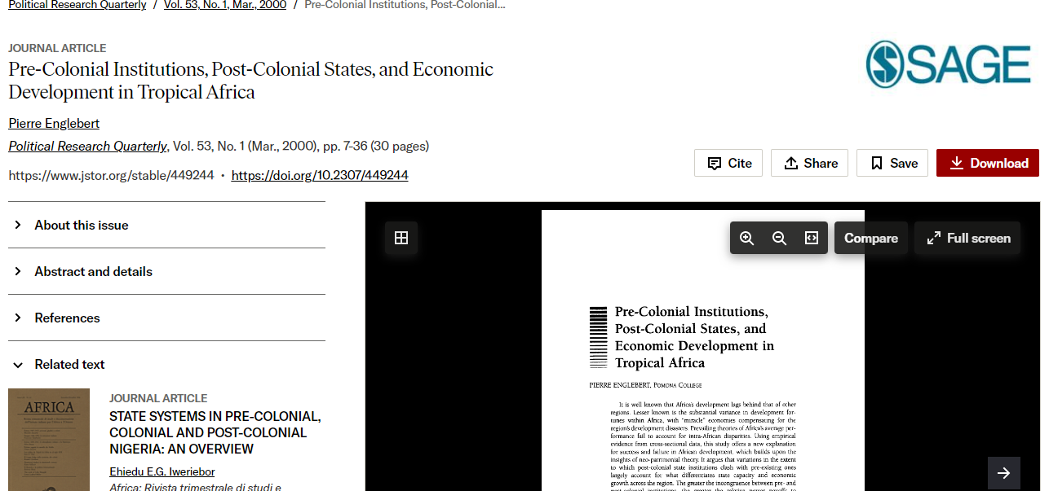
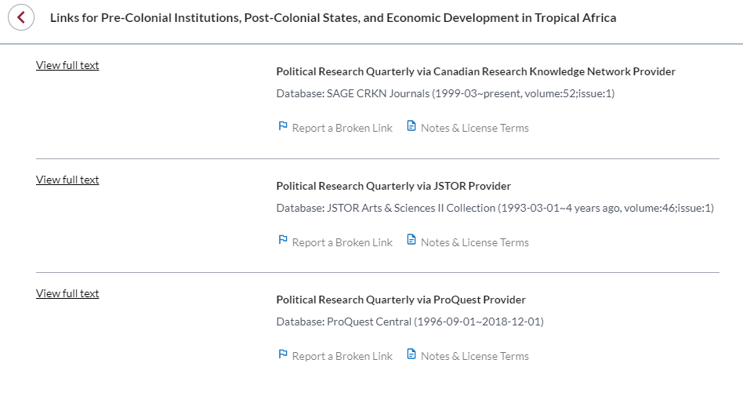

Slide 10
Fombad, C.M. & Steytler, N.C. (Eds). (2021). Democracy, elections, and constitutionalism in Africa. New York: Oxford University Press.

Slide 11
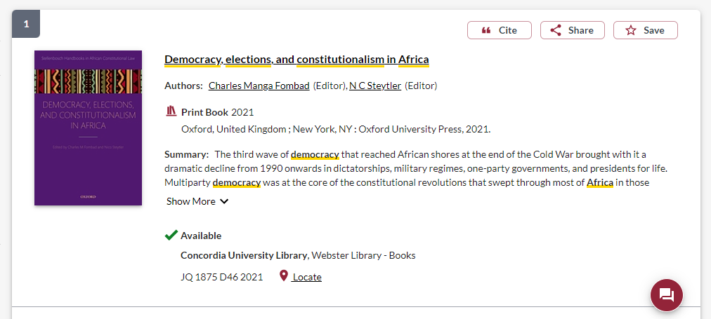
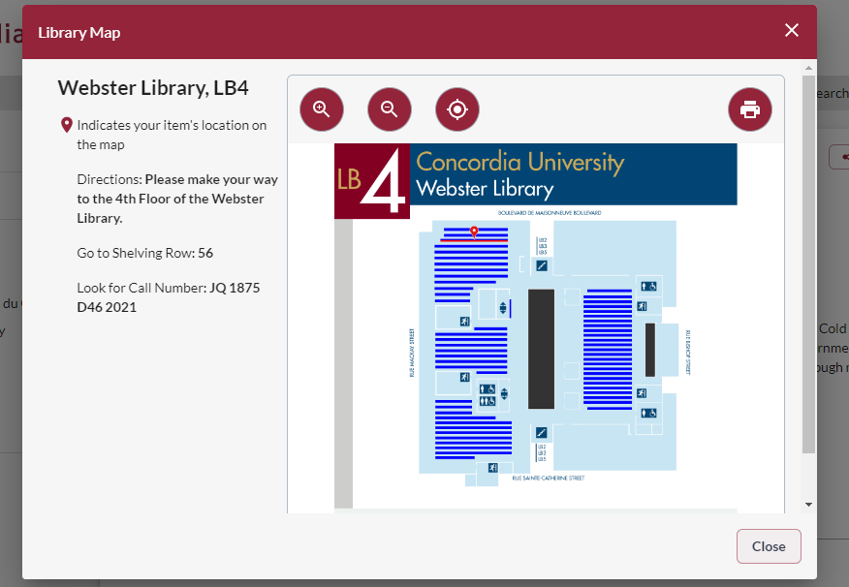
Use this information to locate the book, on shelf 56, on the 4th floor of Webster library.
The call number is the book’s address on the shelf.
This book is in print, in the library, click on ‘Locate’ to find it on the shelf

Slide 12
Search Strategies to find scholarly journal articles

Slide 13
How do we combine search words for the best possible results?
AND: combines concepts and limits your results
politics AND women
election OR voting
OR: allow you to insert synonyms or alternative terms and increases your results

Slide 14
How do we combine search words for the best possible results?
“quotation marks”: If you put two or more words in quotation marks, that exact phrase will be searched and limits your results.
“political institutions”
“climate chanage”
democra*
Finds: democracy, democracies, democratic, democratically, democratization
* - when you add an asterisk on the end of a word, your results will contain all the words with those endings or suffix

Slide 15
Avoid Searching with Linking words
Each author may use different linking words when discussing similar topics.
Effects
Impact
Consequences
Influence
Results
Importance
Significance
Response
Emphasis
Causes
You don’t want your search to be limited to those books and articles that only contain the word “effect” or “consequence”

Slide 16
Breaking down a topic
What explains the frequency and size of protests (or their absence)? Focusing on climate change, how reliably do the scale of protests and their prominence (i.e., in terms of media attention) reflect the depth and breadth of concern about the need for climate action?
Protests (scale, size, frequency, absence)
Climate change
Media attention
Concern
Climate action

Slide 17
Alternate terms
Key concept | Synonyms or alternate terms
Protests (scale, size, frequency, absence) | Strike, demonstration, resistance, revolt, riot, civil disobedience
Climate change | Global warming, climate disaster, climate crisis, climate emergency
Media attention | News coverage, public attention, media exposure, publicity, media interest
Concern | Worry, anxiety, distress, scrutiny, analysis
Climate action | Reduce greenhouse gases, climate policy, climate change mitigation, low carbon economy (UNDP)

Slide 18
(protest OR strike OR demonstration)
AND ("climate change" OR "climate crisis")
AND (media OR News)
AND (coverage OR attention)
AND "Climate action"
AND Africa*

Slide 19
What influences political participation by and representation of women? How important are, for example, culture, political history, and regime type and political institutions?
Key concepts
Synonyms or alternate terms
Political participation/representation
Women
Culture
Political history
Regime type
Political institutions
Voting, elections, political engagement, running for office
Woman, female, gender
Arts, social behaviours, beliefs, social institutions
Politics
Government type, democracy, authoritarian
Courts, judiciary, legislature, parliament, government, state

Slide 20
(women OR gender)
AND Kenya*
AND (elect* OR voting OR voter OR "political participation" OR representat*)
I’m not using all the key concepts and keywords I initially brainstormed in this part of the search.
When you are searching in the Sofia Discovery Tool, which is a library catalogue, you can search at a higher level, more simply, because you are searching primarily through: book titles, tables of contents and subject terms.

Slide 21
How to use a scholarly book
Most scholarly books are edited, and each chapter will be about a different aspect of a broad theme
Check the table of contents and the index (at the end of the book) to locate your topic in the book
Read the chapter or section about your topic
Think of each chapter in an edited book as an article
You can cite multiple chapters from an edited book
You’re not expected to read the entire book, it’s unnecessary and not how scholarly books are usually used in research

Slide 22
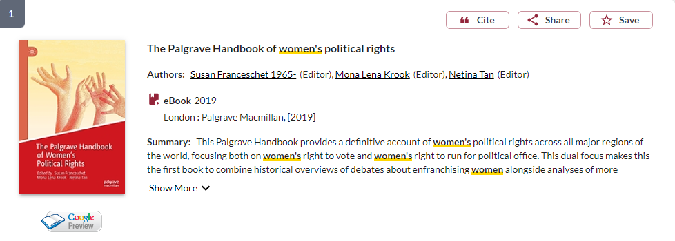
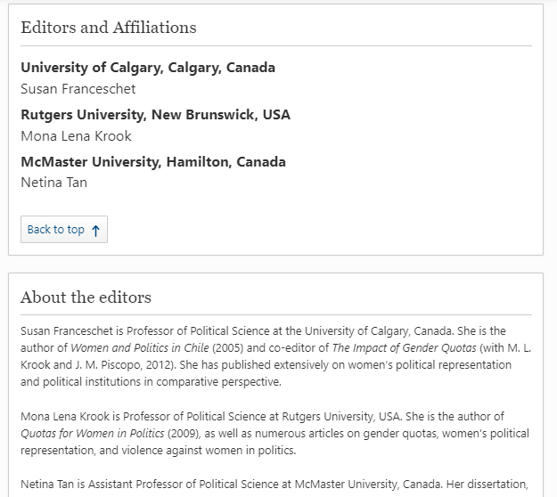
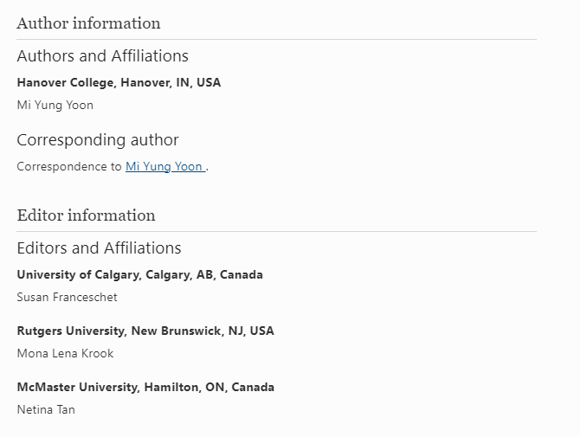
Editor’s academic affiliations should be easy to locate in a book
Individual chapter author affiliations will be indicated in the chapter

Slide 23
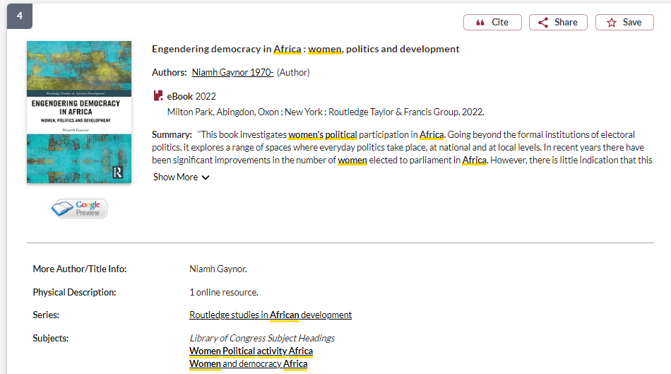
Use the subject headings to find related books at Concordia Library

Slide 24
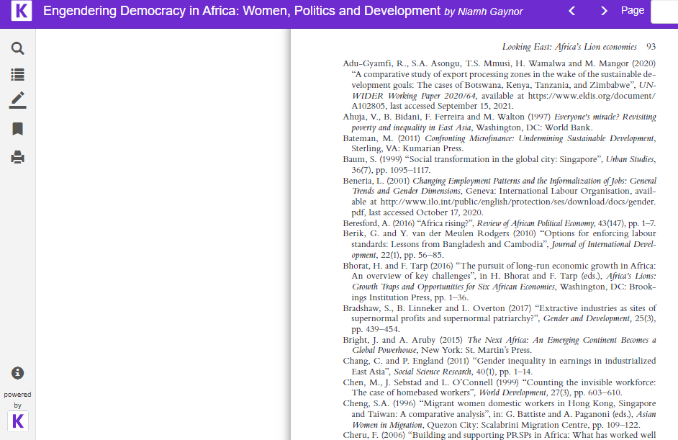
Academic books will have citations throughout the text and footnotes/endnotes, a bibliography or reference list at the end of the book or at the end of each chapter

Slide 25
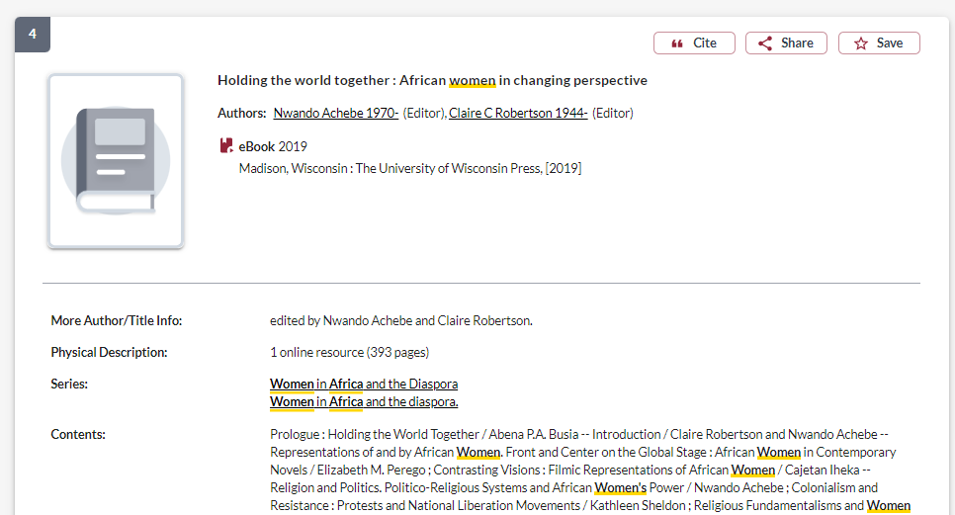
University presses publish academic books
Most academic books should be 200+ pages

Slide 26
Who wrote the book? How can you tell if a book is academic?
Scholarly books often have editors and each chapter will have different authors
You should look for “Contributors”, which will have a list of individual chapter authors, and their biographies either at the beginning or very end of the book
If the book is published by a university press, it is academic
Academic books will usually be 200+ pages long

Slide 27
Scholarly, peer reviewed journal articles
A scholarly journal article is the best of what we know; it builds on previous research.
The purpose of a scholarly journal is to report on research conducted by scholars, and professionals in the field.
Scholarly journals provide in-depth articles that cover specific issues or research questions, while the language and content is geared toward scholars and professionals in the field.
Some articles contain tables and graphs and most contain bibliographies (or reference lists or works cited)
articles in scholarly journals are peer reviewed.

Slide 28
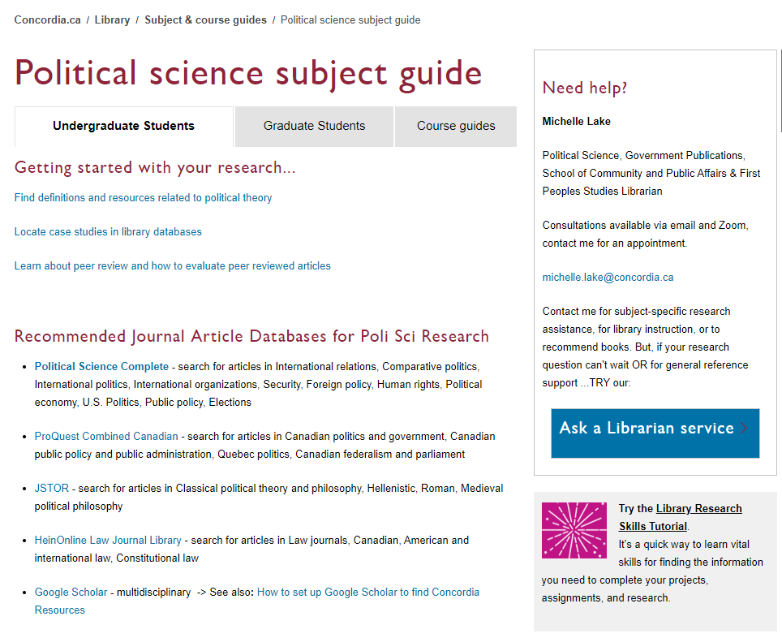

Slide 29
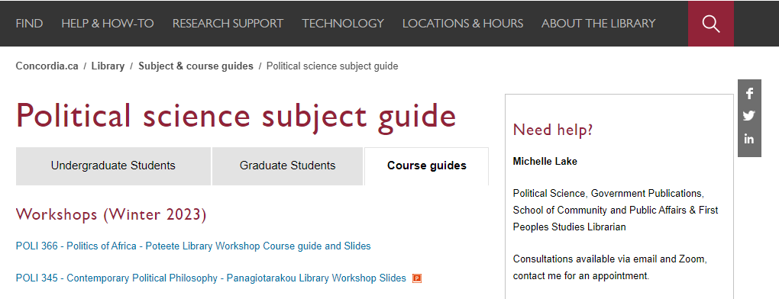
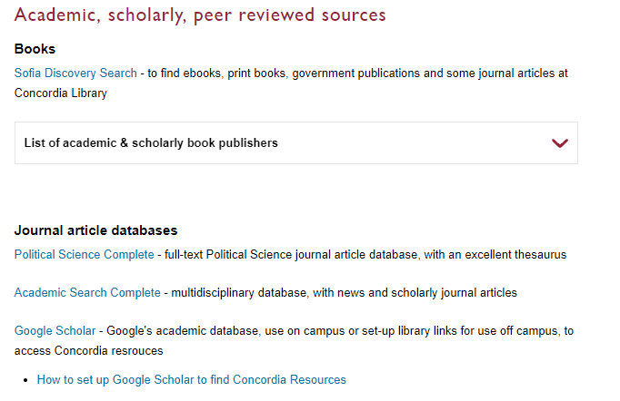

Slide 30
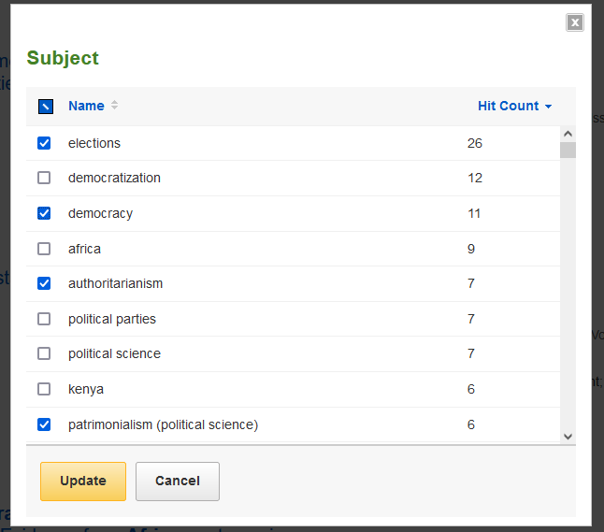
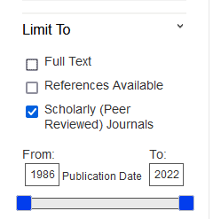
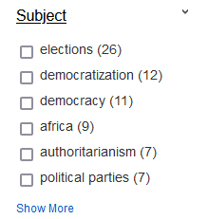
Search:
elect* OR voting OR voter* OR "electoral politics“
AND Africa*
AND patrimonial OR patrimonialism OR autocratic OR oligarchic OR inherited OR particularistic

Slide 31
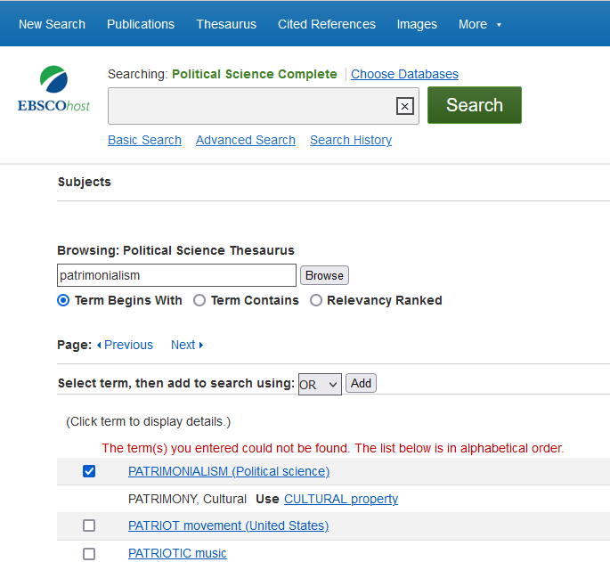
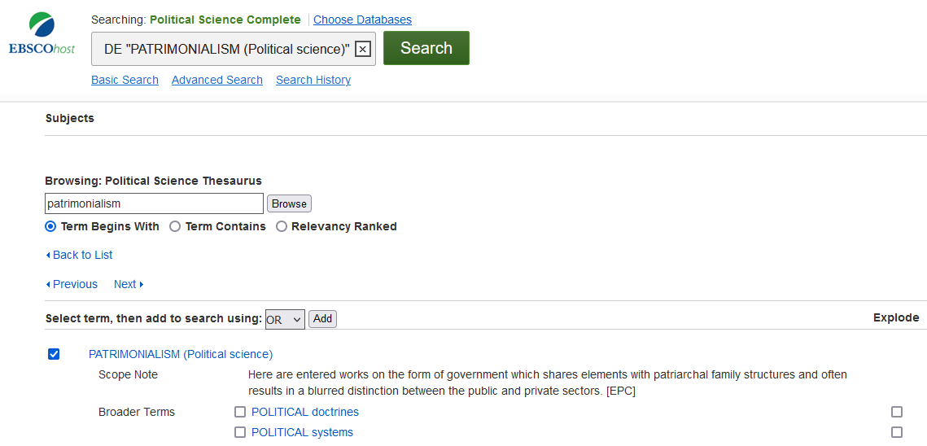

Slide 32
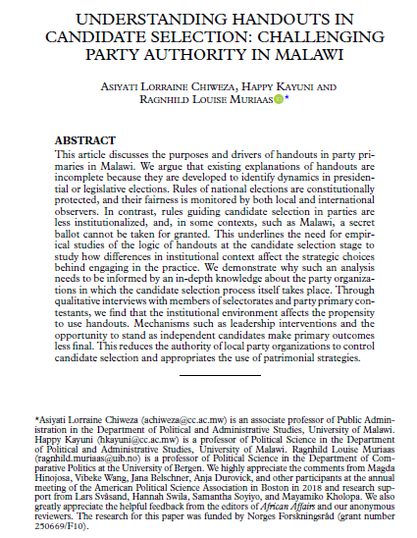
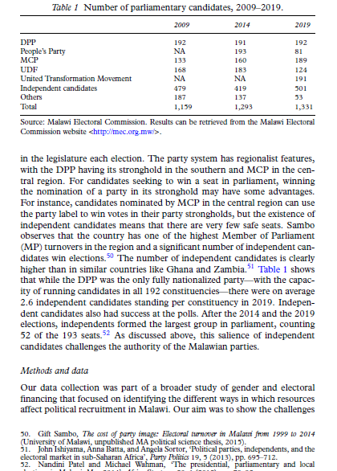
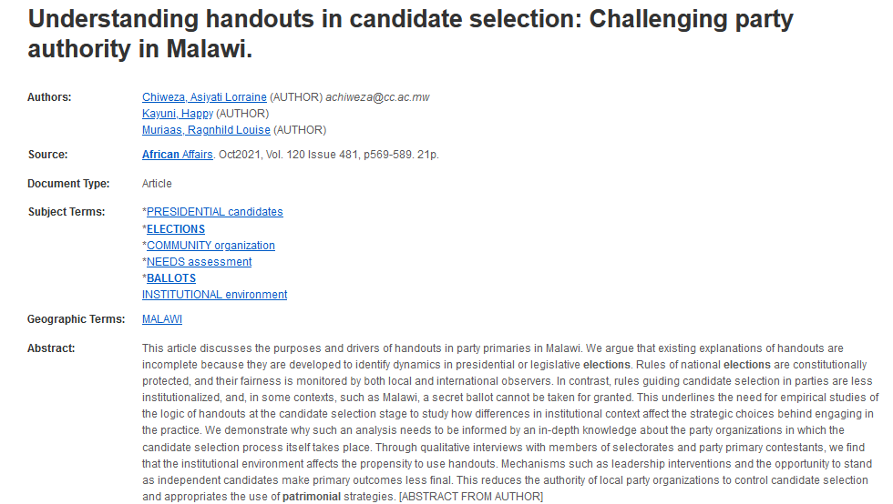
15+ pages long
Tables, charts, graphs included with data.
Citations throughout, footnotes or in-text.
Easily located author affiliations

Slide 33
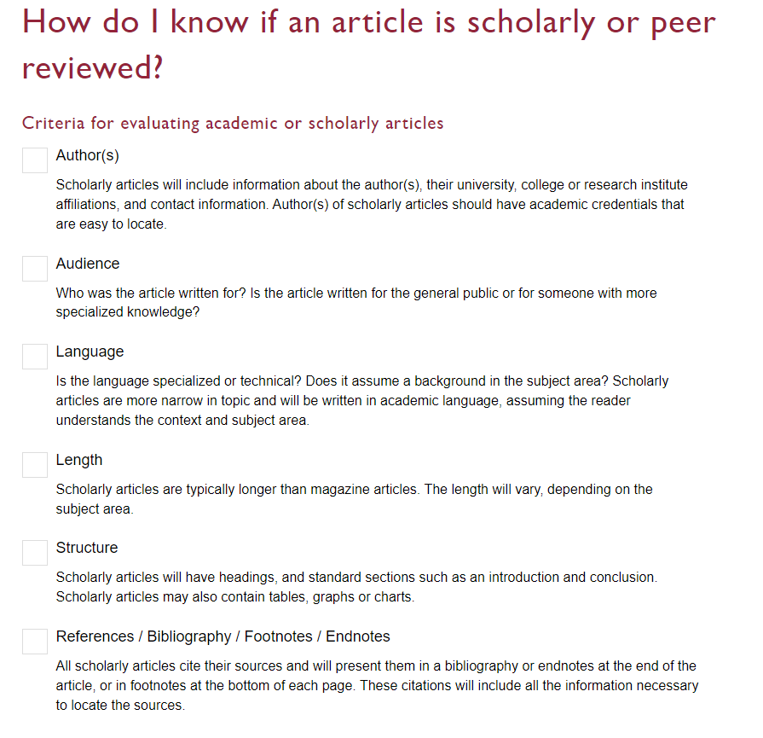

Slide 34
What is peer review? What are peer reviewed, scholarly articles?

Slide 35
Has the article gone through the peer review process? What is peer review? Peer review is a system used to decide if an article should be published in a peer-reviewed journal. Each paper submitted to a peer-reviewed journal is read and evaluated by experts in the article’s subject area. The reviewers assess the article’s validity, importance, and originality, and then recommend whether it should be printed in the journal. The reviewers’ suggestions are considered by the journal’s editor, who makes the final decision about whether to accept or reject the article. Criteria for evaluating academic or scholarly articles

Slide 36
Open Access
“Open-access literature is digital, online, free of charge, and free of most copyright and licensing restrictions. What makes it possible is the internet and the consent of the author or copyright-holder."
Peter Suber, A Very Brief Introduction to Open Access
Concordia Library Open Access guide

Slide 37
The 7 step process to determine blinded peer review and journal reliability

Slide 38
1. Search the journal article databases (i.e. Political Science Complete) for articles on your topic using keywords.

Slide 39
2. Choose article titles that are relevant to your topic.

Slide 40
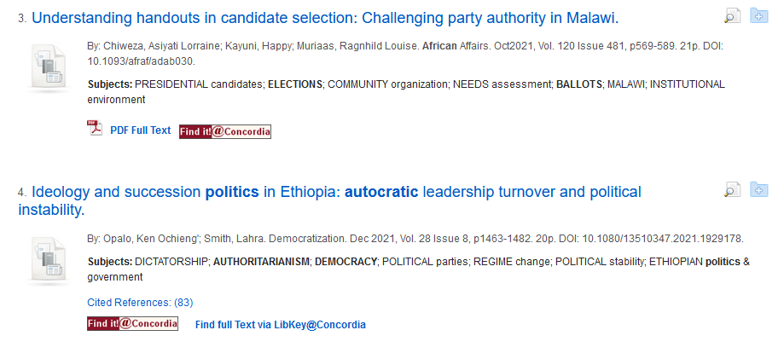
3. Identify the journal titles, from the articles you have selected. The journal title often appears after the article title. It may be found in the “source” area.

Slide 41
4. Search for the journal title in UlrichsWeb

Slide 42
5. Identify if the journal title is a) peer reviewed/refereed and/or b) open access. The referee shirt icon means the journal is peer reviewed /refereed The open lock icon means that the journal is open access
The journal is peer reviewed, but not open access. In this case, we need to confirm that the journal uses blinded peer review and then we’re ready to use this source.

Slide 43
6. If the journal is peer reviewed/refereed and not open access, go to the journal website. On the journal’s website, you should be able to identify whether the journal has a blind peer review process.

Slide 44
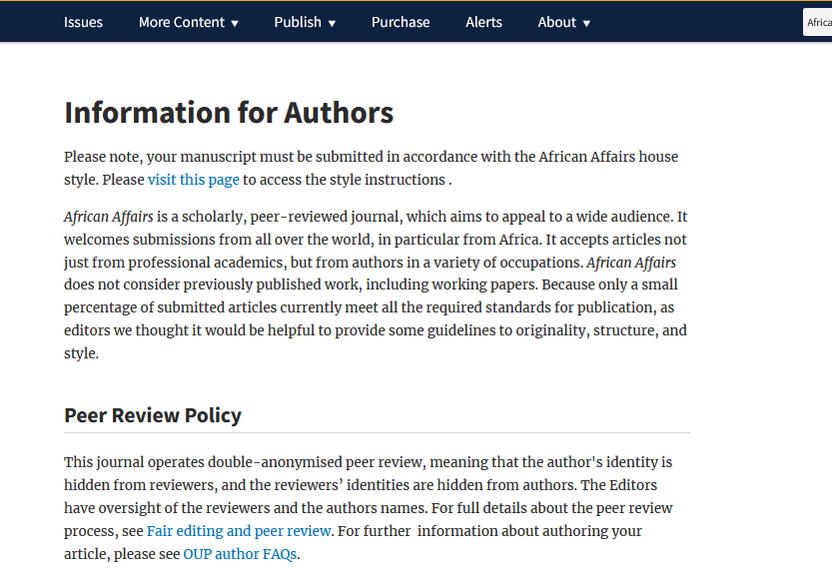
6. a) Look for “journal information”, “instructions for authors” or “submission guidelines” for more about the publishing process and about the type of peer review used by the journal.
6. b) Read the peer review policy, this journal uses double blind peer review

Slide 45
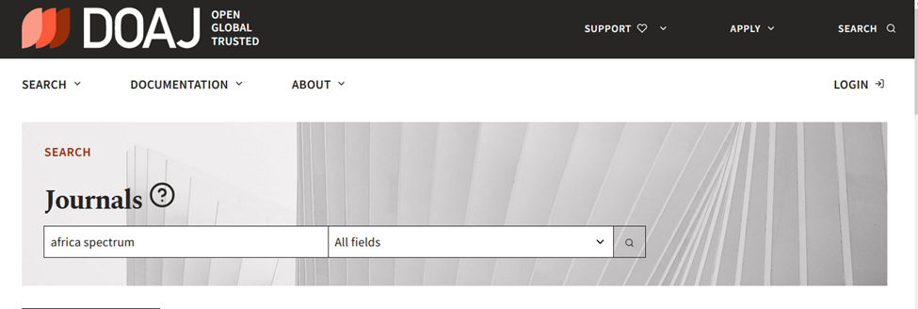
7. If the journal is also open access in Ulrich’s, you will need to check the title further in the DOAJ: Directory of Open Access Journals . Based on this quality check and your assignment instructions, decide whether or not to include the article in question in your assignment.

Slide 46
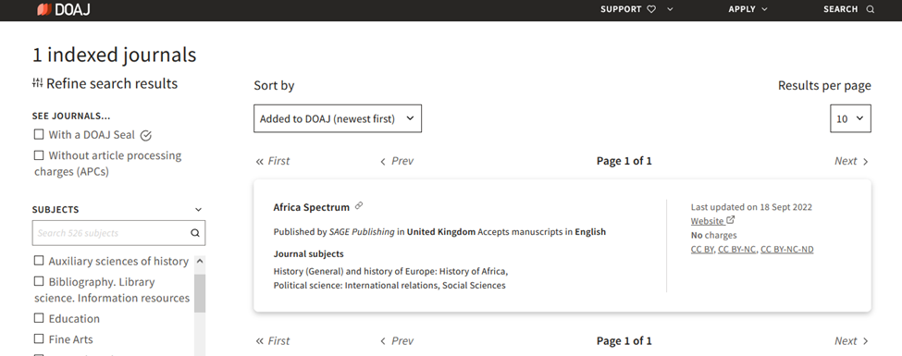
7. a) If the title is listed in the DOAJ, it is considered a reliable open access journal.
This journal title is listed in the DOAJ, so it is a reliable open access journal and we can use articles from it in our paper.

Slide 47
Non-academic sources: Country reports, News articles, NGO reports

Slide 48
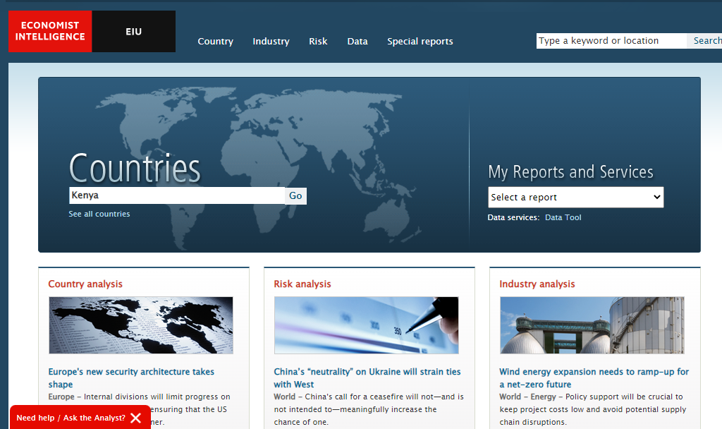
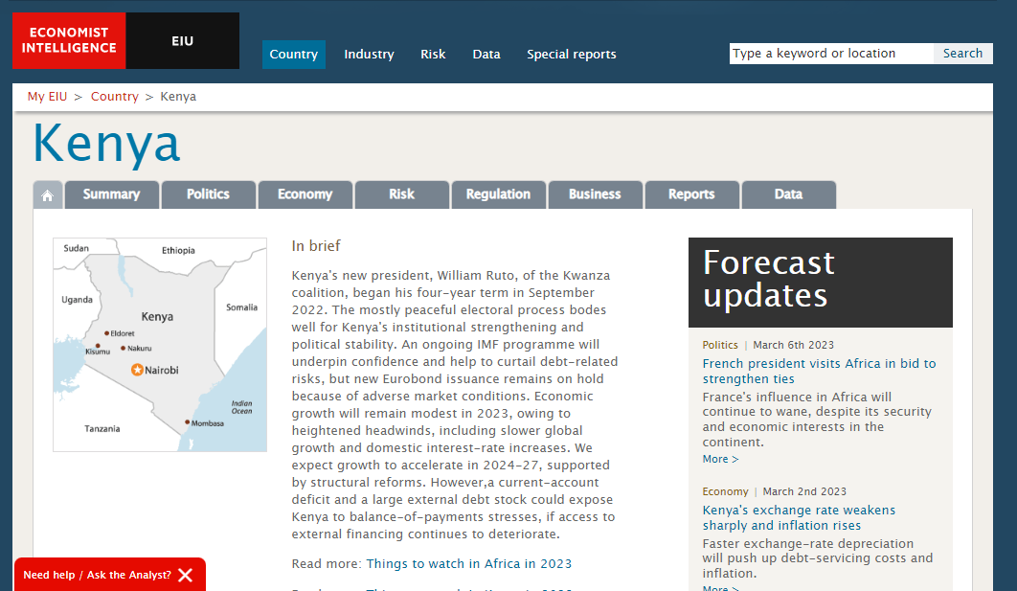
Country profile: Economist Intelligence Unit

Slide 49
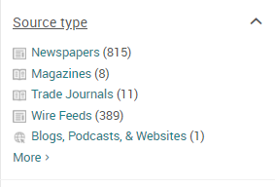
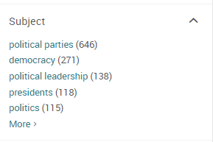
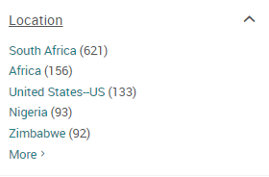
News sources: International Newsstream
Use these limits to narrow down your results

Slide 50
Spotting fake news online
University of Toronto Libraries: How do I spot fake news?
Verifying news stories (or sites you should get to know)
FactCheck.org: monitors the accuracy of U.S. political stories. / PolitiFact: verifies political news stories.
Snopes: fact-checks Internet rumours and stories.
Civic Online Reasoning (from Stanford Education Group): produces research reports, lessons, and videos focused on evaluating online content.
Duke Reporters' Lab Fact-Checking: maintains a database of global fact-checking sites.
Spotting a fake news story
Check the domain name. Does it look strange? Those ending unusual domains such as “.com.co” are fake news.
Refer to the ‘About Us’ area on a website to see what it says, or refer to the websites above for more information on the story or source.
Read multiple news sources to see how (or if) they are reporting on the same story.

Slide 51
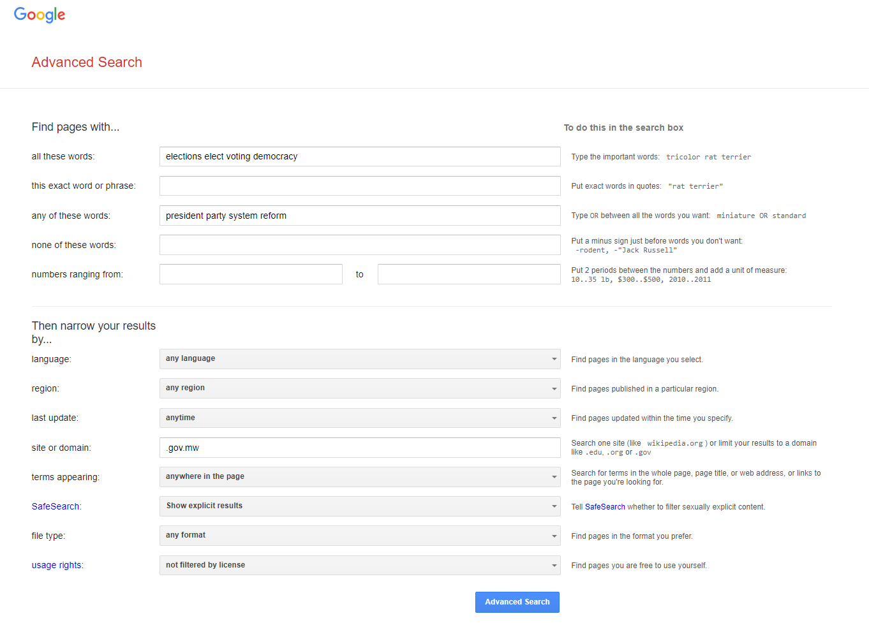
Google Advanced Search in a government domain

Slide 52
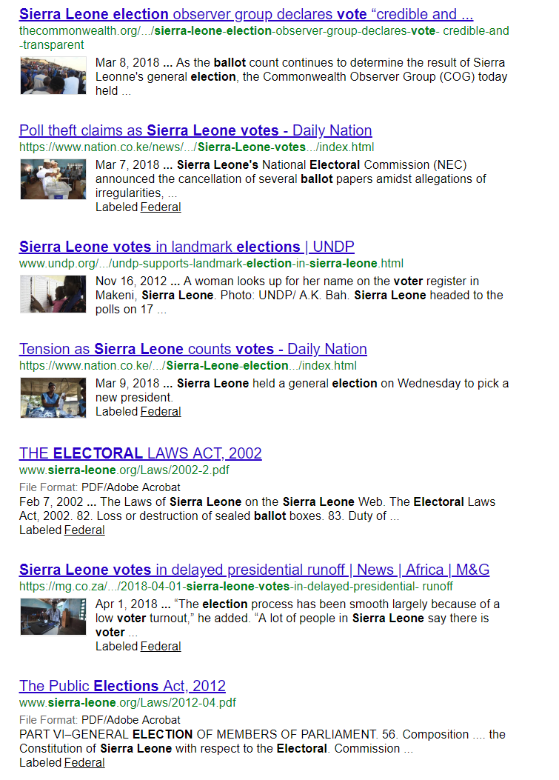
Evaluation of government publications
Questions to Ask
Who is the publisher?
Is it a government? Or an organization?
Check the About Us pages – who is responsible for the website and why are they distributing the information?
Are there symbols or seals from an official government body in the document or website?
When was the information published, are there any dates on the document or website?

Slide 53
There is help available!
Michelle.Lake@Concordia.ca

