Slide 1
POLI 353: Principles of Public Policy Library Workshop
Michelle Lake
Subject Librarian for Political Science, the School of Community and Public Affairs, First Peoples Studies, & Government Publications
Michelle.Lake@Concordia.ca

Slide 2
Who am I?
Michelle Lake, librarian for Political Science, the School of Community and Public Affairs, First Peoples Studies and Government Publications
Michelle.Lake@Concordia.ca / Zoom Office Hours – Wednesdays 2-4pm
What do I do?
Provide research support
Help students with library databases
Help students find and access materials they need
Help with citation issues
Choose the books we buy for the above subject areas

Slide 3
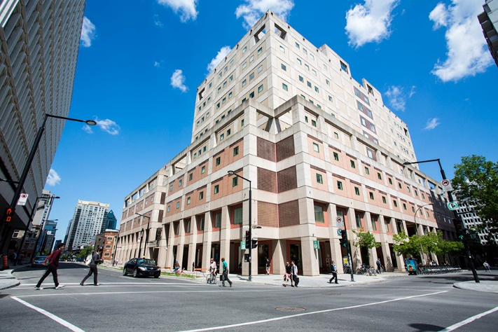
The Librar(ies)
Webster Library – SGW Campus
24/7 access, with student card, after 11pm
2nd, 3rd, 4th, and 5th floor of LB - “Library Building”
Poli Sci, Government Info, Maps, History, Social Sciences, Humanities, Engineering & Fine Arts
Interlibrary Loans
Current Print Journals
Vanier Library – Loyola Campus
24/7 access, with student card, after 11pm
1st, 2nd, and 3rd floor VL – “Vanier Library”
Sciences, Psychology, Communications & Journalism
Special Collections
Print Journal Archive

Slide 4
Library: in person
Services such as the loans desk, Ask Us desk and chat help are not open 24/7, check the library website for hours if you need a particular service.
Course Reserves room is open - need to use the call number of a book to locate them in course reserves
100 print items can be borrowed at a time, laptops & tablets available for loan.
Procedural masks need to be worn at all times in the library.

Slide 5
Print Books
Public aspect of medicine. Medicine and the state. Medicine and society. Epidemics. RA 1-1270 (5th floor)
Political Science & Government: J – JZ (4th floor)
Political institutions and public administration (Canada): JL 1 – JL 500
Law, K-KZ (4th floor)
Canadian Law: KE (LB4)
Social Sciences: Public Policy, Economics, Statistics, Human rights, Social services, Social work, Public welfare: H-HV (4th floor)
History of North and South America, First peoples and Indigenous studies: E-FC (3rd floor)

Slide 6
Locating known items

Slide 7
Lipsky, M. 2010. Street-Level Bureaucrats: Dilemmas of the Individual in the Public Service. Sage.
What is it?
A book -> Search Sofia

Slide 8
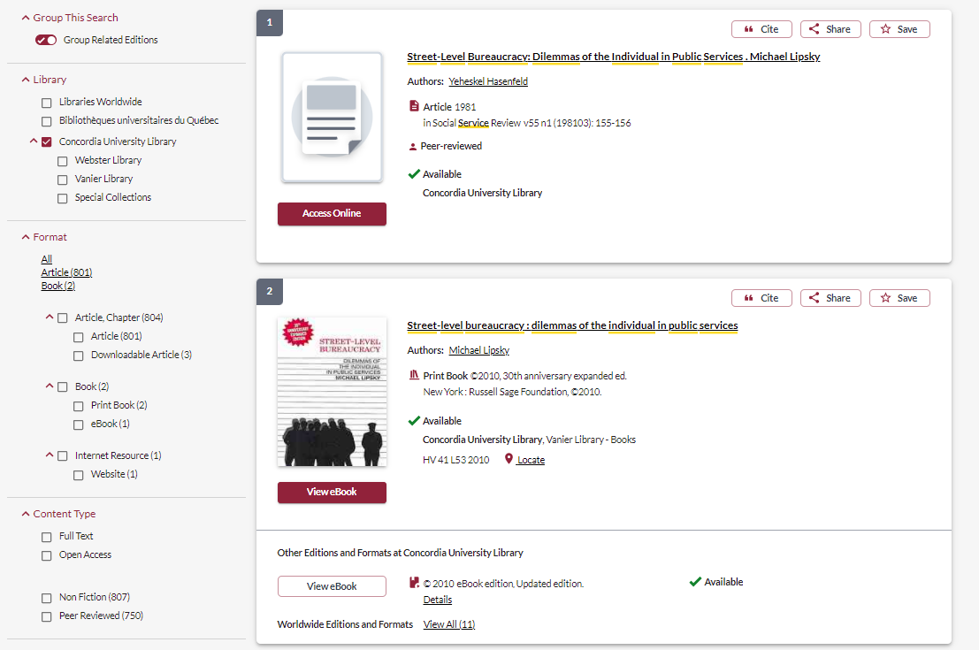
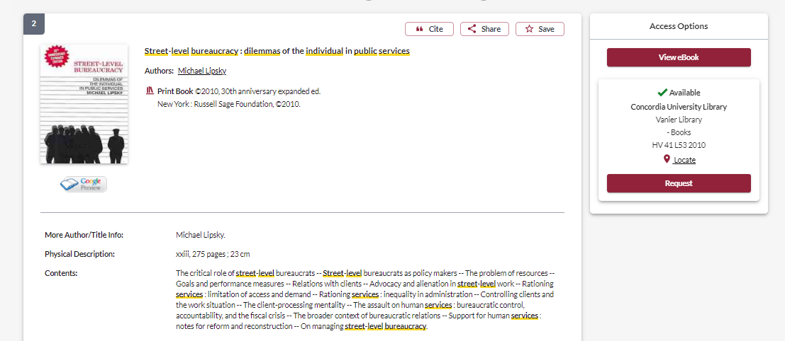
You can request a book from the other campus be brought to Webster and put on hold for you

Slide 9
Smith, M. 2008. Identity and Opportunity: The Lesbian and Gay Rights Movements. In Group Politics and Social Movements in Canada, M. Smith(ed.): 181-202. Peterborough: Broadview Press.
What is it? A book chapter -> Search Sofia

Slide 10
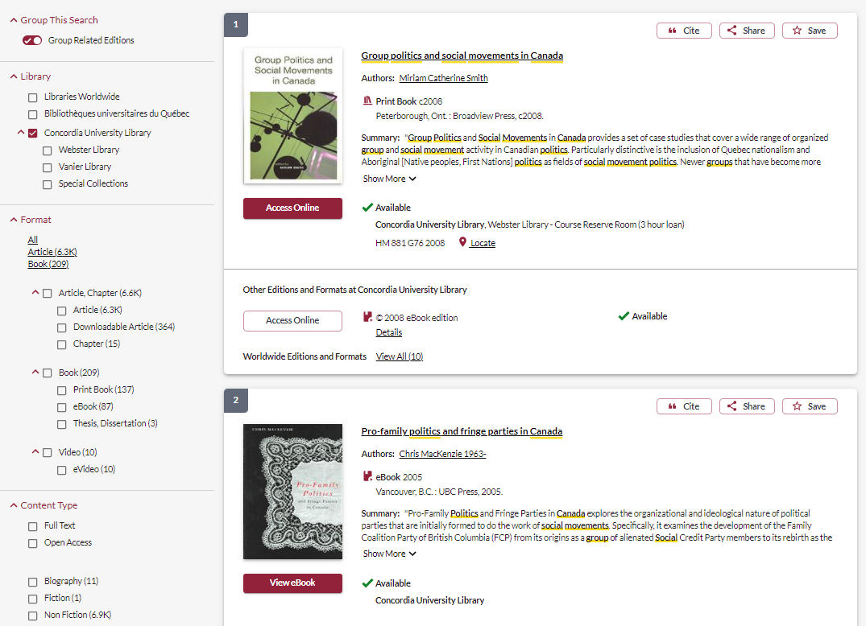
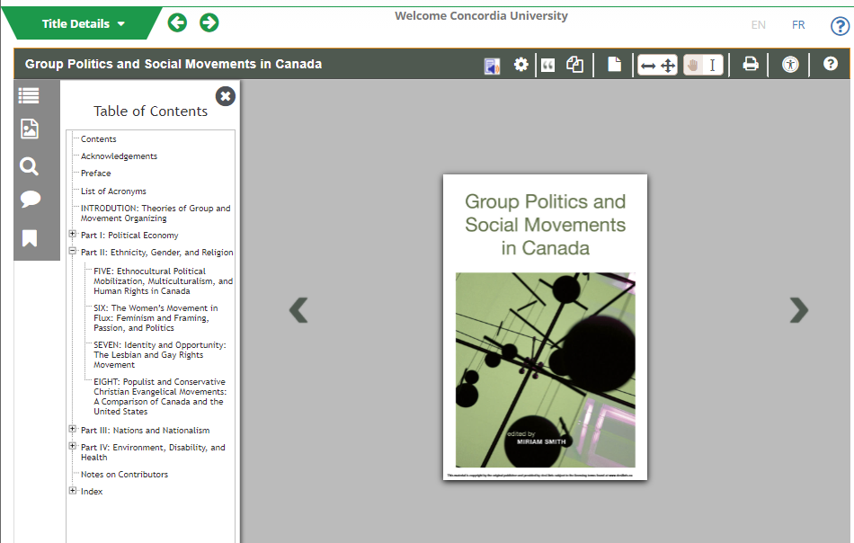

Slide 11
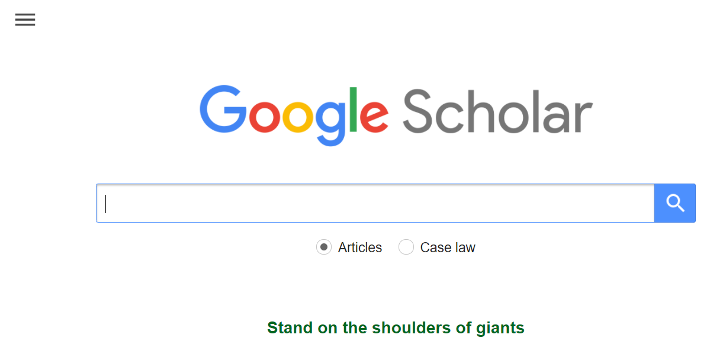
Rochefrort, D. and Cobb, R. 1993. “Problem Definition, Agenda Access, and Policy Choice,” in Policy Studies Journal 21, 1, 56-71.
What is it?
A journal article -> Google Scholar: Scholar.google.ca
Set up Google Scholar to recognize and access Concordia resources

Slide 12
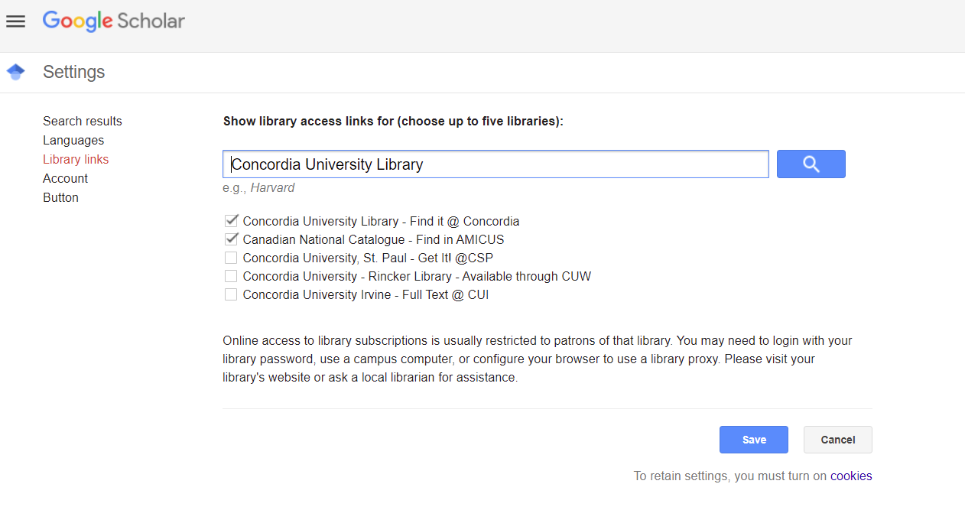

Slide 13
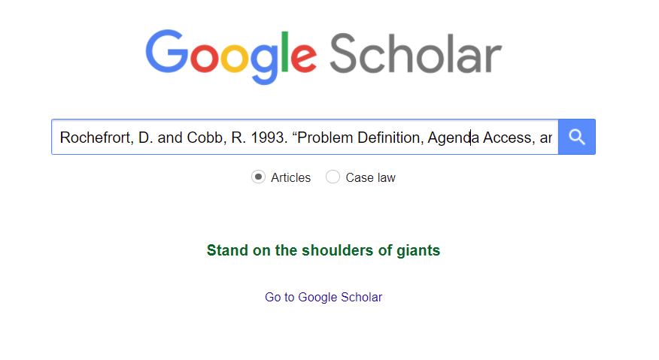
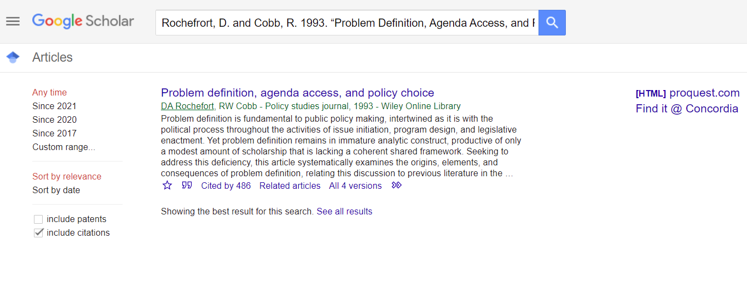

Slide 14
Searching with keywords

Slide 15
Search tips - Databases
AND –limits how many results your search produces
Example: women AND health
OR –increases the number of results your search produces
Example: health OR medical
“ ” -exact phrase - Example: “public policy”
*- truncation: retrieves all words that start with the letters entered.
Example: Environment* finds: environments, environmental, environmentalist, etc.

Slide 16
Avoid Searching with non-essential words
Each author may use different linking words when discussing similar topics.
Effects
Impact
Consequences
Influence
Results
Importance
Significance
You don’t want your search to be limited to those books and articles that only contain the word “effect” or “consequence”.

Slide 17
Breaking down a topic
A team of experts trying to control a global pandemic and the policy implications of that pandemic.
Key concepts: pandemic, public health, government, health experts, control, policy
Alternate additional terms: infectious disease, communicable disease, management, regulation, legislation

Slide 18
Using Sofia to find books, articles and policy documents

Slide 19
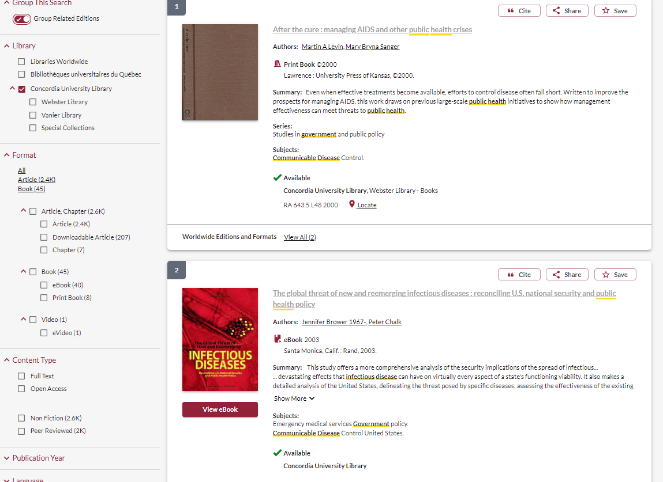
This title looks promising

Slide 20
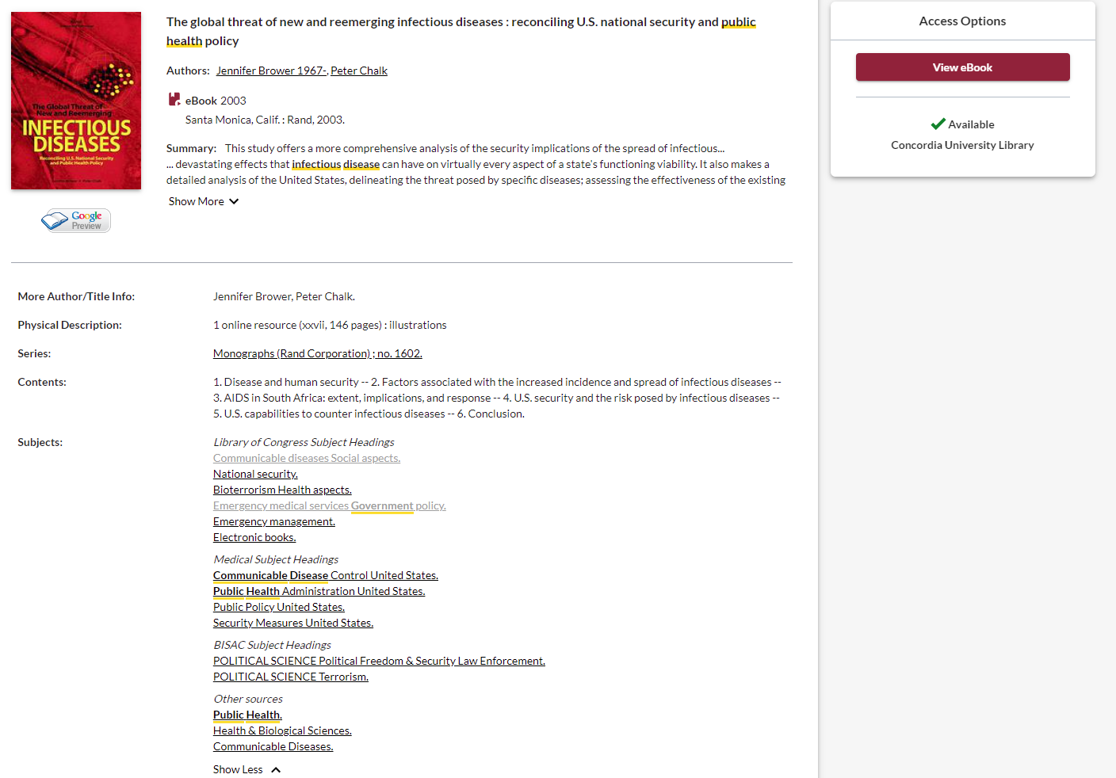
Access options. This is an ebook that can be read online.
Explore the subject headings, they are attached to all books, and you can click them to view all the materials on that subject in the database

Slide 21
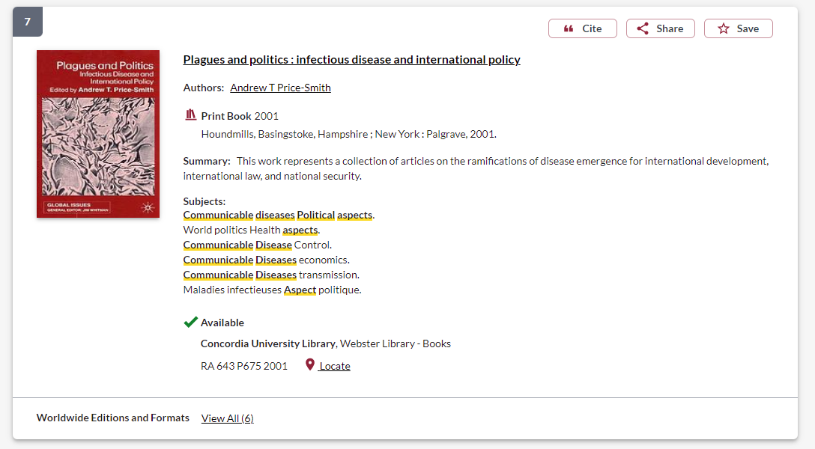
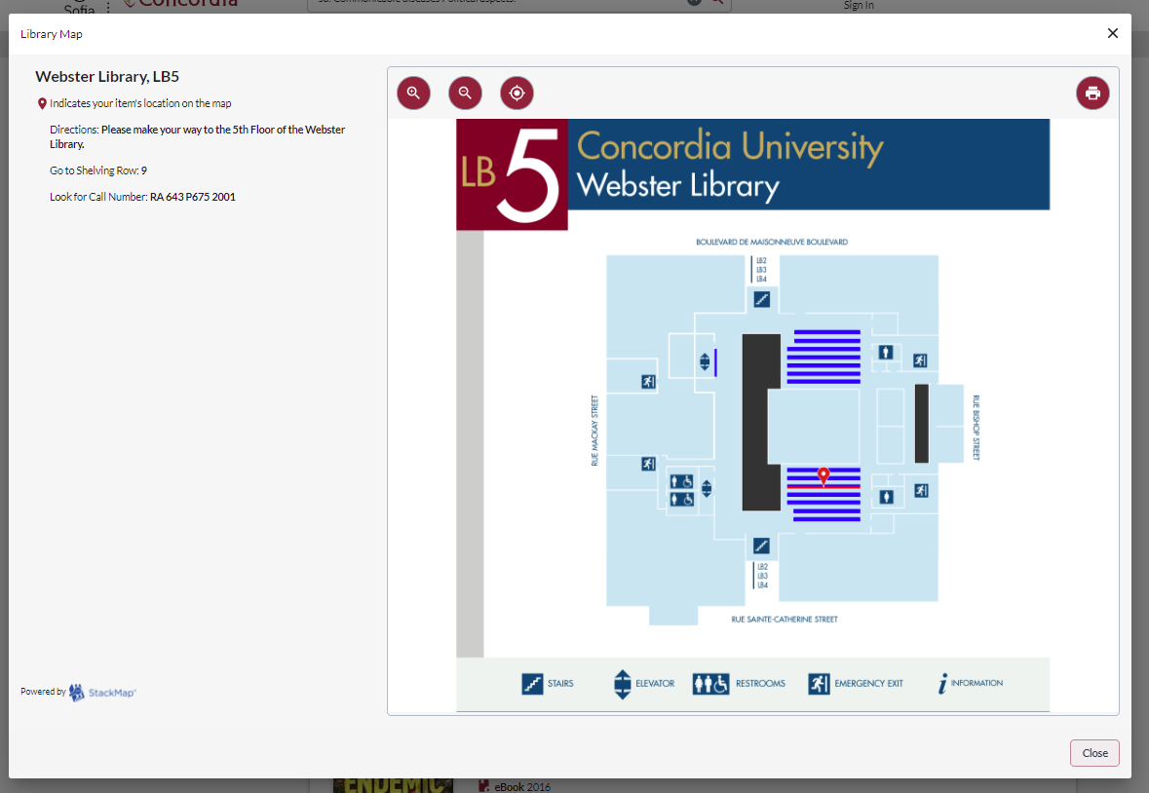

Slide 22
Searching for journal articles

Slide 23
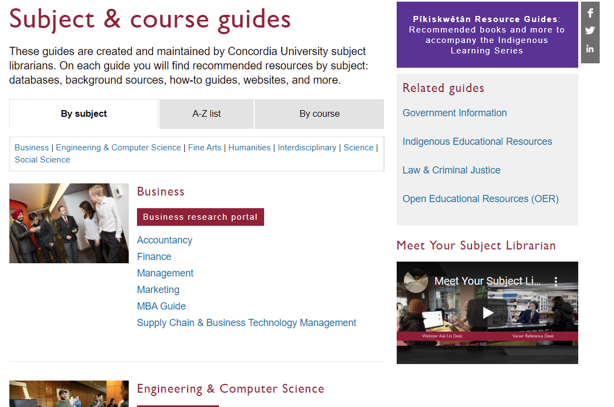
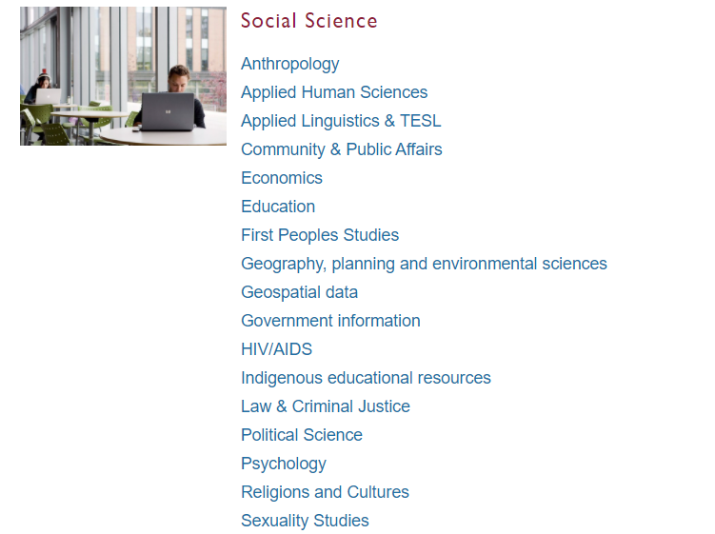

Slide 24
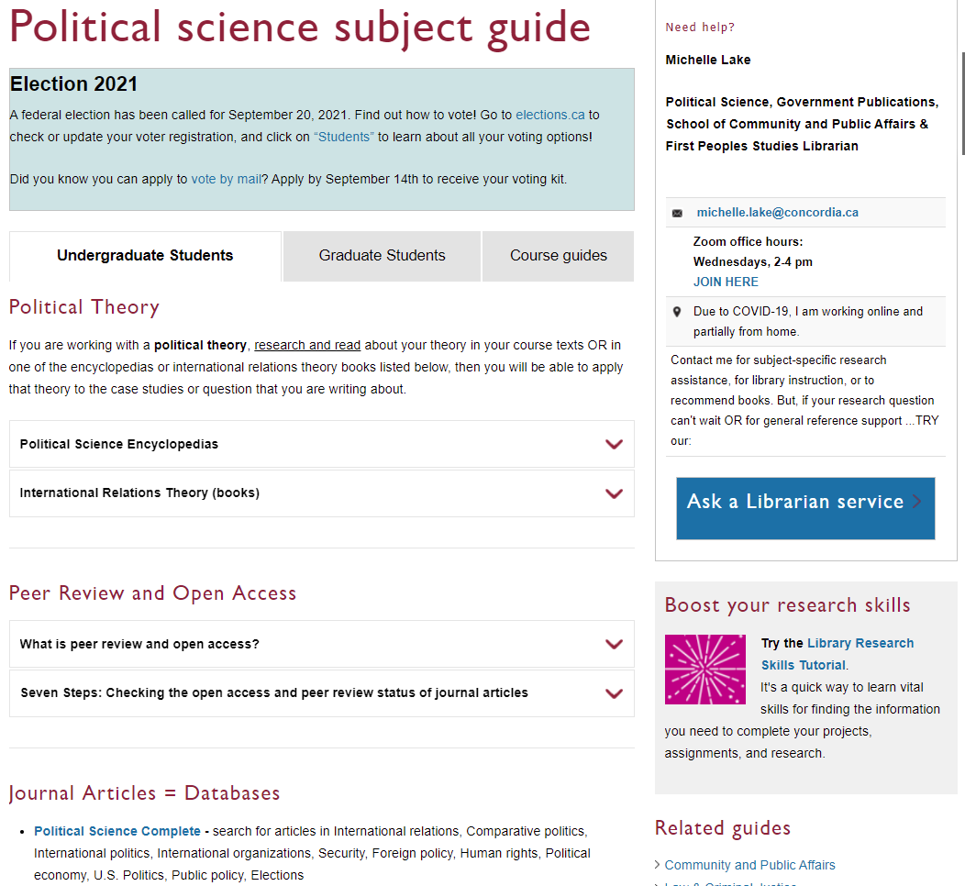
Political Science Complete is Concordia’s largest database of poli sci full-text articles

Slide 25
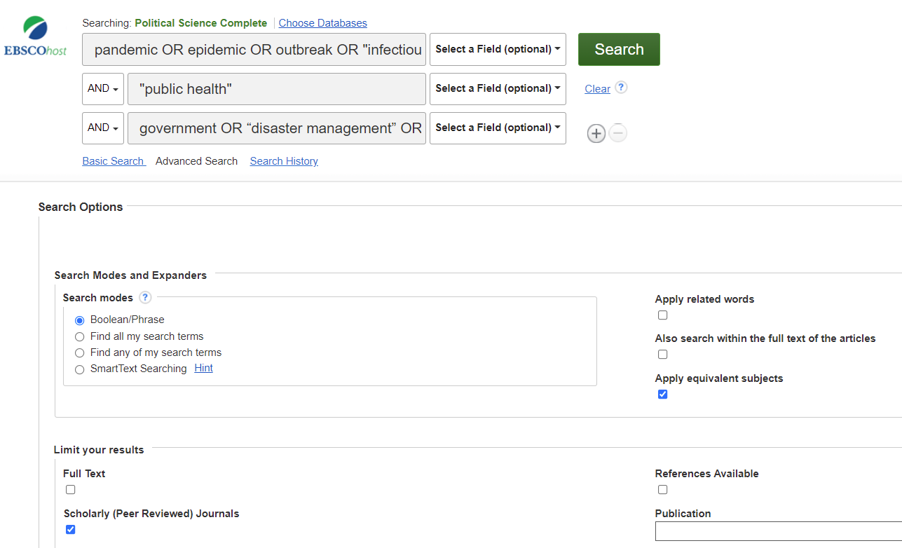
pandemic OR epidemic OR outbreak OR "infectious disease" OR "communicable disease“
AND “public health”
AND government OR “disaster management” OR policy

Slide 26
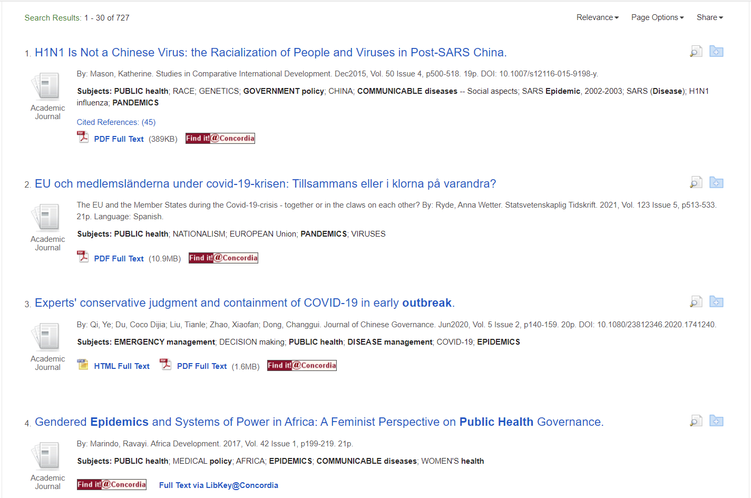
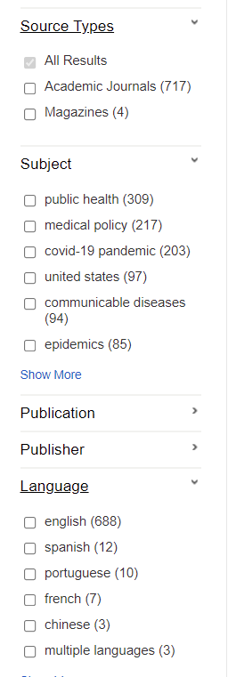
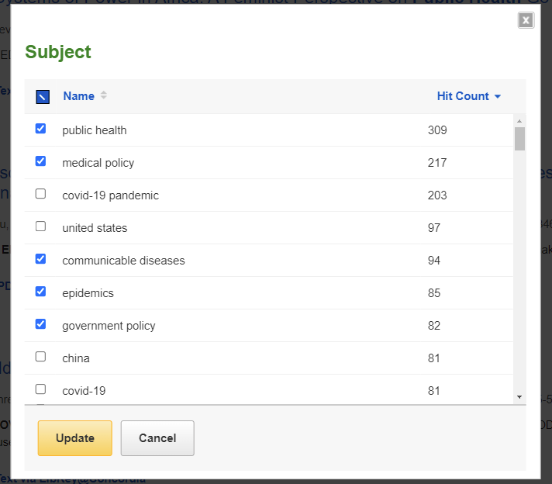

Slide 27
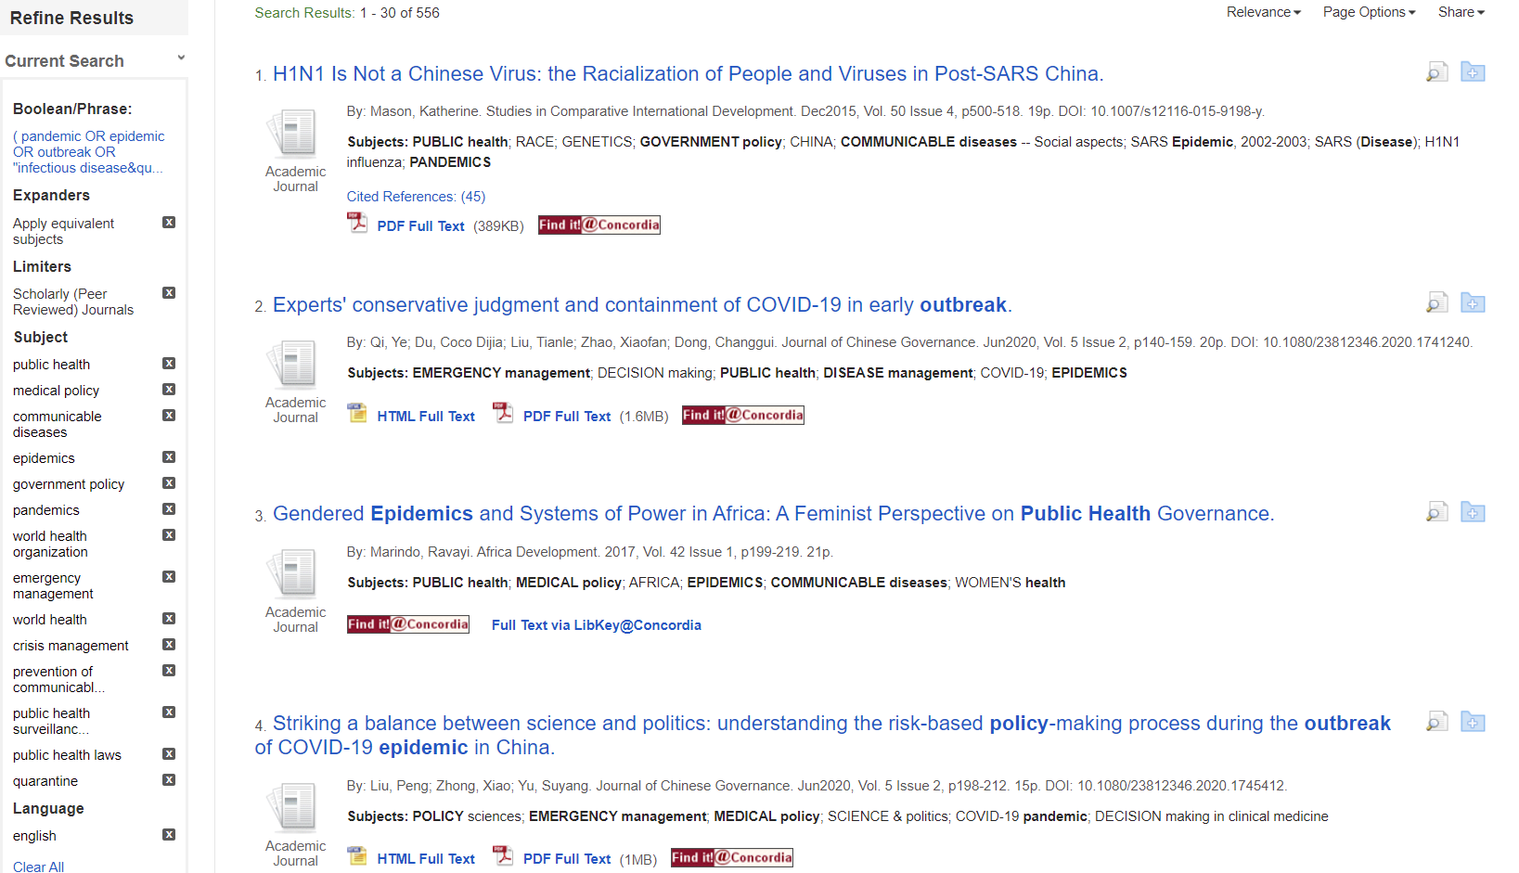
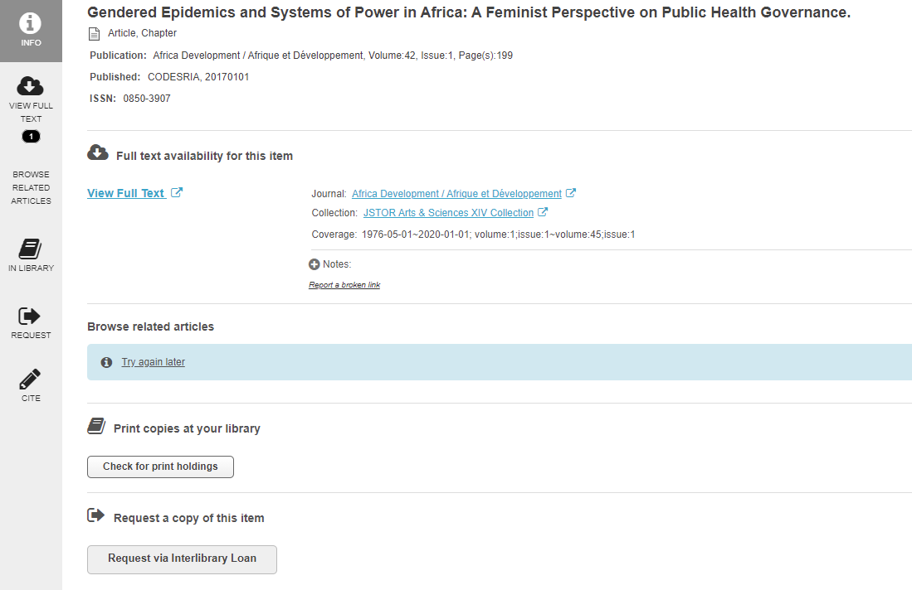
Use Interlibrary loan to request an article Concordia does not have access to

Slide 28
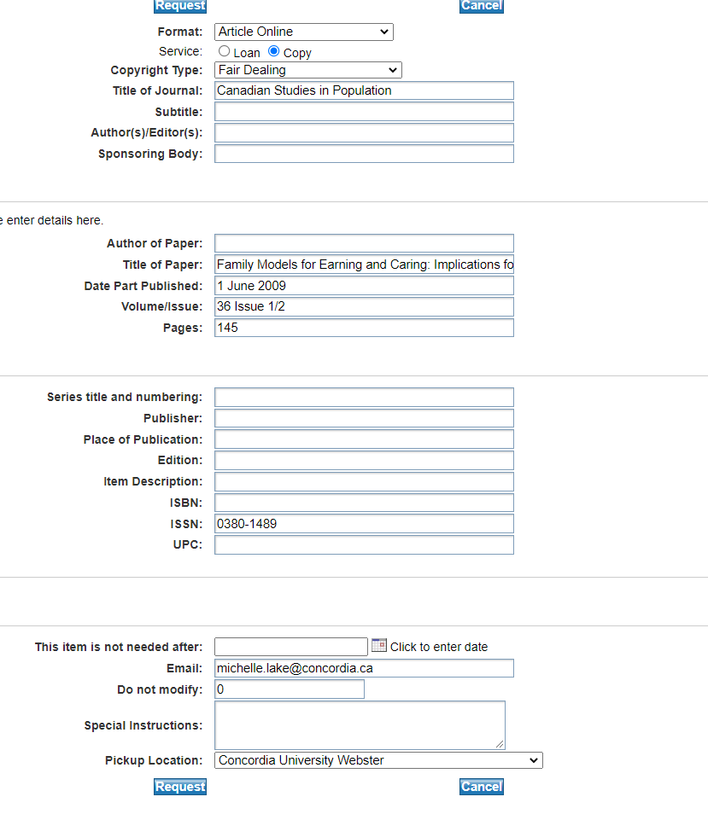
Interlibrary loans (ILL), via Colombo, allows you to access material not available at Concordia University Library.
This service attempts to obtain the research materials you need from other libraries, either in Quebec, Canada or abroad.
In most cases articles and book chapters will be delivered to you electronically.
There are no restrictions on what you can request (ex: book, article, video, microfilm, etc.), but currently we are unable to borrow e-books from other libraries.

Slide 29
Statistics, government, international organization, media and think tanks

Slide 30
Canadian Public Policy Collection – DesLibris
This is an online collection of policy documents from think tanks, non-government agencies, social organizations, government publications and scholarly ebooks. All Canadian publications; you can use your narrowing options to find just “public documents”, or narrow by subject keyword.

Slide 31
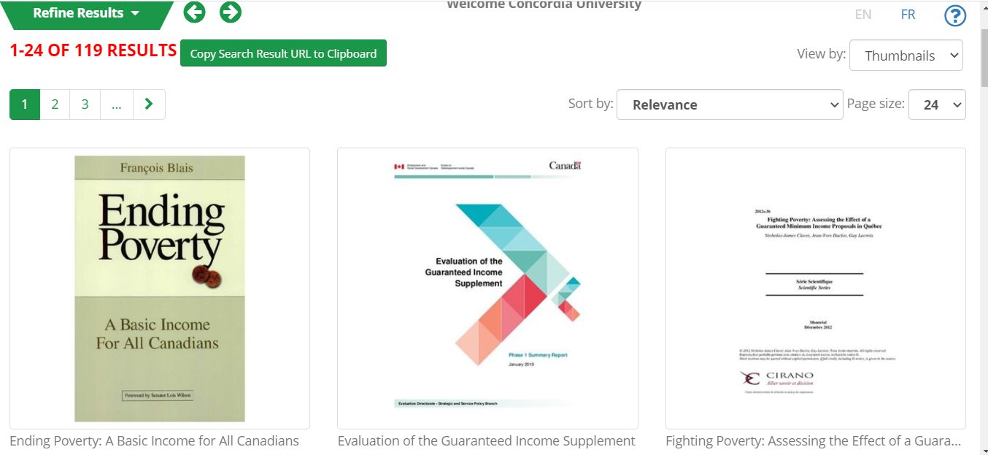
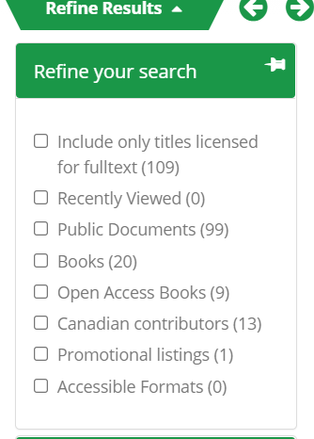

Slide 32
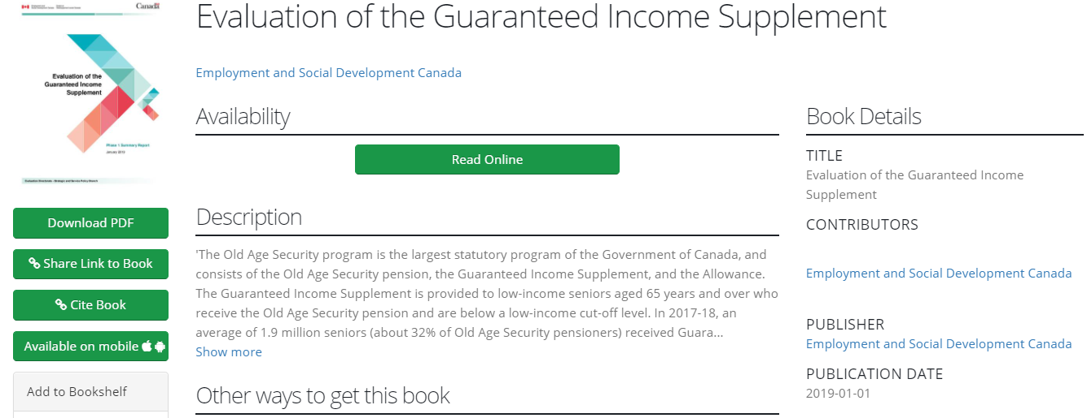
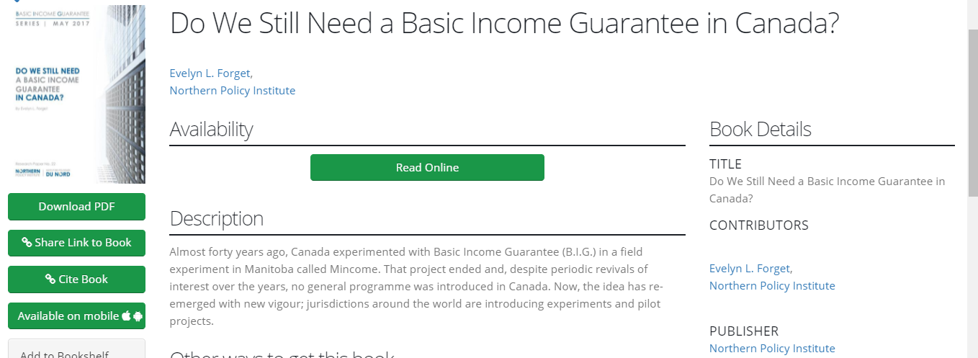

Slide 33
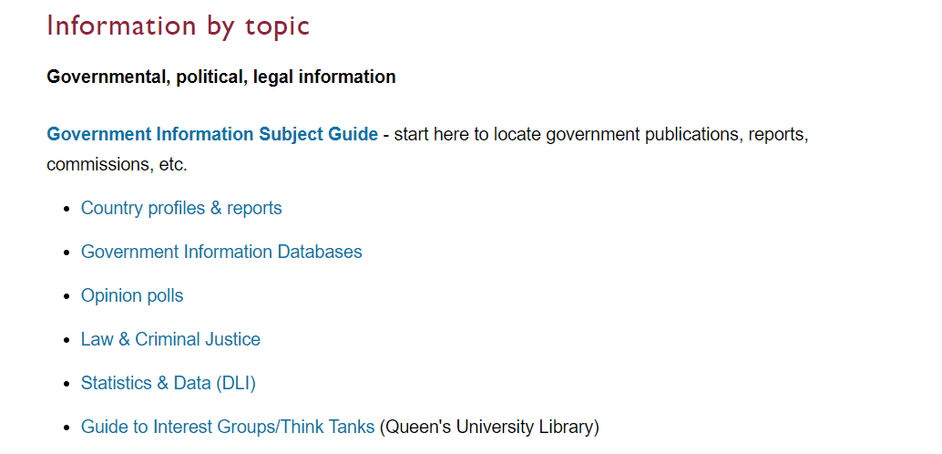

Slide 34
Government Information Search
Search: "public health" pandemic outbreak control management policy

Slide 35
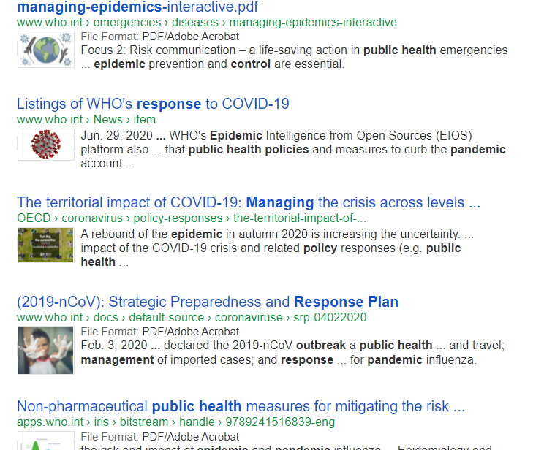
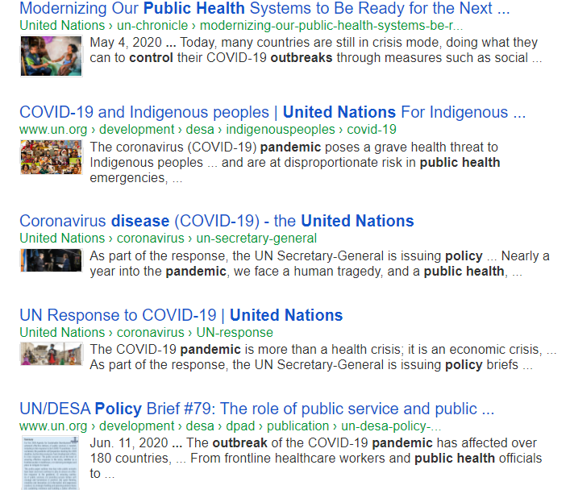

Slide 36
Statistics Canada: statcan.gc.ca

Slide 38
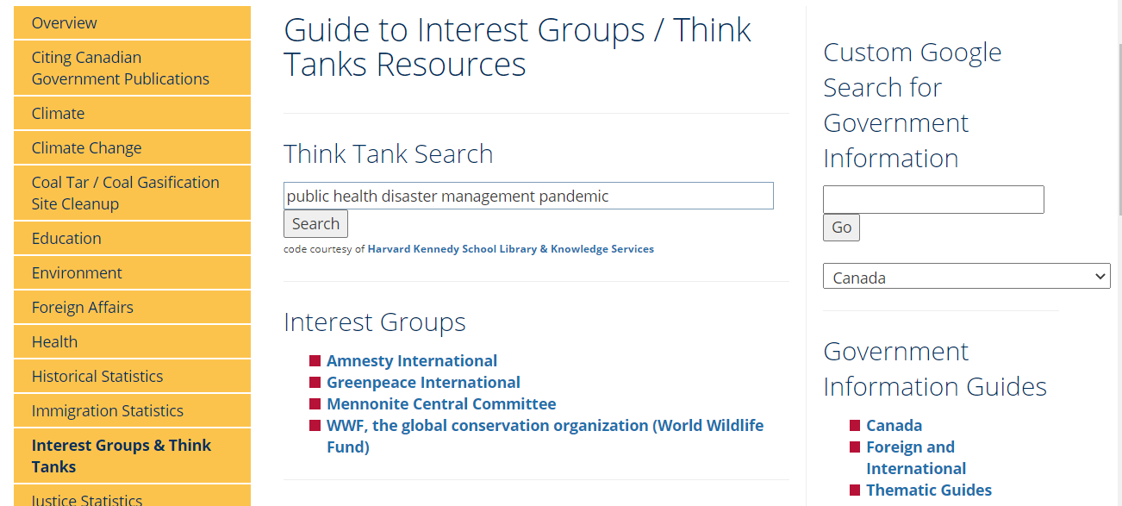
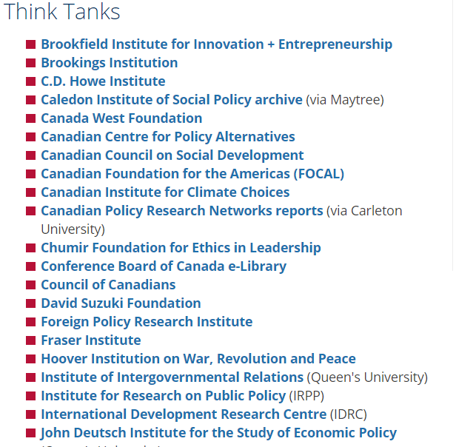

Slide 39
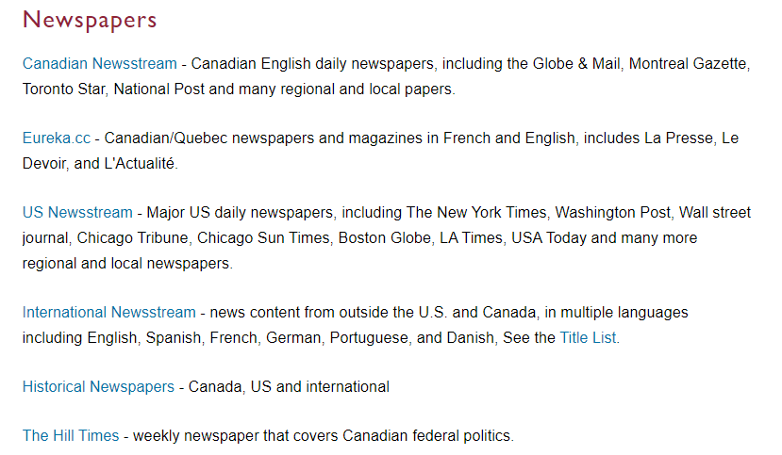
Media & Newspapers

Slide 40
Canadian Newsstream

Slide 41
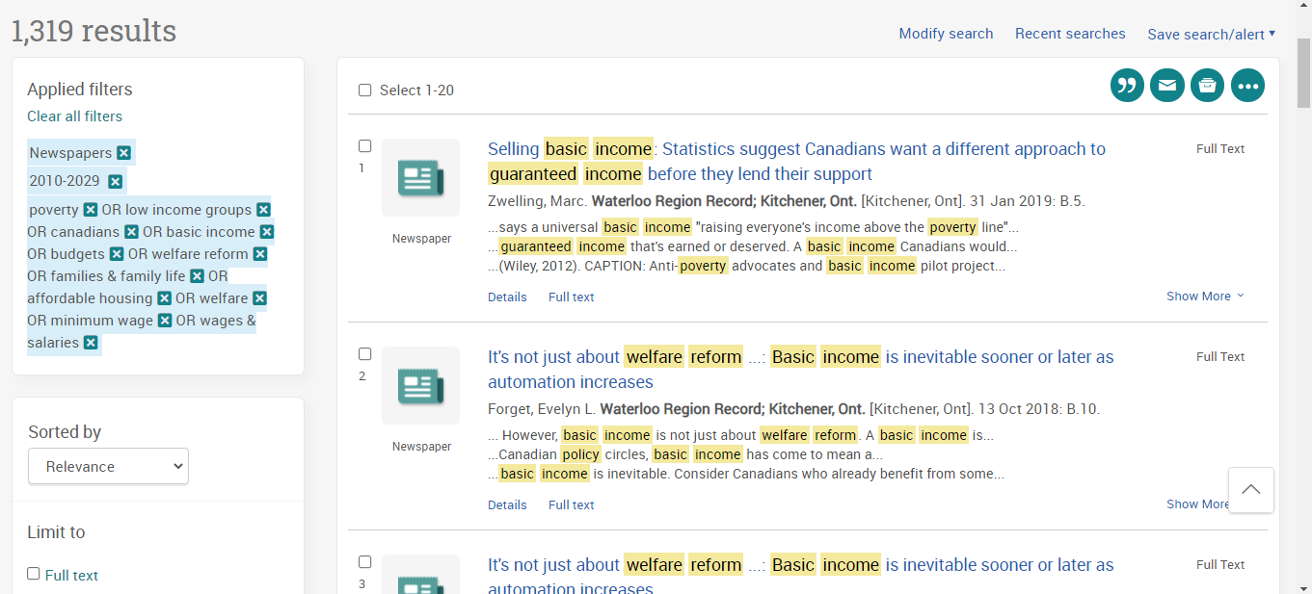
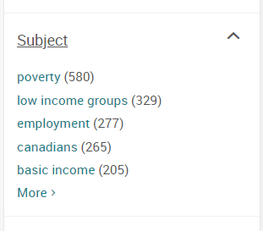

Slide 42
Need help, ask us!

