Slide 1
POLI 322: Israeli Political System Library Workshop
Michelle Lake
Political Science, SCPA, FPST and Government Information Librarian
Michelle.Lake@Concordia.ca

Slide 2
Who am I?
Michelle Lake, librarian for Political Science, the School of Community and Public Affairs, First Peoples Studies, and Government Publications
Michelle.Lake@Concordia.ca / Make an appointment or ask a question
What do I do?
Provide research support
Help students with library databases
Help students find and access materials they need
Help with citation issues
Choose the books we buy for the above subject areas

Slide 3
The Librar(ies)
24/7 access, with student card, after 11pm
Webster Library (LB) – downtown on SGW campus & Vanier Library (VL) on Loyola campus
Webster: Social Sciences, Humanities, Business, Engineering & Fine Arts
Vanier: Science(s), Health, Communications, Journalism and Psychology
Course Reserves Room(s): have the required undergraduate print textbooks for the courses taught at that campus (for example: Webster has the Political Science and SCPA course reserves)

Slide 4
Library Services
Your student card is your library card.
You need it to:
borrow books (up to 100 a time)
borrow a laptop and other technology (for 24 hours)
print on campus (add money to your Dprint account)
access the library overnight during 24/7 hours.
Webster library has 5 book scanners (And Vanier has 2!) that can be used for free to scan chapters from our print books and email them to yourself as a PDF.
To use Library databases, access online articles and ebooks when you are off campus, login with your MyConcordia Netname and password.

Slide 5
How can I find out if the library has access to an item I’m looking for?

Slide 6
The Oxford Handbook of Israeli Politics and Society edited by Reuven Y. Hazan, et al., Oxford University Press, 2021.

Slide 7
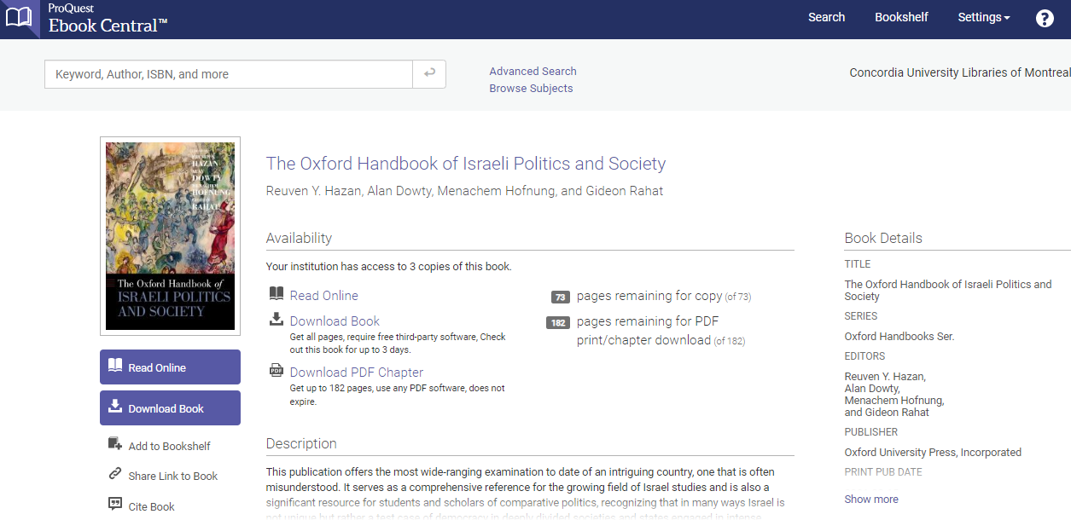
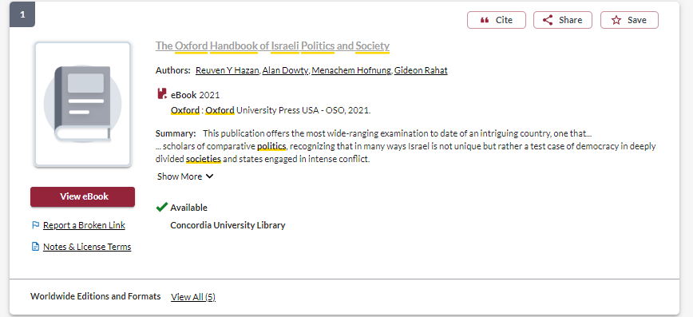

Slide 8
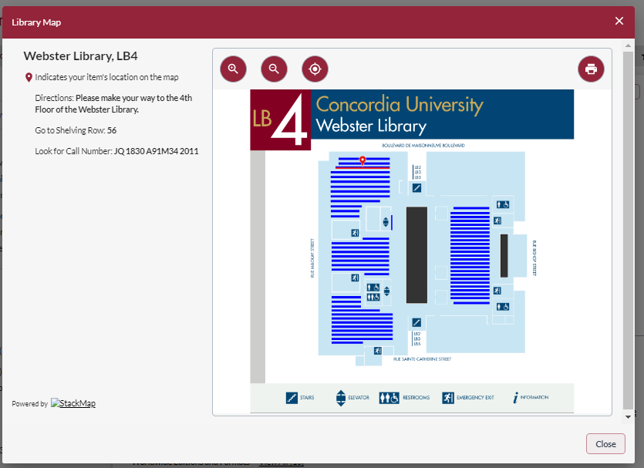
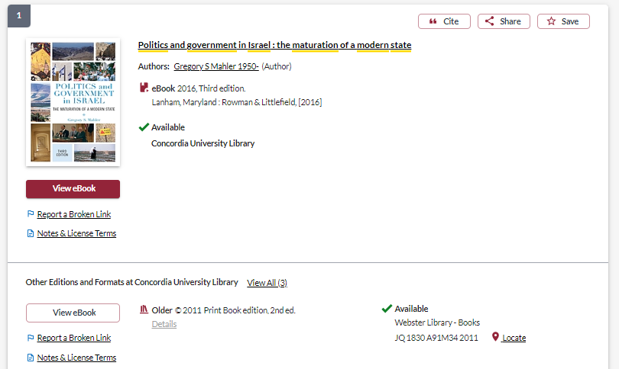
Access online
Borrow or scan chapters from the print book

Slide 9
Nikolenyi, C. (2020). The 2018 Municipal Elections in Jerusalem: A Tale of Fragmentation and Polarization. Contemporary Review of the Middle East, 71(1): pp. 6-24.

Slide 10
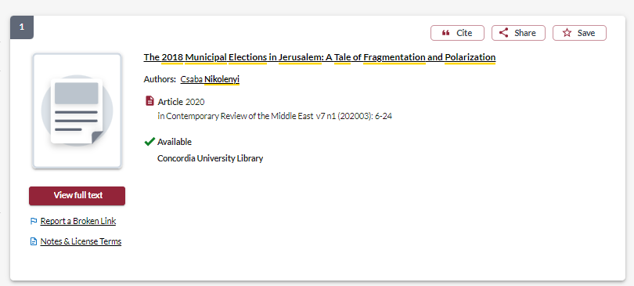
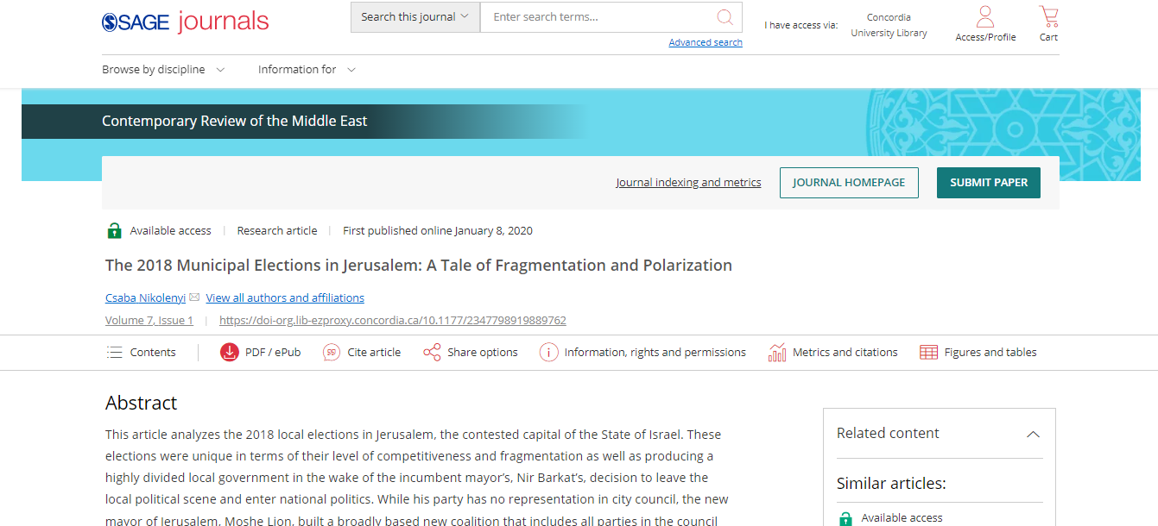

Slide 11
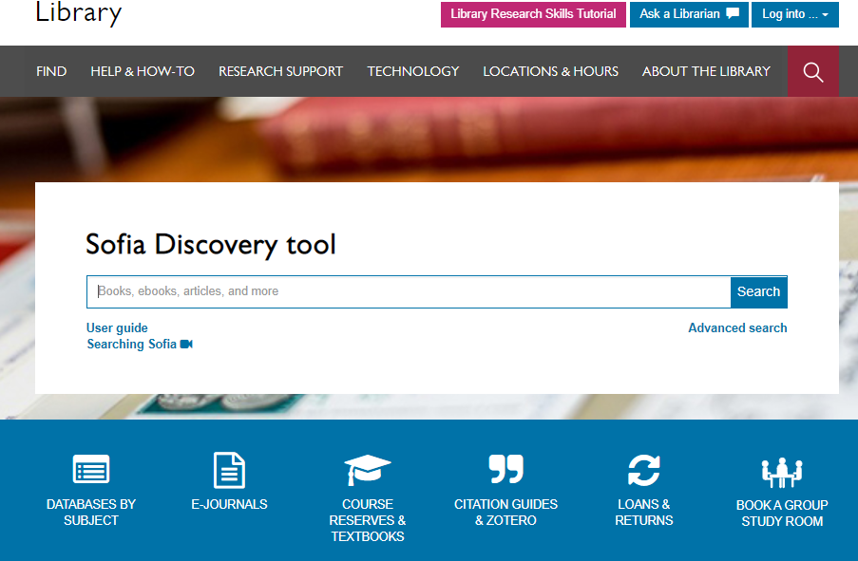

Slide 12
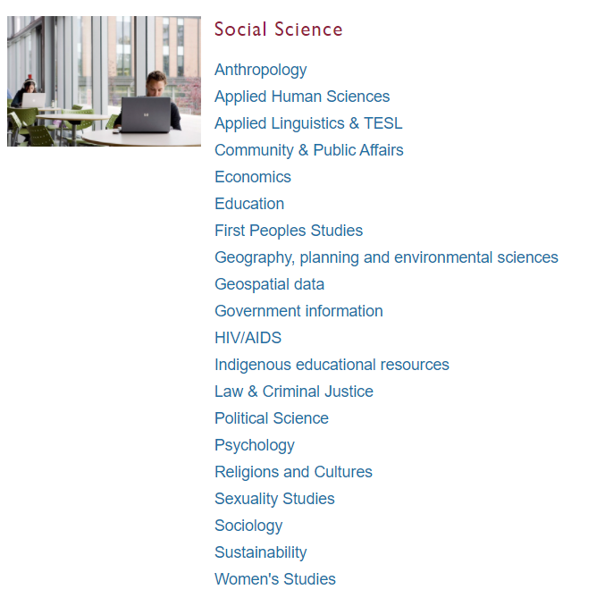
Subject Guide: Political Science

Slide 13
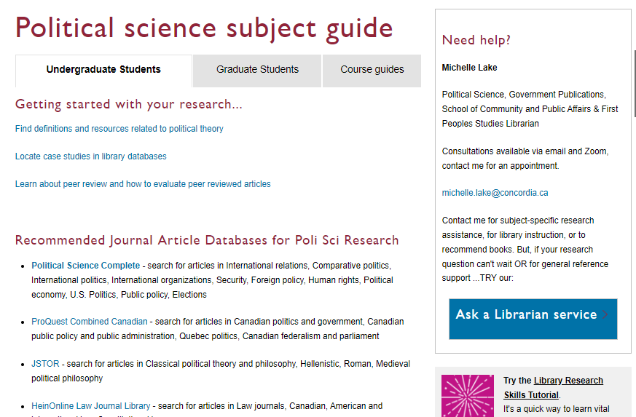

Slide 14
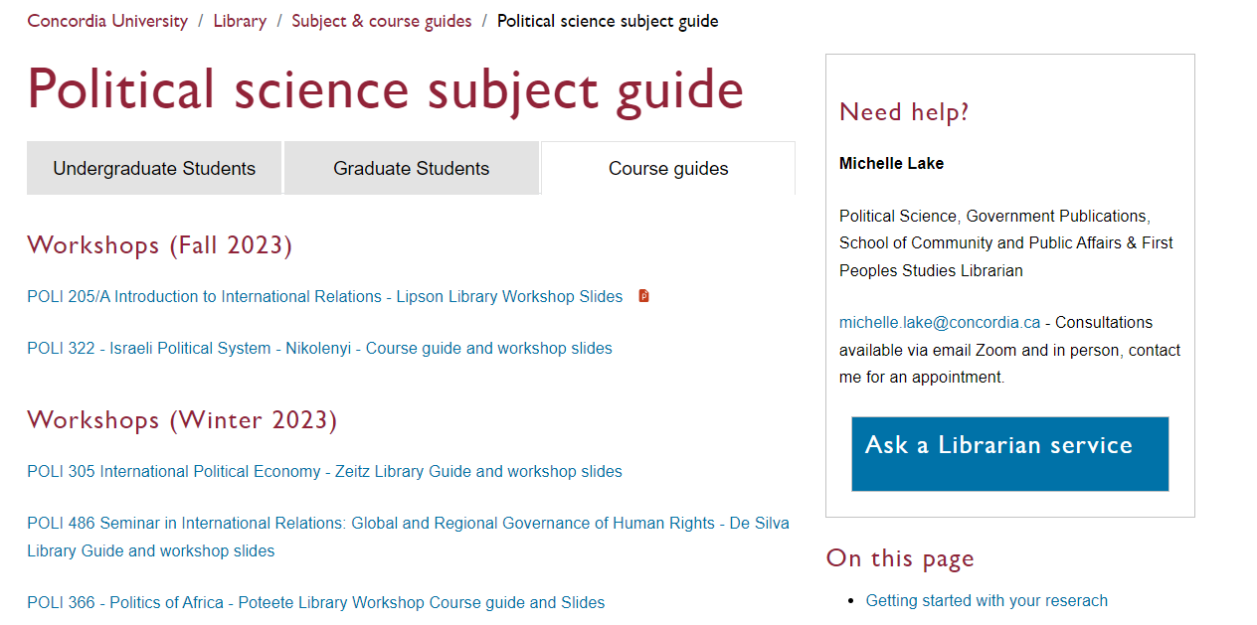

Slide 15
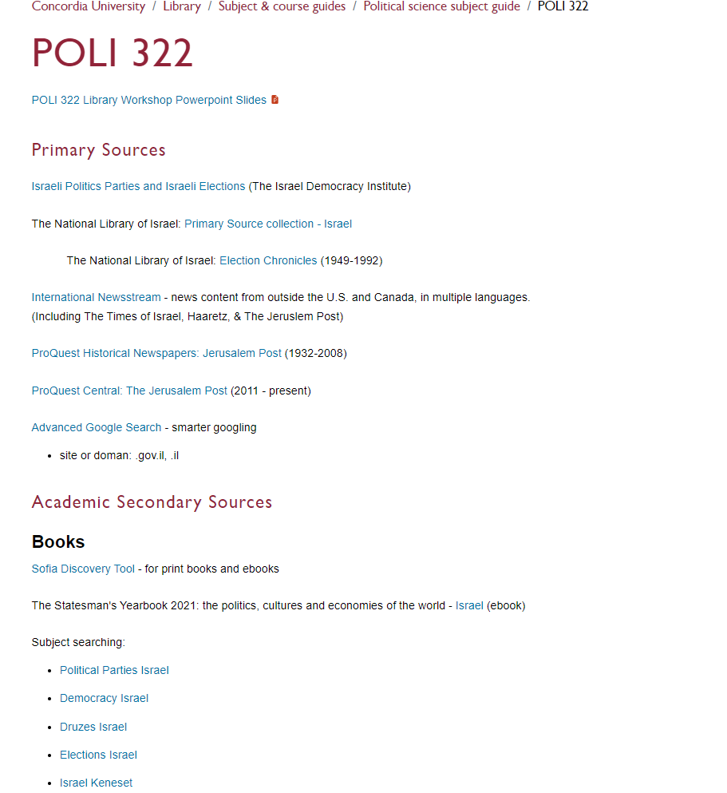
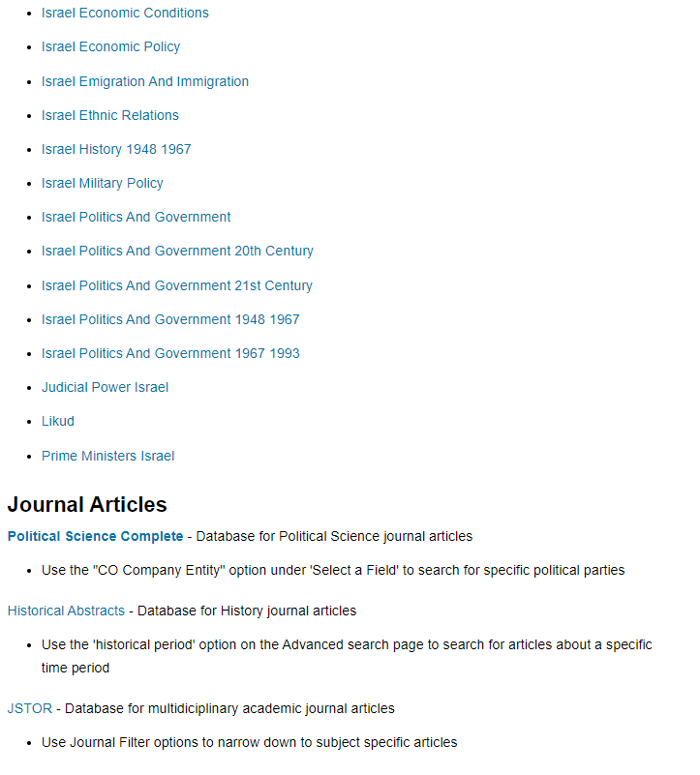

Slide 16
Types of sources
Primary sources: are first-hand testimony or direct evidence concerning a topic under investigation. Created by witnesses or recorders who experienced the events or conditions being documented.
Includes government publications, websites or statistics written and published by governments, publications and websites written and published by international organizations, non-governmental organizations, independent institutions, news and media sources including newspapers, news websites and other media.
Academic Secondary Sources: books and journal articles written by academic researchers, affiliated with universities, colleges and other academic institutions, usually having gone through a peer review process. Published by university presses and in academic journals.

Slide 17
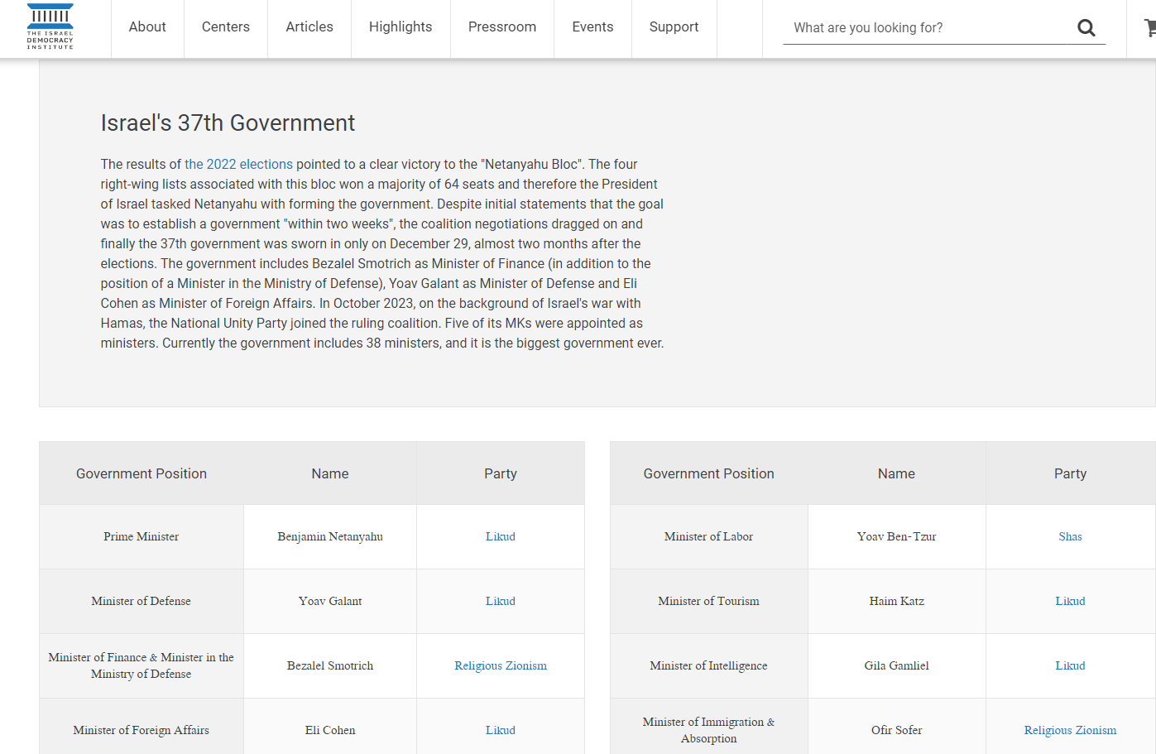
Israel Democracy Institute
Click to find more information on the most recent election
Click on each party name for background information, candidates and election results

Slide 18
National Library of Israel: Primary Sources & Election Chronicles

Slide 19
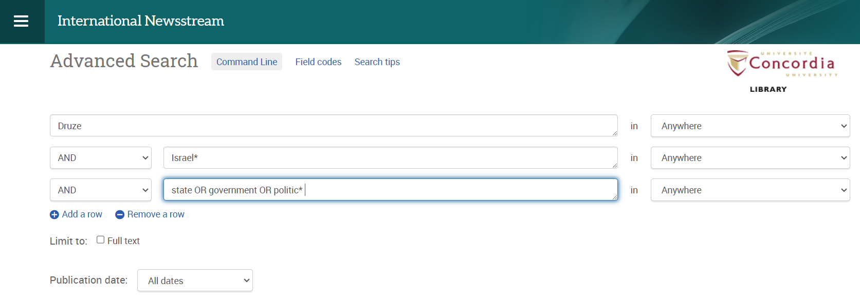
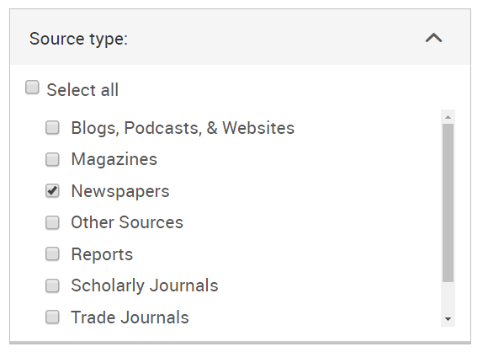
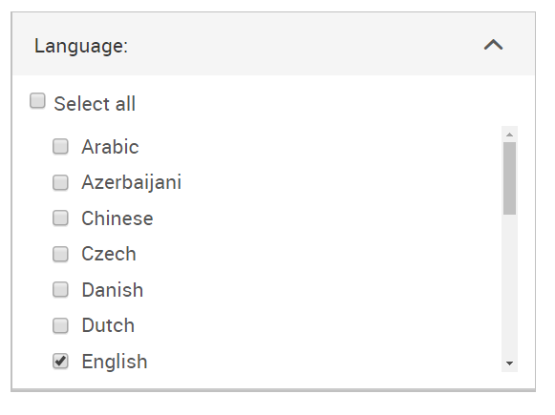
Searching News sources: International Newsstream

Slide 20
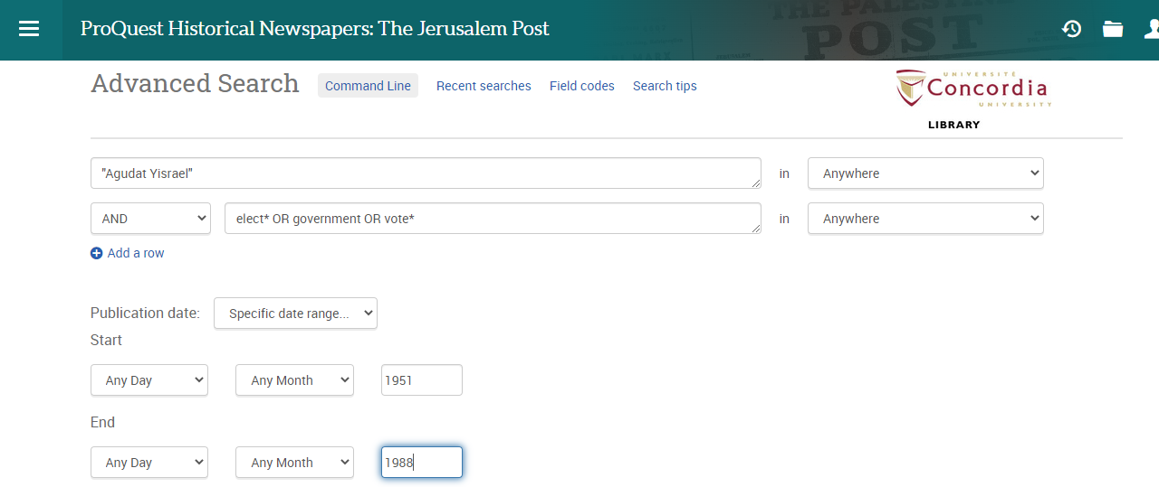
Searching news sources: Jerusalem Post

Slide 21
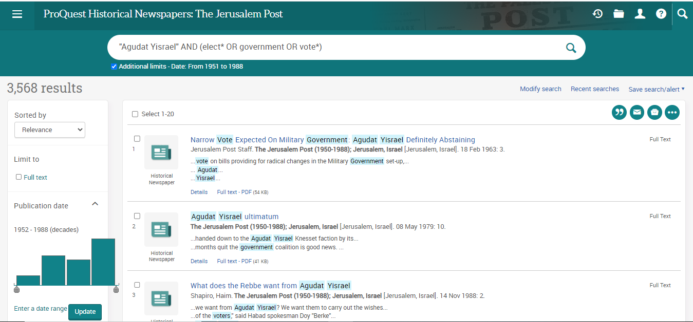
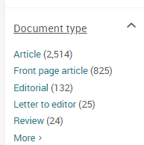

Slide 22
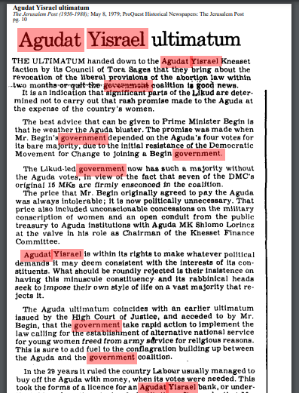
Searching news sources: Jerusalem Post
This database is an online archive and all the historical newspaper images have been scanned as PDFs.
When you search for keywords, they will be highlighted throughout the scanned image.
You can download and save the PDF images of the newspaper.

Slide 23
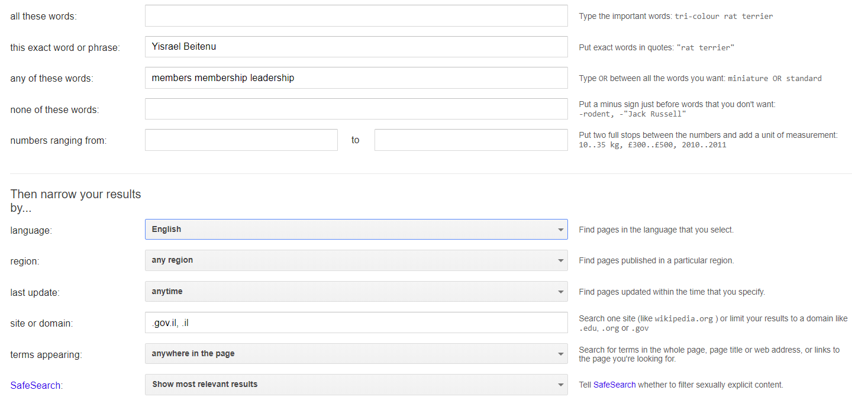
Advanced Google – searching smarter
AND
“phrase search”
OR

Slide 24
Scholarly Sources: Books and Articles

Slide 25
How do we combine search words for the best possible results?
AND: combines concepts and limits your results
politics AND security
state OR government
election OR voting
OR: allows you to insert synonyms or alternative terms and increases your results

Slide 26
How do we combine search words for the best possible results?
“quotation marks”: If you put two or more words in quotation marks, that exact phrase will be searched and limits your results.
“political parties”
“foreign policy”
Democra*
Finds: democracy, democracies, democratic, democratically, democratization
* - when you add an asterisk on the end of a word, your results will contain all the words with those endings or suffix

Slide 27
Avoid Searching with Linking words
Effects
Impact
Consequences
Influence
Results
Importance
Significance
Response
Emphasis
Causes
Each author may use different linking words when discussing similar topics.
You don’t want your search to be limited to those books and articles that only contain the word “effect” or “consequence”

Slide 28
Topic: Since the general elections of 2009, Likud has consistently remained the largest political party in Israel. What explains the apparent dominance of this party?
Key Concepts | Related terms/Synonyms
Israel | Israeli
Elections | Elect, voting, voters, parliament
Likud | Likud-National Liberal Movement, Netanyahu
Political party | Political parties, candidates, party members

Slide 29
Israel* AND Likud AND elect*

Slide 30
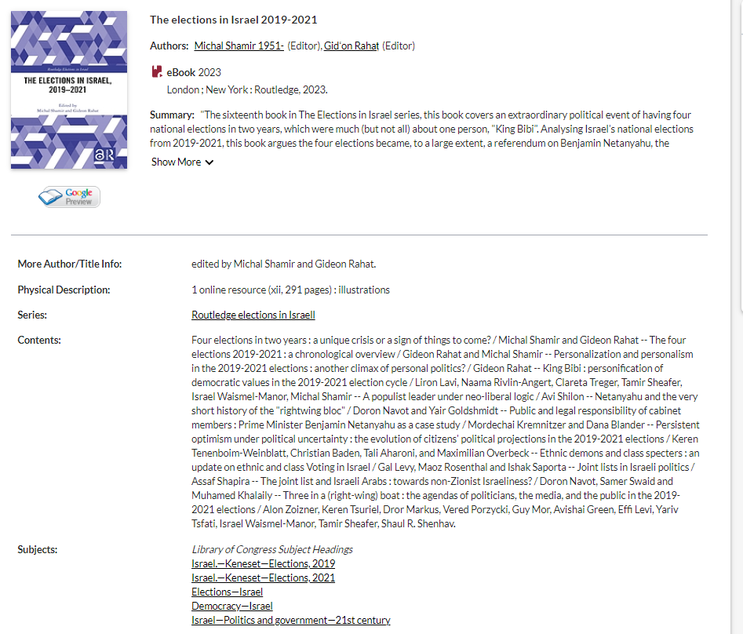
Use the subject headings to find more books relevant to your topic

Slide 31
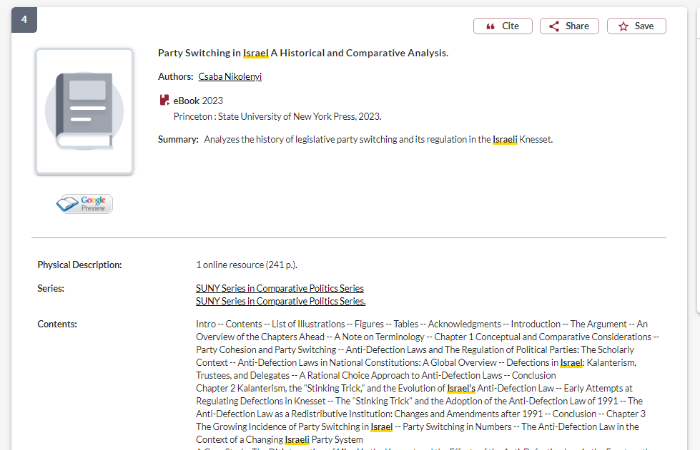
How do I know if a book is academic?
If the book is published by a university press, it is an academic book

Slide 32
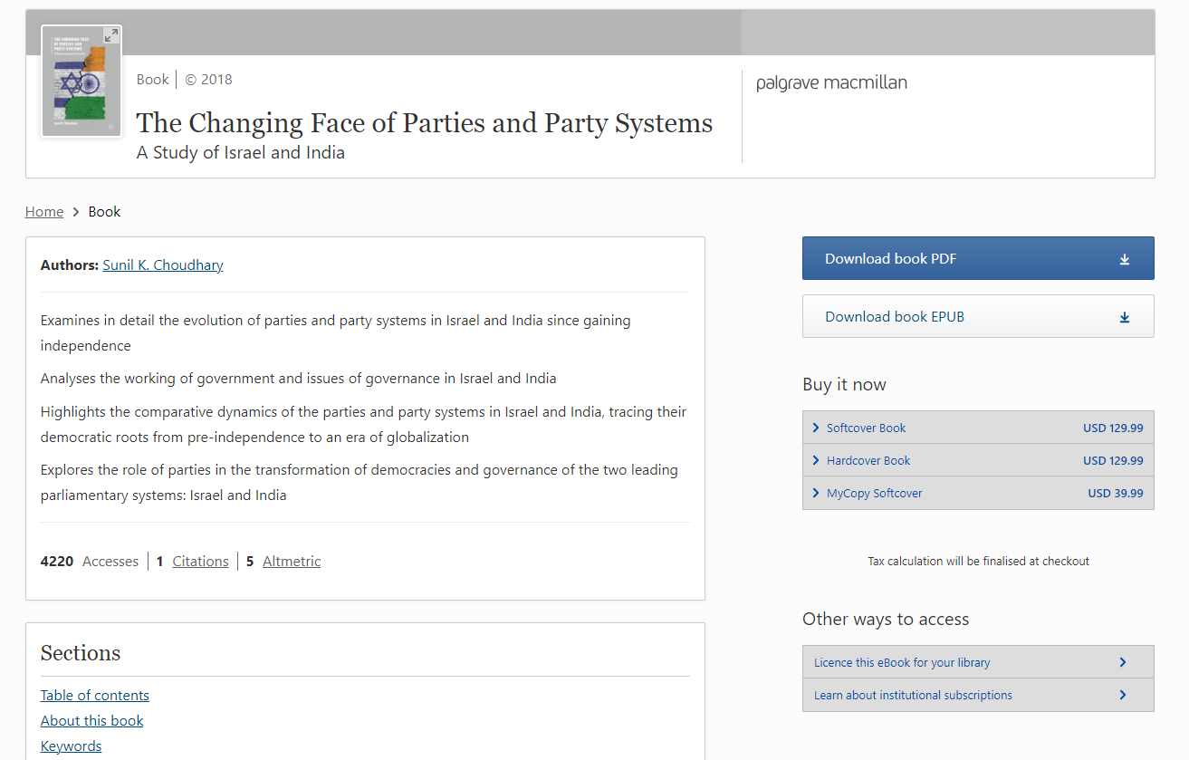
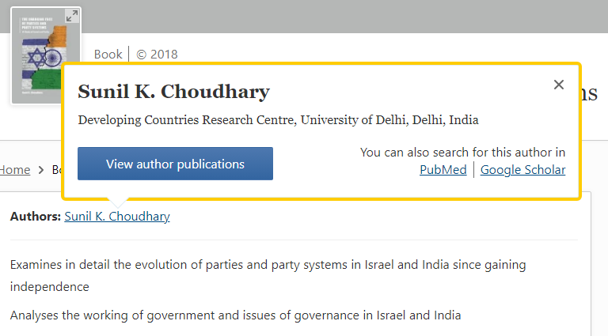
How do I know if a book is academic?
You should be able to locate the author/editor/contributor’s academic affiliations easily

Slide 33
Topic: Israel has a complex multi-party system leading to the formation of coalition governments. Explain why some coalition governments have been more durable than others!
Key Concept | Related terms/Synonyms
Israel | Israeli
Multi-party system | Party system, electoral system, political parties
Coalition government | Proportional representation, political cooperation
Durability | Longevity, long-lasting, permanence

Slide 34
israel* AND (coalition OR collaborative) AND government AND "political parties"

Slide 35
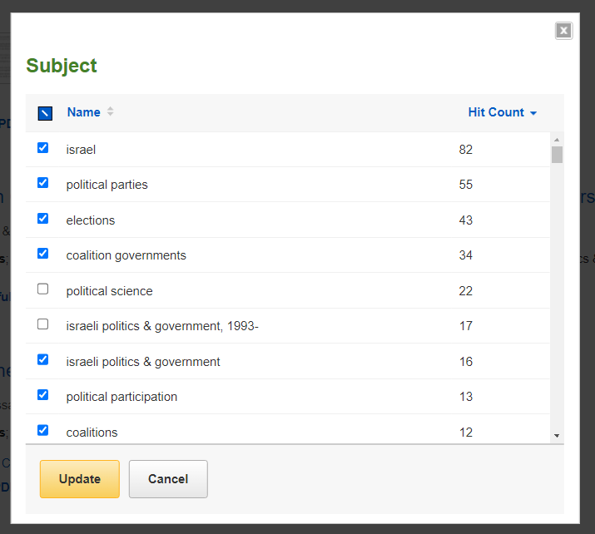
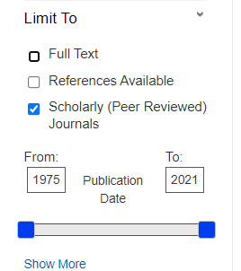
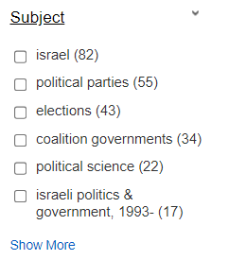
Political Science Complete: Articles

Slide 36
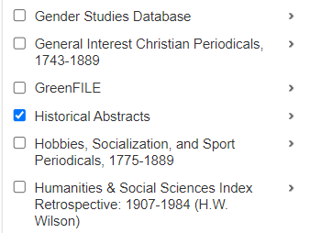
You can search for a specific political party, as a “CO Company Entity”
Search in 2 databases at once

Slide 37
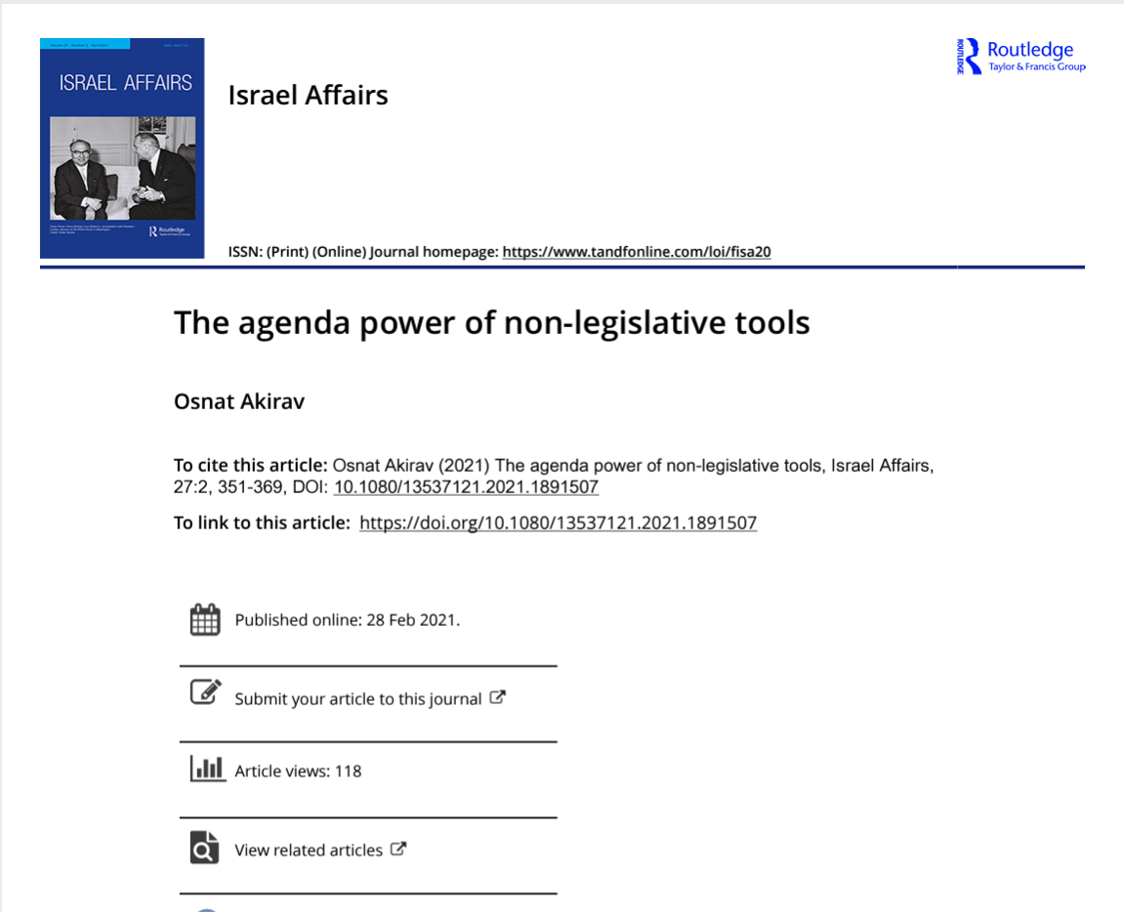
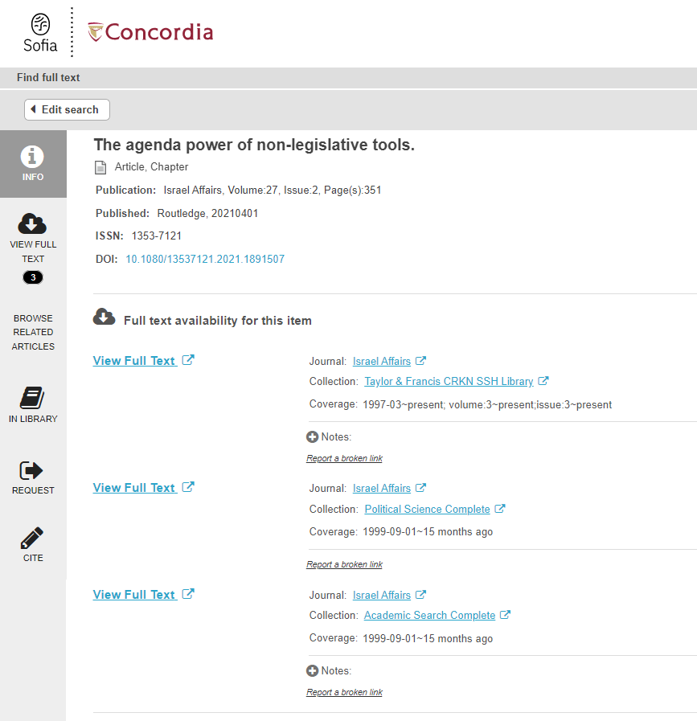
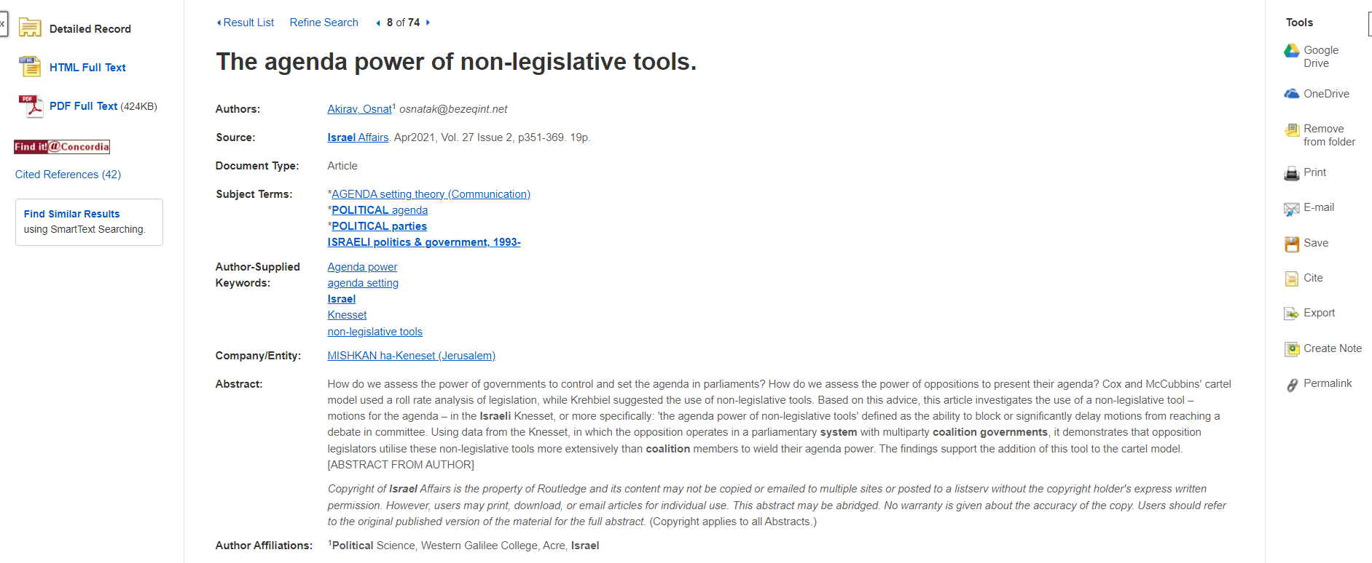
Use Find it @ Concordia if there is no PDF or HTML full text

Slide 38
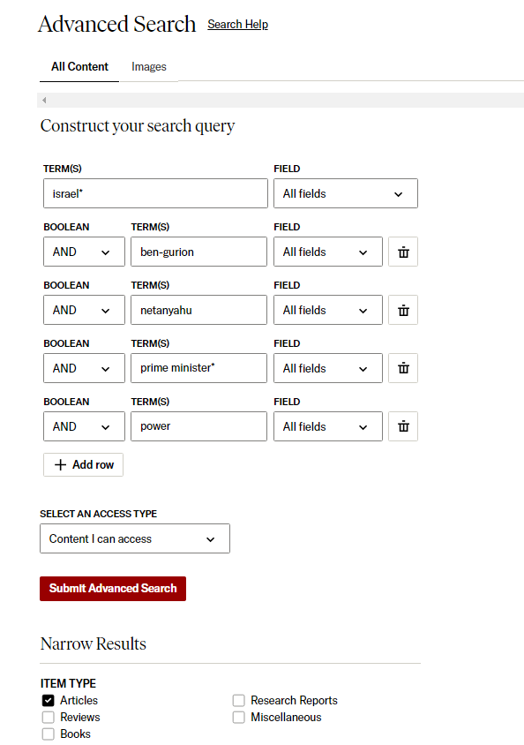
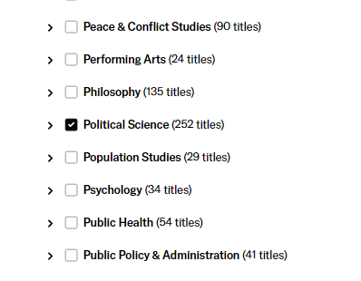
JSTOR: Articles
israel*
AND Ben-Gurion
AND Netanyahu
AND prime minister*
AND power
Narrow by discipline

Slide 39
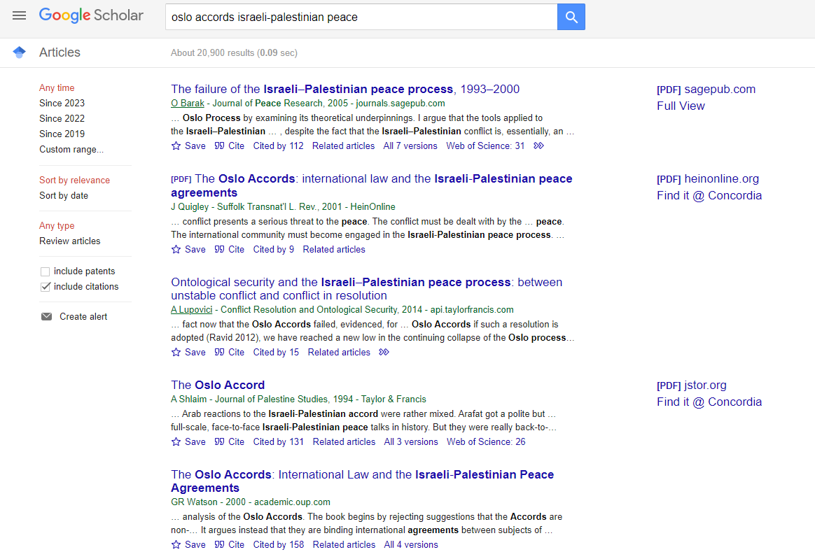
Google Scholar
You can narrow your search results by date, but you cannot narrow down to peer reviewed journal articles only in Google Scholar

Slide 40
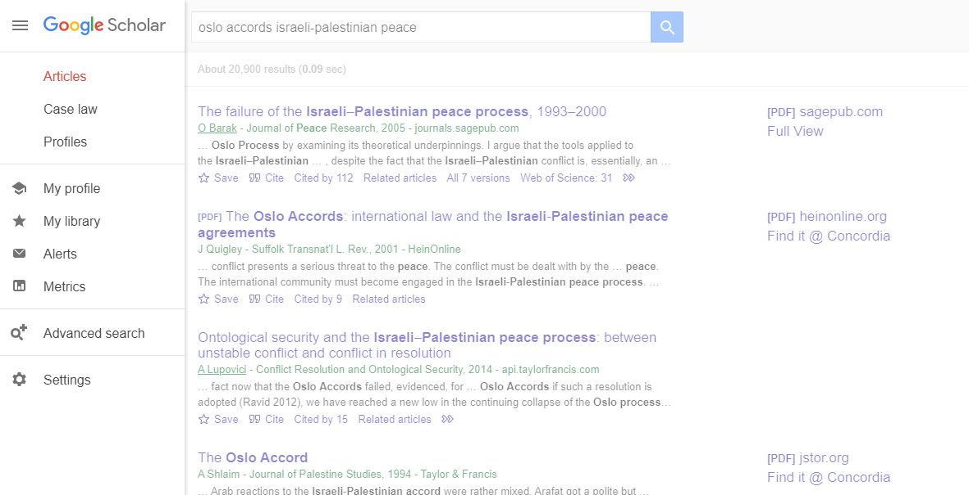
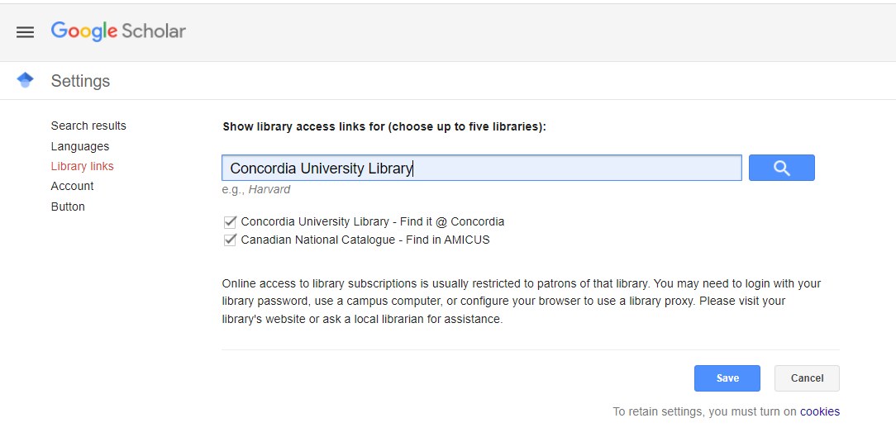

Slide 41
What is peer review? What are peer reviewed, scholarly articles?

Slide 42
Has the article gone through the peer review process? What is peer review? Peer review is a system used to decide if an article should be published in a peer-reviewed journal. Each paper submitted to a peer-reviewed journal is read and evaluated by experts in the article’s subject area. The reviewers assess the article’s validity, importance, and originality, and then recommend whether it should be printed in the journal. The reviewers’ suggestions are considered by the journal’s editor, who makes the final decision about whether to accept or reject the article. Criteria for evaluating academic or scholarly articles

Slide 43
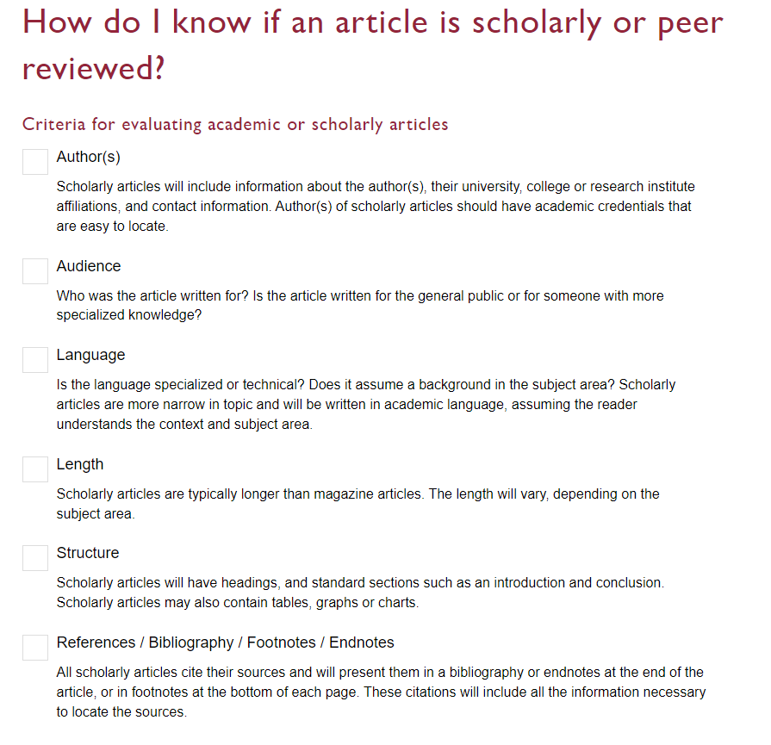

Slide 44
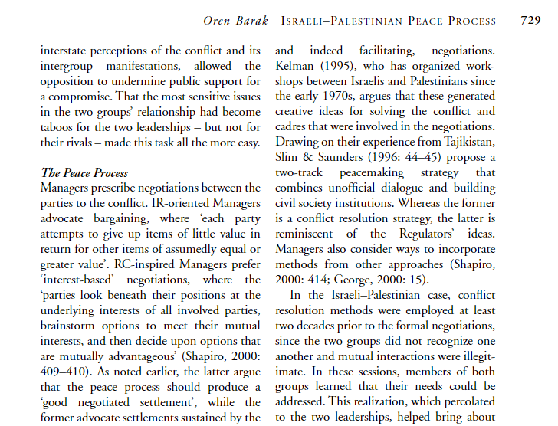
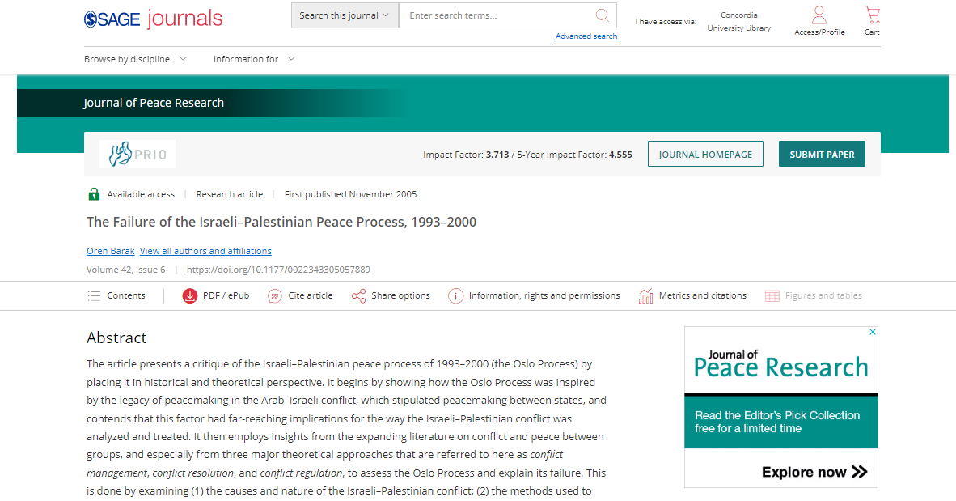
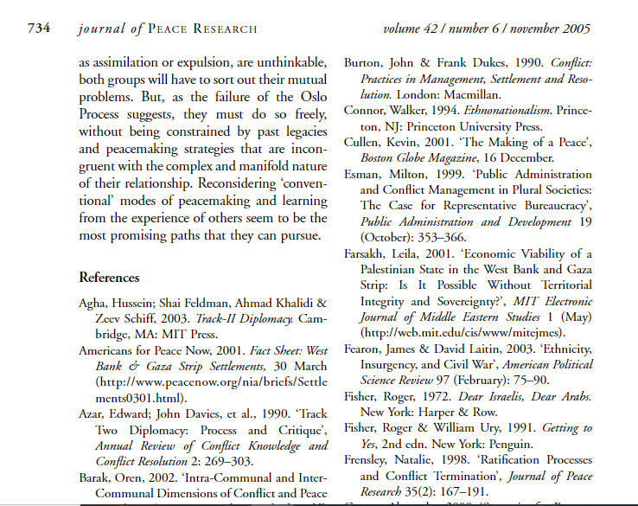
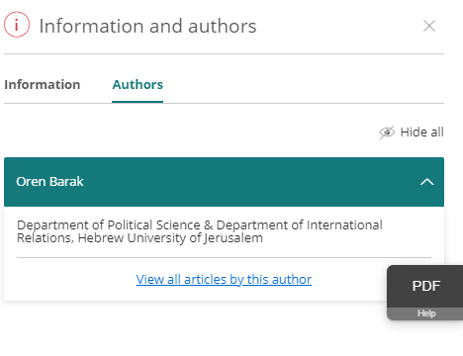
Citations throughout the article and an extensive reference list/bibliography/endnotes/footnotes is available at the end of the article.

Slide 45
Citing your sources

Slide 46
Citation Resources
Help and How to: How to Cite
Chicago (Author-Date) style guide
Citation Help for Undergrads Online! Nov 16, 2023 11am-12pm

Slide 47
Wrap up
Political Science subject guide - POLI 322 Course guide provides quick access to key resources
The poli subject librarian (Michelle) is here to help
Your sources must collectively answer your research question
Evaluate everything you cite in your assignments
Properly cite all your sources!

Slide 48
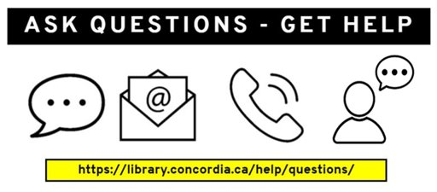
Need help, ask us!
Michelle.Lake@Concordia.ca

