Slide 1
POLI 204 Library Workshop
Michelle Lake
Michelle.Lake@Concordia.ca
Oct 2021

Slide 2
Who am I?
Michelle Lake, librarian for First Peoples Studies, Political Science, the School of Community and Public Affairs, and Government Publications
Michelle.Lake@Concordia.ca / Zoom Office Hours – Wednesdays 2-4pm
What do I do?
Provide research support
Help students with library databases
Help students find and access materials they need
Help with citation issues
Choose the books we buy for the above subject areas

Slide 3
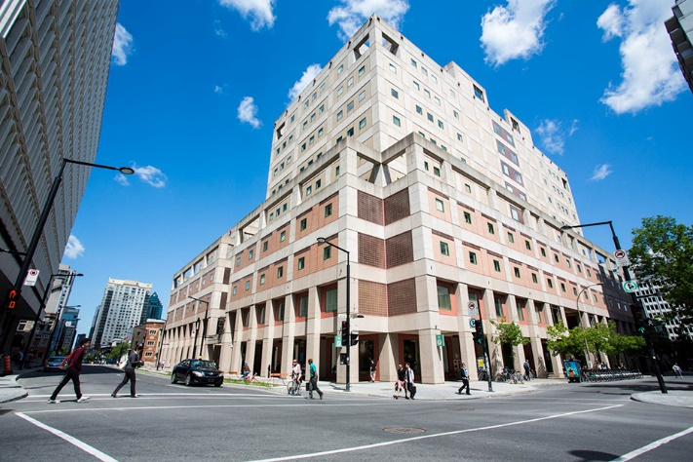
The Librar(ies)
Webster Library – SGW Campus
24/7 access, with student card, after 11pm
2nd, 3rd, 4th, and 5th floor of LB - “Library Building”
Poli Sci, Government Info, Maps, History, Social Sciences, Humanities, Engineering & Fine Arts
Interlibrary Loans
Current Print Journals
Vanier Library – Loyola Campus
24/7 access, with student card, after 11pm
1st, 2nd, and 3rd floor VL – “Vanier Library”
Sciences, Psychology, Communications & Journalism
Special Collections
Print Journal Archive

Slide 4
Library: in person
Services such as the loans desk, Ask Us desk and chat help are not open 24/7, check the library website for hours if you need a particular service.
Course Reserves room is open - you will need to use the call number of a book to locate them in course reserves
Procedural masks need to be worn at all times in the library.

Slide 5
Library Services
Your student card is your library card. You need it to borrow books, borrow a laptop, print and access the library during 24/7 hours.
You can borrow up to 100 print items at a time and renew them online, if no one else requests them. Borrow a laptop for 24 hours or a tablet for 3 days.
Webster library has 5 book scanners that can be used for free to scan chapters from our print books and email them to yourself as a PDF.
To use Library databases, access online articles and ebooks when you are off campus, login with your MyConcordia Netname and password.

Slide 6
Course Reserves via the Library - library.concordia.ca
many ways to access:

Slide 7
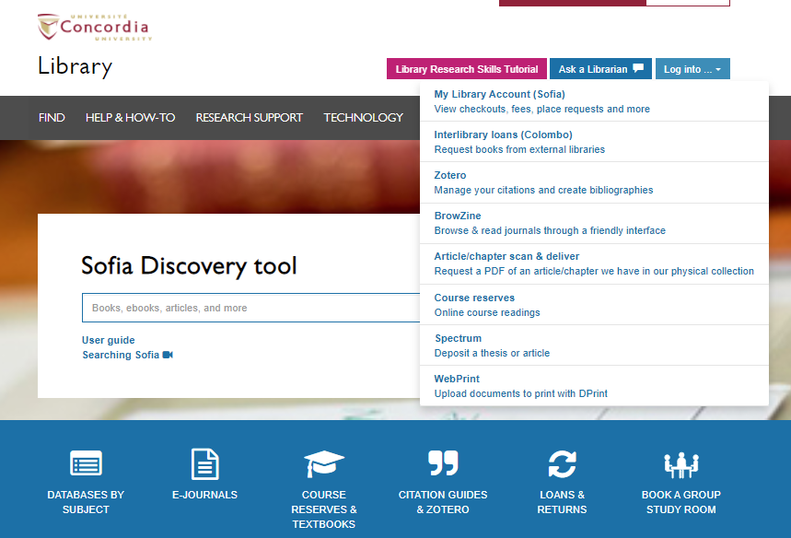

Slide 8
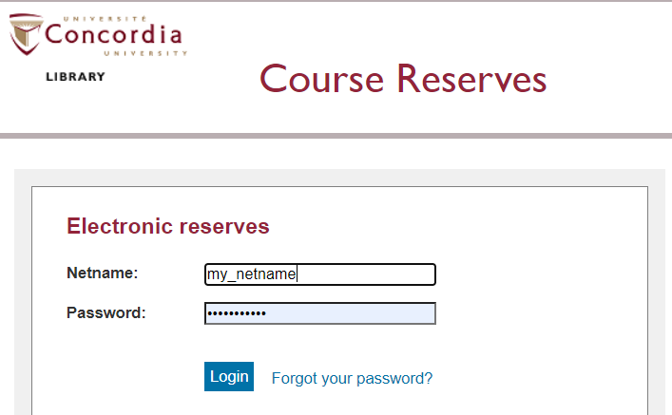

Slide 9
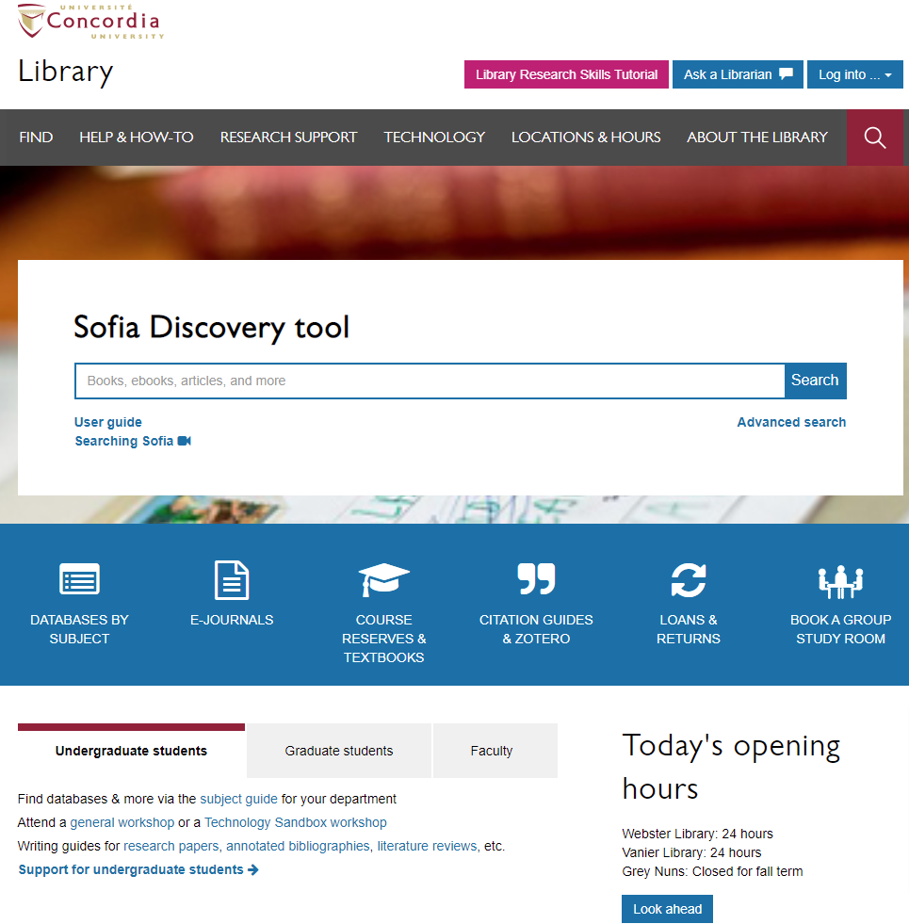
Library website: https://library.concordia.ca/
Use the Sofia Discovery tool to find print books, ebooks, and journal articles from the library.
Book a study room in the library for 2 or more people to use for up to 3 hours
Find your subject guide for your topic area

Slide 10
Locating items when you have the citation information

Slide 11
Donald Savoie. 1999. Governing from the Centre: The Concentration of Power in Canadian Politics. Toronto: University of Toronto Press.

Slide 12
Use the table of contents to navigate through the ebook

Slide 13
Atkinson, M.M., Marchildon, G.P., Phillips, P.W.B., Rasmussen, K.A. & Beland, D. (2013). Governance and public policy in Canada: a view from the provinces. North York: University of Toronto Press.

Slide 14
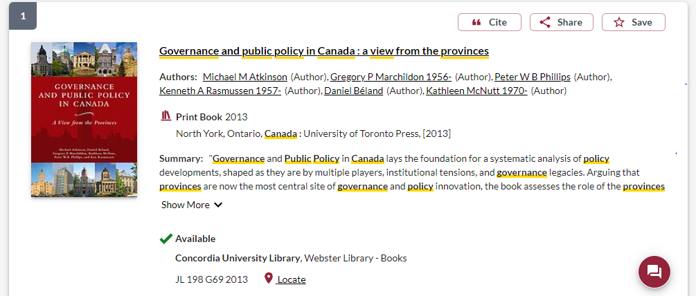
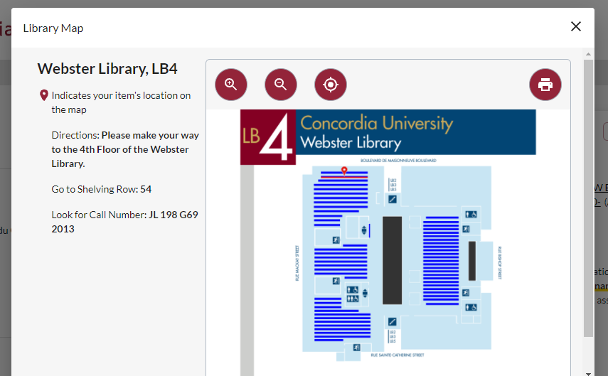

Slide 15
Linda A. White. 2014. “Federalism and Equality Rights Implementation in Canada”, Publius: The Journal of Federalism 44(1): 157-182.

Slide 16
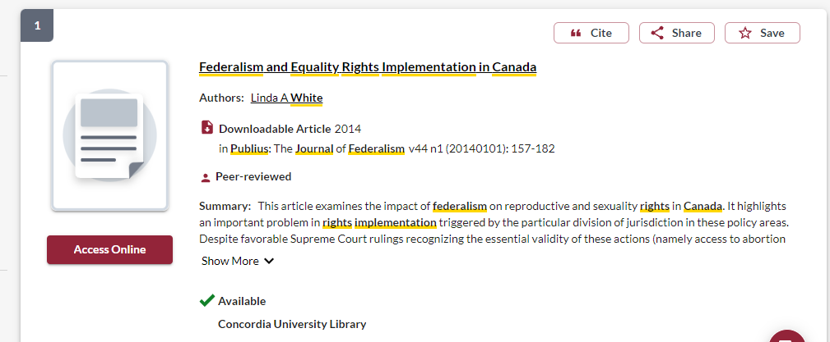
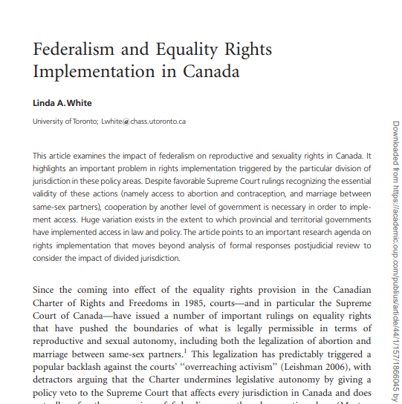
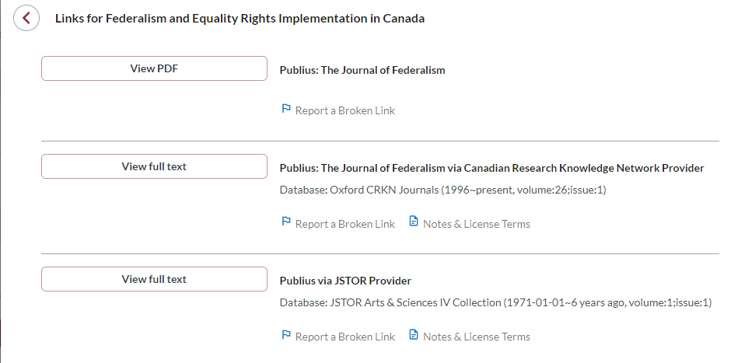

Slide 17
Breaking down a topic & Search strategies

Slide 18
AND –limits how many results your search produces
Example: nationalism AND politics
OR –increases the number of results your search produces
Example: elect OR vote
“ ” -exact phrase, searches for an exact phrase only, rather than each keyword, limits your search results
Example: “political parties”
*- truncation: retrieves all words that start with the letters entered and expands search results
Example: democra* finds democracy, democracies, democratic, democratization

Slide 19
Avoid Searching with Linking words
Effects
Impact
Consequences
Influence
Results
Cause
Importance
Significance
Response
Emphasis
Each author may use different linking words when discussing similar topics.
You don’t want your search to be limited to those books and articles that only contain the word “effect” or “consequence”

Slide 20
What are the causes of women’s underrepresentation in Canadian legislatures?
Key Idea | Keywords
Women | woman, female
Underrepresentation | marginalization, gender inequality, gender gap
Canadian | Canada, provincial, federal
Legislatures | politicians, elected representatives, elections, parliament, legislature, government, politics

Slide 21
Academic Sources: Books

Slide 22
Using Sofia Advanced Search

Slide 23
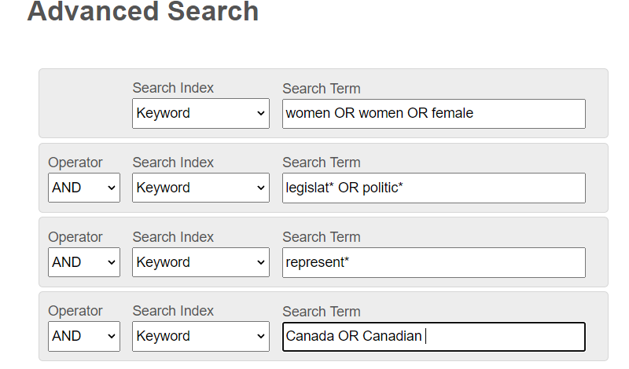
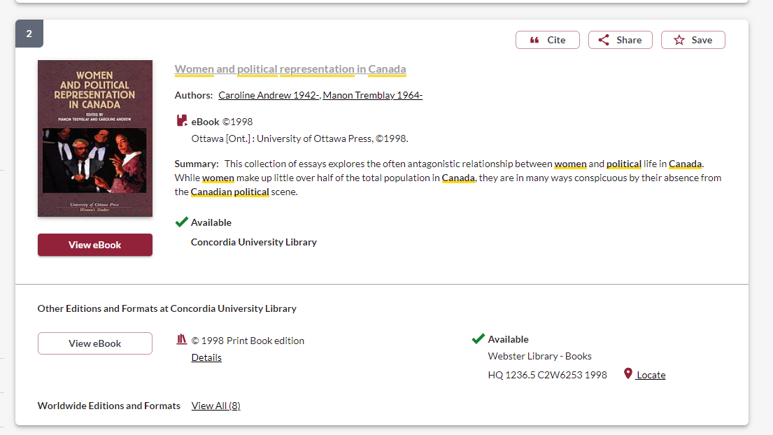
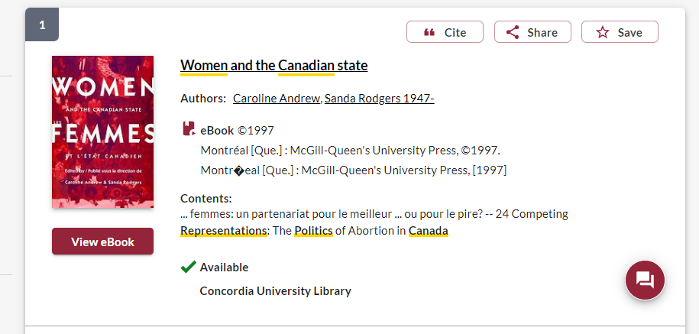

Slide 24
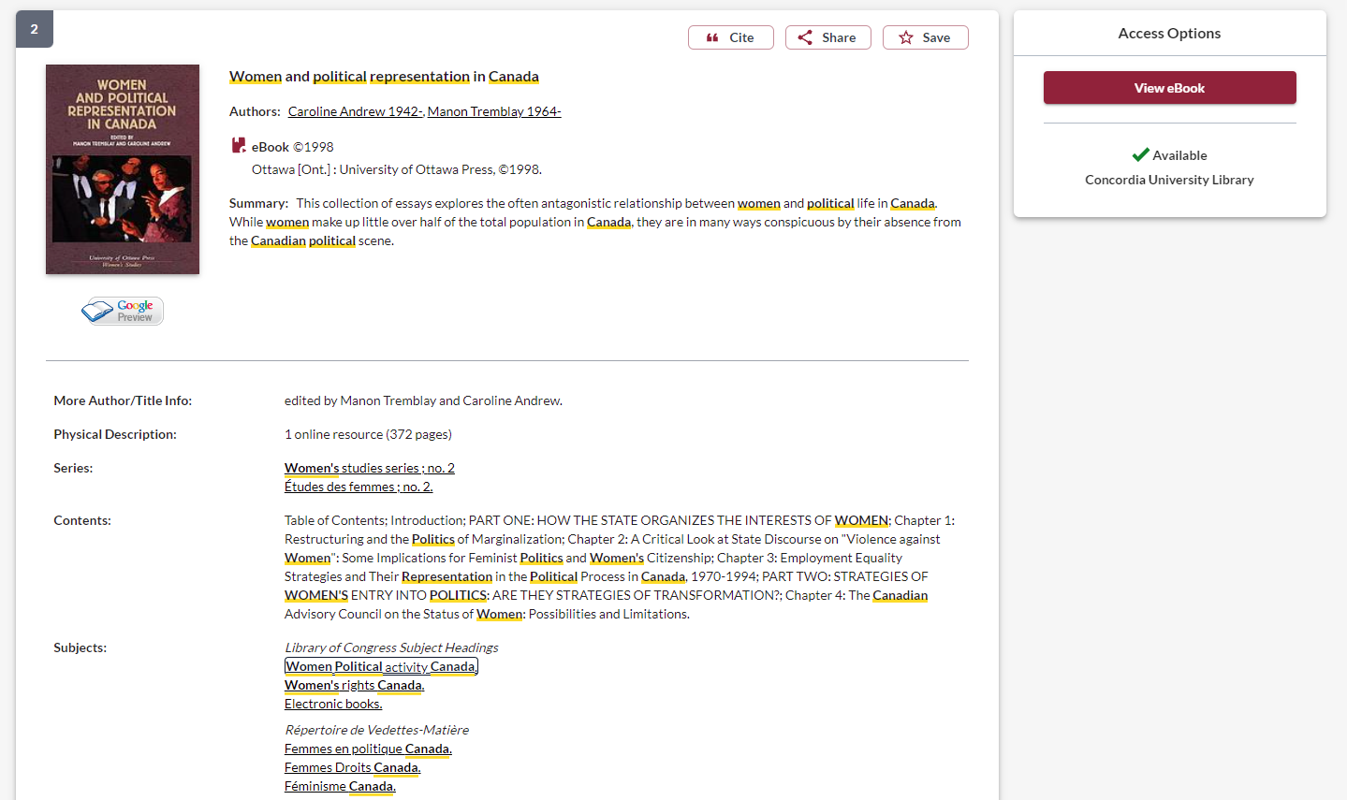
Click on related subject headings to see all the books in this subject area

Slide 25
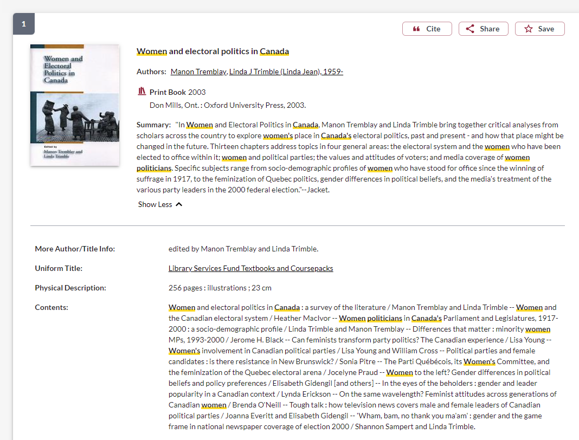
How do I know this is an academic book?
If the publisher is a university press, it is an academic book
Academic books will be at least a couple hundred pages

Slide 26
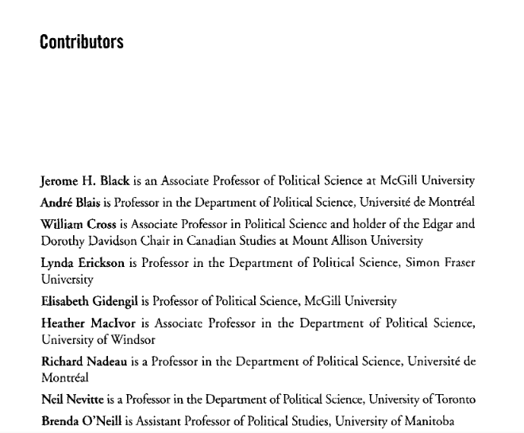
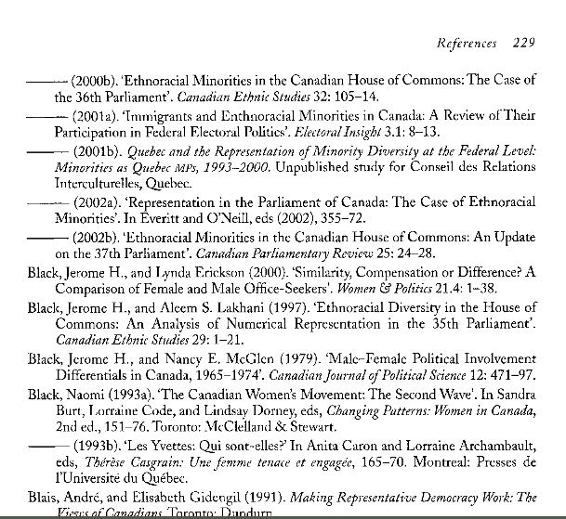
How do I know this is an academic book?
In the book itself look for author affiliations or information about the book’s contributors, are they faculty members at universities?
Academic books will always have a reference list/bibliography/footnotes/endnotes of their sources

Slide 27
Print books at Webster Library
Political Science & Government: J – JZ (4th floor)
Political institutions and public administration (Canada): JL 1 – JL 500
Law, K-KZ (4th floor)
Canadian Law: KE
Social Sciences: Public Policy, Economics, Social welfare: H-HV (4th floor)
Women, Feminism: HQ
History of North and South America (Canadian history), First peoples and Indigenous studies: E-FC (3rd floor)

Slide 28
Academic Sources: Peer reviewed journal articles

Slide 29
go the Library website under:
HELP & HOW-TO
Subject & Course Guides
Social Science
Political Science

Slide 30
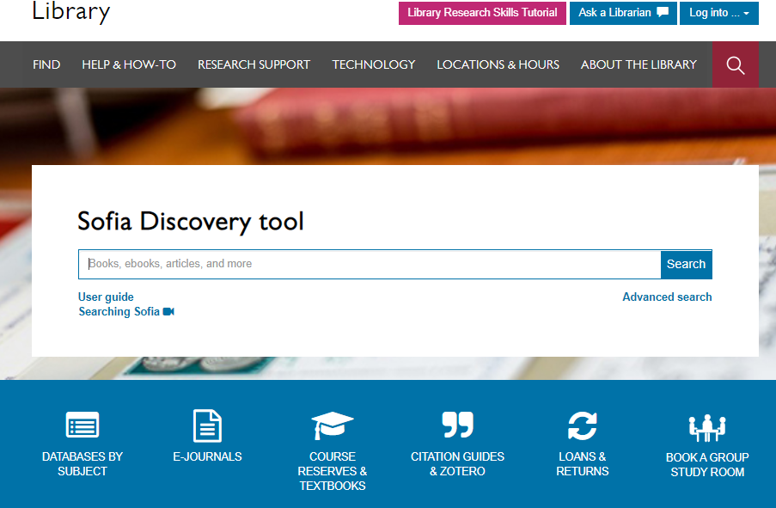

Slide 31
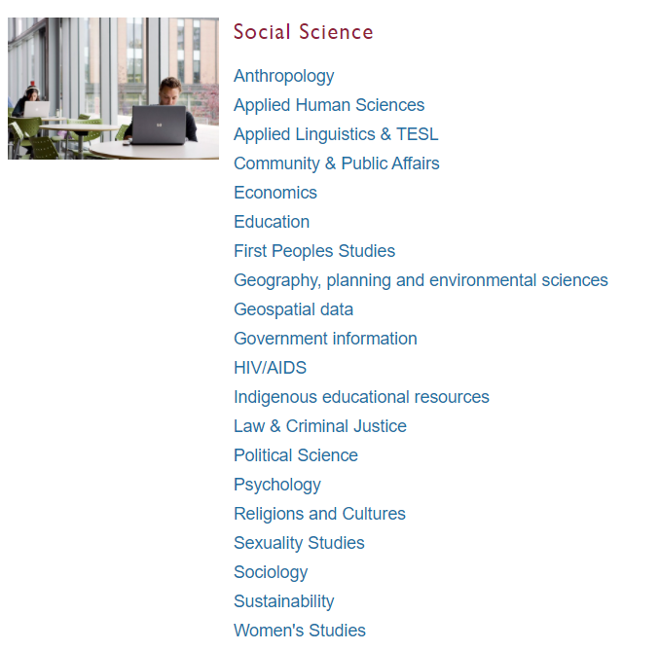
Subject Guide: Political Science

Slide 32
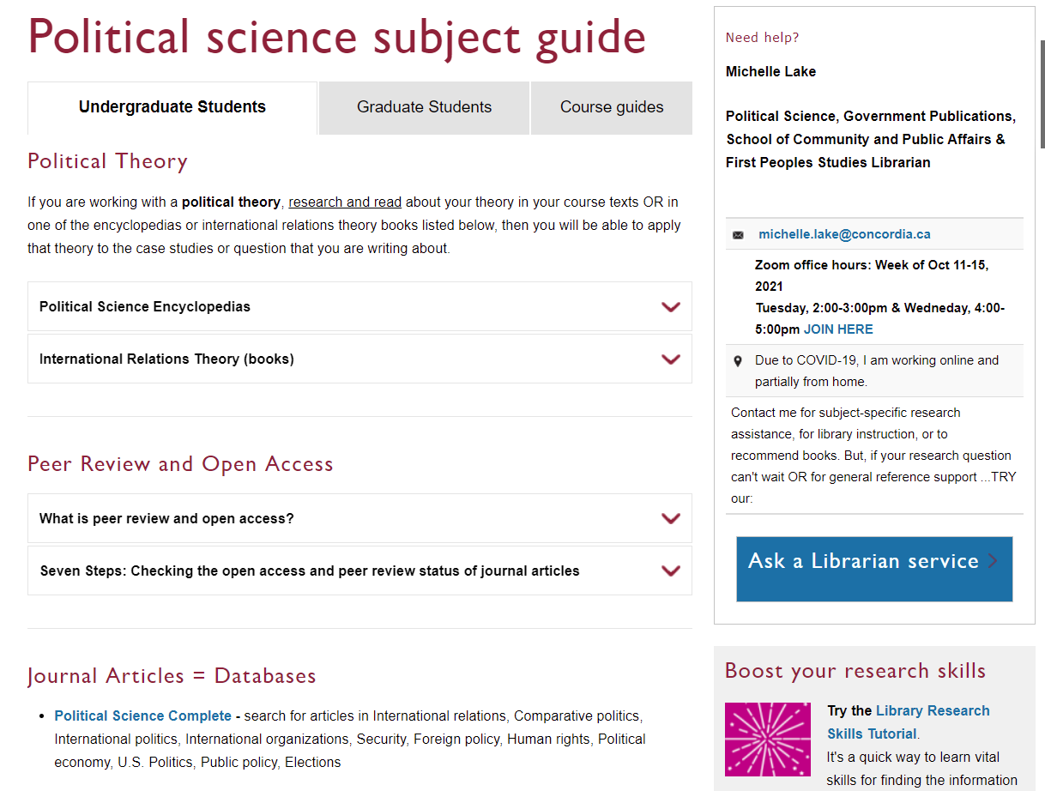
Scroll down to locate the database list

Slide 33
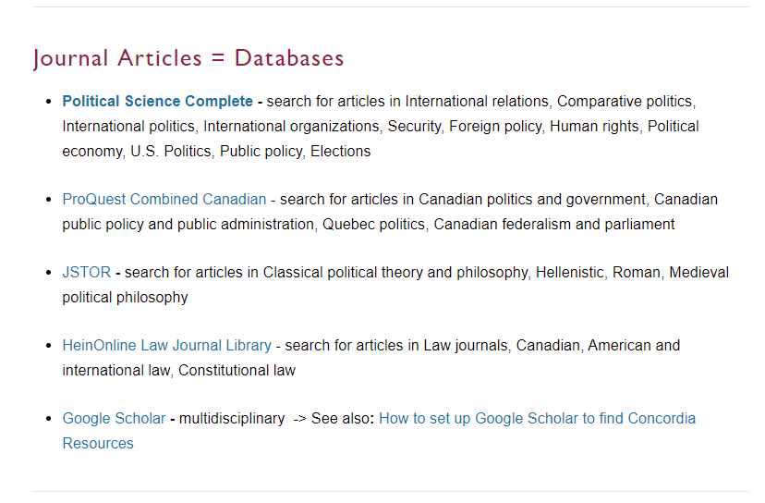
1. Start here: Largest POLI database
2. Good Canadian database, not all journals are PoliSci related
3. Ensure Google Scholar is set up to provide you with Concordia sources

Slide 34
What are the challenges of Indigenous self-government in Canada, and how can be overcome?
Key Idea | Keywords
Indigenous | Aboriginal, First Nations, Inuit Metis, First Peoples
Self-Government | self-determination, Indigenous government, Indigenous governance, land claims, land tenure
Canada | Canadian

Slide 35
Indigenous OR Aboriginal OR "First Nations" OR Inuit OR Metis AND self-government OR self-determination OR "Indigenous governance" OR "Indigenous government" OR "land tenure“ AND Canad*

Slide 36
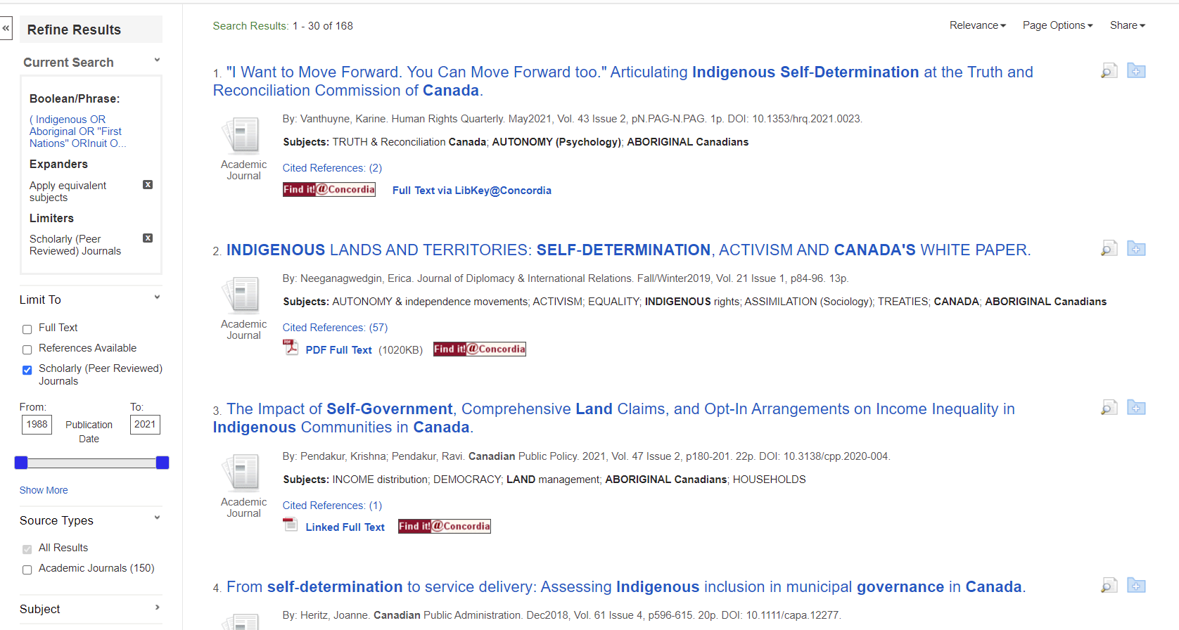
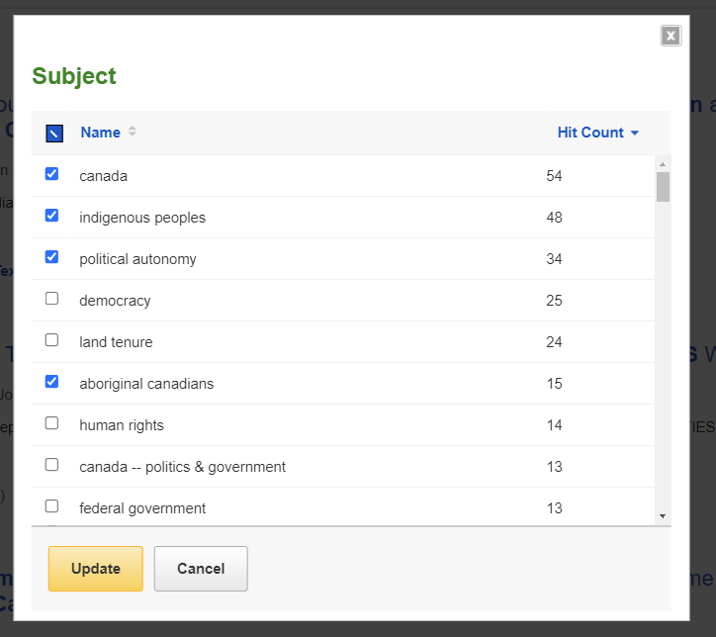
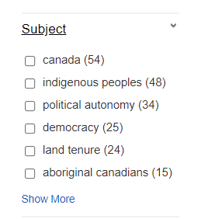

Slide 37
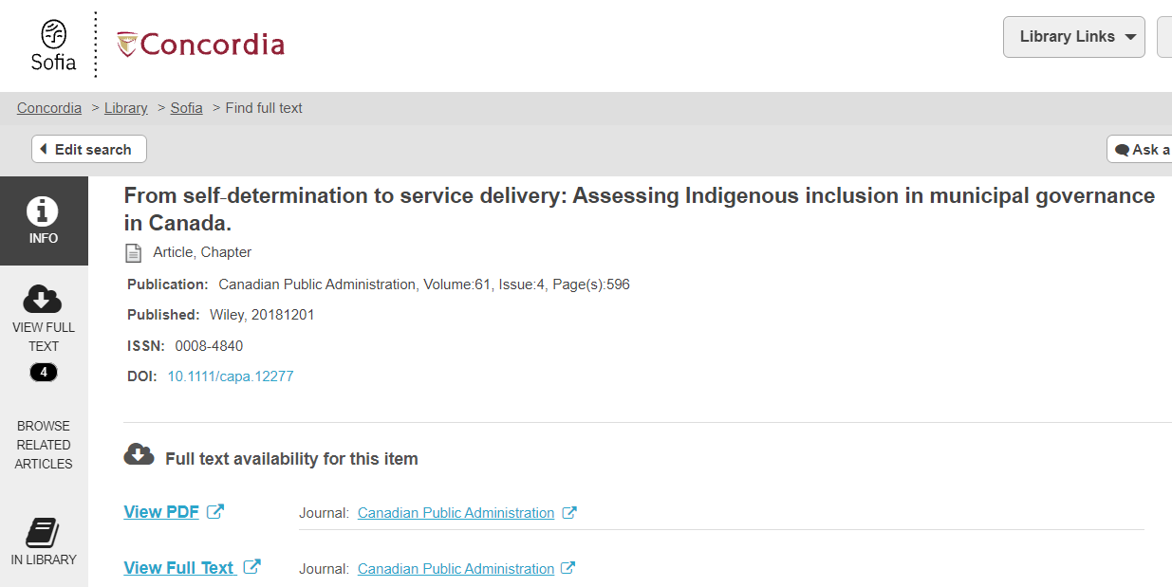
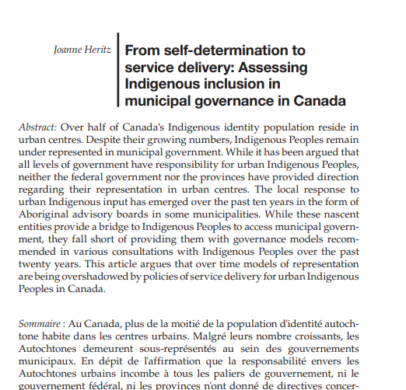
Find it @ Concordia window
Article title
Author
Journal title, date, volume, issue, and pages

Slide 38
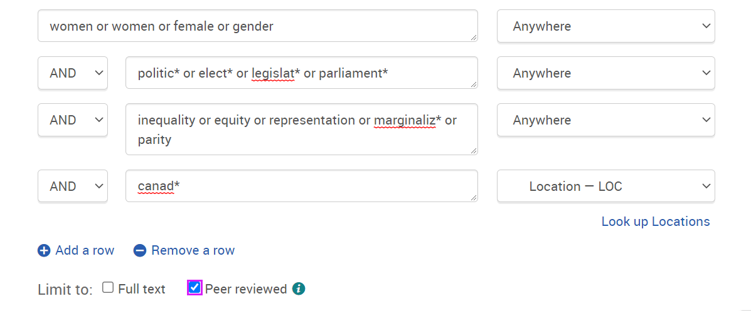

Slide 39
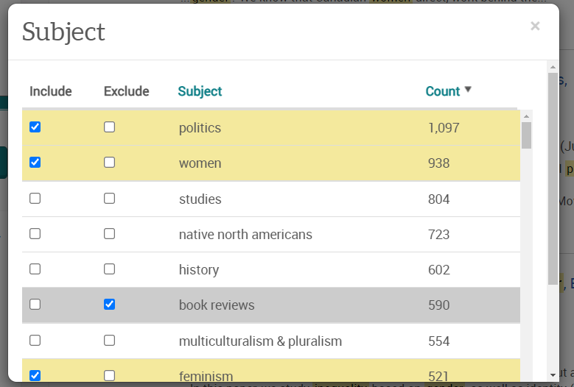
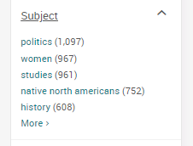

Slide 40
How do I know if an article is academic?
Has the article gone through the peer review process?
What is peer review?
Peer review is a system used to decide if an article should be published in a peer-reviewed journal. Each paper submitted to a peer-reviewed journal is read and evaluated by experts in the article’s subject area.
The reviewers assess the article’s validity, importance, and originality, and then recommend whether it should be printed in the journal.
The reviewers’ suggestions are considered by the journal’s editor, who makes the final decision about whether to accept or reject the article.
Criteria for evaluating academic or scholarly articles

Slide 41
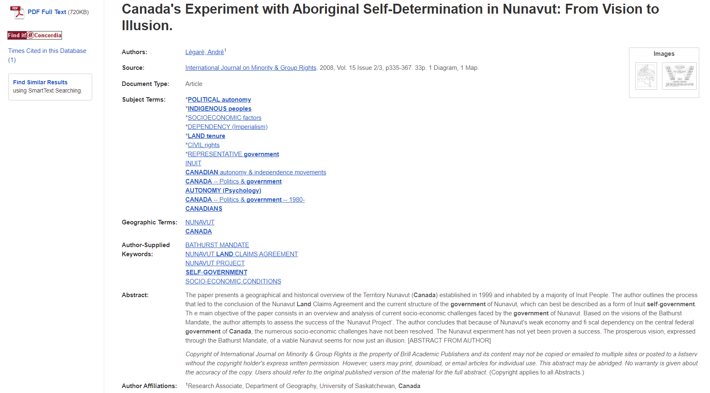
Scholarly articles trend to be 10+ pages long.
Author affiliations

Slide 42
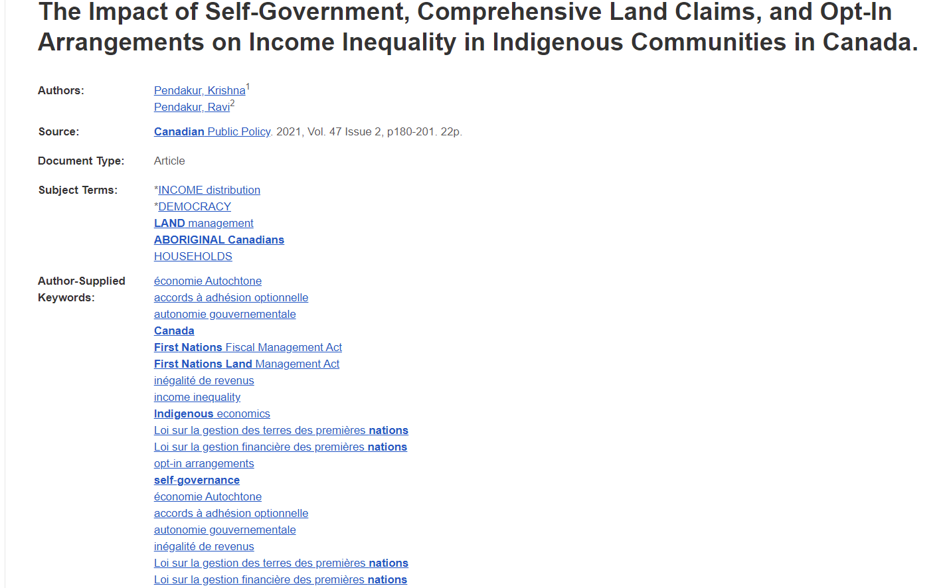
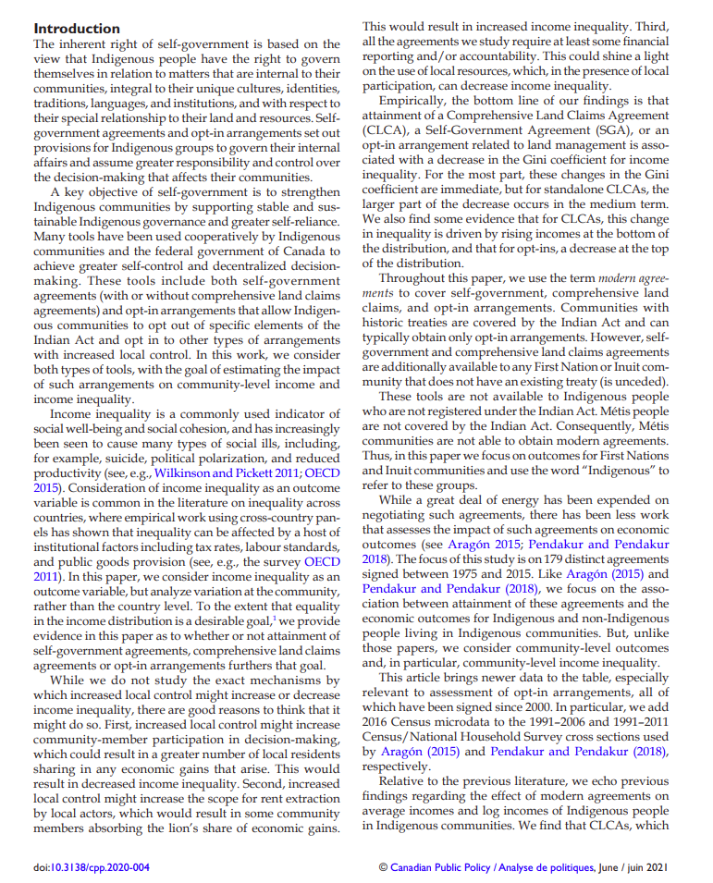
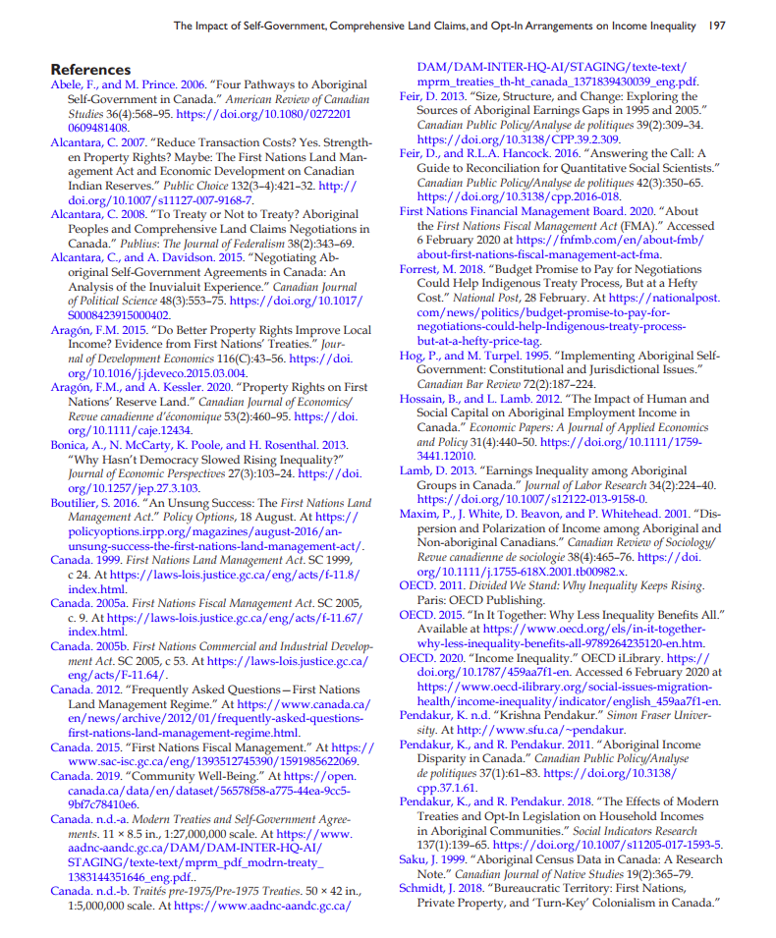
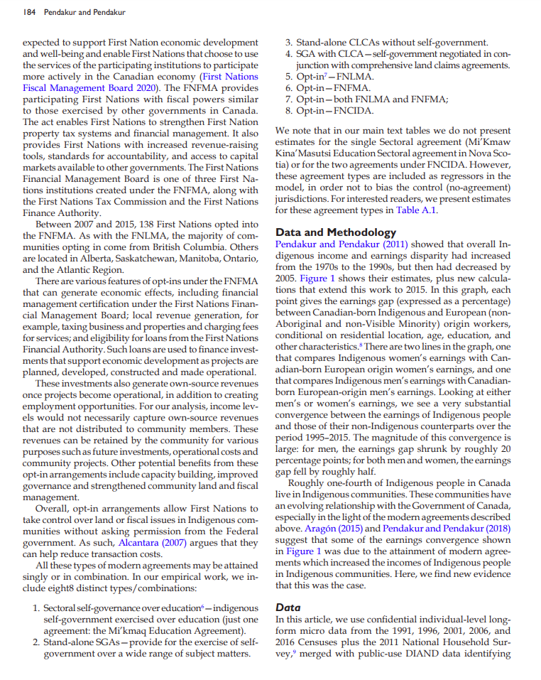
Extensive reference list
Sections
Citations

Slide 43
Elements of a scholarly article to look for:
Length: scholarly articles are longer, usually between 10-30 pages, including a reference list
Credentials/affiliations: authors university departments should be listed, along with contact information
Sections: Many scholarly articles will have similar parts and headings like an abstract, introduction, methodology, literature review and conclusion
Citations: Scholarly articles always cite their sources either with in-text citations or footnotes/endnotes
Reference list: Scholarly articles always provide an extensive reference list/bibliography/works cited list or endnotes, which is a list of sources at the end of the article

Slide 44
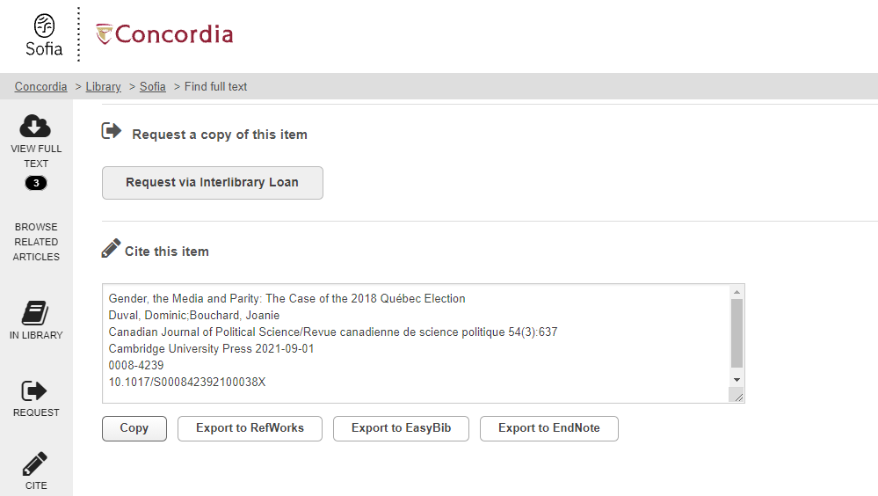
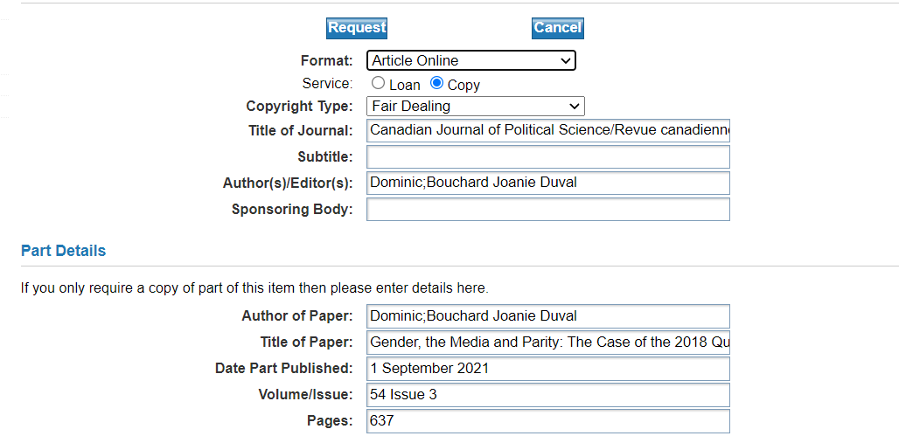
What if Concordia doesn’t have the journal article?

Slide 45
COLOMBO – Interlibrary Loans
Interlibrary loans/COLOMBO
E-Journal Articles
Request e-journal articles from other libraries and a PDF copy will be delivered to your email within a week.
Use the ‘Request via Interlibrary loan’ button in the Find it @ Concordia page to request a specific article.

Slide 46
Citation guides

Slide 47
Need help, ask us!

