Slide 1
POLI 203: Intro to Comparative Politics Library Workshop
Michelle Lake
Michelle.Lake@Concordia.ca

Slide 2
Who am I?
Michelle Lake, librarian for Political Science, the School of Community and Public Affairs, First Peoples Studies and Government Publications
Michelle.Lake@Concordia.ca / Zoom Office Hours – Wednesdays 2-4pm
What do I do?
Provide research support
Help students with library databases
Help students find and access materials they need
Help with citation issues
Choose the books we buy for the above subject areas

Slide 3
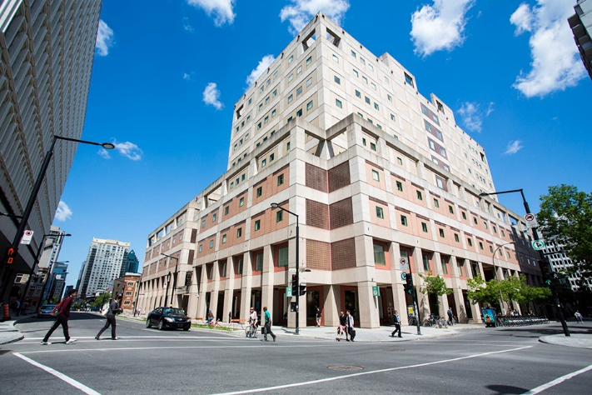
The Librar(ies)
Webster Library – SGW Campus
24/7 access, with student card, after 11pm
2nd, 3rd, 4th, and 5th floor of LB - “Library Building”
Poli Sci, Government Info, Maps, History, Social Sciences, Humanities, Engineering & Fine Arts
Interlibrary Loans
Current Print Journals
Vanier Library – Loyola Campus
24/7 access, with student card, after 11pm
1st, 2nd, and 3rd floor VL – “Vanier Library”
Sciences, Psychology, Communications & Journalism
Special Collections
Print Journal Archive

Slide 4
Library: in person
Services such as the loans desk, Ask Us desk and chat help are not open 24/7, check the library website for hours if you need a particular service.
Course Reserves room is open - you will need to use the call number of a book to locate them in course reserves
Procedural masks need to be worn at all times in the library.

Slide 5
Library Services
Your student card is your library card. You need it to borrow books, borrow a laptop, print and access the library during 24/7 hours.
You can borrow up to 100 print items at a time and renew them online, if no one else requests them. Borrow a laptop for 24 hours or a tablet for 3 days.
Webster library has 5 book scanners that can be used for free to scan chapters from our print books and email them to yourself as a PDF.
To use Library databases, access online articles and ebooks when you are off campus, login with your MyConcordia Netname and password.

Slide 6
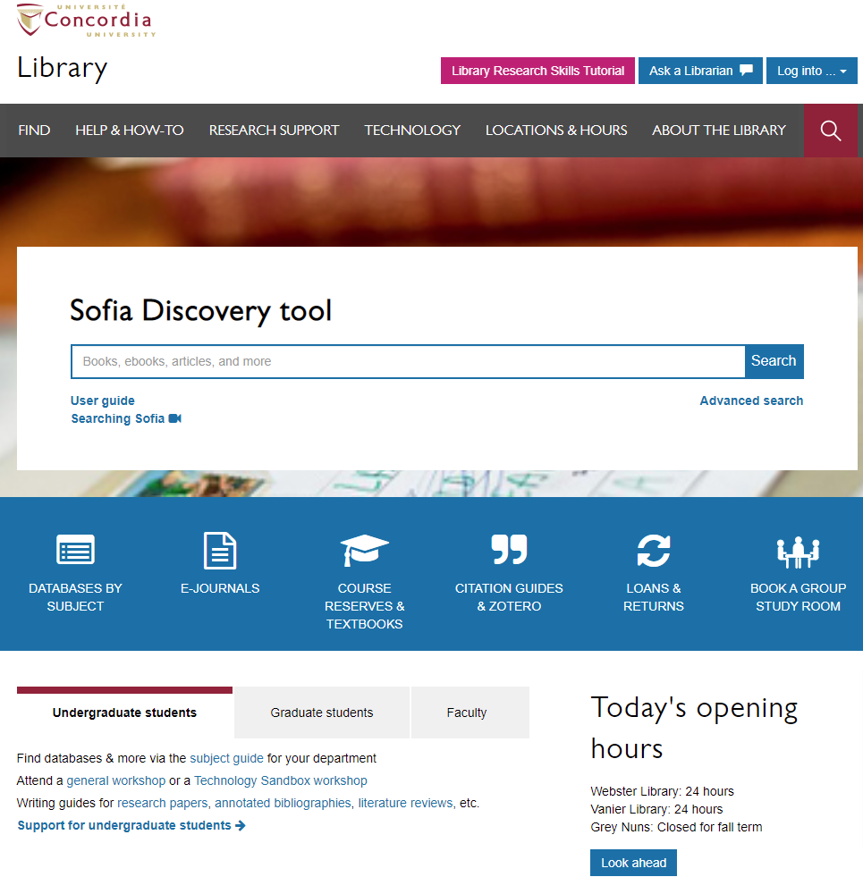
Library website: https://library.concordia.ca/
Use Ask a Librarian chat to ask questions about library research
Use the Sofia Discovery tool to find print books, ebooks, and journal articles from the library.
Book a study room in the library for 2 or more people to use for up to 3 hours
Find your subject guide for your topic area

Slide 7
Locating items when you have the citation information

Slide 8
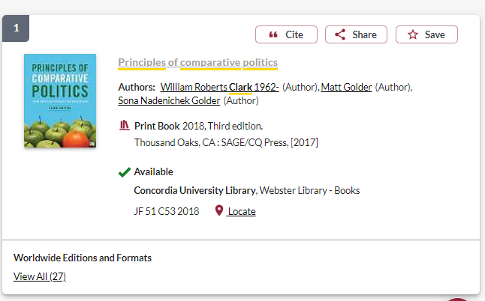
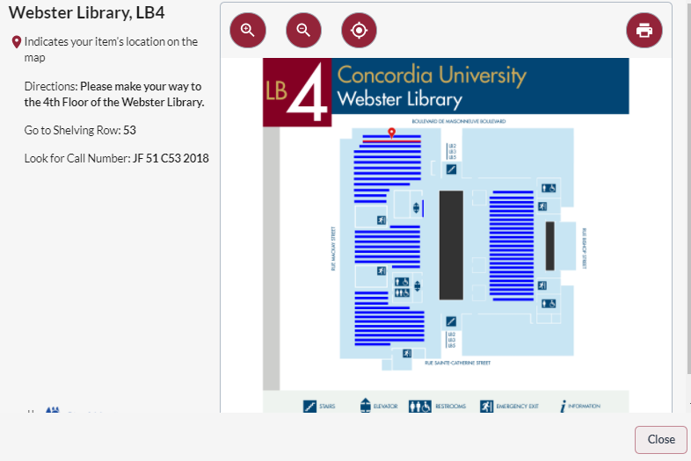
Clark, W.R., Golder, M., & Golder, S.N. (2017). Principles of comparative politics. California: Sage/CQ Press.

Slide 9
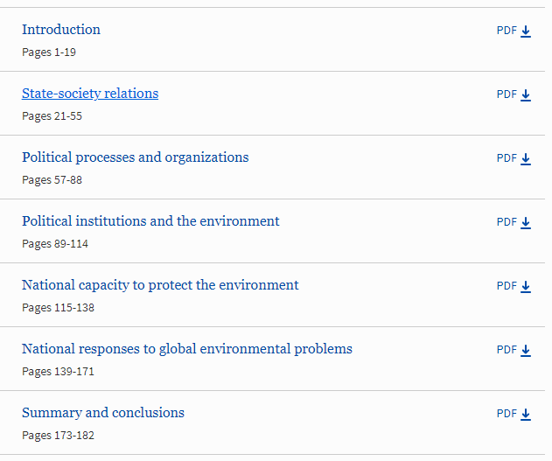
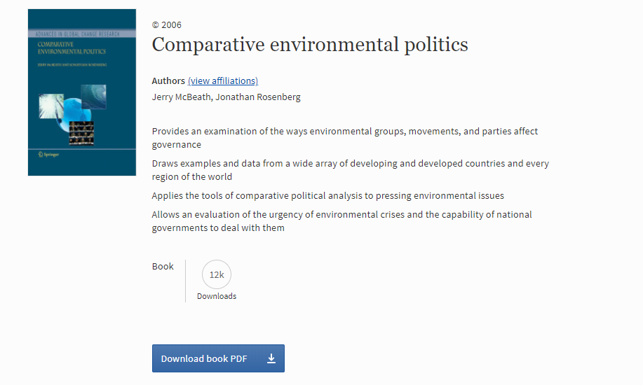
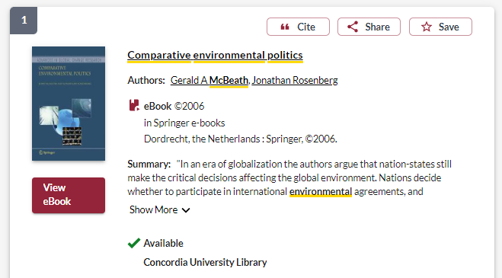
McBeath, G.A., & Rosenberg, J. (2006). Comparative environmental politics. Netherlands: Springer.

Slide 10
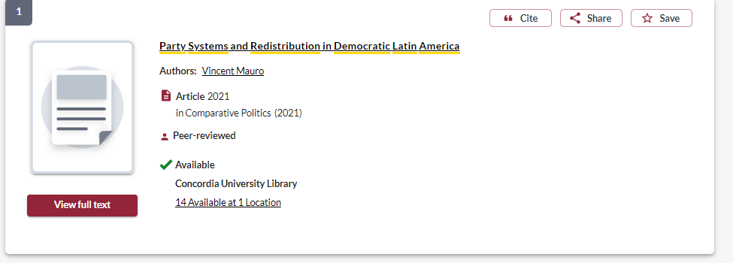
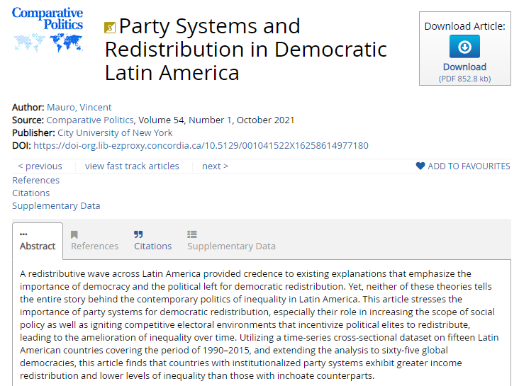
Mauro, V. (2021). Party systems and redistribution in democratic Latin America. Comparative Politics 54(1): 1-23.

Slide 11
Breaking down a topic & Search strategies

Slide 12
Search Tips
AND –limits how many results your search produces
Example: security AND politics
OR –increases the number of results your search produces
Example: state OR government
“ ” -exact phrase, limits your search results
Example: “international cooperation”
*- truncation: retrieves all words that start with the letters entered and expands search results
Example: peace* finds peace, peacebuilding, peacemaking, peacekeeping

Slide 13
Avoid Searching with Linking words
Effects
Impact
Consequences
Influence
Results
Importance
Significance
Response
Emphasis
Each author may use different linking words when discussing similar topics.
You don’t want your search to be limited to those books and articles that only contain the word “effect” or “consequence”

Slide 14
Canada remains the only Western country with an exclusively first-past-the-post electoral system. Assess the prospects for electoral reform federally and provincially. How likely is such a reform? Would such reform increase the representation of women, Indigenous peoples, and racialized communities?

Slide 15
Breaking down a topic
Main ideas
Synonyms/Alternative terms
Canada
First-past-the-post electoral system
Electoral reform
Federal/provincial
Representation of women
Indigenous peoples
Racialized communities
Canadian
FPTP, plurality
Proportional representation
Government

Slide 16
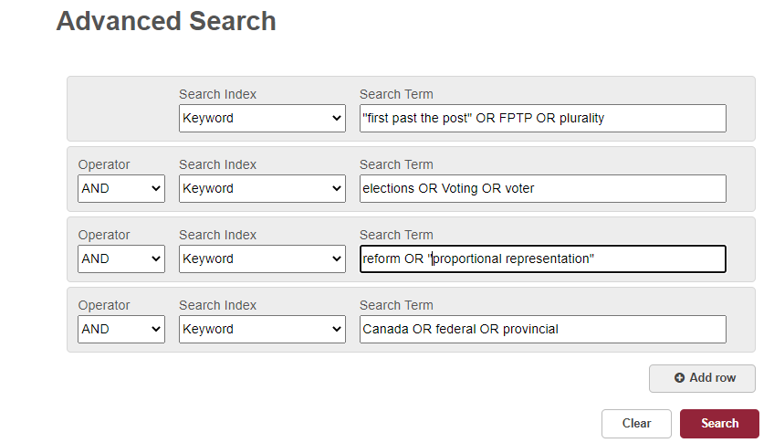
Searching Sofia for scholarly books
AND / OR need to be in ALL CAPS to function in the databases

Slide 17
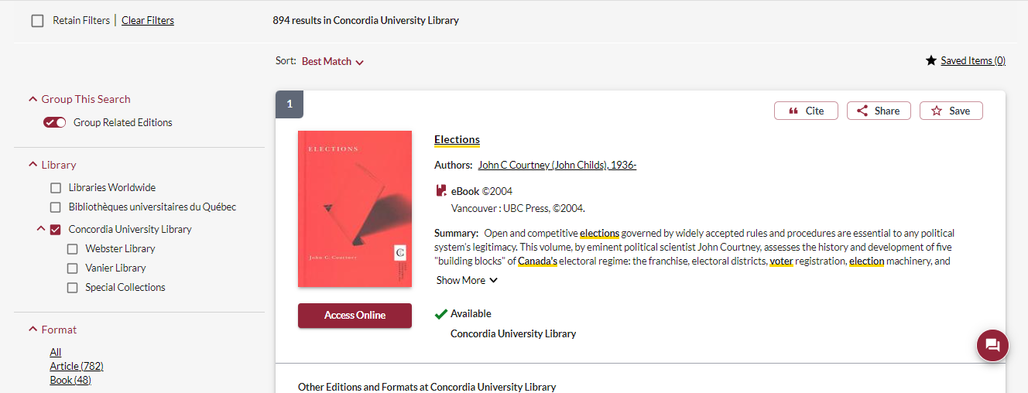
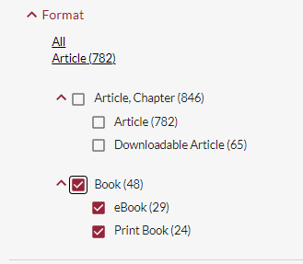
If a book has a university press as a publisher, it is likely a scholarly book
You can use the options from the left hand menu to narrow down to print books or ebooks

Slide 18
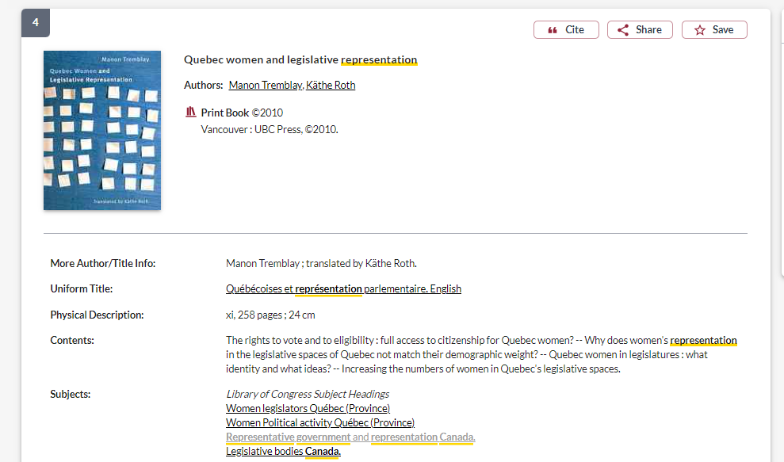
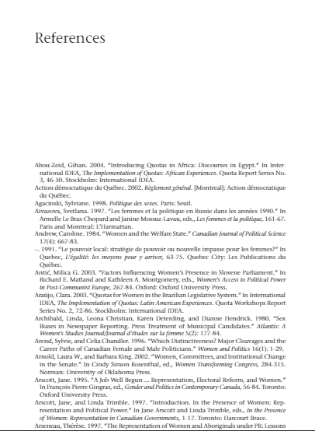
Scholarly books will always have an extensive reference list at the end of the book, or the end of each chapter
Scholarly books should be a couple hundred pages long

Slide 19
Scholarly, Peer Reviewed Articles

Slide 20
go the Library website under:
HELP & HOW-TO
Subject & Course Guides
Social Science
Political Science

Slide 21
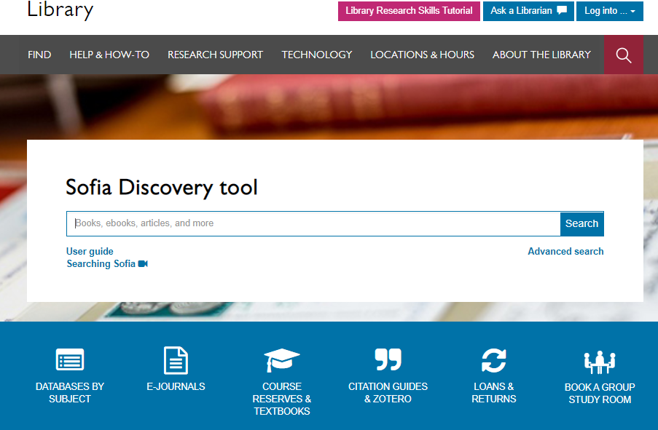

Slide 22
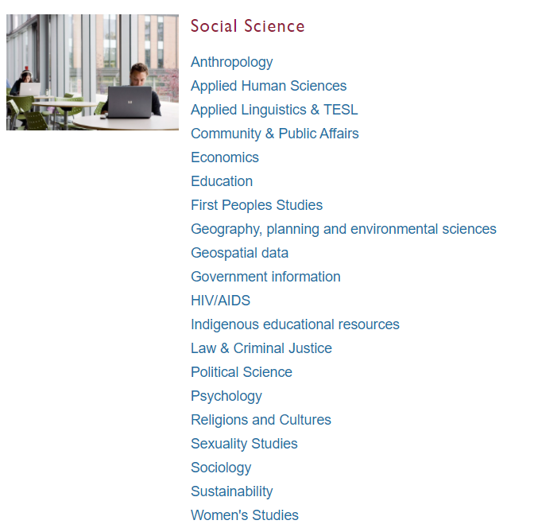
Subject Guide: Political Science

Slide 23
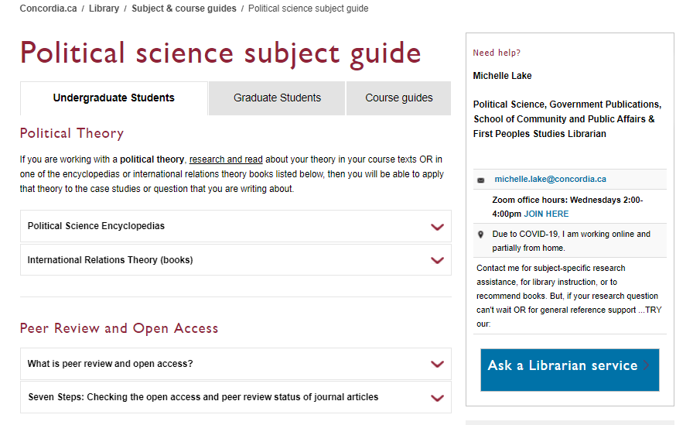
Scroll down to locate the database list

Slide 24
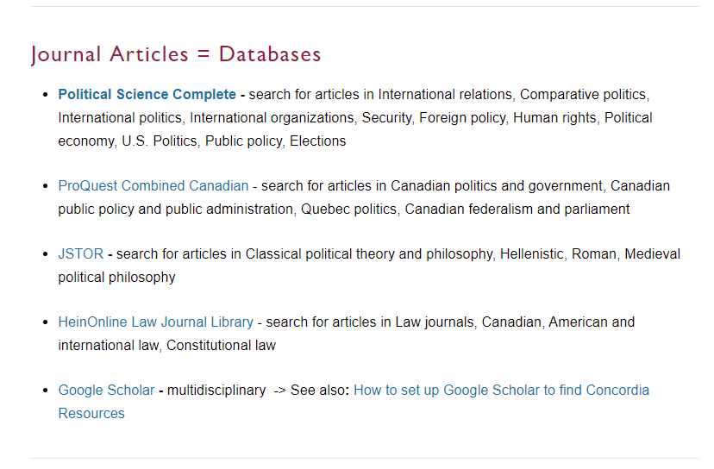
1. Start here: Largest POLI database
2. A good database for Canadian journal articles (not political science focused)
Ensure Google Scholar is set up to provide you with Concordia sources

Slide 25
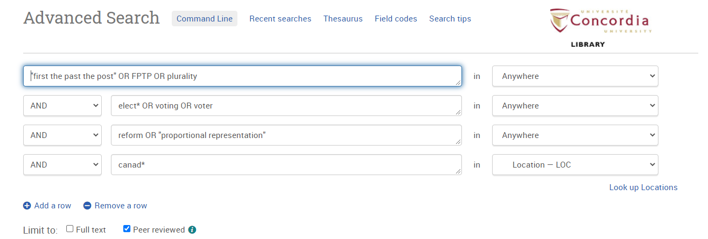
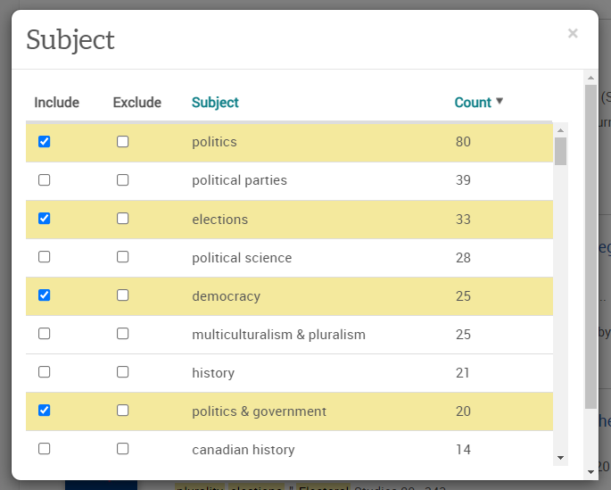
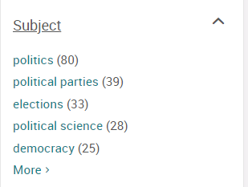
Make sure you select peer review only
Choose Location, to search for Canada as a place rather than just a keyword

Slide 26
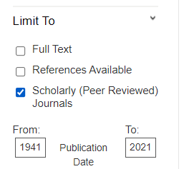
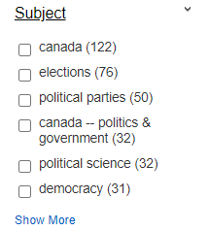
Choose GE to search Canada as a location rather than just a keyword
"first past the post" OR FPTP OR plurality OR reform OR "proportional representation"
AND elect* OR voting OR voter OR vote*
AND Canad*

Slide 27
How do I know if an article is scholarly?
Has the article gone through the peer review process?
What is peer review?
Peer review is a system used to decide if an article should be published in a peer-reviewed journal. Each paper submitted to a peer-reviewed journal is read and evaluated by experts in the article’s subject area.
The reviewers assess the article’s validity, importance, and originality, and then recommend whether it should be printed in the journal.
The reviewers’ suggestions are considered by the journal’s editor, who makes the final decision about whether to accept or reject the article.
Criteria for evaluating academic or scholarly articles

Slide 28
Elements of a scholarly article to look for:
Length: scholarly articles are longer, usually between 10-30 pages, including a reference list
Credentials/affiliations: authors university departments should be listed, along with contact information
Sections: Many scholarly articles will have similar parts and headings like an abstract, introduction, methodology, literature review and conclusion
Citations: Scholarly articles always cite their sources either with in-text citations or footnotes/endnotes
Reference list: Scholarly articles always provide an extensive reference list/bibliography/works cited list or endnotes, which is a list of sources at the end of the article

Slide 29
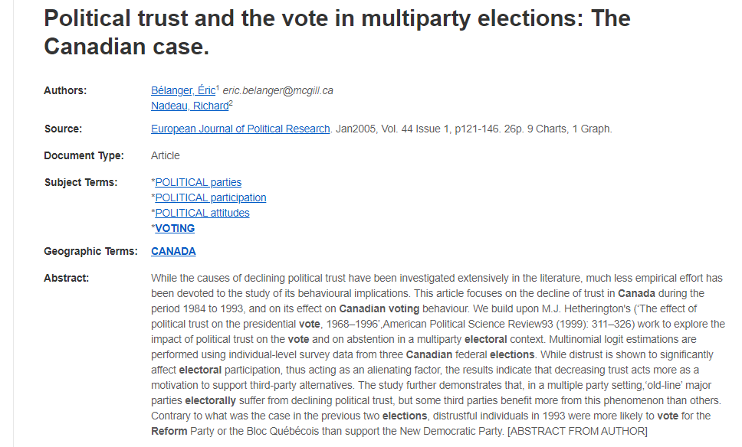
Length, scholarly articles are generally 10+ long.
Charts, graphs, tables, figures are often features of scholarly articles
Author affiliations: scholarly articles have authors associated with universities

Slide 30
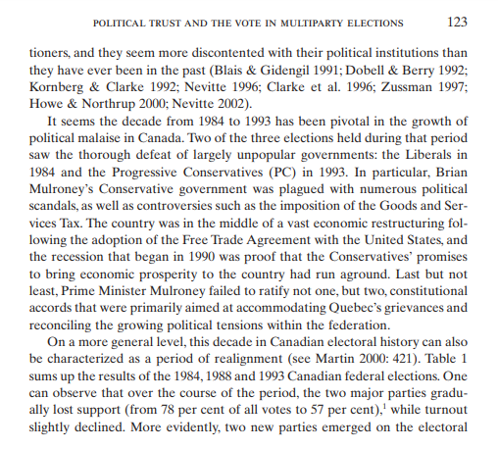
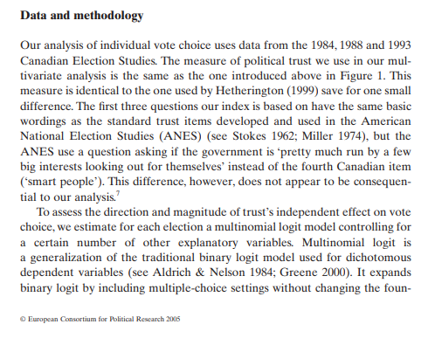
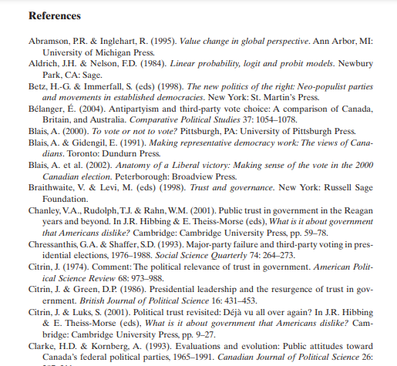
Scholarly articles generally have standard sections like: abstract, introduction, literature review, methodology or methods, results and conclusion
Scholarly articles always contain citations (either in text, footnotes or endnotes, citing other books and articles)
Scholarly articles always have a reference list of the books, articles and other sources cited in the article, either as a reference list, works cited, bibliography, footnotes or endotes

Slide 31
How do I access articles from the databases?

Slide 32
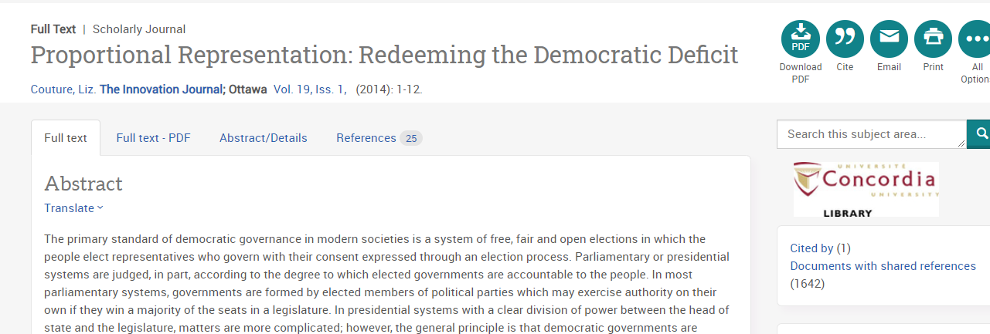
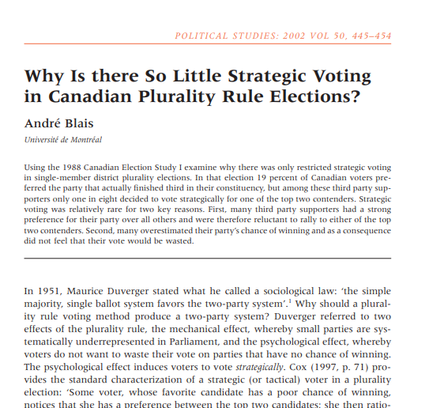
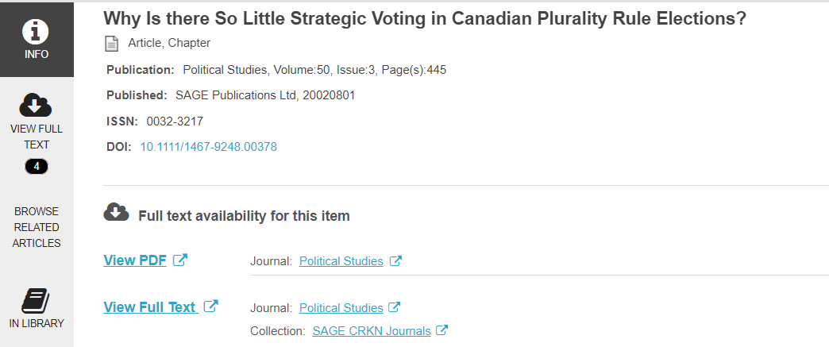

Slide 33
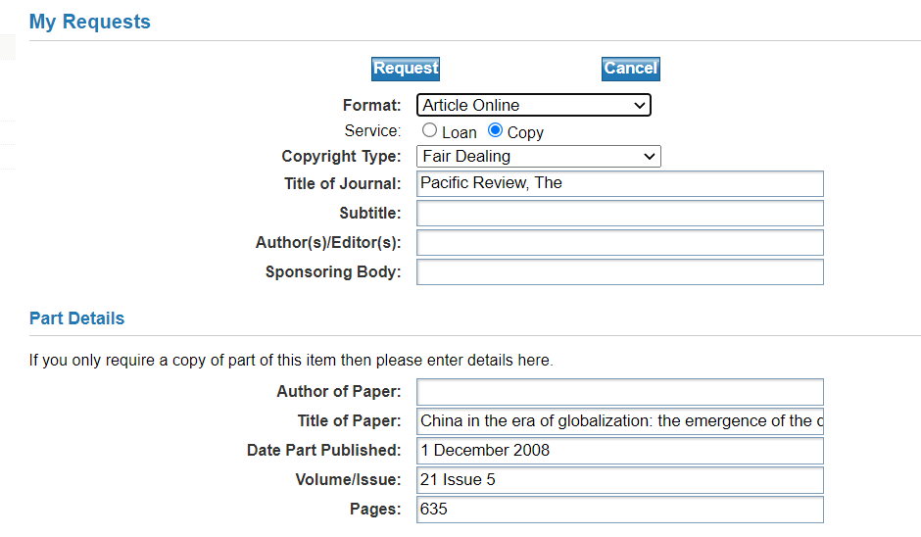
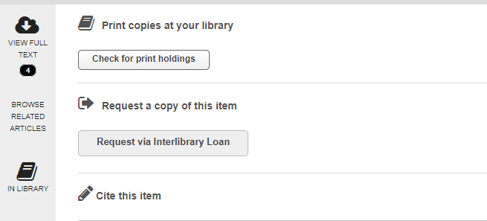
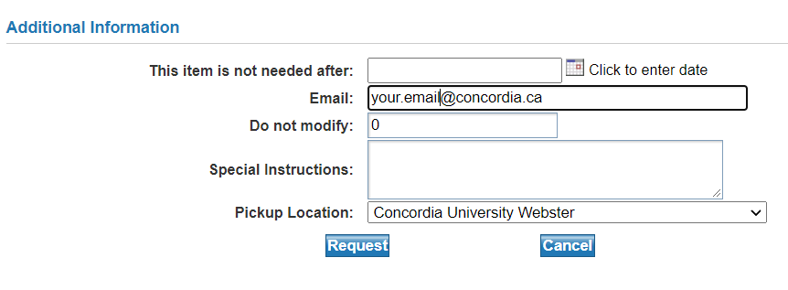
What if there is no PDF access to the article?

Slide 34
COLOMBO – Interlibrary Loans
Interlibrary loans/COLOMBO
E-Journal Articles
Request e-journal articles from other libraries and a PDF copy will be delivered to your email within a week.
Use the ‘Request via Interlibrary loan’ button in the Find it @ Concordia page to request a specific article.

Slide 35
Citation Resources
Chicago Manual of Style: Link
Help and How to: How to Cite
Library Research Skills Tutorial: Citing
Workshop: Zotero for Bibliographies

Slide 36
Need help, ask us!
Michelle.Lake@Concordia.ca

