Slide 1
POLI 203/2 C:Intro to Comparative Politics Library Workshop
Michelle Lake
Political Science, SCPA, FPST and Government Publications Librarian
Michelle.Lake@Concordia.ca

Slide 2
Who am I?
Michelle Lake, librarian for the School of Community and Public Affairs, First Peoples Studies, Political Science, and Government Publications
Michelle.Lake@Concordia.ca / Make an appointment or ask a question
What do I do?
Provide research support
Help students with library databases
Help students find and access materials they need
Help with citation issues
Choose the books we buy for the above subject areas

Slide 3
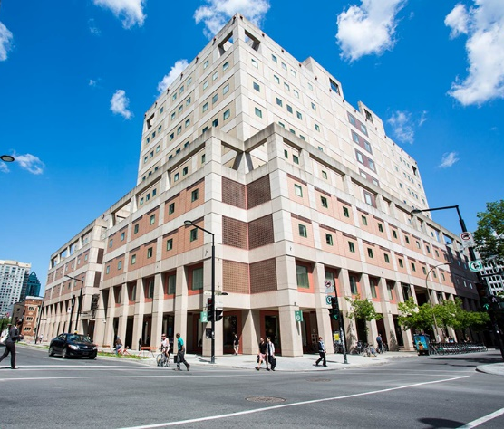
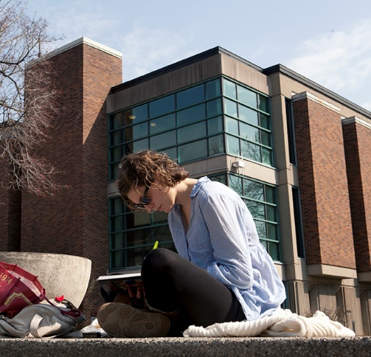
The Librar(ies)
24/7 access, with student card, after 11pm
Webster Library (LB) – downtown on SGW campus & Vanier Library (VL) on Loyola campus
Webster: Social Sciences, Humanities, Business, Engineering & Fine Arts
Vanier: Science(s), Health, Communications, Journalism and Psychology
Course Reserves Room(s): have the required undergraduate print textbooks for the courses taught at that campus (for example: Webster has the Political Science and SCPA course reserves)

Slide 4
Library Services
Your student card is your library card.
You need it to:
borrow books (up to 100 a time)
borrow a laptop and other technology (for 24 hours)
print on campus (add money to your Dprint account)
access the library overnight during 24/7 hours.
Webster library has 5 book scanners (And Vanier has 2!) that can be used for free to scan chapters from our print books and email them to yourself as a PDF.
To use Library databases, access online articles and ebooks when you are off campus, login with your MyConcordia Netname and password.

Slide 5
Electronic Course Reserves

Slide 6
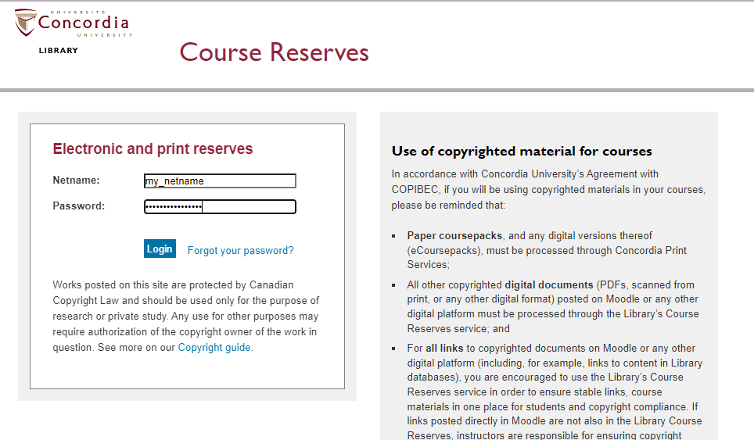

Slide 7
Political Science Subject Guide

Slide 8
go the Library website under:
HELP & HOW-TO
Subject & Course Guides
Social Science
Political Science

Slide 9
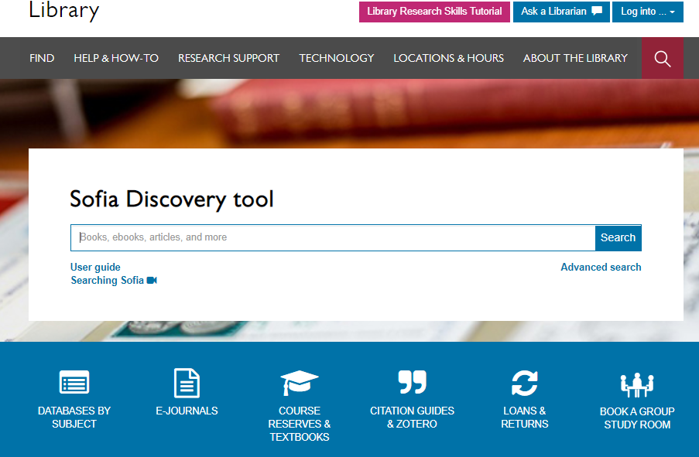

Slide 10
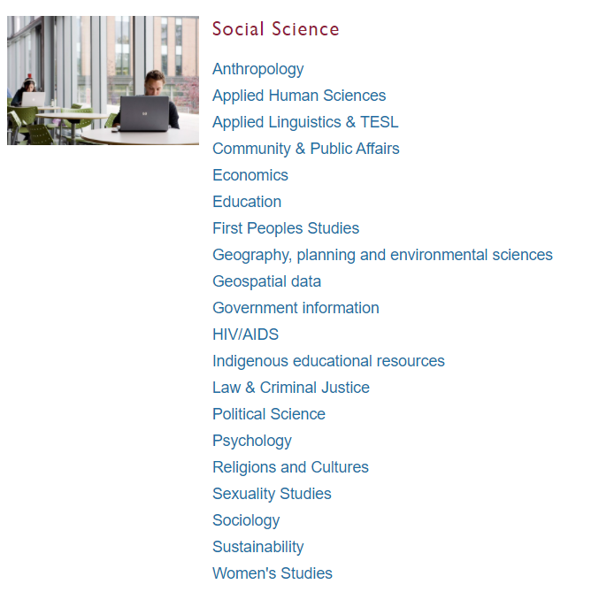
Subject Guide: Political Science

Slide 11
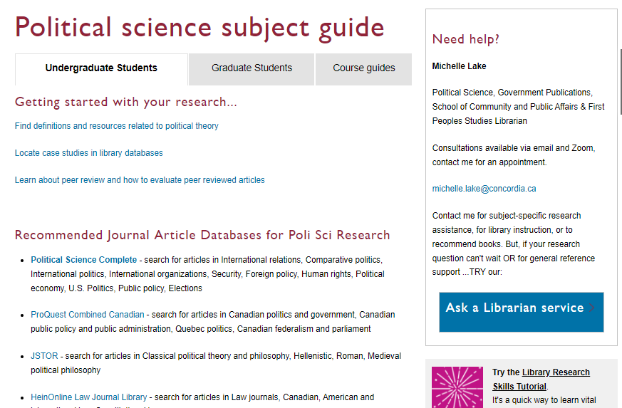

Slide 12
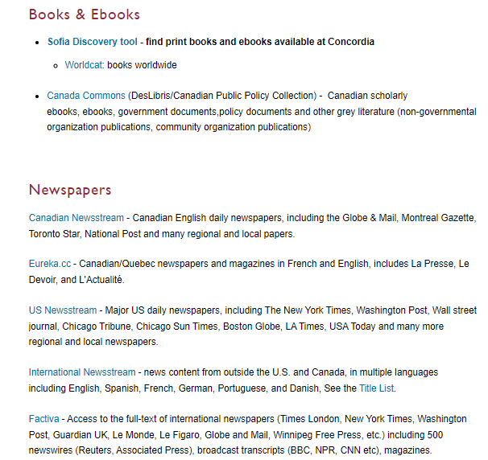
Use Sofia to find books, book chapters and locate some journal articles
Use one of the newsstream databases to find newspaper articles from Canadian, American or International news sources

Slide 13
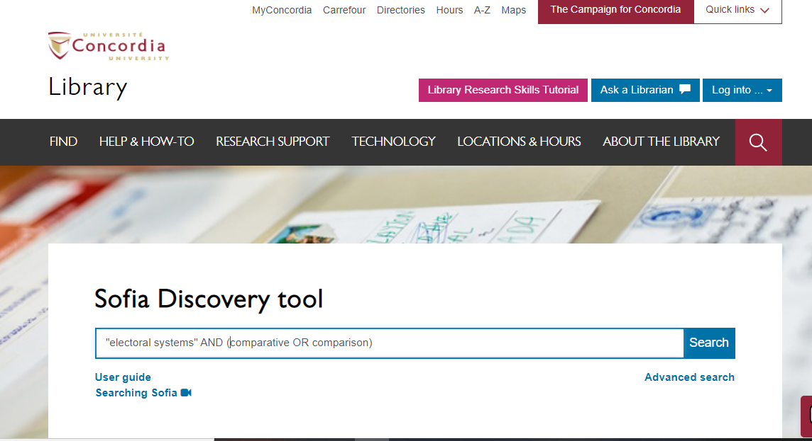

Slide 14
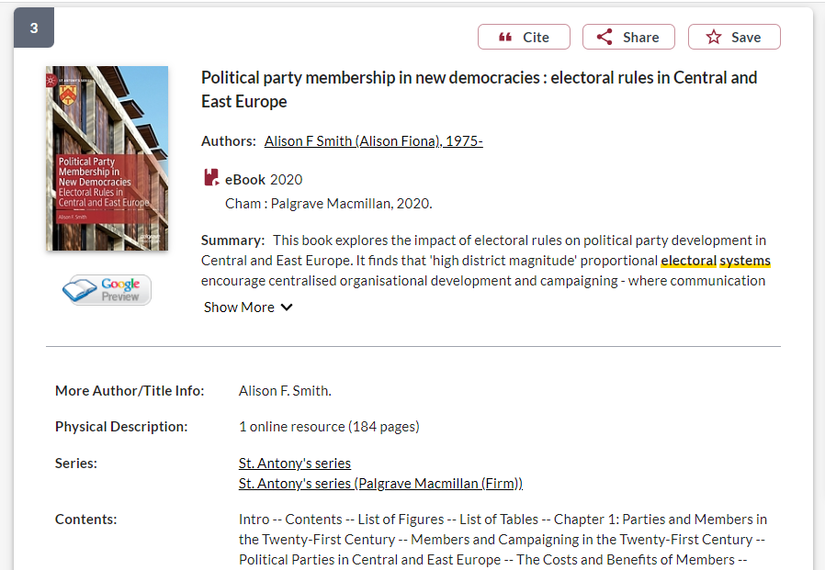
Single authored monograph
Format of the item
Single author

Slide 15
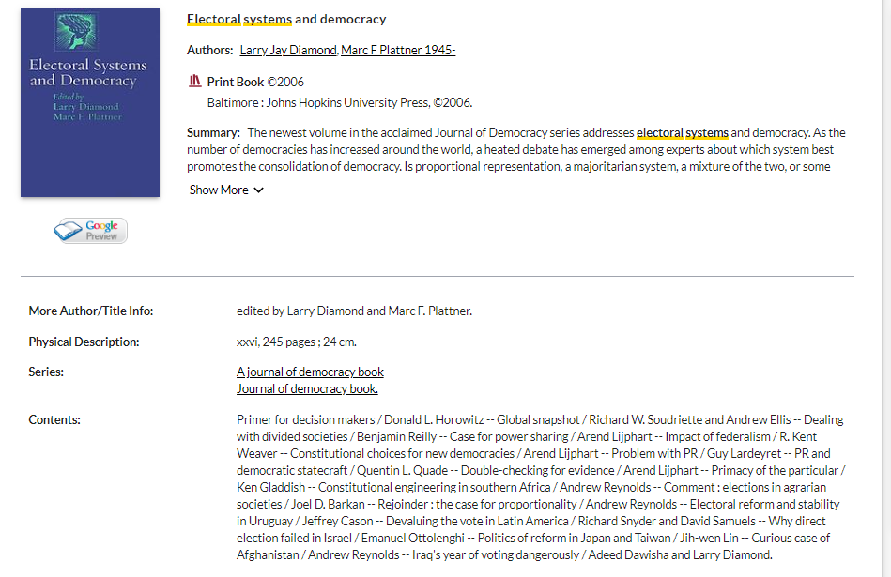
Format of the item
Book chapter within an edited volume
Edited book
Each chapter has its own author

Slide 16
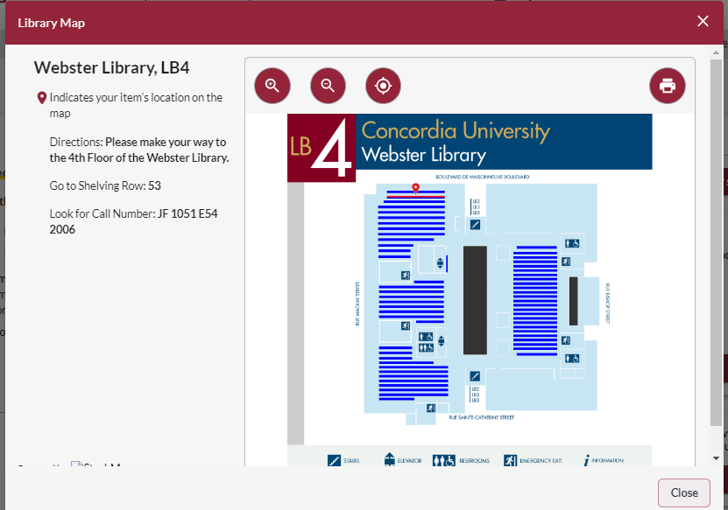
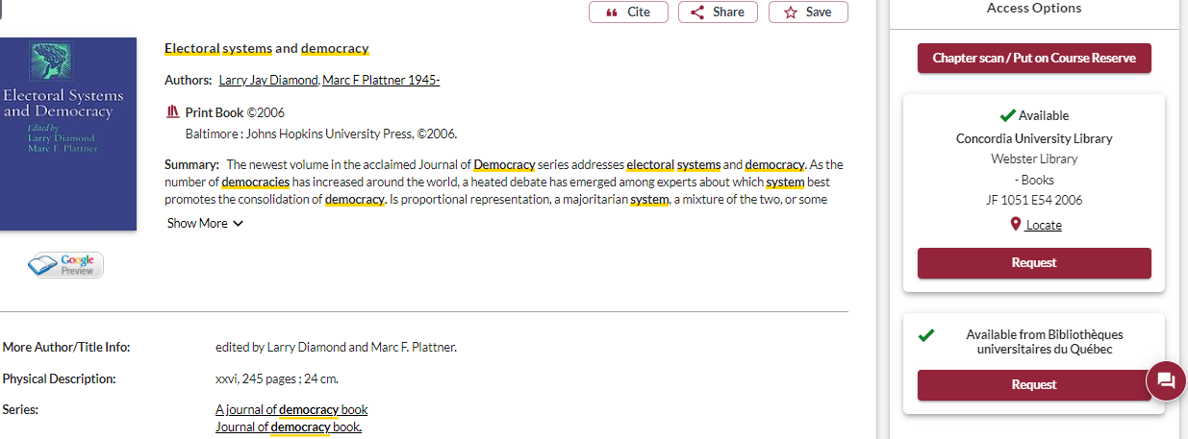
How to access print books

Slide 17
Co-authored academic journal article
Format of item
Volume and issue, also signal this is a journal article

Slide 18
Finding newspaper articles

Slide 19
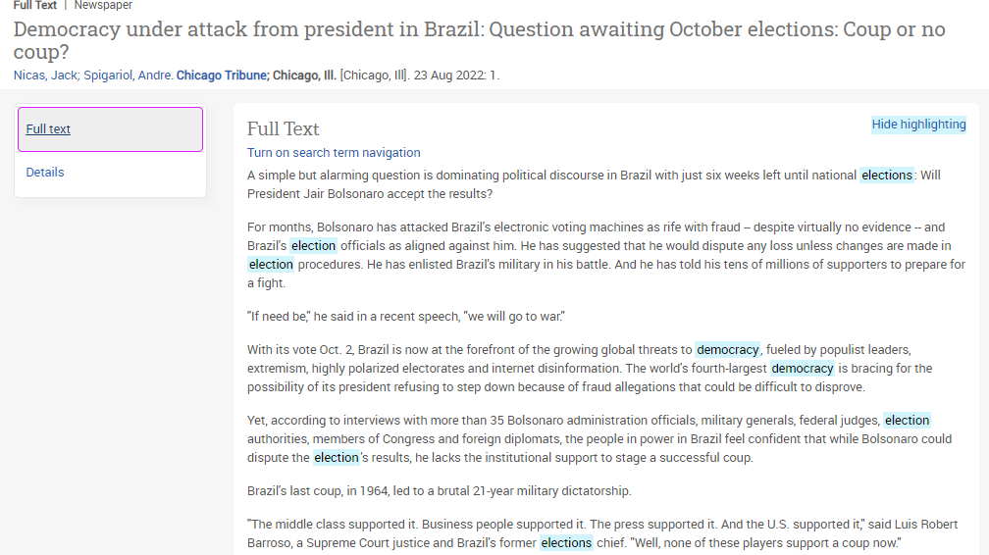
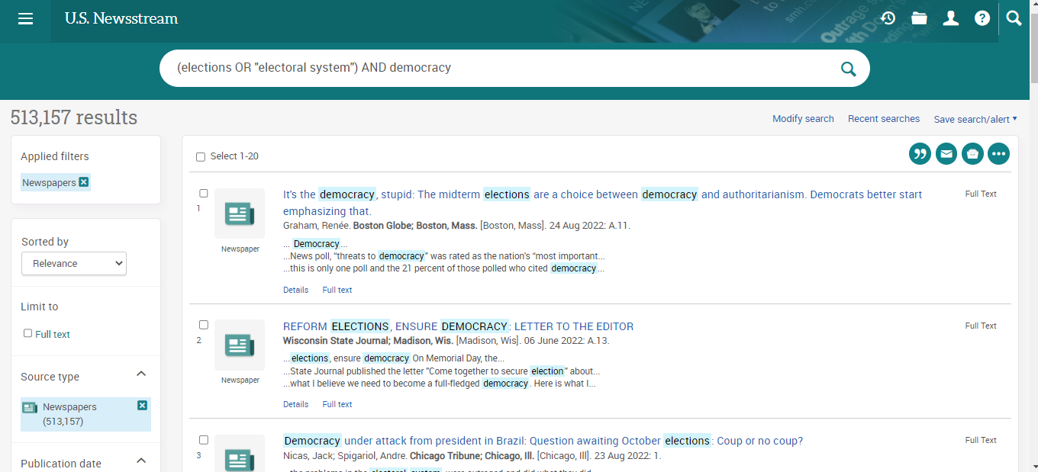

Slide 20
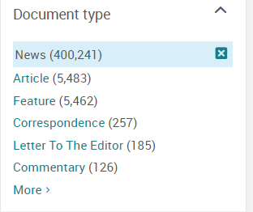
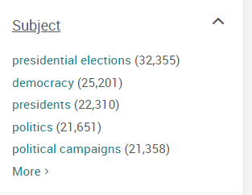
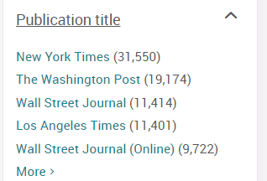
Use the limits menu to narrow your results
By part of the newspaper/by format
By subjects in the article
By the title of the newspaper

Slide 21
How do you start your research? Where do you look first?

Slide 22
Breaking down a topic & Search strategies

Slide 23
How do we combine search words for the best possible results?
AND: combines concepts and limits your results
politics AND security
state OR government
“climate change”
“international cooperation”
OR: allow you to insert synonyms or alternative terms and increases your results
“quotation marks”: If you put two or more words in quotation marks, that exact phrase will be searched and limits your results.

Slide 24
Avoid Searching with Linking words
Effects
Impact
Consequences
Influence
Results
Importance
Significance
Response
Emphasis
Causes
Each author may use different linking words when discussing similar topics.
You don’t want your search to be limited to those books and articles that only contain the word “effect” or “consequence”

Slide 25
Explain the role that ideology and political institutions played in understanding the Brexit vote in the 2016 referendum in the United Kingdom
Key Idea | Keywords
Ideology | Ideologies, beliefs, values, populism
Political Institutions | Government, political parties, parliament
Brexit/2016 Referendum | EU referendum, Euroscepticism
United Kingdom | UK, Great Britain

Slide 26
Find books

Slide 27
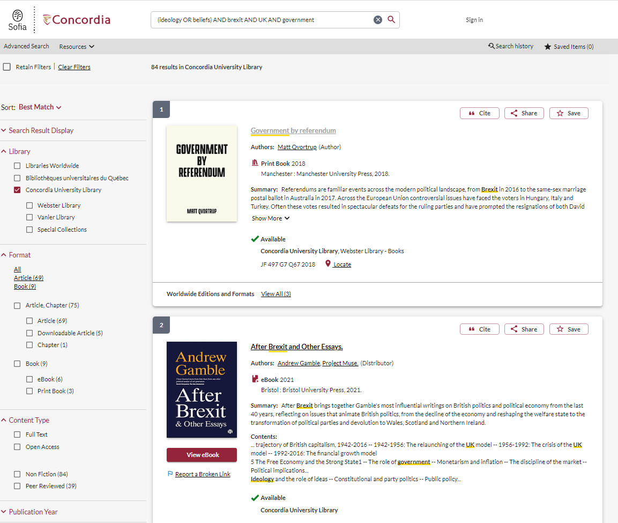
Narrow down by format, are you looking for books? articles?

Slide 28
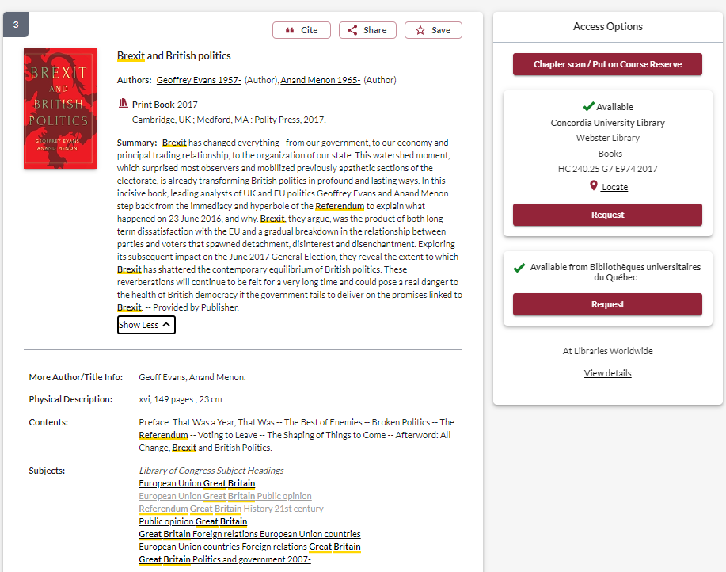
Look for useful subject headings and click for more resources

Slide 29
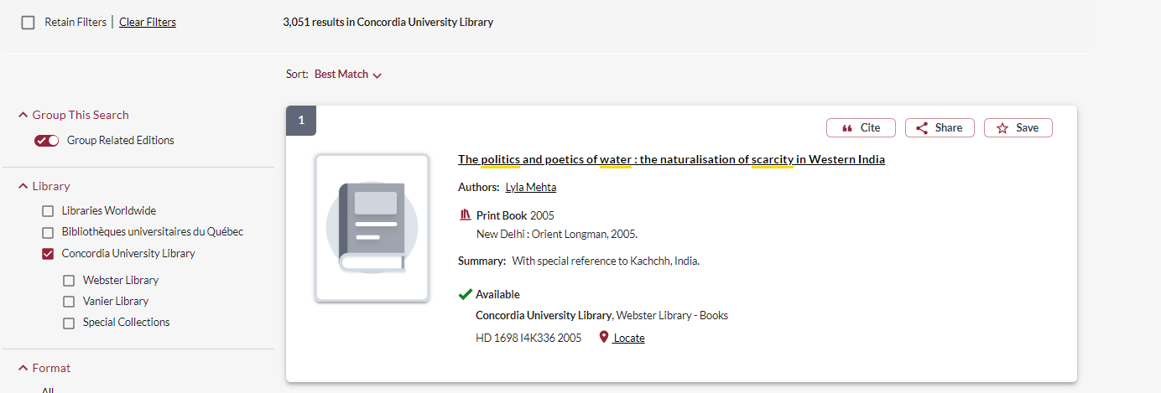
Network Loans

Slide 30
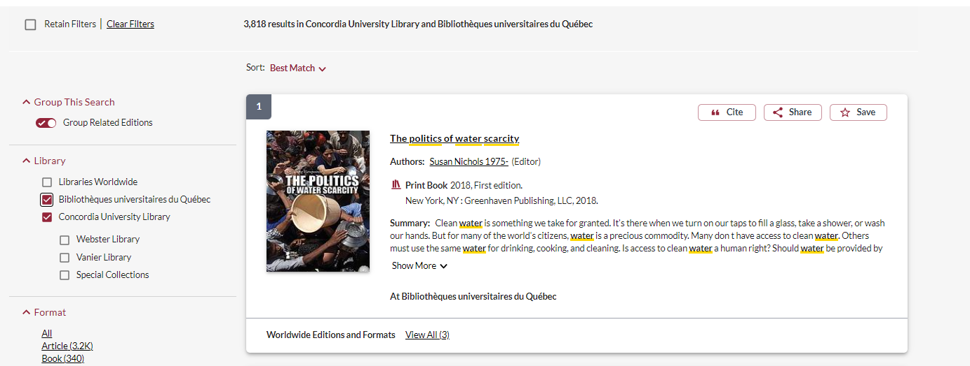
Request the book and it will be delivered to Concordia for your use

Slide 31
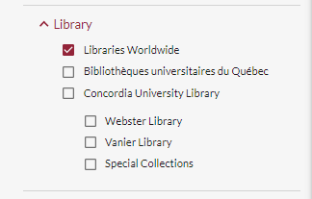
Request a book via Interlibrary Loan
I found this book searching in ‘Libraries worldwide’ and it is not in Concordia’s collection, or in any Quebec university libraries

Slide 32
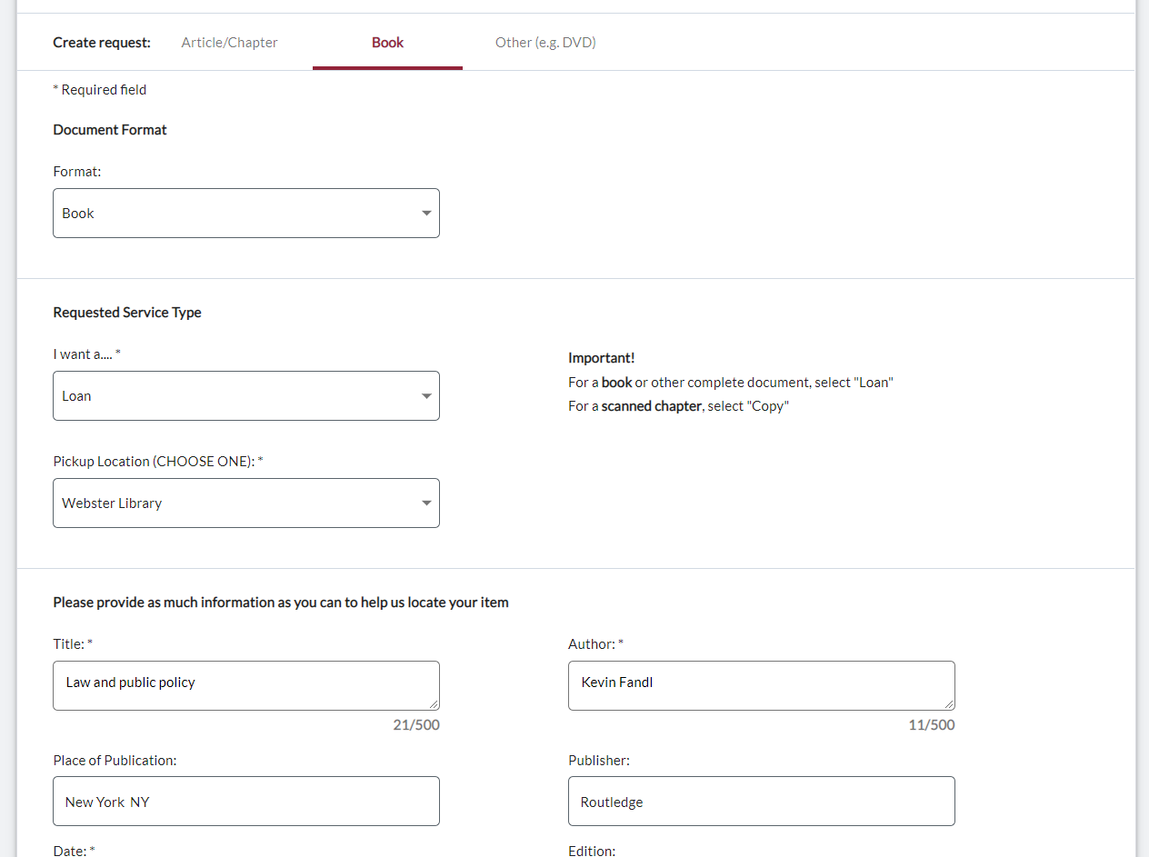

Slide 34
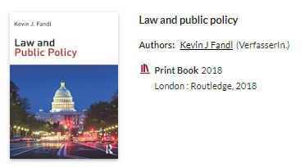
Check the status of your request under the "Requests" tab.​

Slide 35
Finding scholarly journal articles

Slide 36
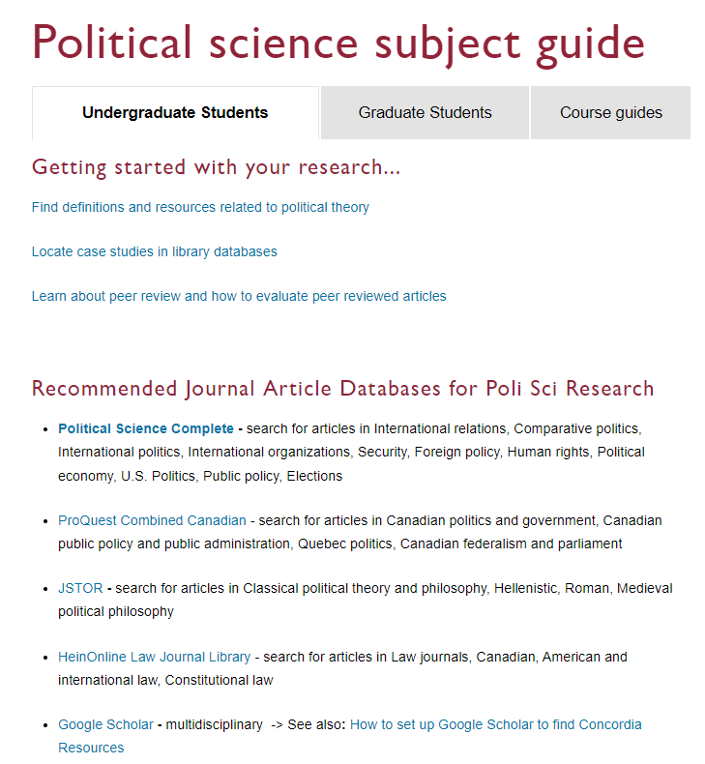
Political Science Complete is the best place to start your journal article research

Slide 37
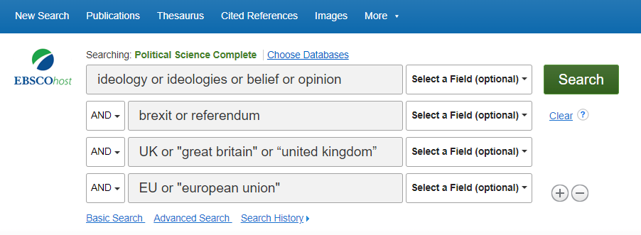
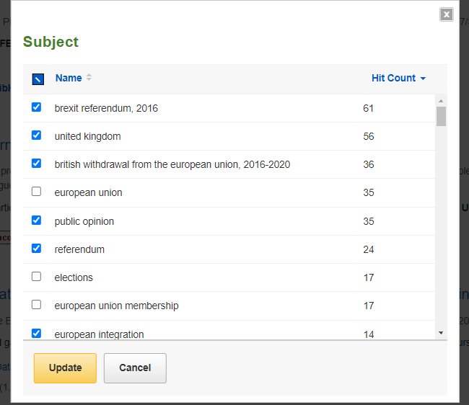
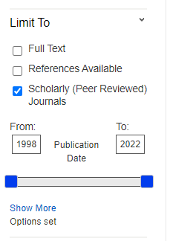
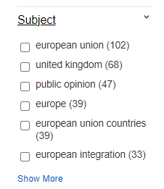

Slide 38
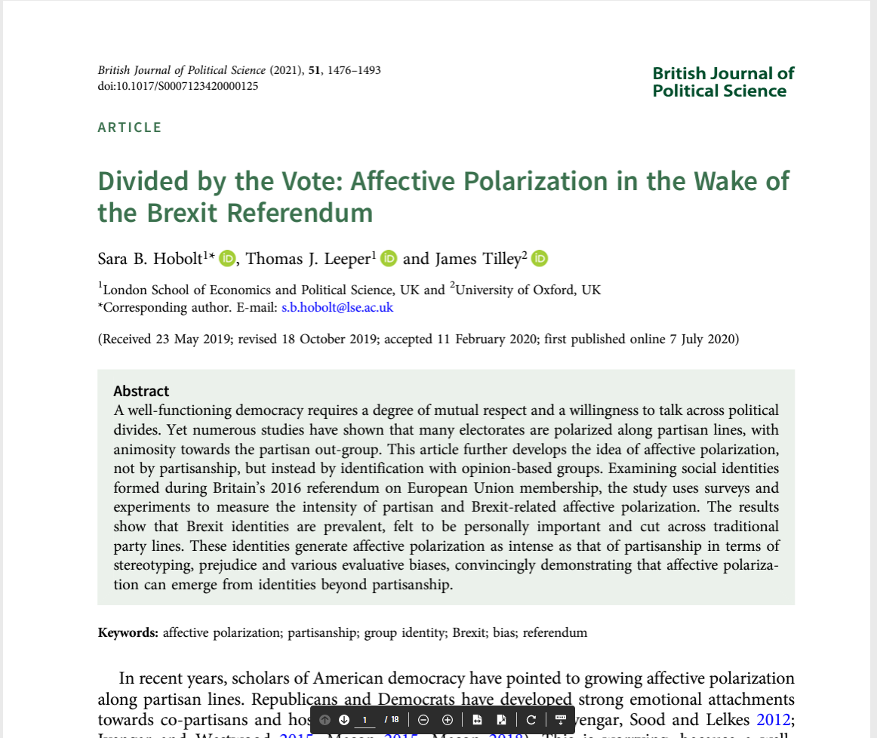
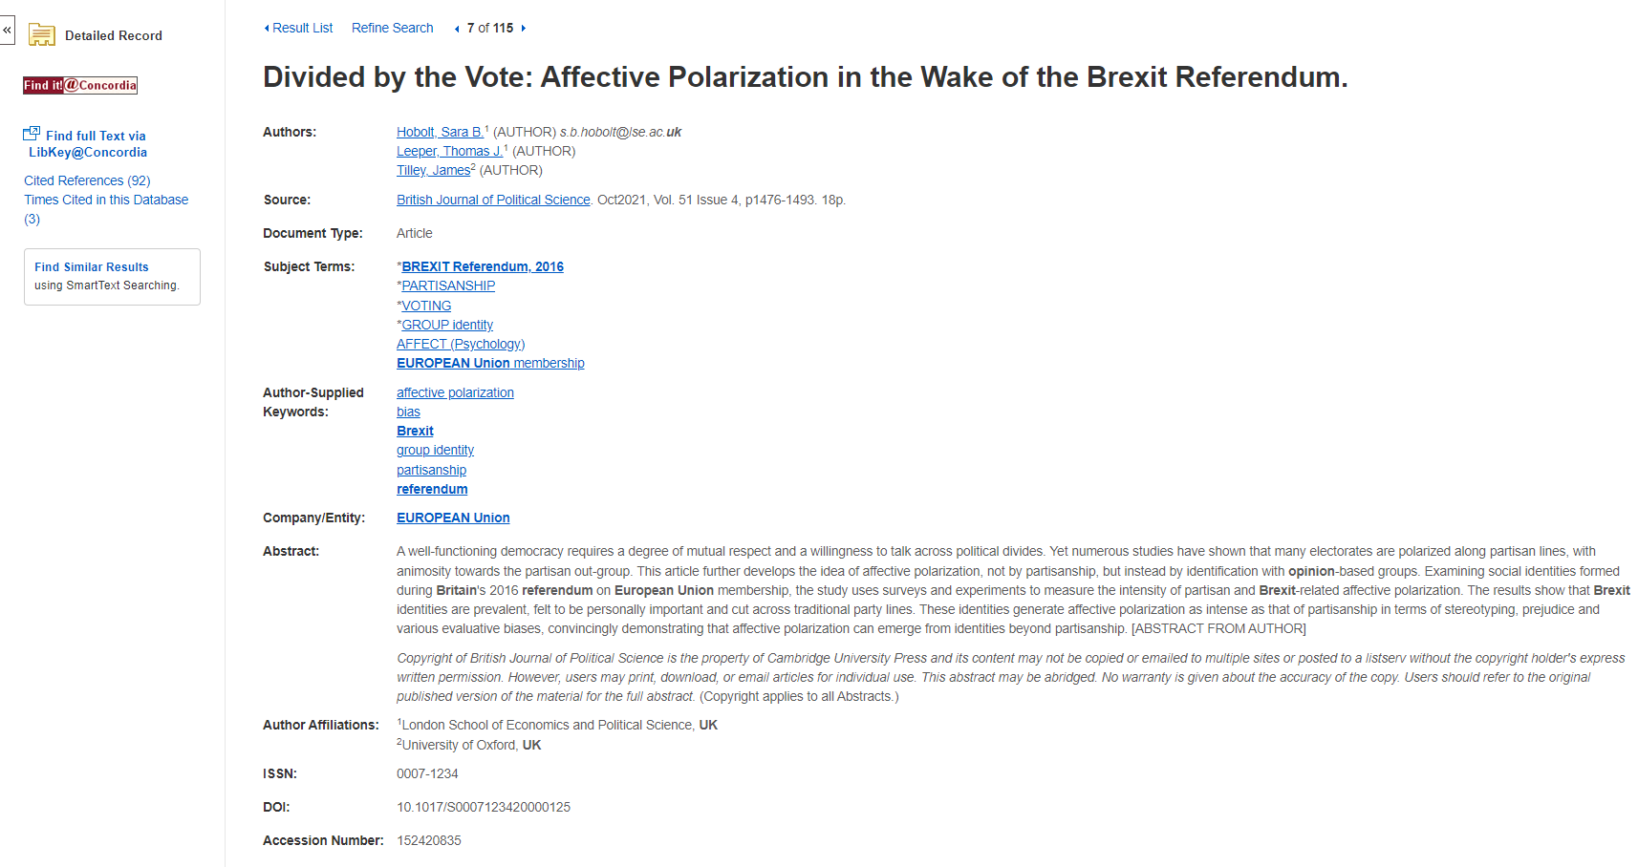
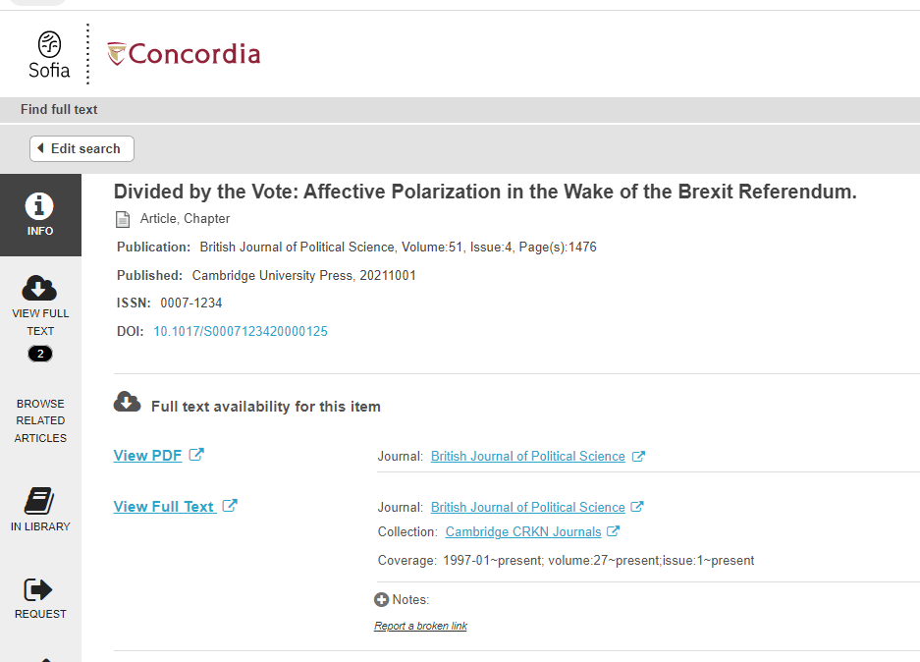
Use find it @ Concordia to find the article if the PDF is not in the database

Slide 39
What is peer review? What are peer reviewed, scholarly articles?

Slide 40
Has the article gone through the peer review process? What is peer review? Peer review is a system used to decide if an article should be published in a peer-reviewed journal. Each paper submitted to a peer-reviewed journal is read and evaluated by experts in the article’s subject area. The reviewers assess the article’s validity, importance, and originality, and then recommend whether it should be printed in the journal. The reviewers’ suggestions are considered by the journal’s editor, who makes the final decision about whether to accept or reject the article. Criteria for evaluating academic or scholarly articles

Slide 41
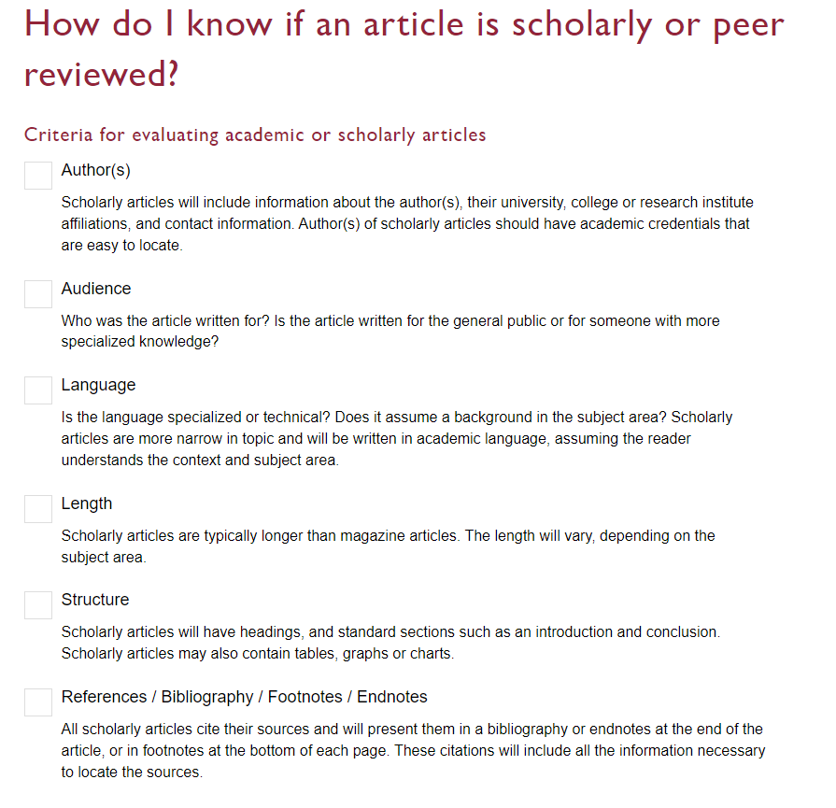

Slide 42
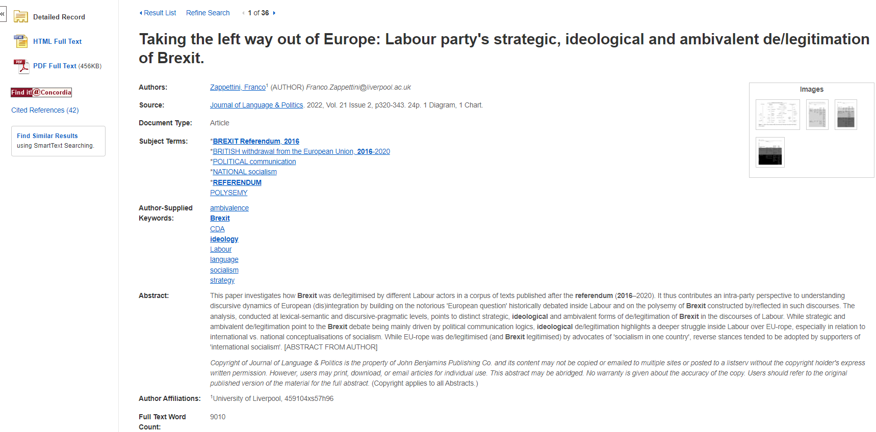
Author
Length: 10-30 pages

Slide 43
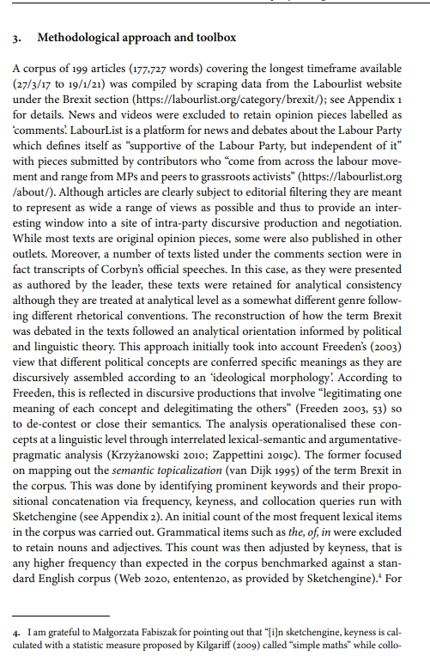
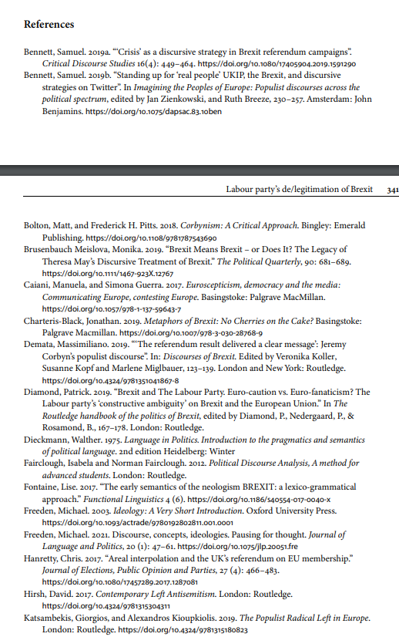
Structure: sections including abstract, intro, methods, literature review, conclusion
Language & audience
Extensive reference list ad citations

Slide 44
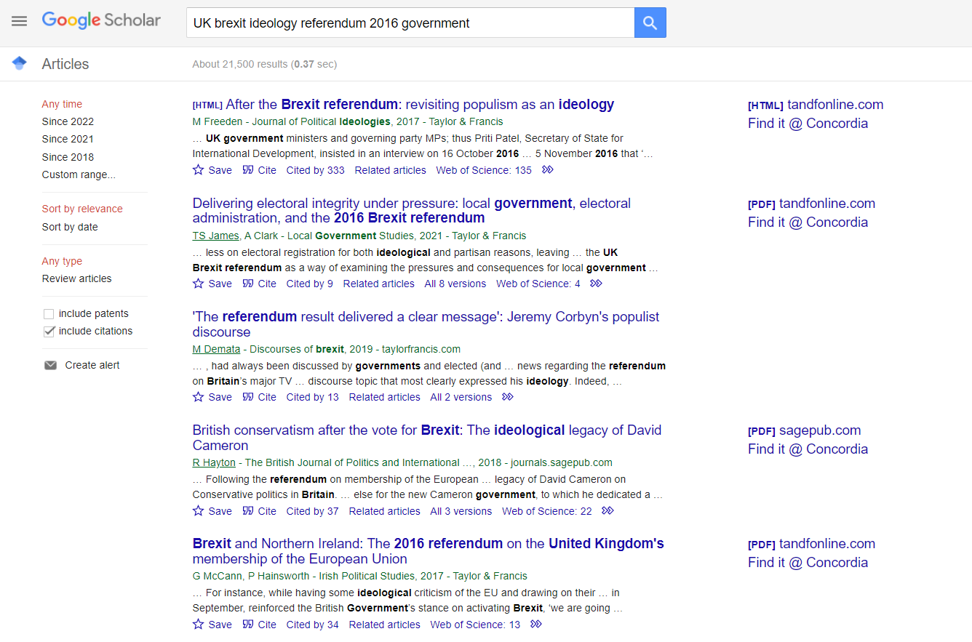

Slide 45
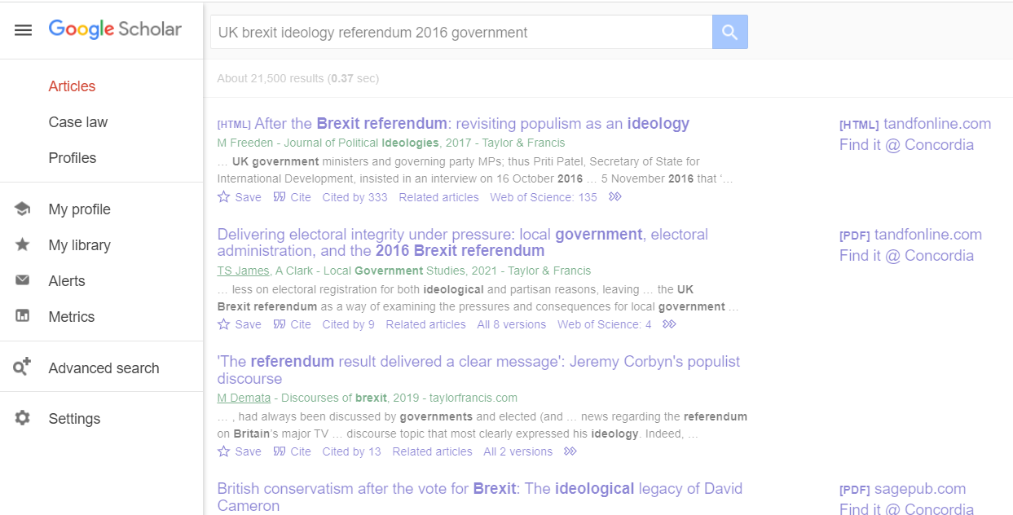
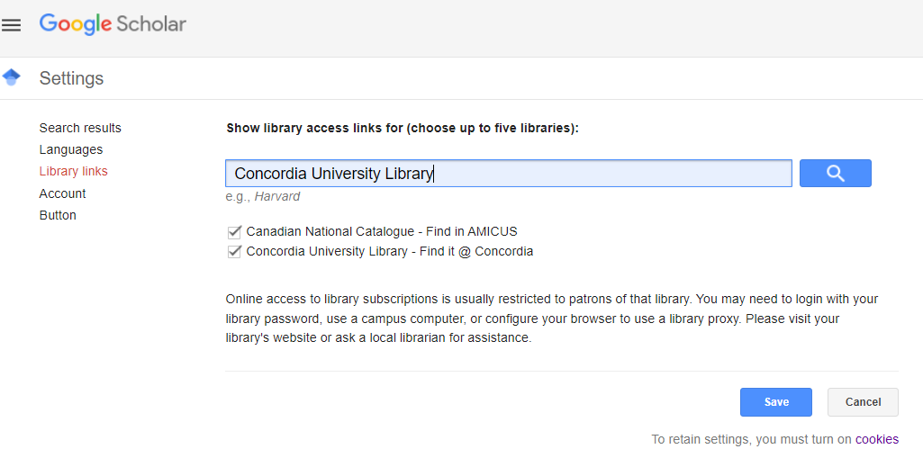

Slide 46
Finding government and international agency publications

Slide 47
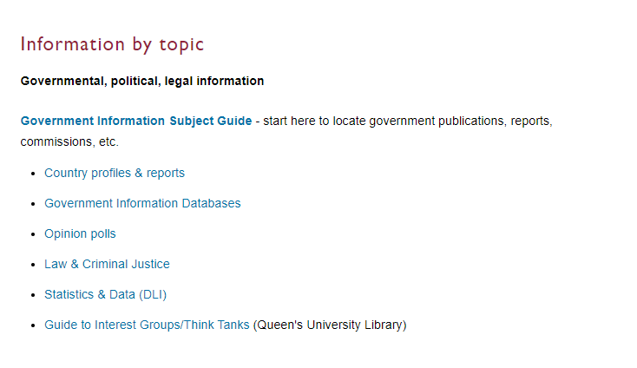

Slide 48
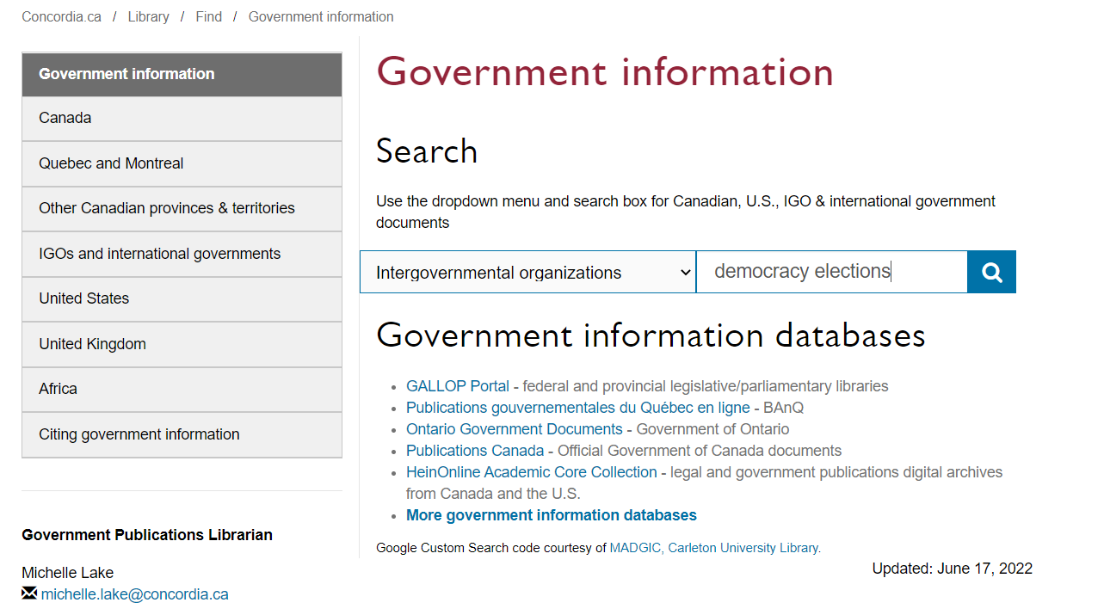

Slide 49
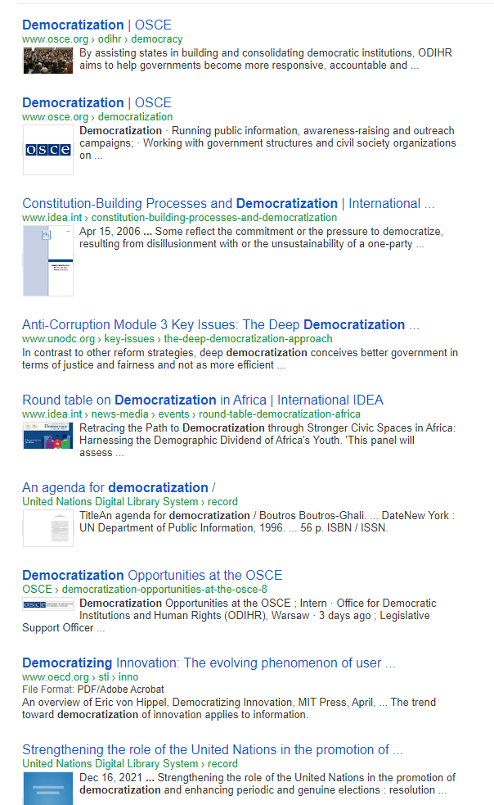
Evaluation of government information and international agency publications
Questions to Ask
Who is the publisher?
Is it a government? Or an organization?
Check the About Us pages – who is responsible for the website and why are they distributing the information? What is the mandate of the agency or institution?
Are there symbols or seals from an official government body in the document or website?
When was the information published, are there any dates on the document or website? How current is the information?

Slide 50
Country Profiles

Slide 51
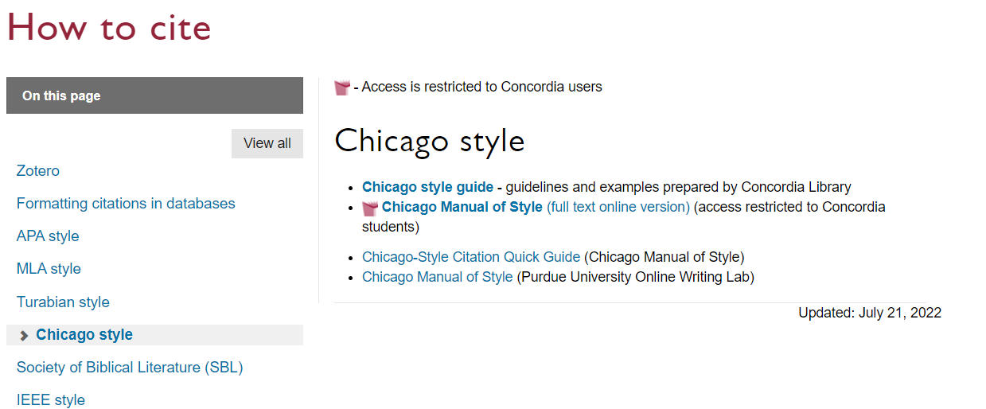
Chicago Style Citation

Slide 52
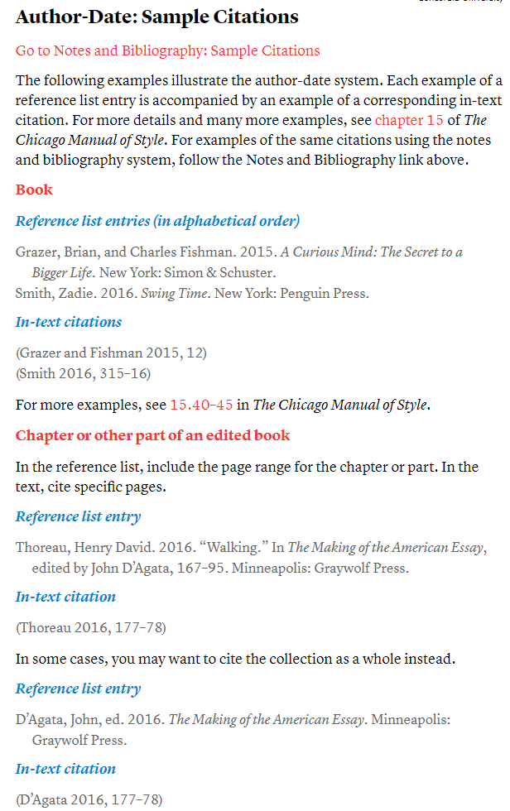
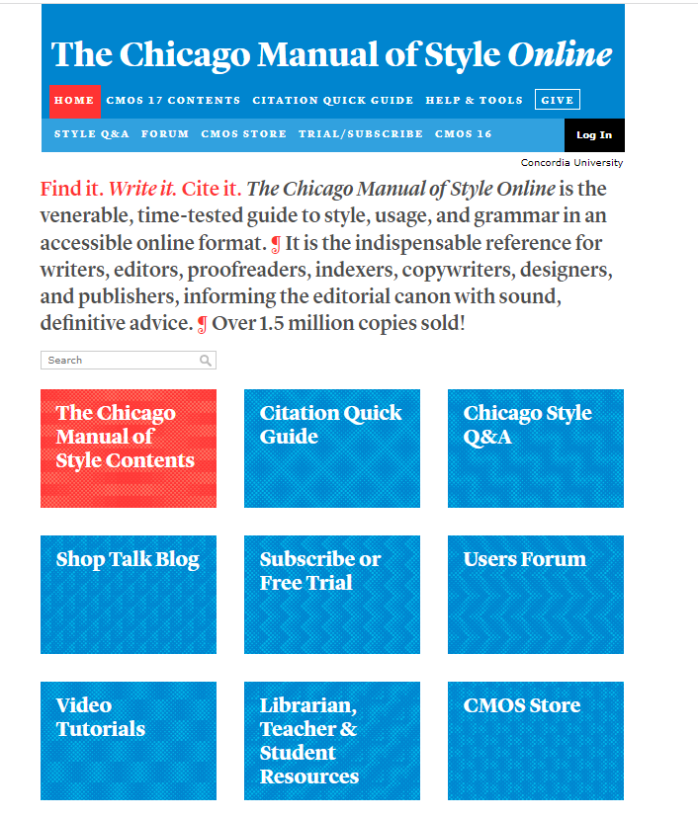

Slide 53
There is help available!
Michelle.Lake@Concordia.ca

Slide 54
Key points from today’s workshop
Go through the library website to connect to everything we have access to at Concordia
Use a POLI recommended databases to find journal articles
Think about and plan your keywords and search strategy
Evaluate all your sources
There is help available at the library!

