Slide 1
Library Orientation for HIST 200: Global History of September 11, 2001
LIBRARY
Wednesday, September 28, 2022
Vince Graziano
History Librarian
vince.graziano@concordia.ca

Slide 2
Workshop Outline
Books and articles in Sofia
Journal articles in History databases
America: History & Life
Historical Abstracts
Primary sources:
What are primary sources?
Evaluating primary sources
Resources in Sofia
Newspapers
Videos & Films
Government Documents

Slide 3
Books and articles in Sofia
Sofia Discovery Tool is used in all Quebec University Libraries
Can be a starting point for library research
Ability to search local library (default), QC libraries, and libraries worldwide
Catalogue includes all electronic and physical books, videos etc available at Concordia Library
Discovery service includes all full-text articles to which Concordia has access
Interlibrary Loan and Article/Chapter Scan built in
Does NOT replace databases
Introductory Video:
Searching Sofia

Slide 4
Electronic Journals
Collections with substantial humanities content:
Project MUSE (Recent issues)
JSTOR (Older issues)
Oxford Journals (recent and archive)
Taylor & Francis (Routledge)
Academic Search Complete (EBSCO)
ProQuest Central
British Periodicals I and II (1681-1939)
American Periodicals (1741-1940)
Periodicals Archive Online (1802-2000)
Many other electronic journal collections

Slide 5
Electronic Books
Collections with substantial humanities content:
Early English Books Online (EEBO) – 1473-1700
Eighteenth Century Collections Online (ECCO)
Early Canadiana Online (until c. 1925)
Oxford Scholarship Online (recent and ongoing)
Cambridge University Press e-books (Package:1995-2007, with individual book additions)
Project MUSE Ebooks (university presses)
Springer E-book Collection, includes Palgrave Macmillan (2010-)
ACLS Humanities E-book
Canada Commons
E-book Central (ProQuest)
EBSCO E-books
Many other electronic books

Slide 6
Journal Articles in History
History Databases
America: History & Life (AHL)
1964-onward on EBSCO platform
Covers only Canadian and USA history
Combined searched with Historical Abstracts
Historical Abstracts (HA)
1955-onward on EBSCO platform
Covers world history, excluding Canada and US
Combined searched with America: History & Life
Databases with History Content
Arts & Humanities Database
1924-onward on ProQuest platform
Humanities & Social Sciences Index Retrospective
1907-1984 on EBSCO platform
Combined search with AHL and HA
Academic Search Complete
Huge multidisciplinary database on EBSCO platform
Dates vary by journal
Combined search with AHL and HA

Slide 7
Search Operators
AND United States AND history
OR autobiography OR memoir
NOT theatre NOT film
“ ” for phrases “United States”
* for truncation Canad*
Nesting () Canad* AND history AND (autobiograph* OR memoir)
Note: multiple search boxes are also a form of nesting
Note: Databases do not require the operators to be in uppercase.
EXCEPTION: UPPERCASE operators MUST be used in Sofia

Slide 8
What are Primary Sources?
Primary sources provide first-hand testimony or direct evidence concerning a topic under investigation. They are created by witnesses or recorders who experienced the events or conditions being documented.
These sources are often created at the time when the events or conditions are happening, but they can also include autobiographies, memoirs, and oral histories recorded later.
Primary sources are characterized by their content, regardless of whether they are available in original format like manuscripts, letters, or diaries, in microform, in digital format, or in published print format.
Primary source documents are usually presented “AS IS”:
Challenges for searching primary source databases include:
Personal names and place names
Abbreviations, pseudonyms, spelling variations, former names of places, abbreviations of given names, titles
Language usage
Many spelling variations and abbreviations
Words that are now considered pejorative or offensive
Figurative language and expressions
Definitions of words may be different

Slide 9
Evaluating Primary Sources
When and by whom was this particular document written? What is the format of the document? Has the document been edited? Was the document published? If so, when and where and how? How do the layout, typographical details, and accompanying illustrations inform you about the purpose of the document, the author's historical and cultural position, and that of the intended audience?
Who is the author, and why did he or she create the document? Why does the author choose to narrate the text in the manner chosen? Remember that the author of the text (i.e., the person who creates it) and the narrator of the text (i.e. the person who tells it) are not necessarily one and the same.
Using clues from the document itself, its form, and its content, who is the intended audience for the text? Is the audience regional? National? A particular subset of "the American people"? How do you think the text was received by this audience? How might the text be received by those for whom it was NOT intended?

Slide 10
Evaluating Primary Sources
How does the text reflect or mask such factors as the class, race, gender, ethnicity, or regional background of its creator/narrator?
How does the author describe, grapple with, or ignore contemporaneous historical events? Why? Which cultural myths or ideologies does the author endorse or attack? Are there any oversights or "blind spots" that strike you as particularly salient? What cultural value systems does the writer/narrator embrace?
From a literary perspective, does the writer employ any generic conventions? Do they use such devices as metaphor, simile, or other rhetorical devices?
With what aspects of the document (content, form, style) can you most readily identify? Which seem most foreign to you? Why? Does the document remind you of contemporaneous or present-day cultural forms that you have encountered? How and why?

Slide 11
Primary Sources in Sofia
Search for primary sources in Sofia by using the Library of Congress Subject Headings (LCSH)
LCSH features standard subdivisions that identify and retrieve primary sources
Advantage is that LCSH terms are portable to other academic library catalogues in Canada & USA
Note: these subdivisions are used for the documents themselves or a listing of documents identified as a bibliography or catalogue (usually paired with sources)
Some subdivisions include (must search in subject):
Sources → Main subdivision for primary sources
Diaries
Correspondence
Interviews
Personal narratives
Slave narratives
Captivity narratives
Pamphlets
Oral history
Description and travel
Early works to 1800

Slide 12
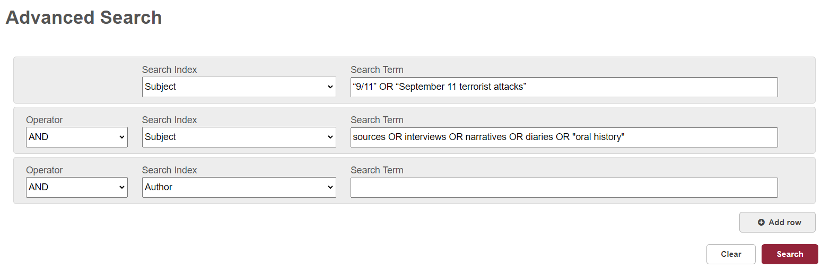
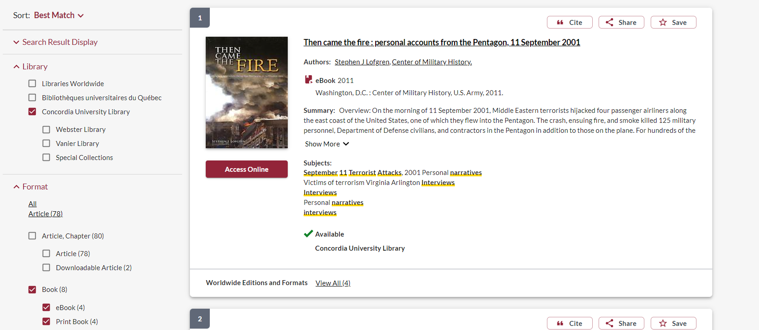
Primary Sources in Sofia Example

Slide 13
Newspapers in Electronic Format
Current:
US Newsstream (~1980-2001)
Canadian Newsstream (~1980-today)
International Newsstream (~1980-today)
Factiva (~1980-today)
US, Canadian & International
More: Current Newspaper databases at Concordia Library
Historical:
ProQuest Historical Newspapers: New York Times (1851 to 3 years ago)
ProQuest Historical Newspapers: Washington Post (1877-2001)
ProQuest Historical Newspapers: Irish Times (1859 to 2 years ago)
ProQuest Historical Newspapers: Wall Street Journal (1889-2010)
ProQuest Historical Newspapers: Globe & Mail (1844-2017)
ProQuest Historical Newspapers: Toronto Star (1894-2019)
Times Digital Archive Times of London (1785-2014)
Google News Archive – very selective coverage
More: Historical Newspapers & Magazines

Slide 14
Videos & Films
Videos: US major TV networks
Vanderbilt Television News Archive
CBS ABC NBC (from 1968), Fox (from 2004), CNN (from 1995)
Not all are viewable due to copyright. Best to choose NBC or CNN.
Films
Documentary films
Docuseek Canadian Collection (until December 31, 2022)
Ethnographic Video Online: Volumes I & II: Foundational Films
Kanopy
Feature Films
Audio Ciné Films – major studios
Criterion on Demand – major studios
Films on Demand: World Cinema Collection
International films
Films on Demand: Master Academic Collection
Documentary and feature films

Slide 15
US Government Documents
Three branches
Executive branch (President and White House)
Legislative branch (Congress)
Judicial branch (Laws & Courts)
Congressional Record -- 3 sections for different years
Daily (1994-2022)
Bound Edition -- Archive (1873-2016)
Congressional Globe (1833-1873)
Concordia Library: US Government Information
Access: https://library.concordia.ca/find/government/usa.php
See also: Browse all 3 branches, including federal Courts
Government sites and portal
Executive branch sites
Congressional sites
Law sites

Slide 16
Help is Available
Library website: help & how-to
History subject guide
Chicago citation style guides
Chicago Manual of Style (full text online)
Ask Us
E-mail form
Chat with our staff
Ask Vince:
vince.graziano@concordia.ca
When sending an email, please state your name and the course (HIST 200 9/11)
Responses via email are possible
Office hours: by appointment, in-person or on ZOOM

