Slide 1
CLAS 343/ HIST 227: History of the Roman Empire (31 BCE - 476 CE) Library workshop
Éthel Gamache
Librarian

Slide 2
Outline
Takeaways from the video Search Smarter, Search Faster
How to choose a research topic
How to find and access resources
Introduction to the Library website & subject guide
Using Sofia and Interlibrary loans
What is a scholar or peer-reviewed article?
Using the databases Année philologique, JSTOR and Academic Search Complete to find academic articles

Slide 3
Takeaways from the video Search Smarter, Search Faster

Slide 4
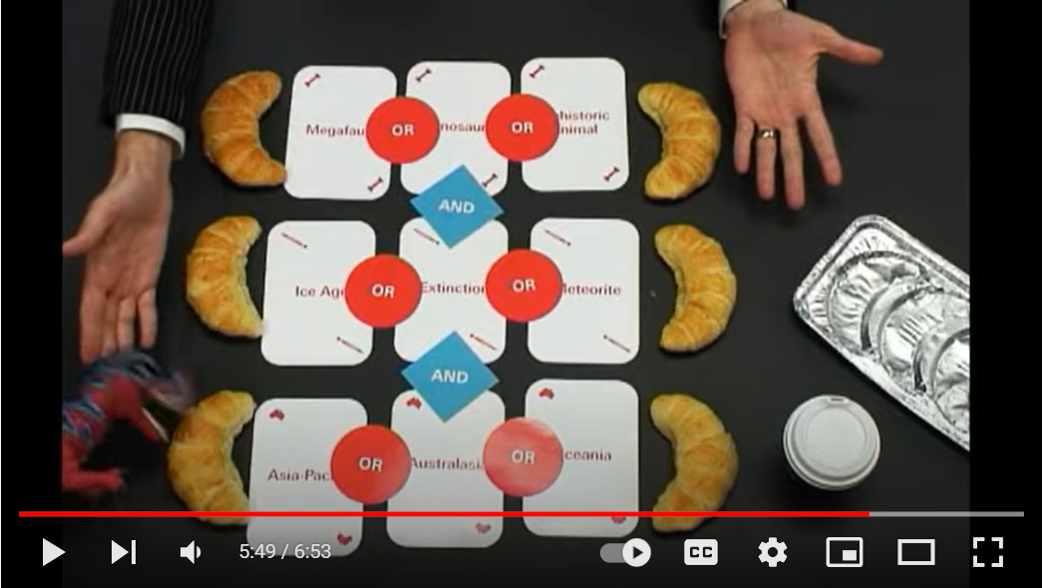

Slide 5
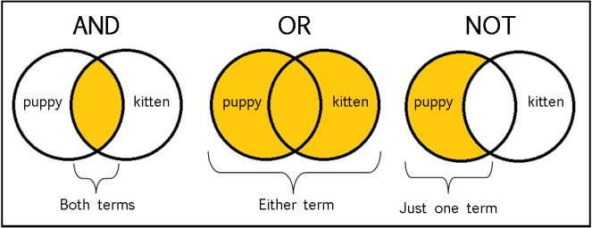
From: The Library of Antiquity, https://libraryofantiquity.wordpress.com/2016/10/07/forgotten-skills-boolean-searches/

Slide 6
Other search operators
Searching for an exact phrase (phrase searching): Quotation marks: “ ”, looks for adjacent words
“Roman Empire”, “service desk”
Truncation: *
relig*: religion, religions, religare, religious, religieux, religieuse

Slide 7
How to choose a research topic

Slide 8
It’s a process
Choosing a research topic is research.
The process is iterative, not linear.

Slide 9
Techniques to limit your topic
The 5W … and 1H: Who? What? When? Where? Why? How?
Mindmapping
Serendipity

Slide 10
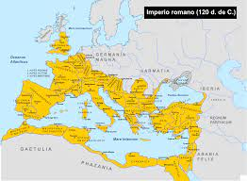
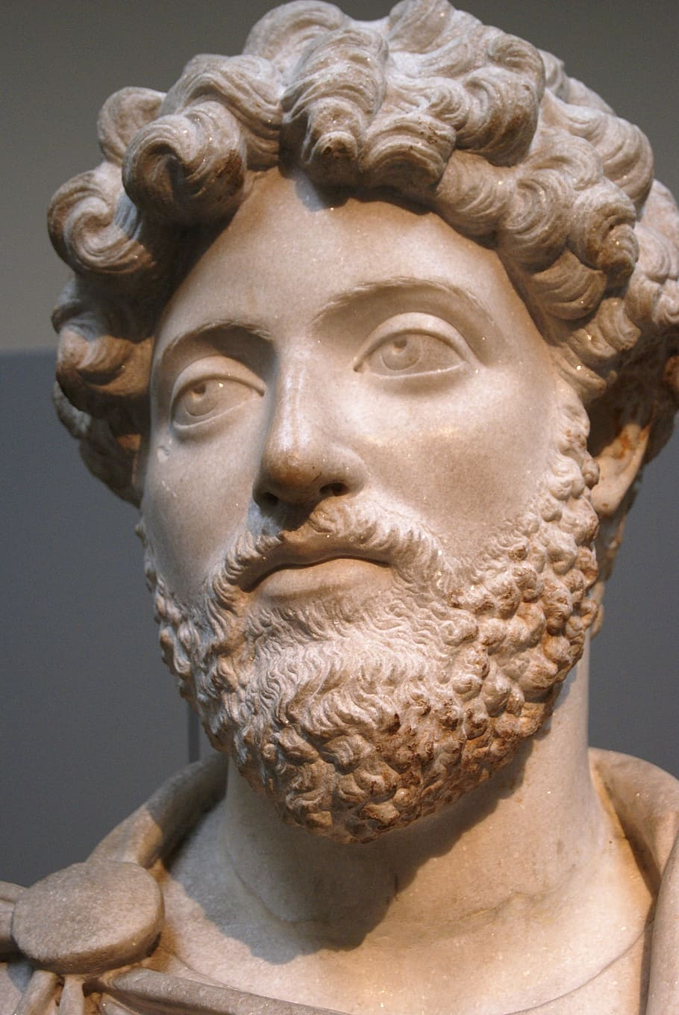
5W and 1H
Who? Emperors
What? territory
When? Between 31 Before the Common Era (BCE) - 476 Common Era (CE)
Where? Roman Empire
Why? Influence of the Emperors on the expansion of the Roman Empire
How? Political and military choices?

Slide 11
citizenship and freedom
Dynamics between the emperors and the Senate
wealth distribution
Mindmapping
social
political
Roman Empire
economic
cultural history
religions
agriculture
standardized currency
landowners/laborers
polytheistic civilization/monotheistic religions

Slide 12
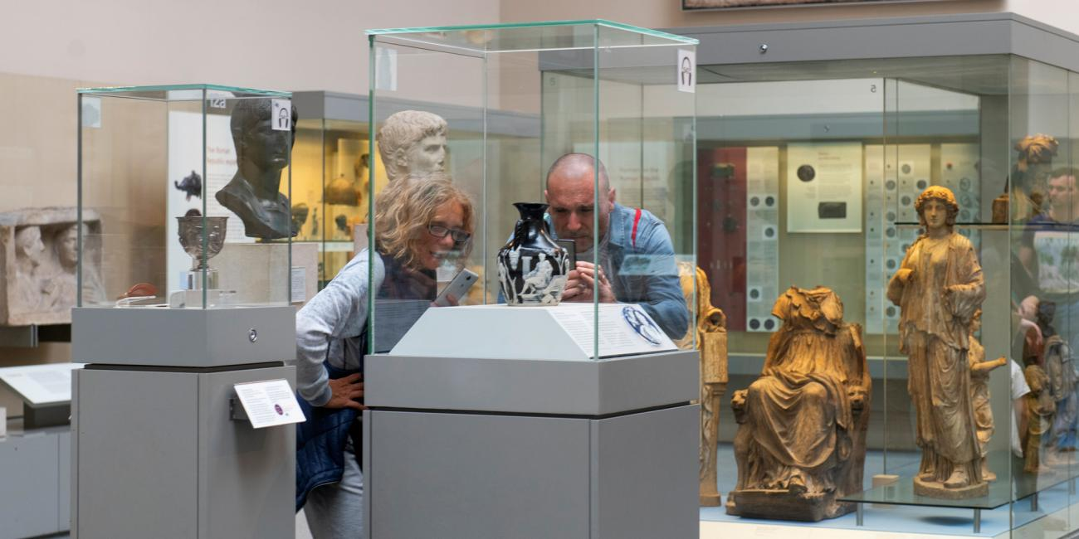
Serendipity

Slide 13
How to find and access resources

Slide 14
Introduction to the Library website & subject guide

Slide 15
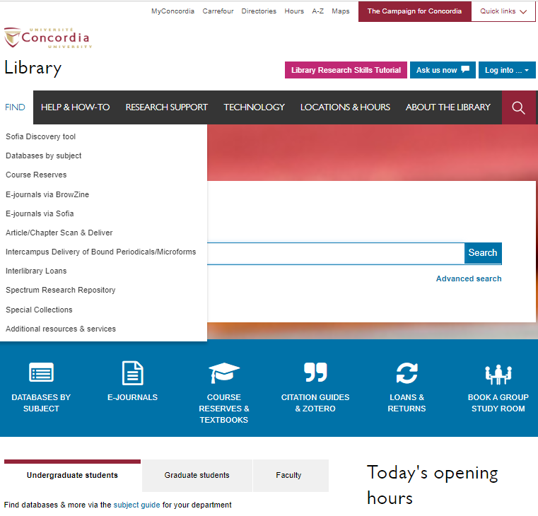
https://library.concordia.ca/

Slide 16
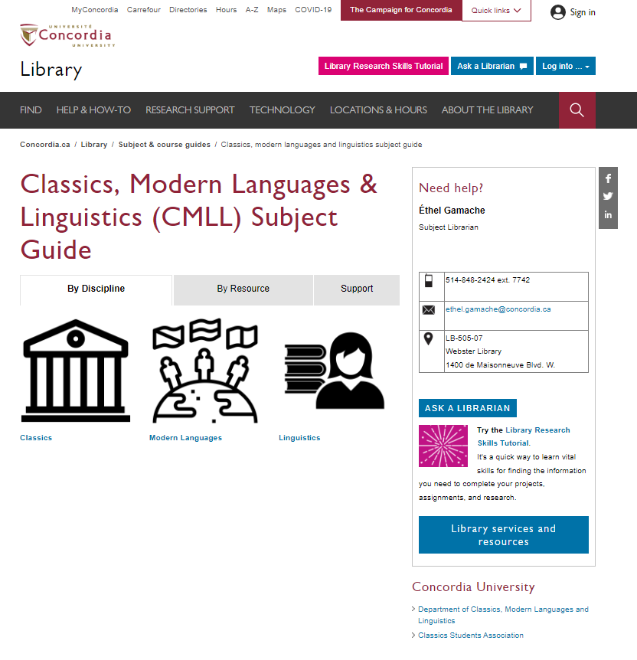

Slide 17
Using Sofia and Interlibrary loans

Slide 18
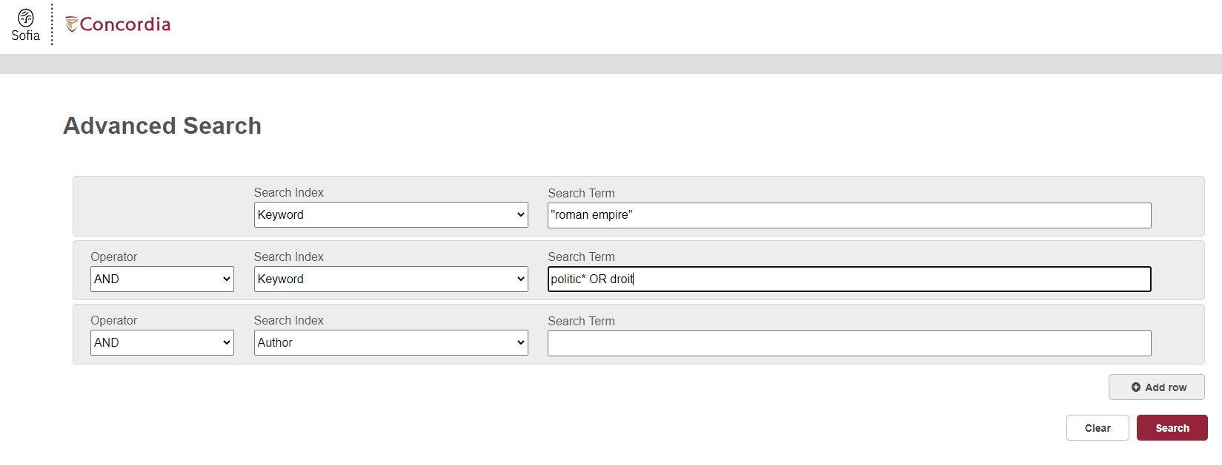
Advanced search in Sofia

Slide 19
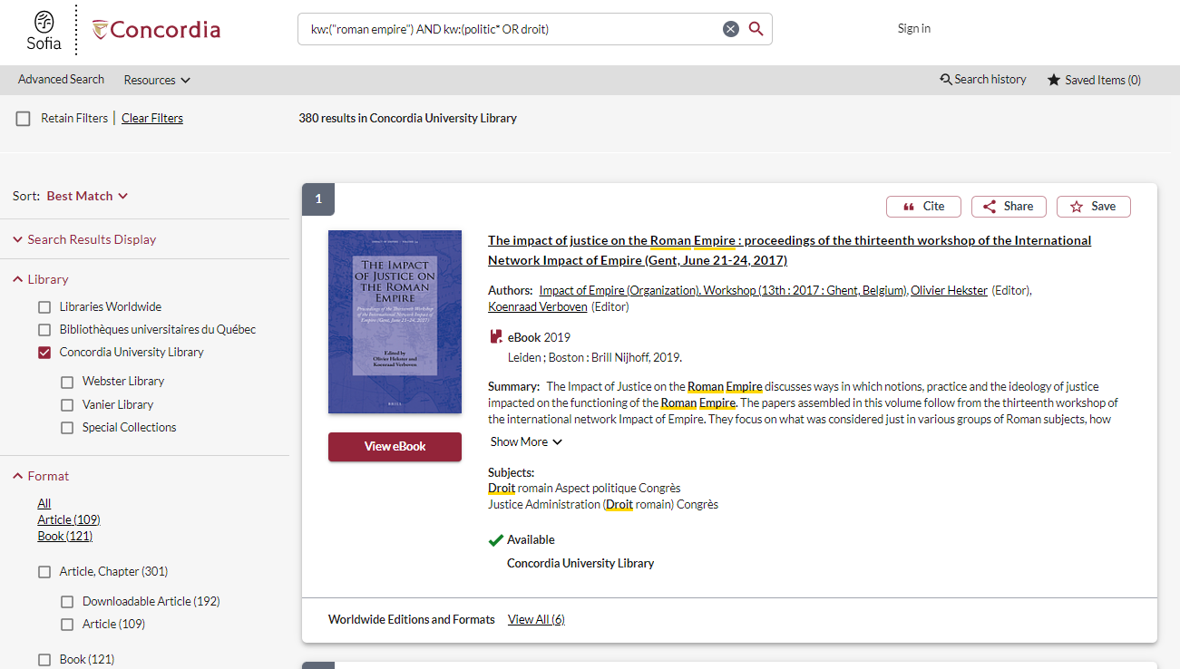

Slide 20
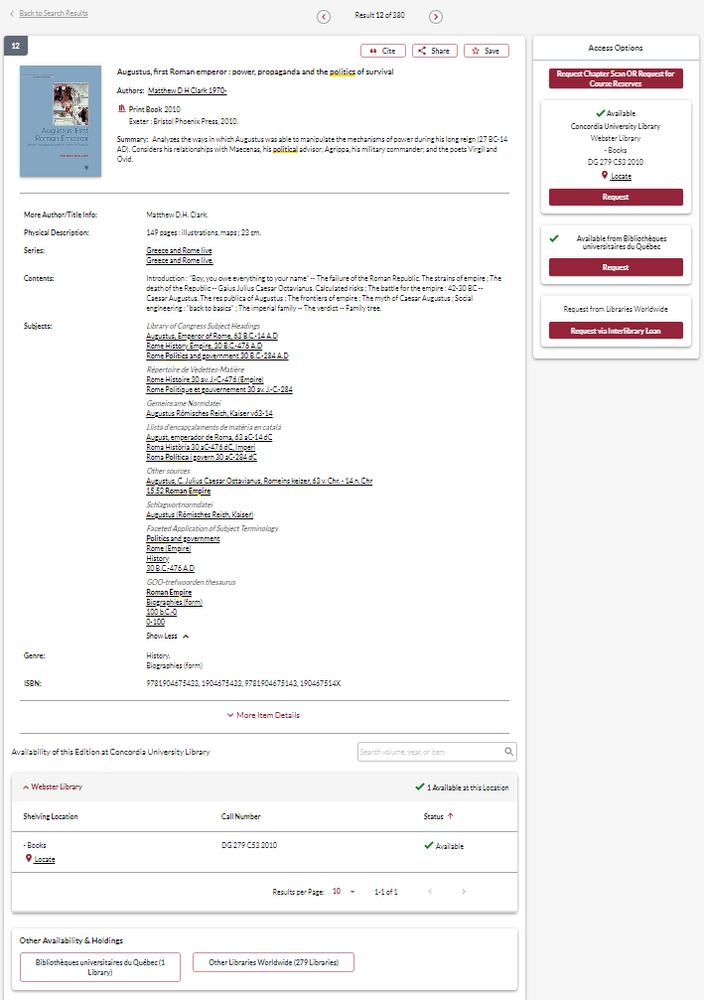

Slide 21
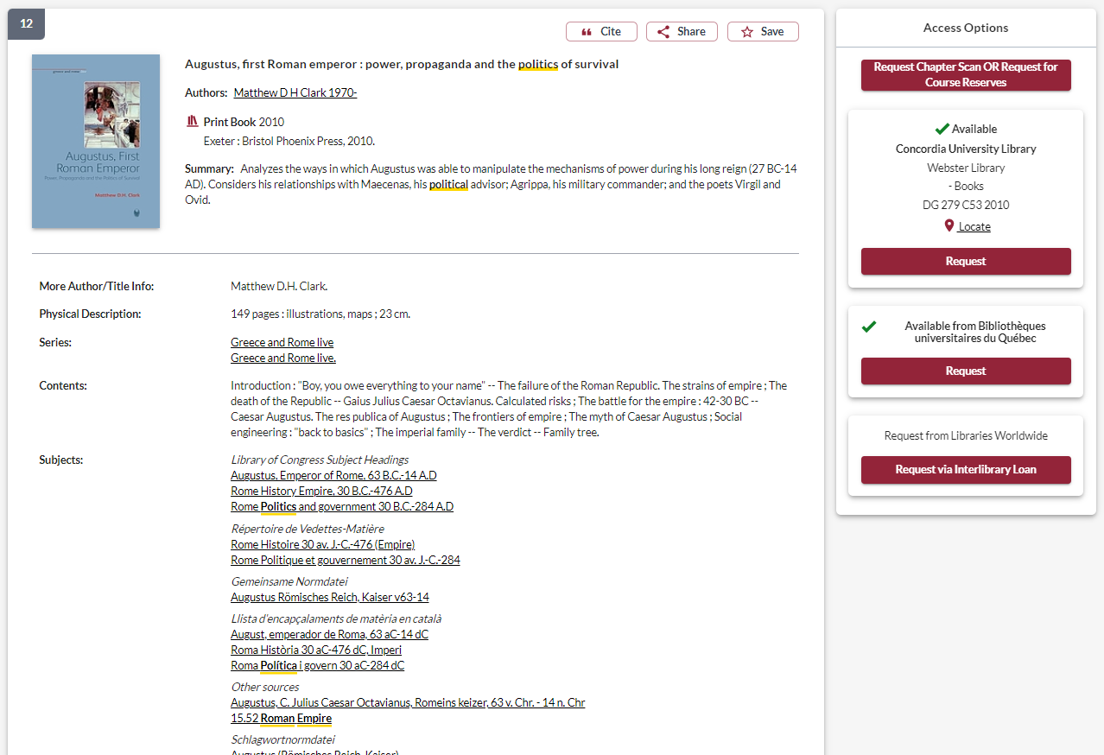
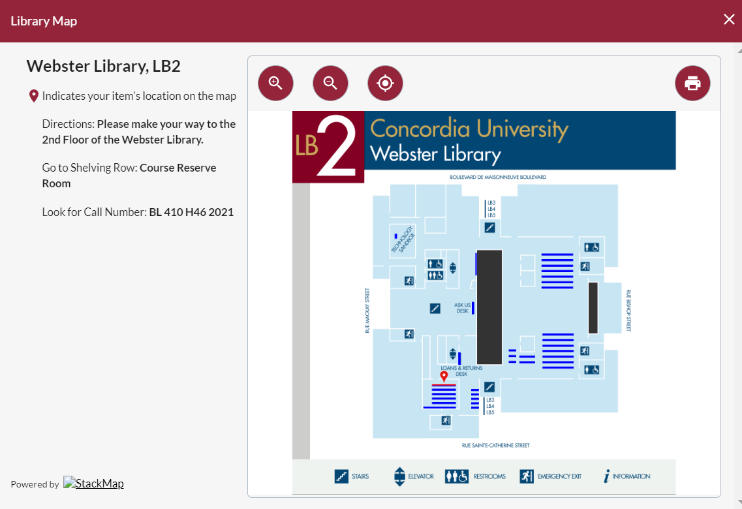

Slide 22
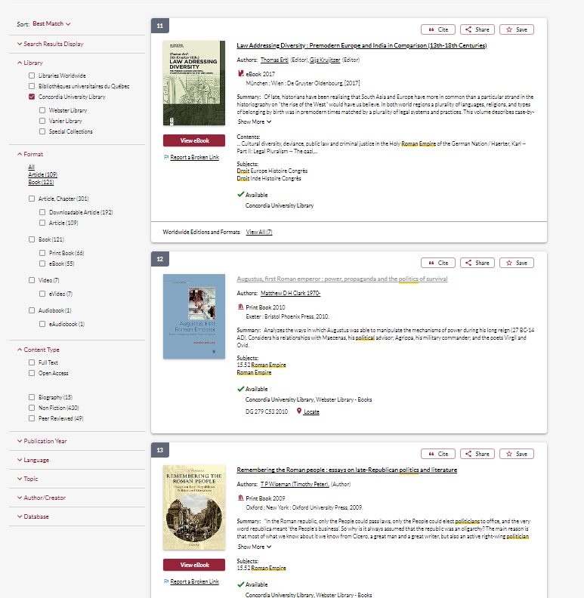

Slide 23
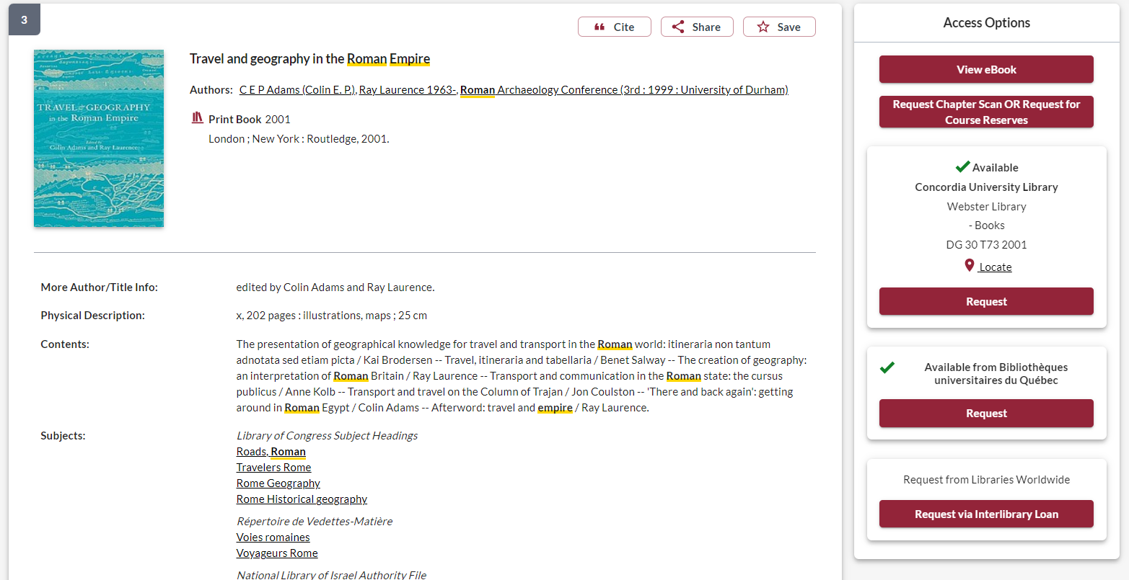

Slide 24
Using Interlibrary loans within Sofia

Slide 25
What is the new interlibrary loans (ILL) service?
ILL requests are made directly in the Sofia Discovery tool:
“Request via Interlibrary Loan” button
Form available under the “Requests” tab in "My Account".

Slide 26
Concordia article/chapter scan & deliver service
Book chapter and journal article scans from Concordia’s print collection can now be requested and tracked in Sofia.
Look for the “Chapter Scan” button in the Access Options panel.

Slide 27
Concordia article/chapter scan & deliver service
Book chapter and journal article scans from Concordia’s print collection can now be requested and tracked in Sofia.
Look for the “Chapter Scan” button in the Access Options panel.

Slide 28
Example – Request a book ("Request via Interlibrary Loan")

Slide 29
Notes:
Let's take a look first at requesting a book via libraries worldwide. If users are having trouble finding an item through Concordia Library or one of the Quebec university libraries, they can expand their search to "libraries worldwide" in Sofia.
If a user was looking to request this book, we can see that there is no "request" button through Concordia or network loans. Users will need to place an ILL request by selecting the "request via interlibrary loan" under the "access options panel". If they wanted a specific chapter scan, they would be able to select the "chapter scan" button, but we will take a look at that process later in today's presentation.

Slide 30
Notes:
The user will need to login to their Sofia account, and will then be brought to this form for book requests (this is a partial view of the form on the screen here). We want to encourage users to try as often as they can to find the record in Sofia, as if they place the ILL through the "request via ILL button", the request form will autofill a lot of information from the record such as ISBN, OCLC#, title, etc. Which is very helpful for staff.
The form will default to a "LOAN" service type. There is messaging to the right explaining that users should select LOAN for a complete document. For a scanned chapter they can select "copy". If by chance users wanted a chapter scan and request it in this way, it won't necessarily be a big issue as the request will still appear in Tipasa. I'll explain this in more detail when we go over article/chapter scan requests.
Be sure to specify the pickup location as Webster or Vanier. It defaults to Webster – we could not get the form to have a blank default for this field.

Slide 31
Notes:
At the bottom of the form, you will see an “additional information” section. You can add in any other information pertaining to the request and/or specify the desired edition.
Submit request.

Slide 32
Check the status of your request under the "Requests" tab.
Notes:
The request can then be found in the requests tab, along with the status. I will show you examples later on of all the different kinds of statuses a user might see, along with how they can monitor their requests.
This "unknown" status shows up for a few moments right after placing a request, it will update quickly to a "submitted" status.

Slide 33
You will receive email notifications when your ILL request is available for pickup or download.
Physical items can be picked up at the Circulation/Loans desks at either Vanier or Webster Library.
ILL requests can be borrowed for 30 days, with up to 4 automatic renewals, or until item is recalled.

Slide 34
Example – Request a book (blank form)

Slide 35
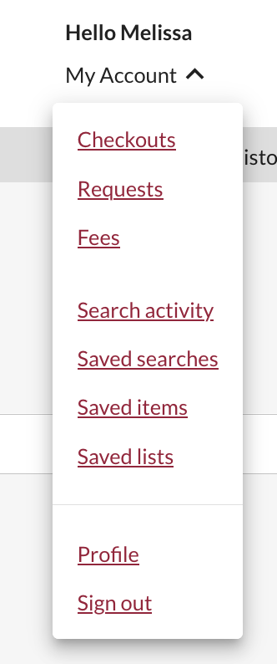
Sign in to "My Account" and select "Requests".
Click on "Create request".
Notes:
Some users might have all the information on hand for their request, or simply just have a difficult time finding the record in Sofia.
Their other option for placing a book request via ILL is to fill out the blank book request form.
Users will need to sign into their My account, and go to the requests option in the drop down menu. Then click on create request

Slide 36
Select Webster or Vanier Library.
Notes:
Select the “Book” form. Fill out the form by providing as much detail as they can to help us locate the item. For the complete book, be sure to select “LOAN”. Select the desired pickup location.

Slide 37
Notes:
Submit the request and then the user can go to their requests tab to view all their requests.

Slide 38
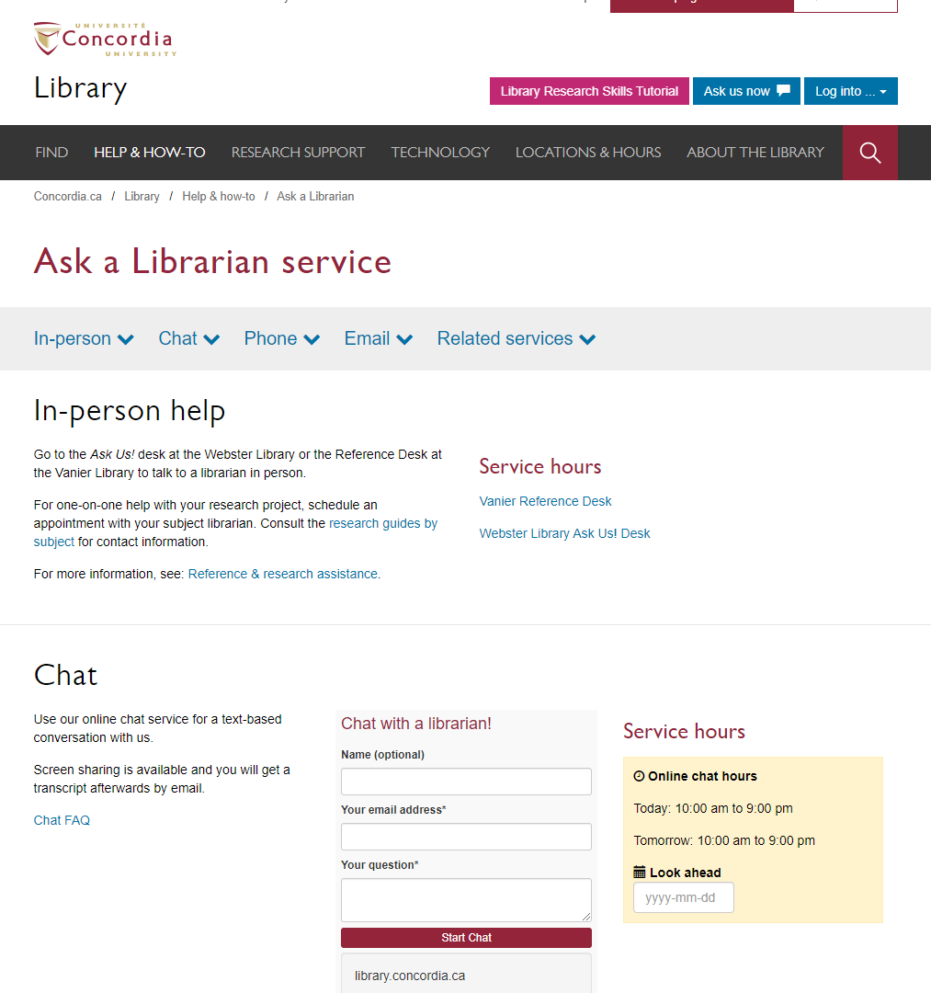
If you have any difficulty finding a document,
reach out to the library team!

Slide 39
What is a scholar or peer-reviewed article?

Slide 40
The peer-review process
Yates, D. [@LegoAcademics]. (2014, August 12). Peer 1: Brillant! Accept with no changes; Peer 2: Groundbreaking! Accept with no changes; Peer 3: Reject. [Tweet]. Twitter. https://twitter.com/LegoAcademics/status/499205005468262400/photo/1

Slide 41
What is the difference?
Google scholar
Library databases
Volume | Quantity | Quick
Depth | Quality | Thorough
Left image: Yinan Chen, Dining Court, public domain, https://pixabay.com/photos/dining-court-shopping-mall-corridor-347314/
Right image: Jason Briscoe, Cooking, public domain, https://unsplash.com/photos/VBsG1VOgLIU
Notes:
Searching in Google Scholar – finding something to eat in a food court
Searching in Library Databases – Cooking at home
Speed vs process

Slide 42
Where should you search?
Library Discovery Tool
Academic Search Complete
(Library Database)
Google Scholar
Eureka.cc
(Library Database)
Grey literature (e.g. government documents, NGO reports, working papers, newsletters, preprints)

Slide 43
Using the databases
Année philologique,
JSTOR and
Academic Search Complete
to find academic articles

Slide 44
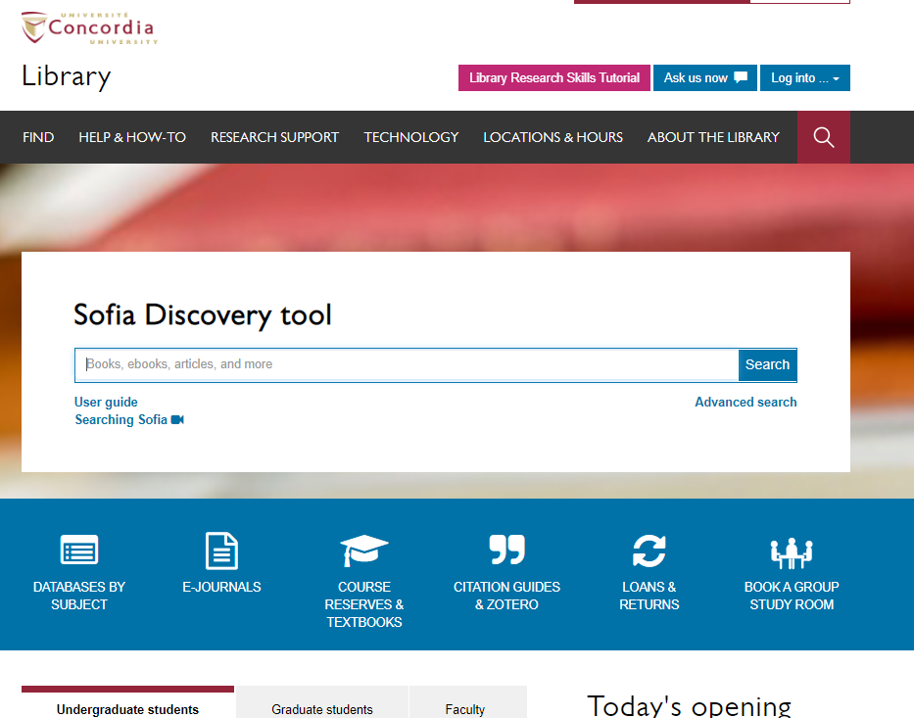

Slide 45
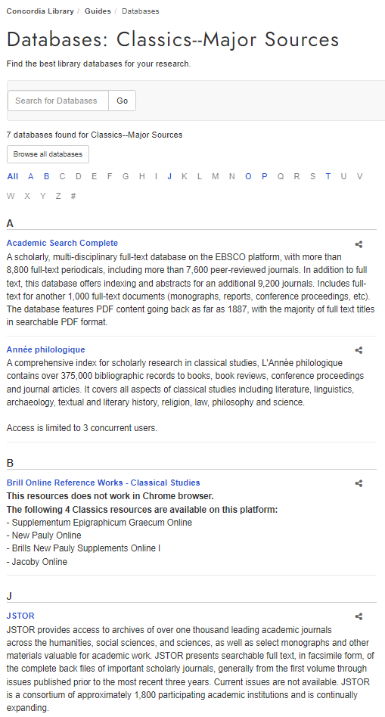

Slide 46
L’Année philologique

Slide 47
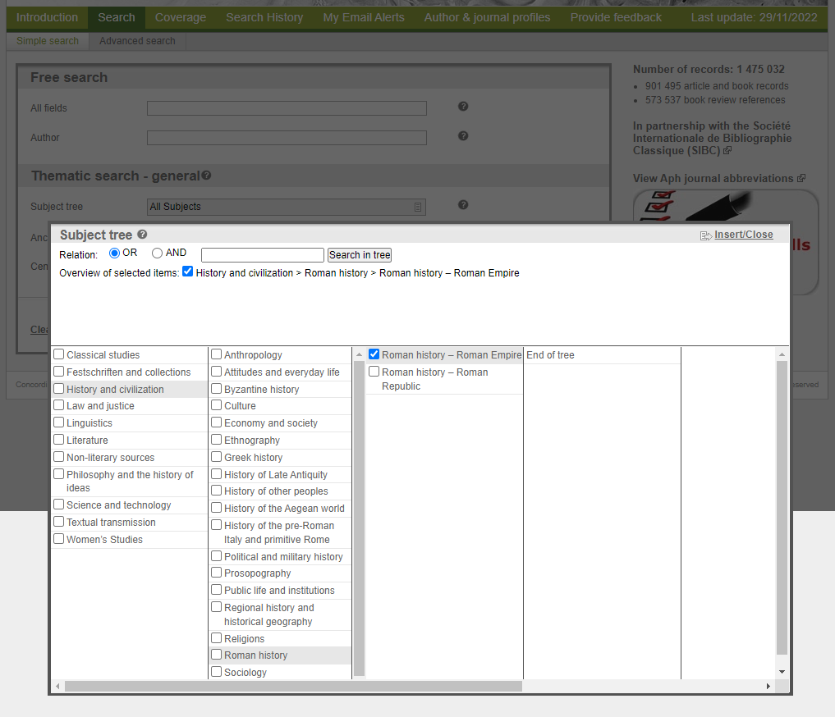

Slide 48
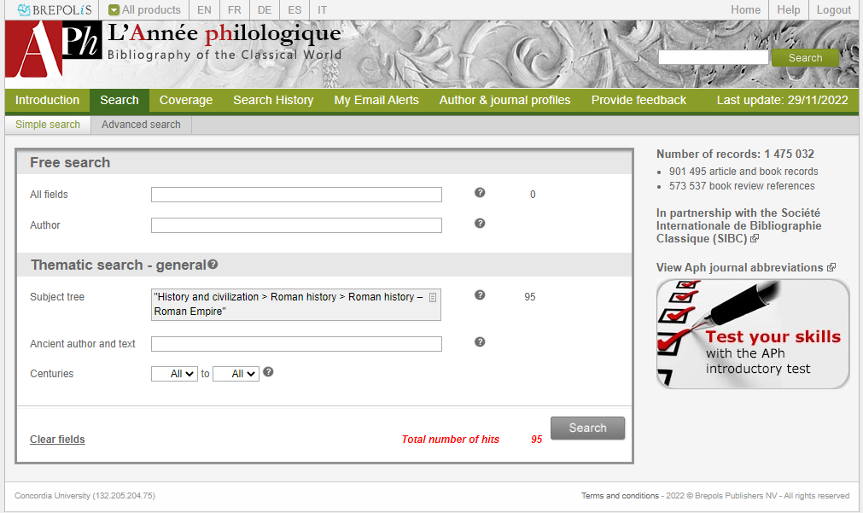

Slide 49
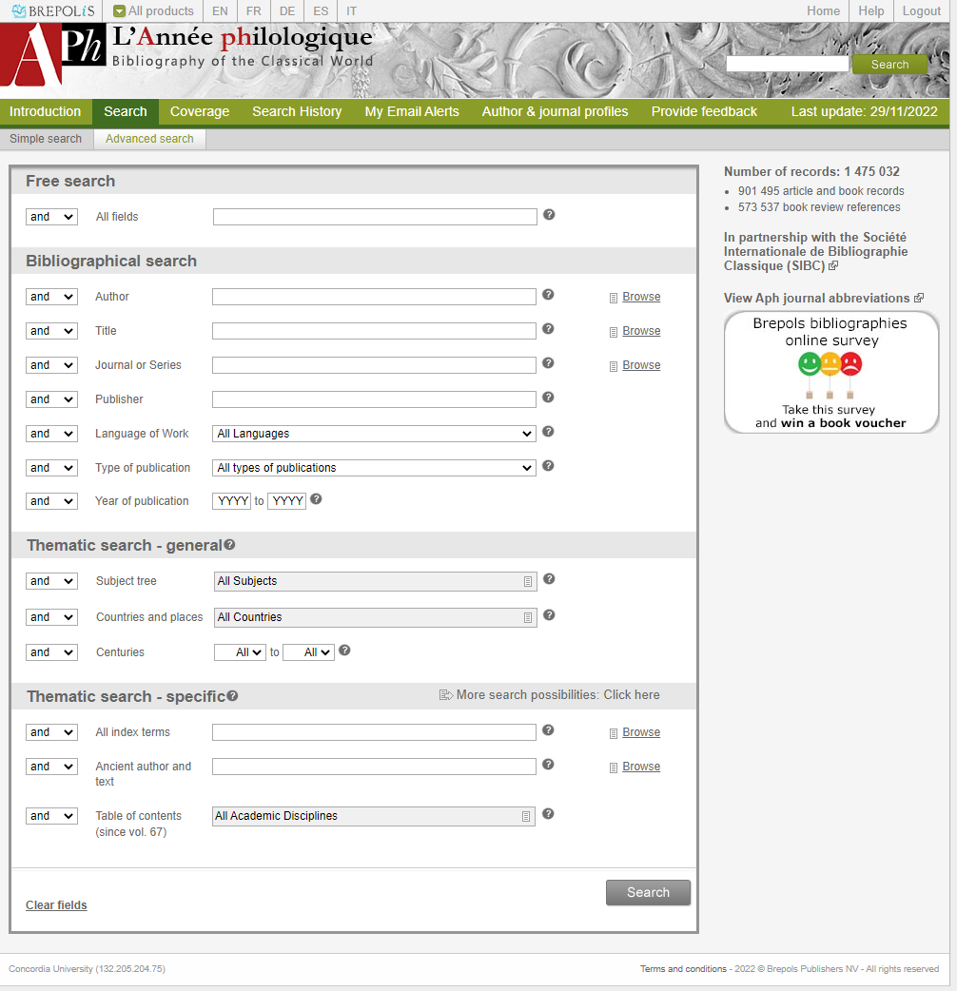

Slide 50
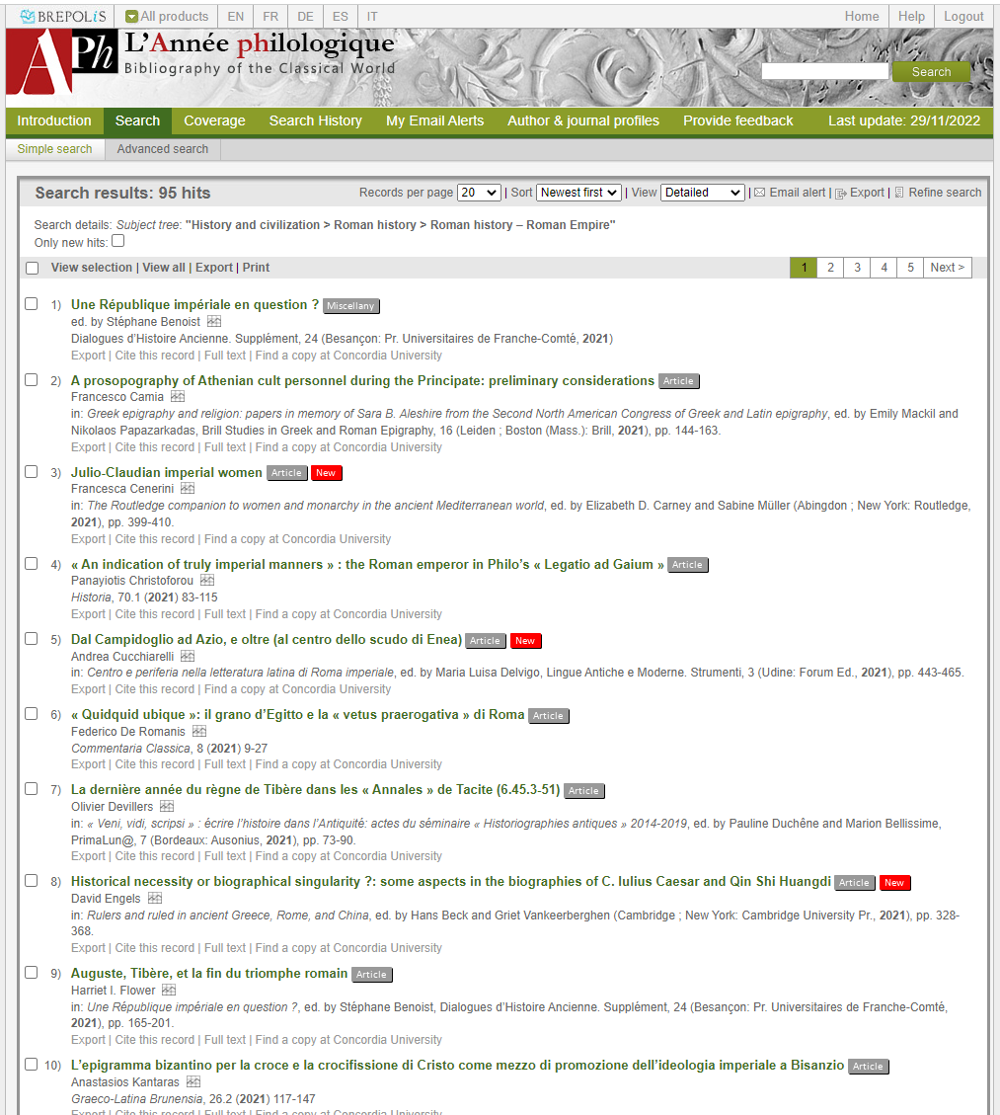

Slide 51
JSTOR

Slide 52
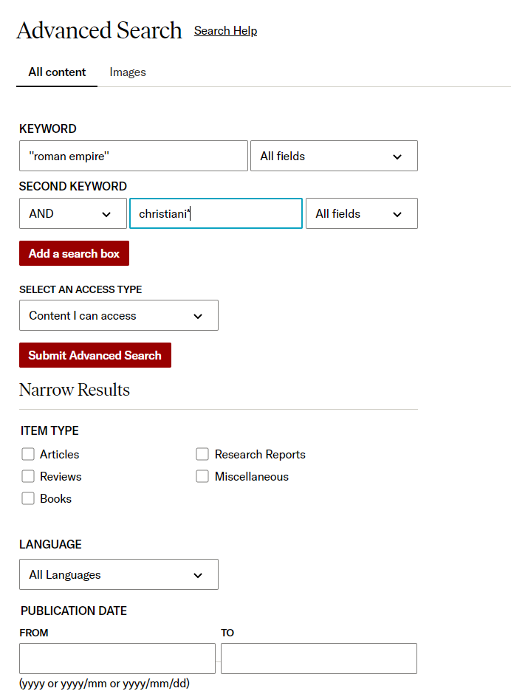

Slide 53
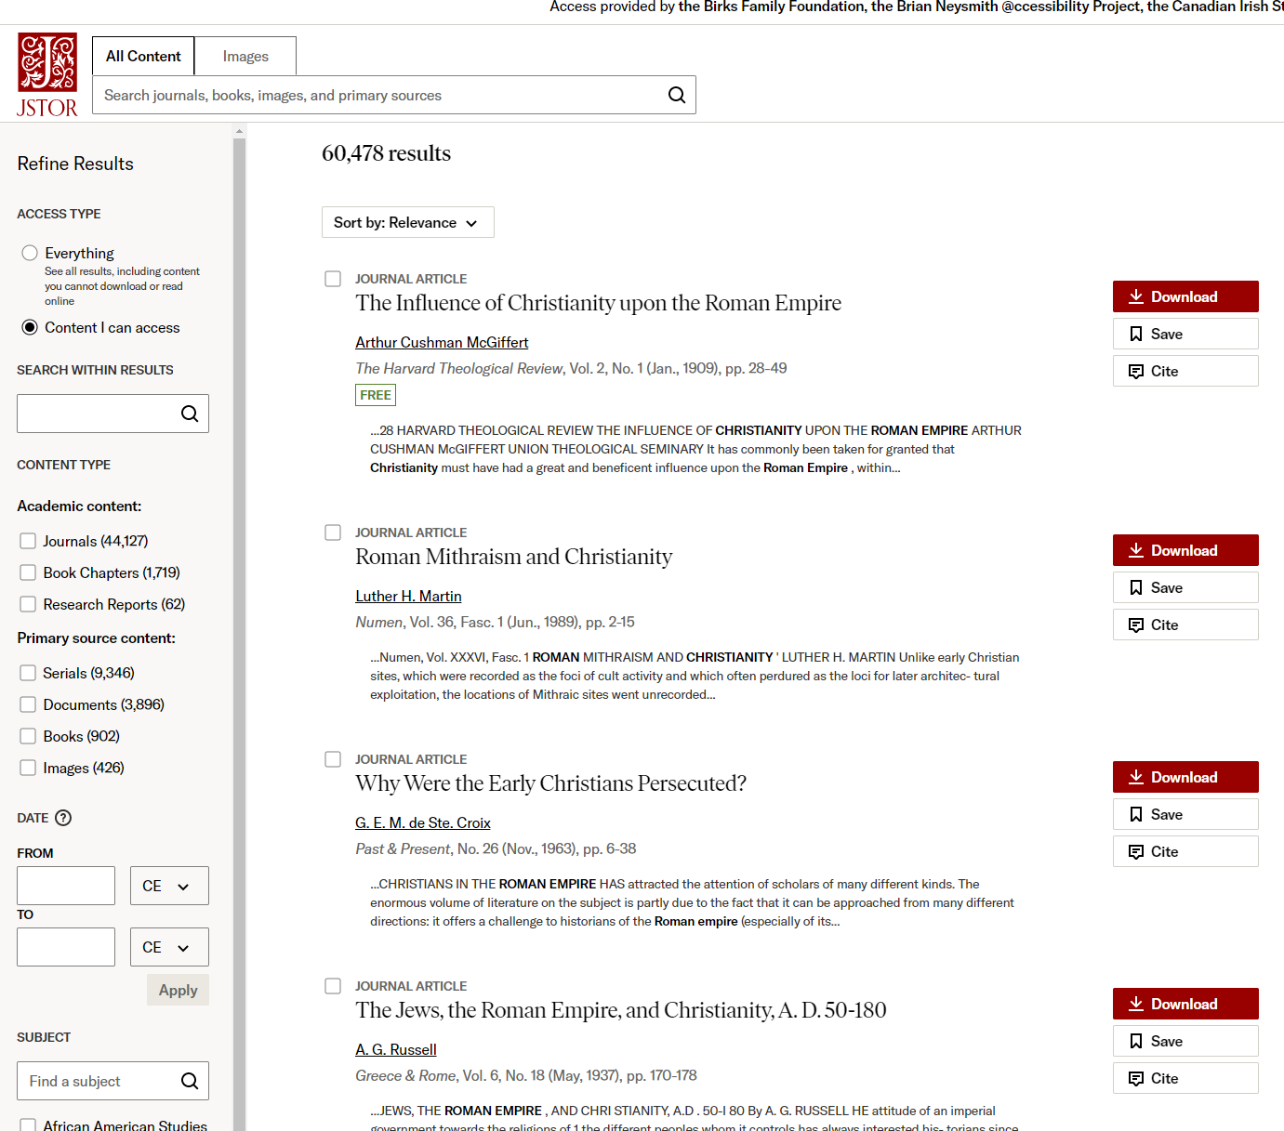

Slide 54
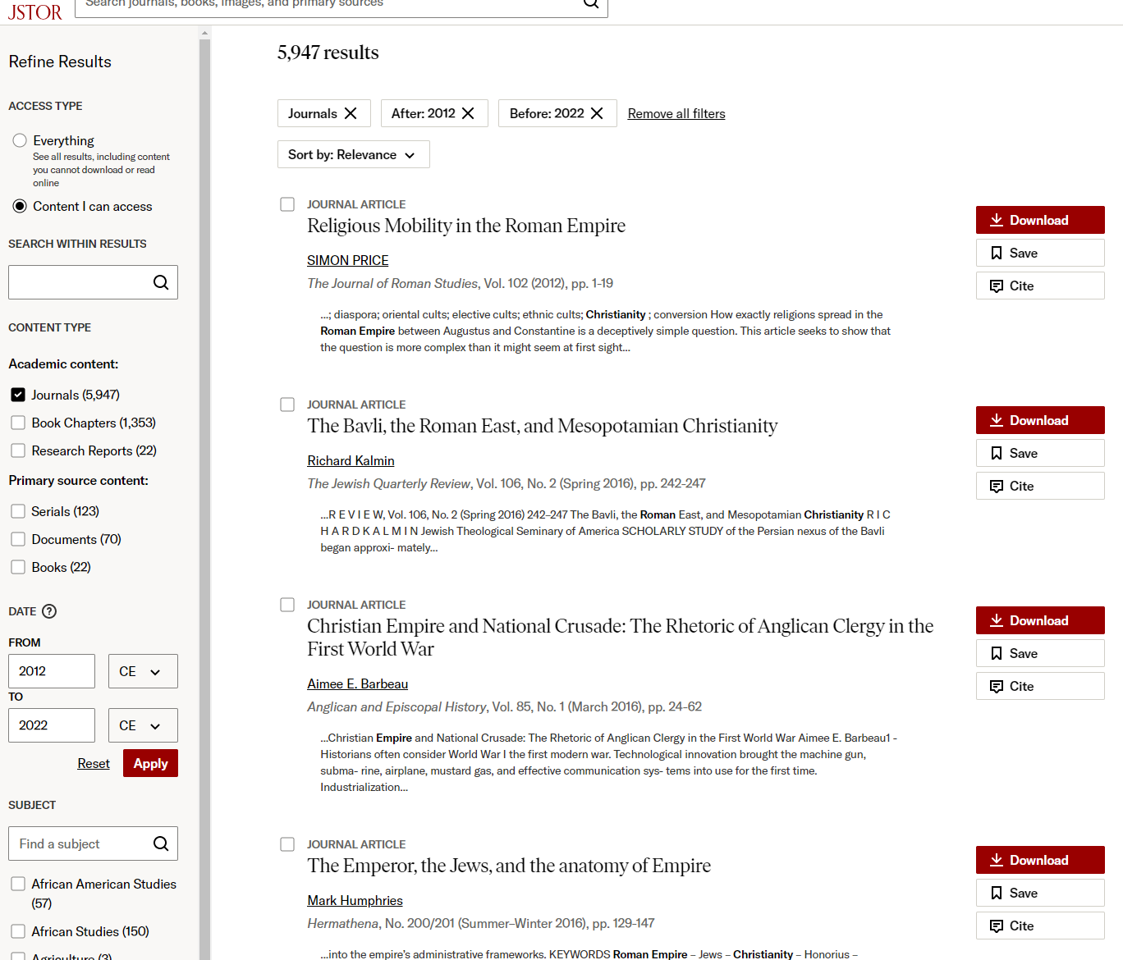

Slide 55
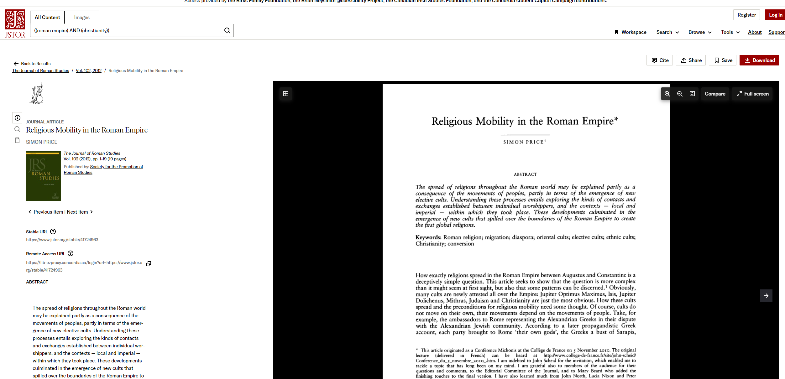

Slide 56
Academic Search Complete

Slide 57
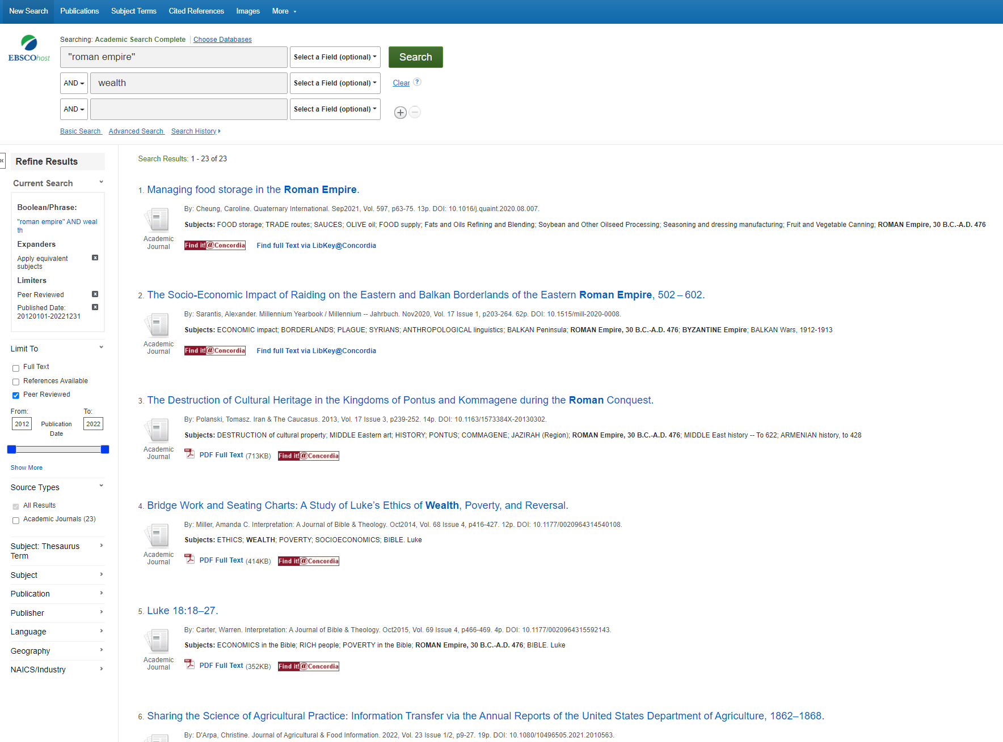

Slide 58
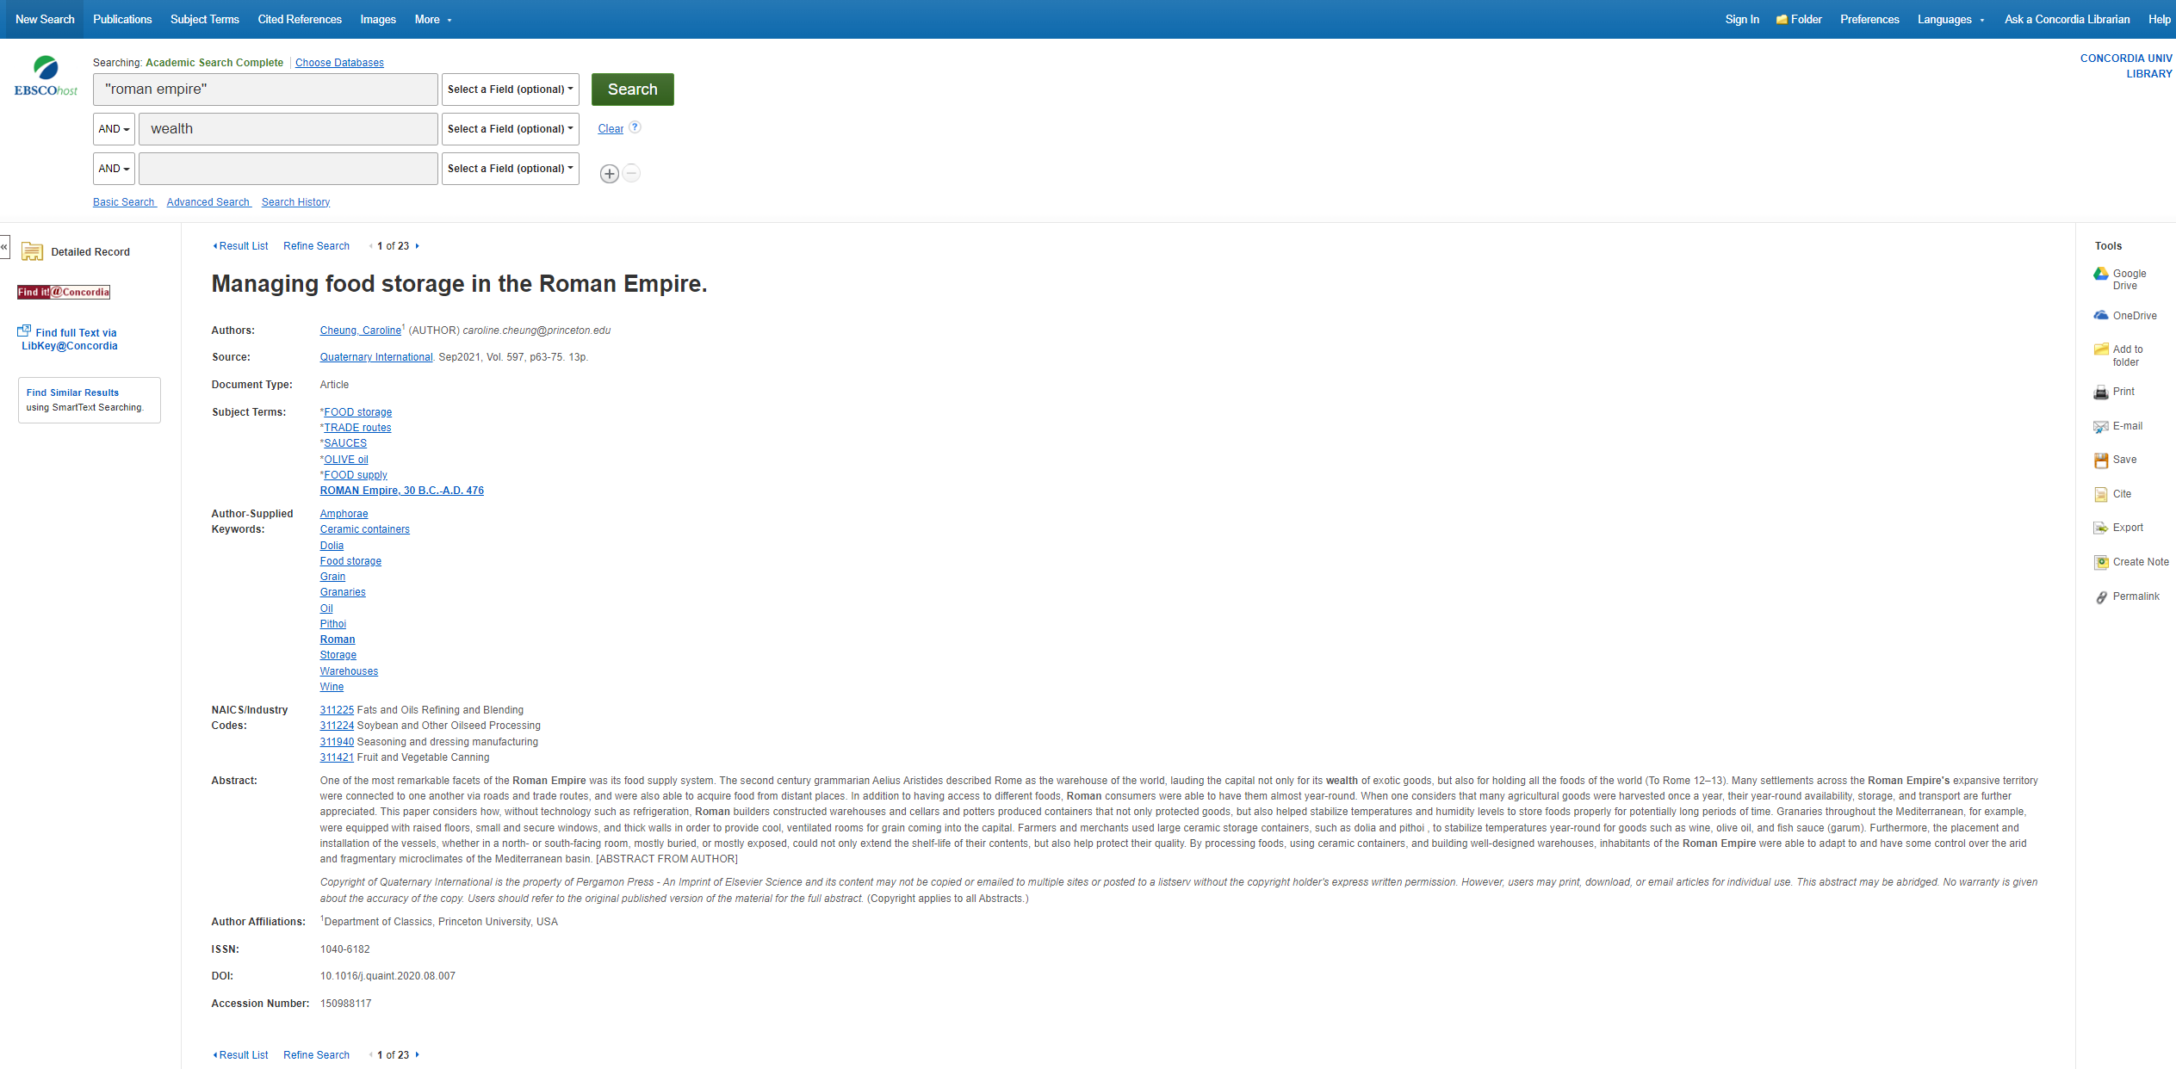

Slide 59
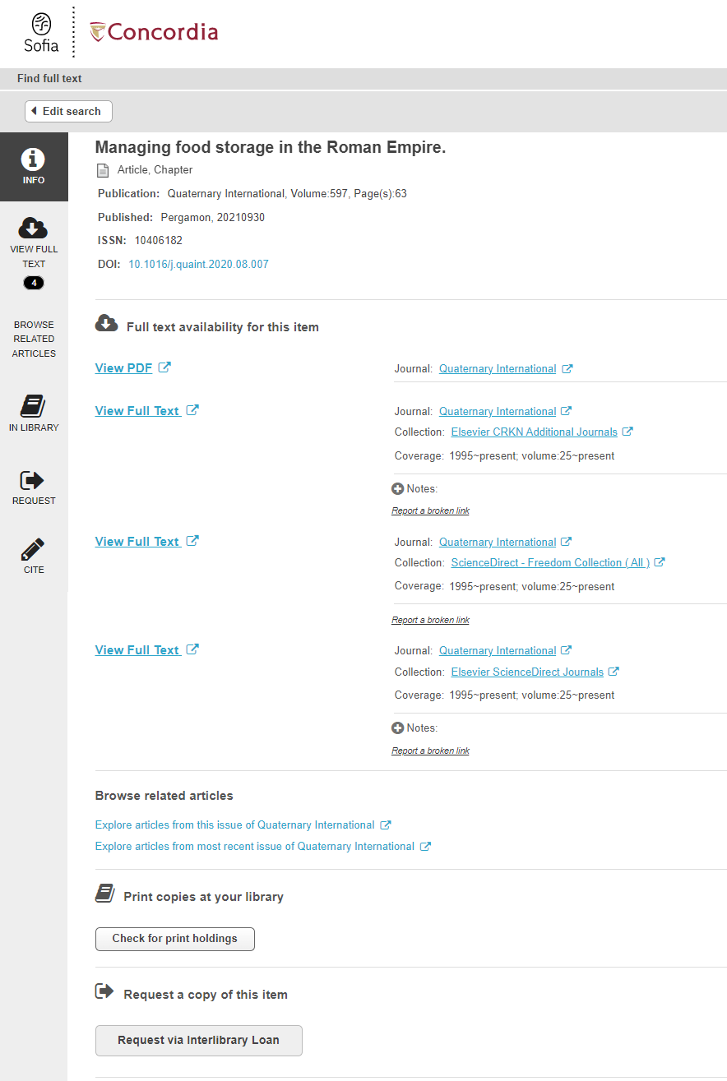
Link resolver

Slide 60
Quiz

Slide 63
Thank you for your participation!
Éthel Gamache
ethel.gamache@concordia.ca

