Slide 1
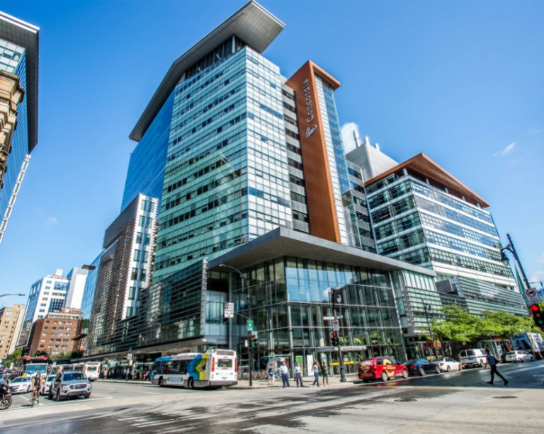
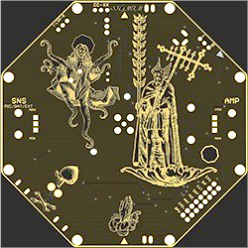
Winter 2022 Orientation Session
Welcome to the
Department of Electrical and Computer Engineering!

Slide 2
Welcome to GCS and ECE
Leadership
Dr. Mourad Debbabi (Dean)
Dr. Yousef Shayan (Chair)
Introduction to Programs
Overview of ECE U/G programs (Dr. Wahab Hamou-Lhadj, Associate Chair, U/G Studies)
ELEC program (Dr. M. Zahangir Kabir, U/G Program Director, ELEC)
COEN program (Dr. Bahareh Goodarzi, U/G Program Director, COEN)
Administrative Information
Academic Regulations (Ms. Tina De Stefano, U/G Program Assistant)
Campus Resources (Ms. Tina De Stefano)
Labs
Remote and in-person labs
(Mr. Dmitry Rozhdestvenskiy, Engineer in Residence)

Slide 3
Overview of ECE programs
U/G programs offered:
B.Eng in Computer Engineering
B.Eng in Electrical Engineering
Information sources:
ECE website > Students > Undergraduate students
http://www.concordia.ca/eceugrad
Undergraduate Calendar:
https://www.concordia.ca/academics/undergraduate/calendar/current.html

Slide 4
Program Structure
Total: 120 credits (CEGEP graduates) + additional credits required for other students
Engineering Core (30.5 credits)
Program (COEN / ELEC) Core
Technical Electives
More info: U/G Calendar, Sec. 71.10 to 71.30.
4

Slide 5
ELEC Program
Total: 120 credits (CEGEP graduate) + additional credits required for other students
Engineering Core (30.5 credits) §71.20.5.
ELEC (General stream) Core (70 credits),
Electives (19.5 credits), in final year
Course sequence:
https://www.concordia.ca/ginacody/electrical-computer-eng/programs/electrical-eng/bachelor/course-sequences.html
Students can take any courses during study term (provided prerequisites are satisfied).
5

Slide 6
ELEC Program: Elective Groups
Elective Groups
Telecommunication Networks and Signal Processing
Microdevices, Electronics and VLSI
Power and Renewable Energy Systems
Controls, Robotics and Avionics
Waves and Electromagnetics
Computer Systems
Biological and Biomedical Engineering
More info: U/G Calendar, Sec. 71.30.1
6

Slide 7
COEN Program
Total: 120 credits (CEGEP graduate) + additional credits required for other students
Engineering Core (27.5 credits) + General Elective (3 credits)
Computer Engineering Core (72.50 credits)
Electives (17 credits)
7
Notes:
General Education elective (3)

Slide 8
COEN Electives
Computer Engineering Electives
Hardware/Electronics/VLSI
Software and System Design
Biological and Biomedical Engineering
Computer Science and Software Engineering
Telecommunications, Networking and Signal Processing
Control, Robotics and Avionics
Other
List of courses for each category: Computer Engineering Options
8
Notes:
Courses are listed in groups to facilitate course selection
For example if you choose biological and biomedical option At least 9 of these credits must be taken from the Biological and Biomedical Engineering Option Electives list

Slide 9
Co-op and Mandatory Work Term
Students in ECE programs are required to be either in the CO-OP program or C-Edge (Career Edge) program.
Co-op students:
3 work terms
2.5 minimum GPA (Also required to stay in Coop)
12 credits minimum per term
Complete ENCS 282 before the first work term
Can not start and end the course plan with a work term
To apply:
Fill out a form
Propose a sequence
https://users.encs.concordia.ca/~mariaf/ECE_Coop/ECE_COOP.pdf
9
Notes:
For example all three work terms can not be in summer, or you can not finish your study by work term and there should be at least one study term. You should be full time all the semesters to remain in COOP
C-Edge12 to 17 weeks

Slide 10
Mandatory Work Term (Cont.)
C-Edge:
1 work term
C-Edge allows for one work terms for non-co-op students
With this program, undergraduate students in eligible programs can obtain one, relevant, paid internship to better your transition to the workplace.
Eligibility: Minimum of 60 credits of 120 credit program
Work terms are assigned by the department in the 3rd year of studies.
Students may make a request to change the work term to the Undergraduate Program Director.
https://www.concordia.ca/academics/co-op/programs/career-edge.html
https://users.encs.concordia.ca/~mariaf/C-Edge/C-Edge.pdf
10

Slide 11
Some academic regulations
The last day for course changes (without any penalty) is called the “add/drop date” or the “Did Not Enter” (DNE) date.
You can discontinue courses after DNE date. In this case, You must pay the fees and the course will remain on your record with the notation DISC or “discontinued”.
All 200-level courses within the program which are prerequisites for other courses must be completed with a C- or higher.
All students in engineering programs must complete all 200-level courses in their programs prior to commencing courses at the 400-level.

