Slide 1
Academic Advising Session For Newly Admitted Students
Computer Science & Software Engineering (CSSE):

Slide 2
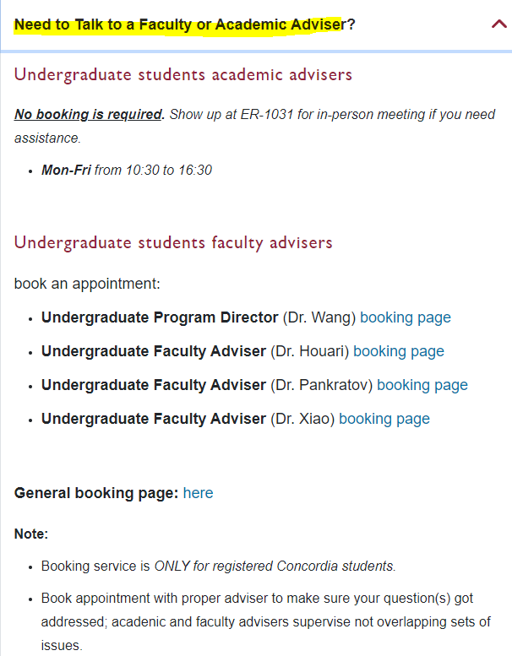
Computer Science & Software Engineering (CSSE):
Two programs:
1. Bachelor of Computer Science (Dr. Wang ugpd-compsci@concordia.ca )
2. Software Engineering (Dr. Rigby peter.rigby@concordia.ca )
3. Chair of the Department: (Dr. Paquet joey.paquet@concordia.ca )
Programs’ assistant: Natallia Lapko and Carly Carruthers
How to contact us:
1. cse-ugrad@concordia.ca
2. in person: ER Building 10th floor
3. drop-in sessions and booked appointments:
https://www.concordia.ca/ginacody/computer-science-software-eng/students/undergraduate.html

Slide 3
Program Requirements:
Bachelor of Engineering, Software Engineering
Bachelor of Computer Science
Bachelor of Computer Science Joint Major in Data Science
Bachelor of Computer Science Joint Major in Computation Arts and Computer Science
Bachelor of Computer Science in Health and Life Sciences
Minor in Computer Science
Extended Credit Program (BCompSc, including Joint Majors)
Extended Credit Program (BCompSc Health and Life Sciences)
Extended Credit Program (SOEN)

Slide 4
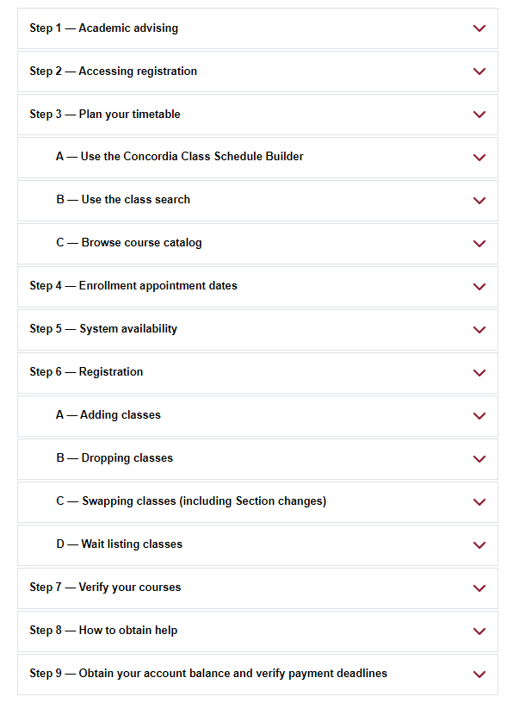
Useful Resources: How to register for a course?
Course registration guide

Slide 5
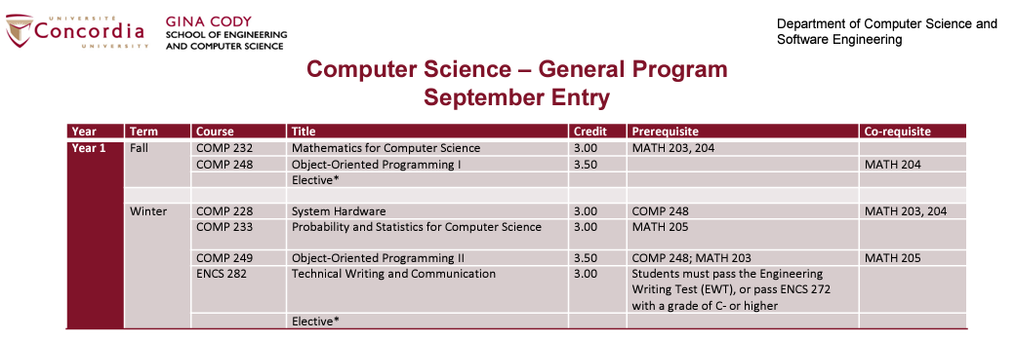
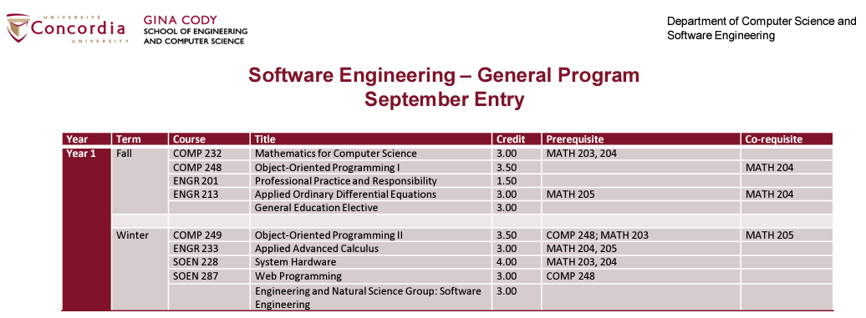
Useful Resources: How can I know what courses to take?
Course sequences

Slide 6
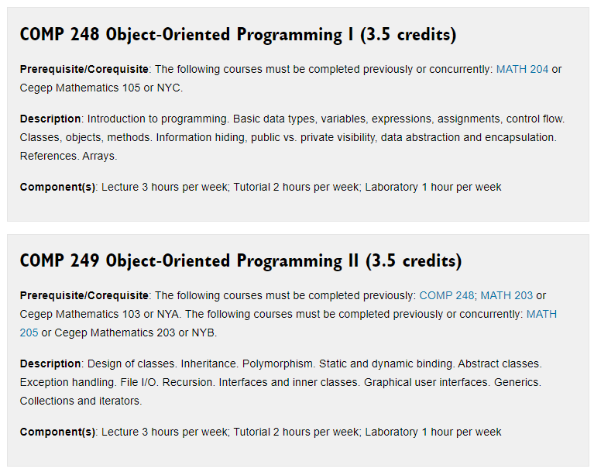
Useful Resources: What the course is about?
Course Descriptions

Slide 7
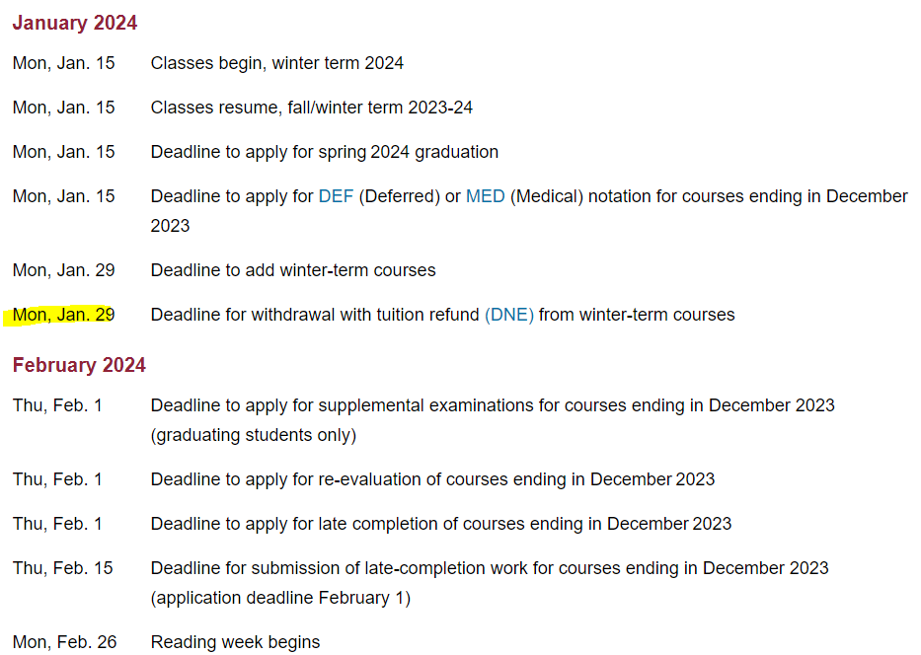
Useful Resources: To know WHEN
Important Academic Dates

Slide 8
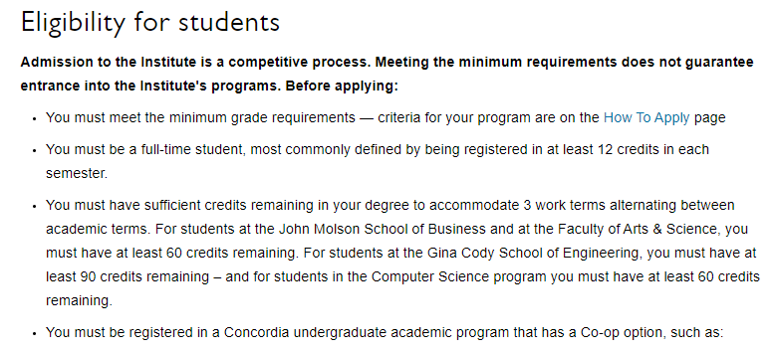
Useful Resources: Coop
Institute for Co-operative Education
COOP Director Dr. Jayakumar: jayakumar@cse.concordia.ca
General inquiries: info.coop@concordia.ca

Slide 9
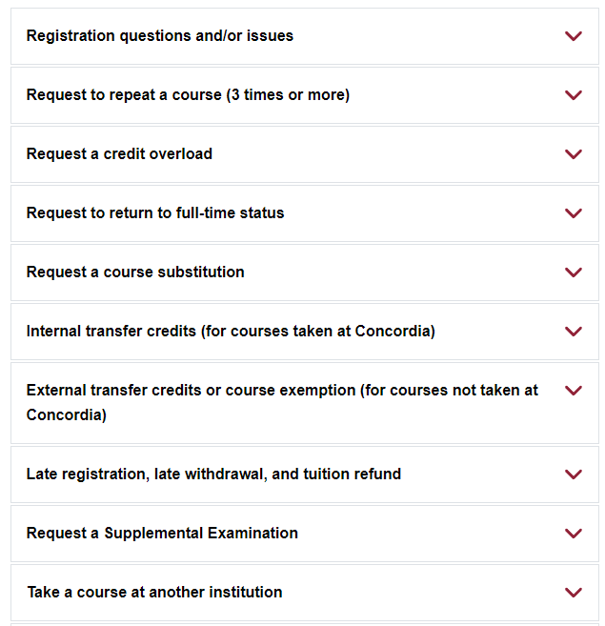
Useful Resources: SAS
Student Academic Services Office (SAS)
General inquiries: sas-front-desk@encs.concordia.ca
Student requests and forms: https://www.concordia.ca/ginacody/students/academic-services/undergraduate/requests.html

Slide 10
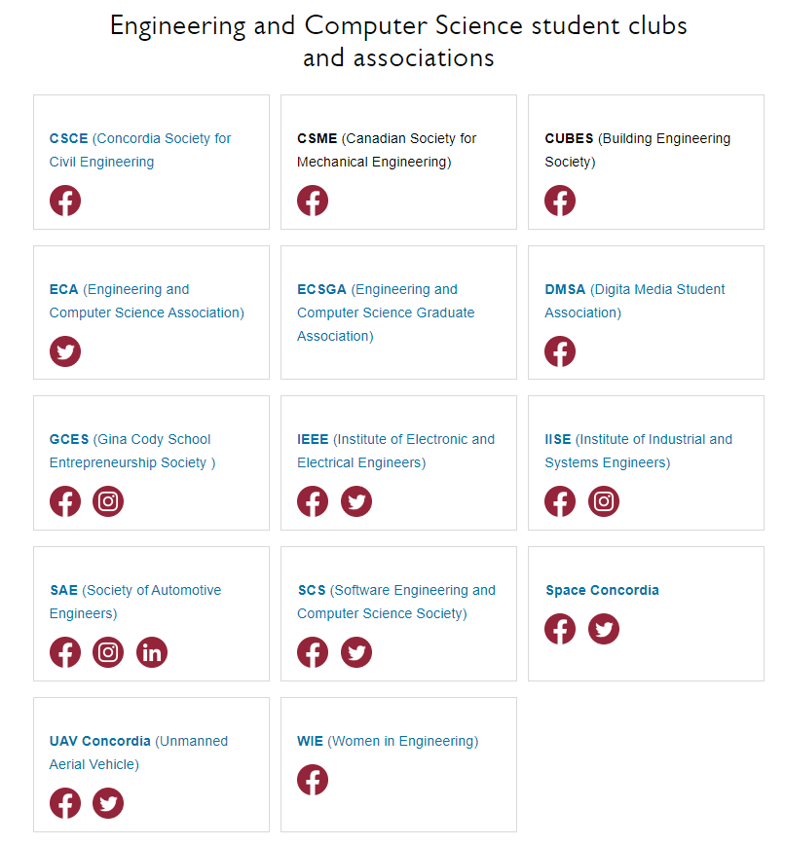
Useful Resources: Student Clubs and Associations
Student Associations

Slide 11
Useful Resources:
Undergraduate Calendar
Department of Computer Science and Software Engineering (CSSE)

